Slide 1




Why Apache Flink is the 4G of Big Data Analytics Frameworks? By Slim Baltagi Director of Big Data Engineering at Capital One With some materials from data-artisans.com
Big Data Scala By the Bay
Oakland, California
August 17, 2015
1

Slide 2
Agenda
What is Apache Flink stack and how it fits into the Big Data ecosystem?
Why Apache Flink is the 4G (4th Generation) of Big Data Analytics Frameworks?
If you like Apache Flink now, what to do next?
2

Slide 3
I. What is Apache Flink stack and how it fits into the Big Data ecosystem?
What are Big Data, Batch and Stream Processing?
What is a typical Big Data Analytics Stack?
What is Apache Flink?
What is Flink Execution Engine?
What are Flink APIs?
What are Flink Domain Specific Libraries?
What is Flink Architecture?
What is Flink Programming Model?
What are Flink tools?
How Apache Flink integrates with Apache Hadoop and other open source tools?
3

Slide 4
II. Why Flink is the 4G (4th Generation) of Big Data Analytics Frameworks?
How Big Data Analytics engines evolved?
What are the principles on which Flink is built on?
Why Flink is an alternative to Hadoop MapReduce?
Why Flink is an alternative to Apache Spark?
Why Flink is an alternative to Apache Storm?
What are the benchmarking results against Flink?
4

Slide 5
III. If you like Apache Flink, what can you do next?
Who is using Apache Flink?
How to get started quickly with Apache Flink?
Where to learn more about Apache Flink?
How to contribute to Apache Flink?
Is there an upcoming Flink conference?
What are some Key Takeaways?
5

Slide 6

1. What is Big Data?
“Big Data refers to data sets large enough [Volume] and data streams fast enough [Velocity], from heterogeneous data sources [Variety], that has outpaced our capability to store, process, analyze, and understand.”
6

Slide 7
What is batch processing?
Many big data sources represent series of events that are continuously produced. Example: tweets, web logs, user transactions, system logs, sensor networks, …
Batch processing: These events are collected together for a certain period of time (a day for example) and stored somewhere to be processed as a finite data set.
What’s the problem with ‘process-after-store’ model:
Unnecessary latencies between data generation and analysis & actions on the data.
Implicit assumption that the data is complete after a given period of time and can be used to make accurate predictions.
7

Slide 8
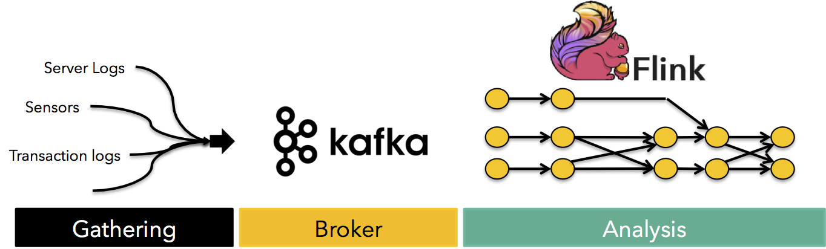
What is stream processing?
Many applications must continuously receive large streams of live data, process them and provide results in real-time. Real-Time means business time!
A typical design pattern in streaming architecture
http://www.kdnuggets.com/2015/08/apache-flink-stream-processing.html
The 8 Requirements of Real-Time Stream Processing, Stonebraker et al. 2005 http://blog.acolyer.org/2014/12/03/the-8-requirements-of-real-time-stream-processing/
8

Slide 9
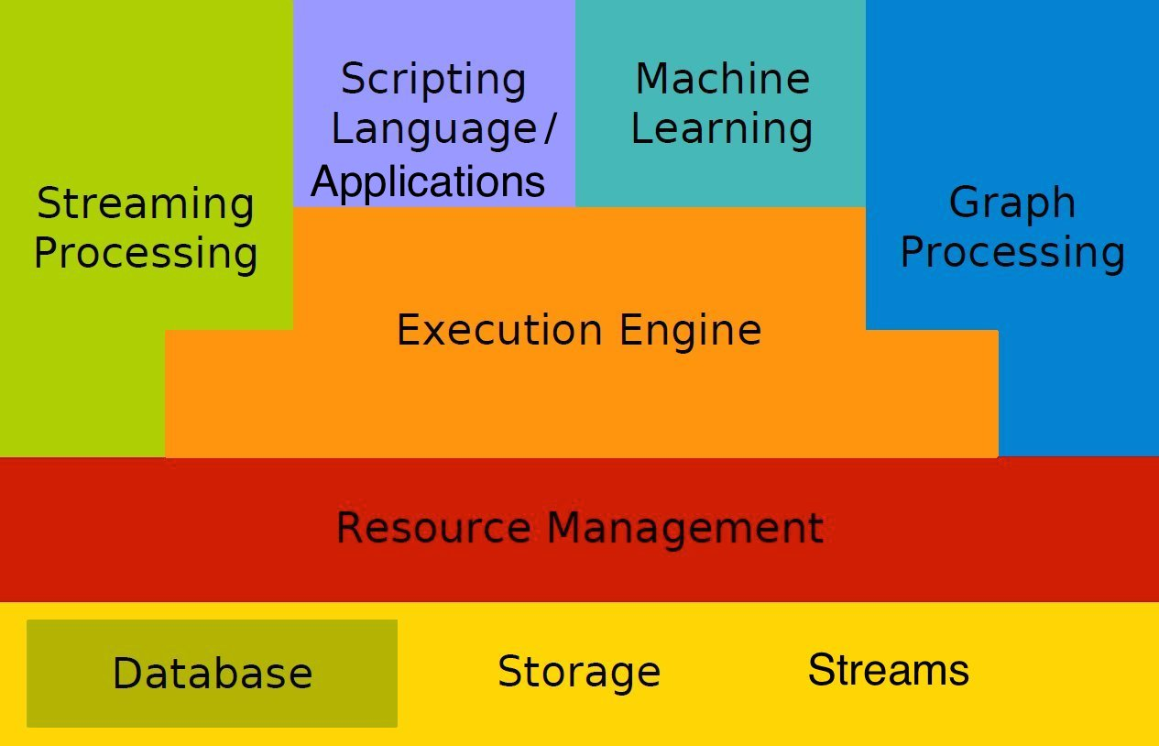
2. What is a typical Big Data Analytics Stack: Hadoop, Spark, Flink, …?
9

Slide 10

3. What is Apache Flink?
Apache Flink, like Apache Hadoop and Apache Spark, is a community-driven open source framework for distributed Big Data Analytics. Apache Flink engine exploits data streaming, in-memory processing, pipelining and iteration operators to improve performance.
Apache Flink has its origins in a research project called Stratosphere of which the idea was conceived in late 2008 by professor Volker Markl from the Technische Universität Berlin in Germany.
In German, Flink means agile or swift. Flink joined the Apache incubator in April 2014 and graduated as an Apache Top Level Project (TLP) in December 2014.
10

Slide 11

3. What is Apache Flink?
Apache Flink written in Java and Scala, provides:
Big data processing engine: distributed and scalable streaming dataflow engine
Several APIs in Java/Scala/Python:
DataSet API – Batch processing
DataStream API – Real-Time streaming analytics
Table API - Relational Queries
Domain-Specific Libraries:
FlinkML: Machine Learning Library for Flink
Gelly: Graph Library for Flink
Shell for interactive data analysis
11

Slide 12
What is Apache Flink stack?
Google Dataflow
Cascading (WiP)
Zeppelin
Table
Dataflow (WiP)
FlinkML
Storm
Table
Gelly
Hadoop M/R
SAMOA
MRQL
APIs & LIBRARIES
DataSet (Java/Scala/Python)
Batch Processing
DataStream (Java/Scala)
Stream Processing
Batch Optimizer
Stream Builder
SYSTEM
Runtime - Distributed Streaming Dataflow
Local
Single JVM
Embedded
Docker
Cluster
Standalone
YARN, Tez,
Mesos (WIP)
Cloud
Google’s GCE
Amazon’s EC2
IBM Docker Cloud, …
DEPLOY
Files
Local
HDFS
S3, Azure Storage
Tachyon
Databases
MongoDB
HBase
SQL
…
Streams
Flume
Kafka
RabbitMQ
…
STORAGE
12

Slide 13
4. What is Flink Execution Engine?
The core of Flink is a distributed and scalable streaming dataflow engine with some unique features:
True streaming capabilities: Execute everything as streams
Native iterative execution: Allow some cyclic dataflows
Handling of mutable state
Custom memory manager: Operate on managed memory
Cost-Based Optimizer: for both batch and stream processing
13

Slide 14

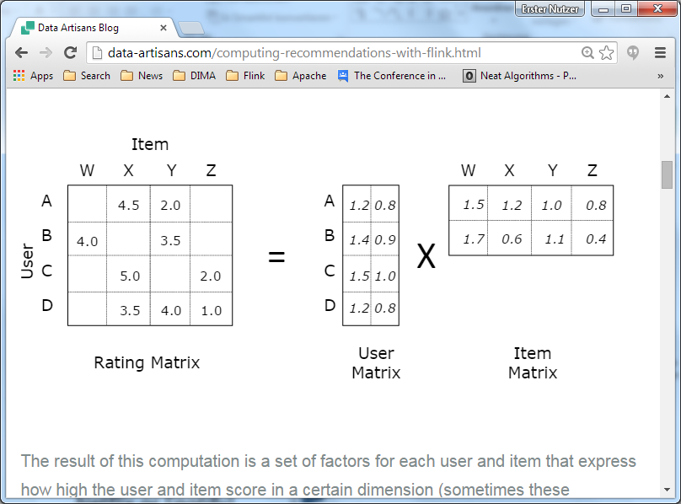
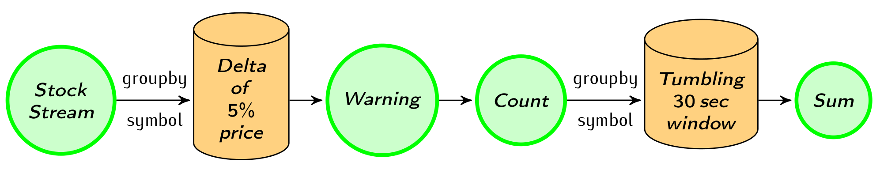
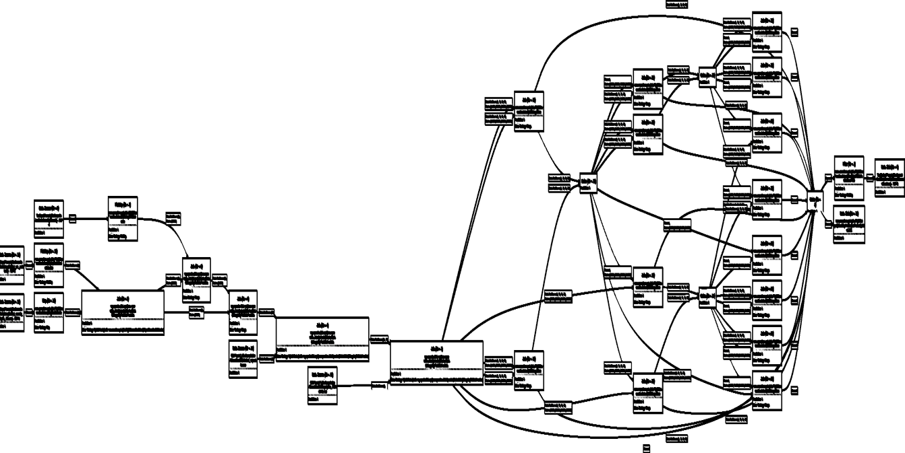
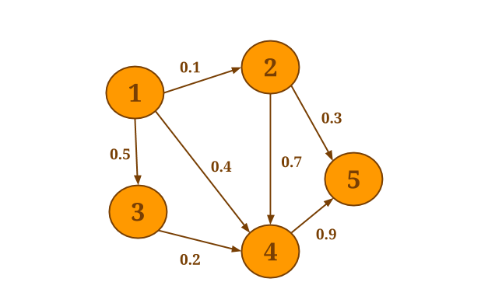
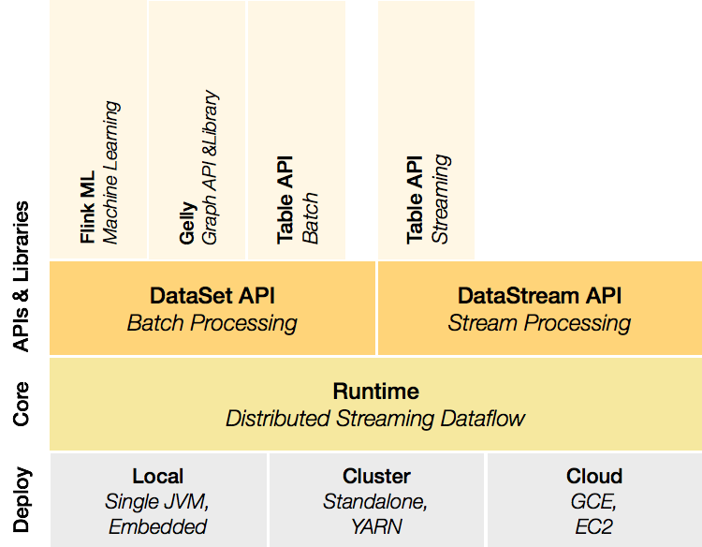
The only hybrid (Real-Time Streaming + Batch) open source distributed data processing engine natively supporting many use cases:
Real-Time stream processing
Machine Learning at scale
Batch Processing
Graph Analysis
14

Slide 15
5. Flink APIs
5.1 DataSet API for static data - Java, Scala, and Python
5.2 DataStream API for unbounded real-time streams - Java and Scala
5.3 Table API for relational queries - Scala and Java
15

Slide 16
5.1 DataSet API – Batch processing
case class Word (word: String, frequency: Int)
DataSet API (batch): WordCount
val env = ExecutionEnvironment.getExecutionEnvironment()
val lines: DataSet[String] = env.readTextFile(...)
lines.flatMap {line => line.split(" ")
.map(word => Word(word,1))}
.groupBy("word").sum("frequency")
.print()
env.execute()
DataStream API (streaming): Window WordCount
val env = StreamExecutionEnvironment.getExecutionEnvironment()
val lines: DataStream[String] = env.fromSocketStream(...)
lines.flatMap {line => line.split(" ")
.map(word => Word(word,1))}
.window(Time.of(5,SECONDS)).every(Time.of(1,SECONDS))
.groupBy("word").sum("frequency")
.print()
env.execute()
16
Notes:
Flink has mirrored Java and Scala APIs that offer the same functionality, including by-name addressing.
Example: Window WordCount
case class Word (word: String, frequency: Int)
val env = StreamExecutionEnvironment.getExecutionEnvironment()
val lines = env.fromSocketStream(...)
Lines .
flatMap {line => line.split(" ").map(word => Word(word,1))}
.window(Count.of(100)).every(Count.of(10))
.groupBy("word").sum("frequency")
.print()
env.execute()

Slide 17
5.2 DataStream API – Real-Time Streaming Analytics
Still in Beta as of June 24th 2015 ( Flink 0.9 release)
Flink Streaming provides high-throughput, low-latency stateful stream processing system with rich windowing semantics.
Flink Streaming provides native support for iterative stream processing.
Data streams can be transformed and modified using high-level functions similar to the ones provided by the batch processing API.
It has built-in connectors to many data sources like Flume, Kafka, Twitter, RabbitMQ, etc
17
Notes:
See example for iterative stream processing:
http://www.slideshare.net/GyulaFra/flink-streaming-43445818/16
and
http://www.slideshare.net/GyulaFra/flink-streaming-43445818/17

Slide 18
5.2 DataStream API – Real-Time Streaming Analytics
Flink being based on a pipelined (streaming) execution engine akin to parallel database systems allows to:
implement true streaming & batch
integrate streaming operations with rich windowing semantics seamlessly
process streaming operations in a pipelined way with lower latency than micro-batch architectures and without the complexity of lambda architectures.
Apache Flink and the case for stream processing
http://www.kdnuggets.com/2015/08/apache-flink-stream-processing.html
Flink Streaming web resources at the Flink Knowledge Base http://sparkbigdata.com/component/tags/tag/49-flink-streaming
18

Slide 19
5.2 DataStream API – Real-Time Streaming Analytics
Streaming Fault-Tolerance added in Flink 0.9 (released on June 24th , 2015) allows Exactly-once processing delivery guarantees for Flink streaming programs that analyze streaming sources persisted by Apache Kafka.
Data Streaming Fault Tolerance document: http://ci.apache.org/projects/flink/flink-docs-master/internals/stream_checkpointing.html
‘Lightweight Asynchronous Snapshots for Distributed Dataflows’ http://arxiv.org/pdf/1506.08603v1.pdf June 28, 2015
Distributed Snapshots: Determining Global States of Distributed Systems February 1985, Chandra-Lamport algorithm http://research.microsoft.com/en-us/um/people/lamport/pubs/chandy.pdf
19

Slide 20
5.2 DataStream API – Roadmap
Job Manager High Availability using Apache Zookeeper – 2015 Q3
Event time to handle out-of-order events, 2015 Q3
Watermarks to ensure progress of jobs – 2015 Q3
Streaming machine learning library – 2015 Q3
Streaming graph processing library – 2015 Q3
Integration with Zeppelin – 2015 ?
Graduation of DataStream API from “beta” status – 2015 ?
20
Notes:
See http://www.slideshare.net/GyulaFra/flink-streaming-43445818/25

Slide 21
5.3 Table API – Relational Queries
Table API (queries)
val customers = envreadCsvFile(…).as('id, 'mktSegment)
.filter("mktSegment = AUTOMOBILE")
val orders = env.readCsvFile(…)
.filter( o => dateFormat.parse(o.orderDate).before(date) )
.as("orderId, custId, orderDate, shipPrio")
val items = orders
.join(customers).where("custId = id")
.join(lineitems).where("orderId = id")
.select("orderId, orderDate, shipPrio,
extdPrice * (Literal(1.0f) – discount) as revenue")
val result = items
.groupBy("orderId, orderDate, shipPrio")
.select("orderId, revenue.sum, orderDate, shipPrio")
21

Slide 22
5.3 Table API – Relational Queries
Table API, written in Scala, was added in February 2015. Still in Beta as of June 24th 2015 ( Flink 0.9 release)
Flink provides Table API that allows specifying operations using SQL-like expressions instead of manipulating DataSet or DataStream.
Table API can be used in both batch (on structured data sets) and streaming programs (on structured data streams).http://ci.apache.org/projects/flink/flink-docs-master/libs/table.html
Flink Table web resources at the Apache Flink Knowledge Base: http://sparkbigdata.com/component/tags/tag/52-flink-table
22

Slide 23
6. Flink Domain Specific Libraries
6.1 FlinkML – Machine Learning Library
6.2 Gelly – Graph Analytics for Flink
23

Slide 24
6.1 FlinkML - Machine Learning Library
FlinkML is the Machine Learning (ML) library for Flink. It is written in Scala and was added in March 2015. Still in beta as of June 24th 2015 ( Flink 0.9 release)
FlinkML aims to provide:
an intuitive API
scalable ML algorithms
tools that help minimize glue code in end-to-end ML applications
FlinkML will allow data scientists to:
test their models locally using subsets of data
use the same code to run their algorithms at a much larger scale in a cluster setting.
24

Slide 25
6.1 FlinkML
FlinkML is inspired by other open source efforts, in particular:
scikit-learn for cleanly specifying ML pipelines
Spark’s MLLib for providing ML algorithms that scale with cluster size.
FlinkML unique features are:
Exploiting the in-memory data streaming nature of Flink.
Natively executing iterative processing algorithms which are common in Machine Learning.
Streaming ML designed specifically for data streams.
25

Slide 26
6.1 FlinkML
Learn more about FlinkML at http://ci.apache.org/projects/flink/flink-docs-master/libs/ml/
You can find more details about FlinkML goals and where it is headed in the vision and roadmap here: FlinkML: Vision and Roadmap https://cwiki.apache.org/confluence/display/FLINK/FlinkML%3A+Vision+and+Roadmap
Check more FlinkML web resources at the Apache Flink Knowledge Base: http://sparkbigdata.com/component/tags/tag/51-flinkml
Interested in helping out the Apache Flink project? Please check: How to contribute? http://flink.apache.org/how-to-contribute.html http://flink.apache.org/coding-guidelines.html
26

Slide 27
6.2 Gelly – Graph Analytics for Flink
Gelly is a Graph API for Flink. Gelly Java API was added in February 2015. Gelly Scala API started in May 2015 and is Work In Progress.
Gelly is still in Beta as of June 24th 2015 ( Flink 0.9 release).
Gelly provides:
A set of methods and utilities to create, transform and modify graphs
A library of graph algorithms which aims to simplify the development of graph analysis applications
Iterative graph algorithms are executed leveraging mutable state
27

Slide 28
6.2 Gelly – Graph Analytics for Flink
Gelly is Flink's large-scale graph processing API which leverages Flink's efficient delta iterations to map various graph processing models (vertex-centric and gather-sum-apply) to dataflows.
Gelly allows Flink users to perform end-to-end data analysis, without having to build complex pipelines and combine different systems.
It can be seamlessly combined with Flink's DataSet API, which means that pre-processing, graph creation, graph analysis and post-processing can be done in the same application.
28

Slide 29
6.2 Gelly – Graph Analytics for Flink
Large-scale graph processing with Apache Flink - Vasia Kalavri, February 1st, 2015http://www.slideshare.net/vkalavri/largescale-graph-processing-with-apache-flink-graphdevroom-fosdem15
Graph streaming model and API on top of Flink streaming and provides similar interfaces to Gelly – Janos Daniel Balo, June 30, 2015http://kth.diva-portal.org/smash/get/diva2:830662/FULLTEXT01.pdf
Check out more Gelly web resources at the Apache Flink Knowledge Base:http://sparkbigdata.com/component/tags/tag/50-gelly
Interested in helping out the Apache Flink project?http://flink.apache.org/how-to-contribute.html http://flink.apache.org/coding-guidelines.html
29

Slide 30
7. What is Flink Architecture?
Flink implements the Kappa Architecture: run batch programs on a streaming system.
References about the Kappa Architecture:
Questioning the Lambda Architecture - Jay Kreps , July 2nd, 2014 http://radar.oreilly.com/2014/07/questioning-the-lambda-architecture.html
Turning the database inside out with Apache Samza -Martin Kleppmann, March 4th, 2015
http://www.youtube.com/watch?v=fU9hR3kiOK0 (VIDEO)
http://martin.kleppmann.com/2015/03/04/turning-the-database-inside-out.html(TRANSCRIPT)
http://blog.confluent.io/2015/03/04/turning-the-database-inside-out-with-apache-samza/ (BLOG)
30

Slide 31
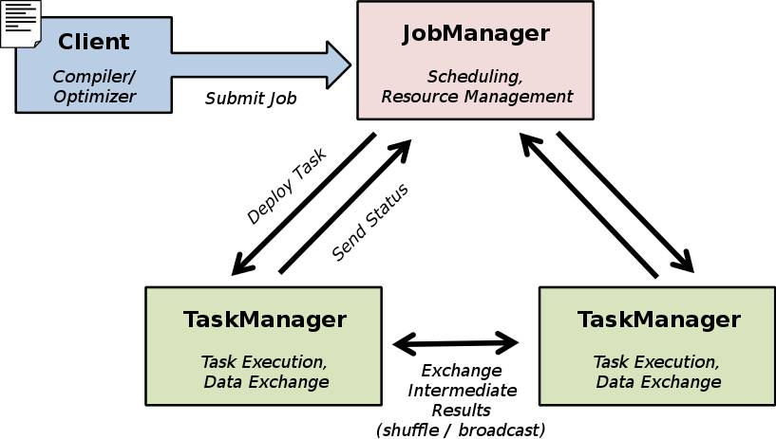
7. What is Flink Architecture?
7.1 Client
7.2 Master (Job Manager)
7.3 Worker (Task Manager)
31

Slide 32

7.1 Client
Type extraction
Optimize: in all APIs not just SQL queries as in Spark
Construct job Dataflow graph
Pass job Dataflow graph to job manager
Retrieve job results
case class Path (from: Long, to: Long)
val tc = edges.iterate(10) {
paths: DataSet[Path] =>
val next = paths
.join(edges)
.where("to")
.equalTo("from") {
(path, edge) =>
Path(path.from, edge.to)
}
.union(paths)
.distinct()
next
}
GroupRed
sort
Type extraction
forward
Join
Hybrid Hash
Optimizer
buildHT
probe
Job Manager
hash-part [0]
hash-part [0]
Map
Filter
DataSource
lineitem.tbl
Client
Data Source
orders.tbl
32

Slide 33
7.2 Job Manager (JM)
Parallelization: Create Execution Graph
Scheduling: Assign tasks to task managers
State tracking: Supervise the execution
GroupRed
sort
Task Manager
GroupRed
GroupRed
GroupRed
sort
GroupRed
forward
sort
sort
sort
Task Manager
forward
Join
Hybrid Hash
forward
Join
Hybrid Hash
forward
Join
Hybrid Hash
Join
Hybrid Hash
forward
probe
buildHT
probe
buildHT
probe
buildHT
Join
Hybrid Hash
probe
buildHT
hash-part [0]
hash-part [0]
hash-part [0]
hash-part [0]
hash-part [0]
DataSource
lineitem.tbl
Map
hash-part [0]
hash-part [0]
hash-part [0]
buildHT
probe
DataSource
lineitem.tbl
Map
DataSource
lineitem.tbl
Task Manager
Map
Filter
Map
Filter
Filter
Data Source
orders.tbl
DataSource
lineitem.tbl
hash-part [0]
hash-part [0]
Data Source
orders.tbl
Filter
Data Source
orders.tbl
DataSource
lineitem.tbl
Map
Data Source
orders.tbl
Filter
Data Source
orders.tbl
Job Manager
Task Manager
33

Slide 34
7.2 Job Manager (JM)
JobManager High Availability (HA) is being implemented now and expected to be available in next release Flink 0.10 https://issues.apache.org/jira/browse/FLINK-2287
Setup ZooKeeper for distributed coordination is already implemented in Flink 0.10 https://issues.apache.org/jira/browse/FLINK-2288
These are the related documents to JM HA:
https://ci.apache.org/projects/flink/flink-docs-master/setup/jobmanager_high_availability.html
https://cwiki.apache.org/confluence/display/FLINK/JobManager+High+Availability
34

Slide 35
7.3 Task Manager ( TM)
Operations are split up into tasks depending on the specified parallelism
Each parallel instance of an operation runs in a separate task slot
The scheduler may run several tasks from different operators in one task slot
Task Manager
Task Manager
Task Manager
Slot
Slot
Slot
35

Slide 36
8. What is Flink Programming Model?
DataSet and DataStream as programming abstractions are the foundation for user programs and higher layers.
Flink extends the MapReduce model with new operators that represent many common data analysis tasks more naturally and efficiently.
All operators will start working in memory and gracefully go out of core under memory pressure.
36

Slide 37
8.1 DataSet
Central notion of the programming API
Files and other data sources are read into DataSets
DataSet<String> text = env.readTextFile(…)
Transformations on DataSets produce DataSets
DataSet<String> first = text.map(…)
DataSets are printed to files or on stdout
first.writeAsCsv(…)
Execution is triggered with env.execute()
37

Slide 38
8.1 DataSet
Used for Batch Processing
Source
Data Set
Operation
Data Set
Sink
Example: Map and Reduce operation
b | h
2 | 1
3 | 5
7 | 4
… | …
Map
Reduce
a
12
…
38

Slide 39
8.2 DataStream
Real-time event streams
Source
Data Stream
Operation
Data Stream
Sink
Example: Stream from a live financial stock feed
Alert if Microsoft > 120
Write event to database
Stock Feed
Name | Price
Microsoft | 124
Google | 516
Apple | 235
… | …
Microsoft | 124
Google | 516
Apple | 235
Sum every 10 seconds
Alert if sum > 10000
Microsoft | 124
Apple | 235
Google | 516
39

Slide 40
9. What are Apache Flink tools?
9.1 Command-Line Interface (CLI)
9.2 Job Client Web Interface
9.3 Job Manager Web Interface
9.4 Interactive Scala Shell
9.5 Zeppelin Notebook
40

Slide 41
9.1 Command-Line Interface (CLI)
Example:
./bin/flink run ./examples/flink-java-examples-0.9.0-WordCount.jar
bin/flink has 4 major actions
run #runs a program
info #displays information about a program.
list #lists running and finished programs. -r & -s
./bin/flink list -r -s
cancel #cancels a running program. –I
See more examples: https://ci.apache.org/projects/flink/flink-docs-master/apis/cli.html
41

Slide 42
9.2 Job Client Web Interface
Flink provides a web interface to:
Submit jobs
Inspect their execution plans
Execute them
Showcase programs
Debug execution plans
Demonstrate the system as a whole
42

Slide 43
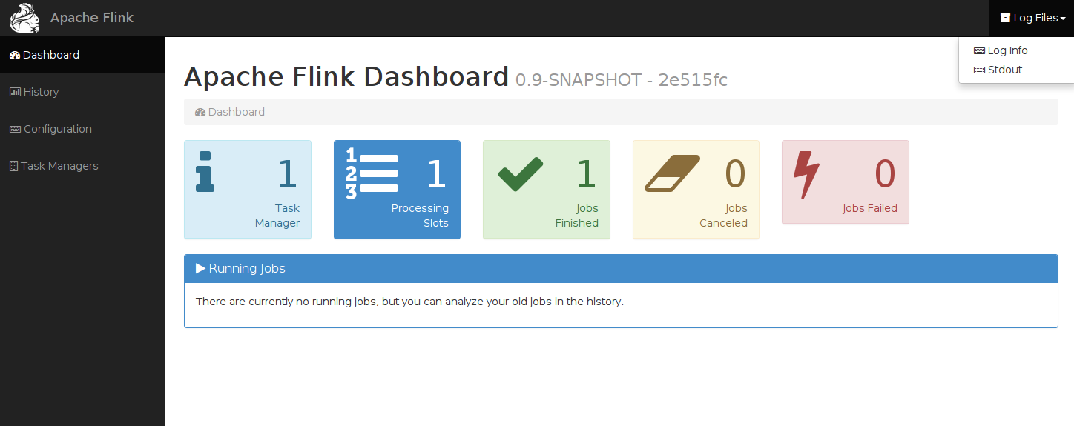
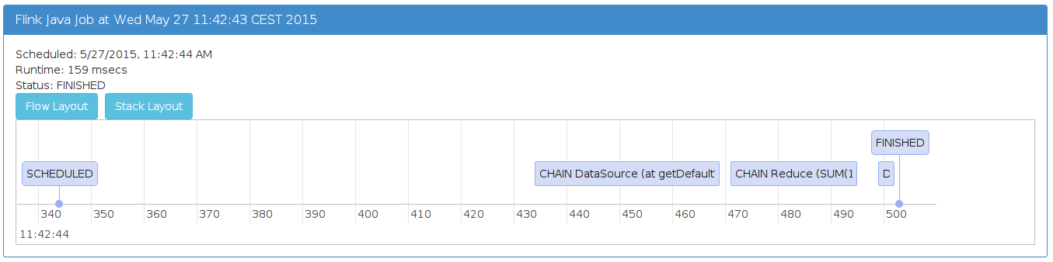
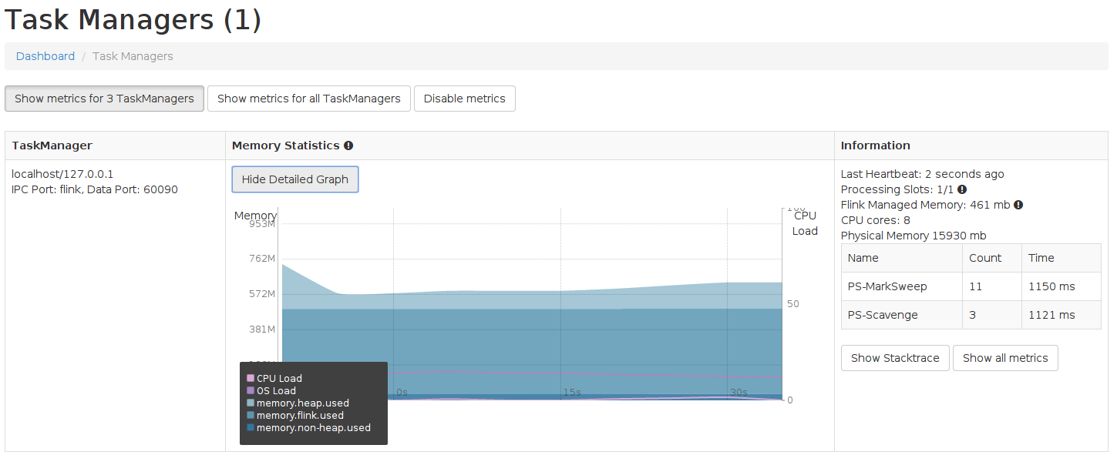
9.3 Job Manager Web Interface
Overall system status
Job execution details
Task Manager resource
utilization
43

Slide 44
9.3 Job Manager Web Interface
The JobManager web frontend allows to :
Track the progress of a Flink program as all status changes are also logged to the JobManager’s log file.
Figure out why a program failed as it displays the exceptions of failed tasks and allow to figure out which parallel task first failed and caused the other tasks to cancel the execution.
44

Slide 45
9.4 Interactive Scala Shell
Flink comes with an Interactive Scala Shell - REPL ( Read Evaluate Print Loop ) :
./bin/start-scala-shell.sh
Interactive queries
Let’s you explore data quickly
It can be used in a local setup as well as in a cluster setup.
The Flink Shell comes with command history and auto completion.
Complete Scala API available
So far only batch mode is supported. There is plan to add streaming in the future:
https://ci.apache.org/projects/flink/flink-docs-master/scala_shell.html
45

Slide 46
9.5 Zeppelin Notebook
Web-based interactive computation environment
Collaborative data analytics and visualization tool
Combines rich text, execution code, plots and rich media
Exploratory data science
Saving and replaying of written code
Storytelling
46

Slide 47
10. How Apache Flink integrates with Hadoop and other open source tools?
Flink integrates well with other open source tools for data input and output as well as deployment.
Hadoop integration out of the box:
HDFS to read and write. Secure HDFS support
Deploy inside of Hadoop via YARN
Reuse data types (that implement Writables interface)
YARN Setup http://ci.apache.org/projects/flink/flink-docs-master/setup/yarn_setup.html
YARN Configuration
http://ci.apache.org/projects/flink/flink-docs-master/setup/config.html#yarn
47

Slide 48

10. How Apache Flink integrates with Hadoop and other open source tools?
Hadoop Compatibility in Flink by Fabian Hüske - November 18, 2014 http://flink.apache.org/news/2014/11/18/hadoop-compatibility.html
Hadoop integration with a thin wrapper (Hadoop Compatibility layer) to run legacy Hadoop MapReduce jobs, reuse Hadoop input and output formats and reuse functions like Map and Reduce. https://ci.apache.org/projects/flink/flink-docs-master/apis/hadoop_compatibility.html
Flink is compatible with Apache Storm interfaces and therefore allows reusing code that was implemented for Storm.
https://ci.apache.org/projects/flink/flink-docs-master/apis/storm_compatibility.html
48
Notes:
rm flink-0.9.0-bin-hadoop27.tgz

Slide 49













10. How Apache Flink integrates with Hadoop and other open source tools?
Service | Open Source Tool
Storage/Serving Layer
Data Formats
Data Ingestion Services
Resource Management
49

Slide 50



10. How Apache Flink integrates with Hadoop and other open source tools?
Apache Bigtop (Work-In-Progress) http://bigtop.apache.org
Here are some examples of how to read/write data from/to HBase: https://github.com/apache/flink/tree/master/flink-staging/flink-hbase/src/test/java/org/apache/flink/addons/hbase/example
Using Kafka with Flink: https://ci.apache.org/projects/flink/flink-docs-master/apis/ streaming_guide.html#apache-kafka
Using MongoDB with Flink: http://flink.apache.org/news/2014/01/28/querying_mongodb.html
Amazon S3, Microsoft Azure Storage
50

Slide 51



10. How Apache Flink integrates with Hadoop and other open source tools?
Apache Flink + Apache SAMOA for Machine Learning on streams http://samoa.incubator.apache.org/
Flink Integrates with Zeppelin
http://zeppelin.incubator.apache.org/
Flink on Apache Tez
http://tez.apache.org/
Flink + Apache MRQL http://mrql.incubator.apache.org
Flink + Tachyon
http://tachyon-project.org/
Running Apache Flink on Tachyon http://tachyon-project.org/Running-Flink-on-Tachyon.html
Flink + XtreemFS http://www.xtreemfs.org/
51

Slide 52

10. How Apache Flink integrates with Hadoop and other open source tools?
Google Cloud Dataflow (GA on August 12, 2015) is a fully-managed cloud service and a unified programming model for batch and streaming big data processing.
https://cloud.google.com/dataflow/ (Try it FREE)
http://goo.gl/2aYsl0
Flink-Dataflow is a Google Cloud Dataflow SDK Runner for Apache Flink. It enables you to run Dataflow programs with Flink as an execution engine.
The integration is done with the open APIs provided by Google Data Flow.
Flink Streaming support is Work in Progress
52

Slide 53
Agenda
What is Apache Flink stack and how it fits into the Big Data ecosystem?
Why Apache Flink is the 4G (4th Generation) of Big Data Analytics Frameworks?
If you like Apache Flink now, what to do next?
53

Slide 54
II. Why Flink is the 4G (4th Generation) of Big Data Analytics Frameworks?
How Big Data Analytics engines evolved?
What are the principles on which Flink is built on?
Why Flink is an alternative to Hadoop MapReduce?
Why Flink is an alternative to Apache Spark?
Why Flink is an alternative to Apache Storm?
What are the benchmarking results against Flink?
54

Slide 55


1. How Big Data Analytics engines evolved?
Batch | Batch Interactive | Batch Interactive Near-Real Time Streaming Iterative processing | Hybrid (Streaming +Batch) Interactive Real-Time Streaming Native Iterative processing
MapReduce | Direct Acyclic Graphs (DAG) Dataflows | RDD: Resilient Distributed Datasets | Cyclic Dataflows
1st Generation (1G) | 2ndGeneration (2G) | 3rd Generation (3G) | 4th Generation (4G)
55

Slide 56
2. What are the principles on which Flink is built on? (Might not have been all set upfront but emerged!)
1. Get the best of both worlds: MPP technology and Hadoop MapReduce Technologies
Draws on concepts from
MPP Database Technology
Draws on concepts from
Hadoop MapReduce
Technology
Add
Declarativity
Query optimization
Efficient parallel in-memory and out-of-core algorithms
Massive scale-out
User Defined Functions
Complex data types
Schema on read
Streaming
Iterations
Advanced Dataflows
General APIs
56

Slide 57
2. What are the principles on which Flink is built on?
2. All streaming all the time: execute everything as streams including batch!!
3. Write like a programming language, execute like a database.
4. Alleviate the user from a lot of the pain of:
manually tuning memory assignment to intermediate operators
dealing with physical execution concepts (e.g., choosing between broadcast and partitioned joins, reusing partitions).
57

Slide 58
2. What are the principles on which Flink is built on?
5. Little configuration required
• Requires no memory thresholds to configure – Flink manages its own memory
• Requires no complicated network configurations – Pipelining engine requires much less memory for data exchange
• Requires no serializers to be configured – Flink handles its own type extraction and data representation
6. Little tuning required: Programs can be adjusted to data automatically – Flink’s optimizer can choose execution strategies automatically
58

Slide 59
2. What are the principles on which Flink is built on?
7. Support for many file systems:
Flink is File System agnostic. BYOS: Bring Your Own Storage
8. Support for many deployment options:
Flink is agnostic to the underlying cluster infrastructure. BYOC: Bring Your Own Cluster
9. Be a good citizen of the Hadoop ecosystem
Good integration with YARN and Tez
10. Preserve your investment in your legacy Big Data applications: Run your legacy code on Flink’s powerful engine using Hadoop and Storm compatibilities layers and Cascading adapter.
59

Slide 60
2. What are the principles on which Flink is built on?
11. Native Support of many use cases:
Batch, real-time streaming, machine learning, graph processing, relational queries on top of the same streaming engine
Support building complex data pipelines leveraging native libraries without the need to combine and manage external ones.
60

Slide 61
3. Why Flink is an alternative to Hadoop MapReduce?
Flink offers cyclic dataflows compared to the two-stage, disk-based MapReduce paradigm.
The application programming interface (API) for Flink is easier to use than programming for Hadoop’s MapReduce.
Flink is easier to test compared to MapReduce.
Flink can leverage in-memory processing, data streaming and iteration operators for faster data processing speed.
Flink can work on file systems other than Hadoop.
61

Slide 62
3. Why Flink is an alternative to Hadoop MapReduce?
Flink lets users work in a unified framework allowing to build a single data workflow that leverages, streaming, batch, sql and machine learning for example.
Flink can analyze real-time streaming data.
Flink can process graphs using its own Gelly library.
Flink can use Machine Learning algorithms from its own FlinkML library.
Flink supports interactive queries and iterative algorithms, not well served by Hadoop MapReduce.
62

Slide 63


3. Why Flink is an alternative to Hadoop MapReduce?
11. Flink extends MapReduce model with new operators: join, cross, union, iterate, iterate delta, cogroup, …
Input
Map
Reduce
Output
S
Red
Join
Output
DataSet
DataSet
DataSet
Input
Map
DataSet
DataSet
63

Slide 64
4. Why Flink is an alternative to Storm?
Higher Level and easier to use API
Lower latency
Thanks to pipelined engine
Exactly-once processing guarantees
Variation of Chandy-Lamport
Higher throughput
Controllable checkpointing overhead
Flink Separates application logic from recovery
Checkpointing interval is just a configuration parameter
64

Slide 65
4. Why Flink is an alternative to Storm?
6. More light-weight fault tolerance strategy
7. Stateful operators
8. Native support for iterative stream processing.
9. Flink does also support batch processing
Flink offers Storm compatibility
Flink is compatible with Apache Storm interfaces and therefore allows reusing code that was implemented for Storm.
https://ci.apache.org/projects/flink/flink-docs-master/apis/storm_compatibility.html
65

Slide 66
4. Why Flink is an alternative to Storm?
‘Twitter Heron: Stream Processing at Scale’ by Twitter or “Why Storm Sucks by Twitter themselves”!! http://dl.acm.org/citation.cfm?id=2742788
Recap of the paper: ‘Twitter Heron: Stream Processing at Scale’ - June 15th , 2015 http://blog.acolyer.org/2015/06/15/twitter-heron-stream-processing-at-scale/
High-throughput, low-latency, and exactly-once stream processing with Apache Flink. The evolution of fault-tolerant streaming architectures and their performance – Kostas Tzoumas, August 5th 2015
http://data-artisans.com/high-throughput-low-latency-and-exactly-once-stream-processing-with-apache-flink/
66

Slide 67
5. Why Flink is an alternative to Spark?
5.1. True Low latency streaming engine
Spark’s micro-batches aren’t good enough!
unified batch and real-time streaming in a single engine
5.2. Native closed-loop iteration operators
make graph and machine learning applications run much faster
5.3. Custom memory manager
no more frequent Out Of Memory errors!
Flink’s own type extraction component
Flink’s own serialization component
67

Slide 68
5. Why Flink is an alternative to Apache Spark?
5.4. Automatic Cost Based Optimizer
little re-configuration and little maintenance when the cluster characteristics change and the data evolves over time
5.5. Little configuration required
5.6. Little tuning required
5.7. Flink has better performance
68

Slide 69
5.1. True low latency streaming engine
Many time-critical applications need to process large streams of live data and provide results in real-time. For example:
Financial Fraud detection
Financial Stock monitoring
Anomaly detection
Traffic management applications
Patient monitoring
Online recommenders
Some claim that 95% of streaming use cases can be handled with micro-batches!? Really!!!
69

Slide 70
5.1. True low latency streaming engine
Spark’s micro-batching isn’t good enough!
Ted Dunning talk at the Bay Area Apache Flink Meetup on August 27, 2015
http://www.meetup.com/Bay-Area-Apache-Flink-Meetup/events/224189524/
Ted will describe several use cases where batch and micro batch processing is not appropriate and describe why this is so.
He will also describe what a true streaming solution needs to provide for solving these problems.
These use cases will be taken from real industrial situations, but the descriptions will drive down to technical details as well.
70

Slide 71
5.1. True low latency streaming engine
“I would consider stream data analysis to be a major unique selling proposition for Flink. Due to its pipelined architecture Flink is a perfect match for big data stream processing in the Apache stack.” – Volker Markl
Ref.: On Apache Flink. Interview with Volker Markl, June 24th 2015 http://www.odbms.org/blog/2015/06/on-apache-flink-interview-with-volker-markl/
Apache Flink uses streams for all workloads: streaming, SQL, micro-batch and batch. Batch is just treated as a finite set of streamed data. This makes Flink the most sophisticated distributed open source Big Data processing engine (not the most mature one yet!).
71

Slide 72
5.2. Iteration Operators
Why Iterations? Many Machine Learning and Graph processing algorithms need iterations! For example:
Machine Learning Algorithms
Clustering (K-Means, Canopy, …)
Gradient descent (Logistic Regression, Matrix Factorization)
Graph Processing Algorithms
Page-Rank, Line-Rank
Path algorithms on graphs (shortest paths, centralities, …)
Graph communities / dense sub-components
Inference (Belief propagation)
72

Slide 73
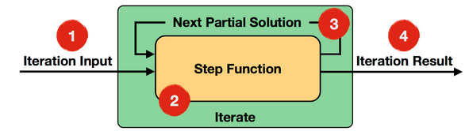
5.2. Iteration Operators
Flink's API offers two dedicated iteration operations: Iterate and Delta Iterate.
Flink executes programs with iterations as cyclic data flows: a data flow program (and all its operators) is scheduled just once.
In each iteration, the step function consumes the entire input (the result of the previous iteration, or the initial data set), and computes the next version of the partial solution
73

Slide 74
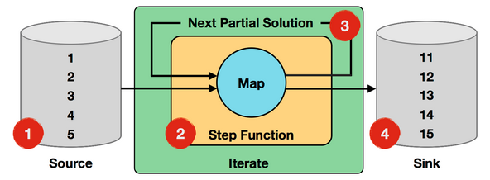
5.2. Iteration Operators
Delta iterations run only on parts of the data that is changing and can significantly speed up many machine learning and graph algorithms because the work in each iteration decreases as the number of iterations goes on.
Documentation on iterations with Apache Flinkhttp://ci.apache.org/projects/flink/flink-docs-master/apis/iterations.html
74

Slide 75



5.2. Iteration Operators
Non-native iterations in Hadoop and Spark are implemented as regular for-loops outside the system.
for (int i = 0; i < maxIterations; i++) {
// Execute MapReduce job
}
Client
Step
Step
Step
Step
Step
75
Notes:
SEE http://www.grid.ucy.ac.cy/file/Talks/talks/DeepAnalysiswithApacheFlink_2nd_cloud_workshop.pdf
Built-in vs. driver-based looping
Driver-based looping:
Loop outside the system, in driver program
Iterative program looks like many independent jobs
VS
Built-in:
Dataflow with Feedback edges
System is iteration-aware, can optimize the job

Slide 76
5.2. Iteration Operators
Although Spark caches data across iterations, it still needs to schedule and execute a new set of tasks for each iteration.
Spinning Fast Iterative Data Flows - Ewen et al. 2012 : http://vldb.org/pvldb/vol5/p1268_stephanewen_vldb2012.pdf The Apache Flink model for incremental iterative dataflow processing. Academic paper.
Recap of the paper, June 18, 2015http://blog.acolyer.org/2015/06/18/spinning-fast-iterative-dataflows/
Documentation on iterations with Apache Flinkhttp://ci.apache.org/projects/flink/flink-docs-master/apis/iterations.html
76

Slide 77
5.3. Custom Memory Manager
Features:
C++ style memory management inside the JVM
User data stored in serialized byte arrays in JVM
Memory is allocated, de-allocated, and used strictly using an internal buffer pool implementation.
Advantages:
Flink will not throw an OOM exception on you.
Reduction of Garbage Collection (GC)
Very efficient disk spilling and network transfers
No Need for runtime tuning
More reliable and stable performance
77

Slide 78
5.3. Custom Memory Manager
Flink contains its own memory management stack. To do that, Flink contains its own type extraction and serialization components.
JVM Heap
User code objects
Unmanaged
public class WC {
public String word;
public int count;
}
Sorting, hashing, caching
Managed
empty
page
Shuffles/ broadcasts
Network Buffers
Pool of Memory Pages
78

Slide 79
5.3. Custom Memory Manager
Peeking into Apache Flink's Engine Room - by Fabian Hüske, March 13, 2015 http://flink.apache.org/news/2015/03/13/peeking-into-Apache-Flinks-Engine-Room.html
Juggling with Bits and Bytes - by Fabian Hüske, May 11,2015
https://flink.apache.org/news/2015/05/11/Juggling-with-Bits-and-Bytes.html‪
Memory Management (Batch API) by Stephan Ewen- May 16, 2015‬https://cwiki.apache.org/confluence/pages/viewpage.action?pageId=53741525‬
Flink is currently working on providing an Off-Heap option for its memory management component: https://github.com/apache/flink/pull/290
79

Slide 80
5.3. Custom Memory Manager
Compared to Flink, Spark is still behind in custom memory management but it is catching up with its project Tungsten for Memory Management and Binary Processing: manage memory explicitly and eliminate the overhead of JVM object model and garbage collection. April 28, 2014https://databricks.com/blog/2015/04/28/project-tungsten-bringing-spark-closer-to-bare-metal.html
It seems that Spark is adopting something similar to Flink and the initial Tungsten announcement read almost like Flink documentation!!
80

Slide 81
5.4. Built-in Cost-Based Optimizer
Apache Flink comes with an optimizer that is independent of the actual programming interface.
It chooses a fitting execution strategy depending on the inputs and operations.
Example: the "Join" operator will choose between partitioning and broadcasting the data, as well as between running a sort-merge-join or a hybrid hash join algorithm.
This helps you focus on your application logic rather than parallel execution.
Quick introduction to the Optimizer: section 6 of the paper: ‘The Stratosphere platform for big data analytics’http://stratosphere.eu/assets/papers/2014-VLDBJ_Stratosphere_Overview.pdf
81

Slide 82


5.4. Built-in Cost-Based Optimizer
What is Automatic Optimization? The system's built-in optimizer takes care of finding the best way to execute the program in any environment.
Hash vs. Sort
Partition vs. Broadcast
Caching
Reusing partition/sort
Execution Plan A
Execution Plan C
Execution Plan B
Run locally on a data sample on the laptop
Run on large files on the cluster
Run a month later after the data evolved
82

Slide 83
5.4. Built-in Cost-Based Optimizer
In contrast to Flink’s built-in automatic optimization, Spark jobs have to be manually optimized and adapted to specific datasets because you need to manually control partitioning and caching if you want to get it right.
Spark SQL uses the Catalyst optimizer that supports both rule-based and cost-based optimization. References:
Spark SQL: Relational Data Processing in Sparkhttp://people.csail.mit.edu/matei/papers/2015/sigmod_spark_sql.pdf
Deep Dive into Spark SQL’s Catalyst Optimizer https://databricks.com/blog/2015/04/13/deep-dive-into-spark-sqls-catalyst-optimizer.html
83

Slide 84
5.5. Little configuration required
Flink requires no memory thresholds to configure
Flink manages its own memory
Flink requires no complicated network configurations
Pipelining engine requires much less memory for data exchange
Flink requires no serializers to be configured
Flink handles its own type extraction and data representation
84

Slide 85
5.6. Little tuning required
Flink programs can be adjusted to data automatically
Flink’s optimizer can choose execution strategies automatically
85

Slide 86
5.7. Flink has better performance
Why Flink provides a better performance?
Custom memory manager
Native closed-loop iteration operators make graph and machine learning applications run much faster .
Role of the built-in automatic optimizer. For example, more efficient join processing
Pipelining data to the next operator in Flink is more efficient than in Spark.
See next section about the benchmarking results against Flink?
86

Slide 87
6. What are the benchmarking results against Flink?
6.1. Benchmark between Spark 1.2 and Flink 0.8
6.2. TeraSort on Hadoop MapReduce 2.6, Tez 0.6, Spark 1.4 and Flink 0.9
6.3. Hash join on Tez 0.7, Spark 1.4, and Flink 0.9
6.4. Benchmark between Storm 0.9.3 and Flink 0.9
6.5 More benchmarks being planned!
87

Slide 88
6.1 Benchmark between Spark 1.2 and Flink 0.8 http://goo.gl/WocQci
The results were published in the proceedings of the 18th International Conference, Business Information Systems 2015, Poznań, Poland, June 24-26, 2015. Chapter 3: Evaluating New Approaches of Big Data Analytics Frameworks, pages 28-37. http://goo.gl/WocQci
Apache Flink outperforms Apache Spark in the processing of machine learning & graph algorithms and also relational queries.
Apache Spark outperforms Apache Flink in batch processing.
88

Slide 89
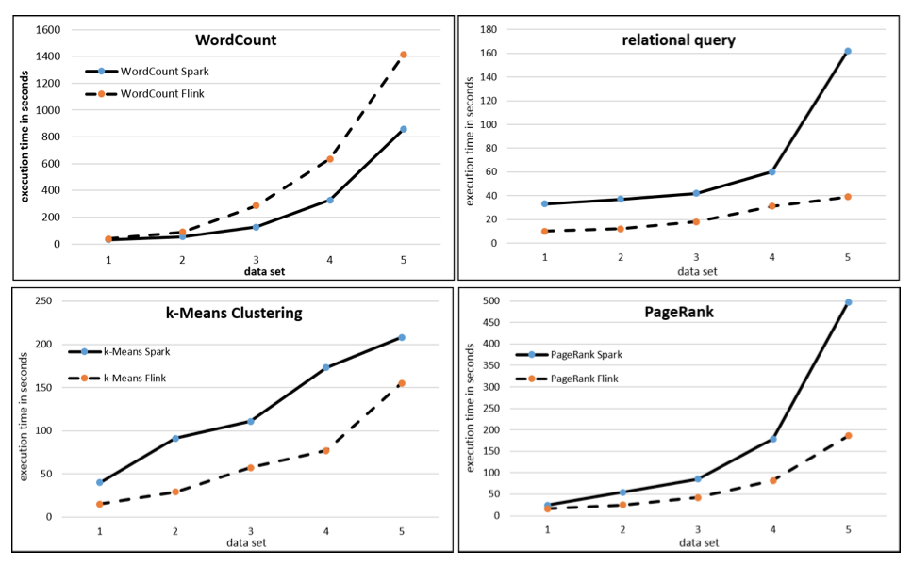
6.1 Benchmark between Spark 1.2 and Flink 0.8 http://goo.gl/WocQci
89

Slide 90
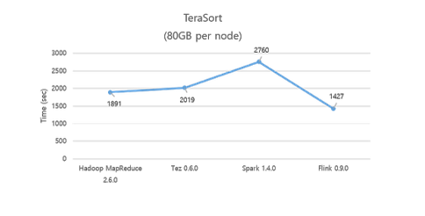
6.2 TeraSort on Hadoop MapReduce 2.6, Tez 0.6, Spark 1.4 and Flink 0.9 http://goo.gl/yBS6ZC
On June 26th 2015, Flink 0.9 shows the best performance and a lot better utilization of disks and network compared to MapReduce 2.6, Tez 0.6, Spark 1.4.
90

Slide 91
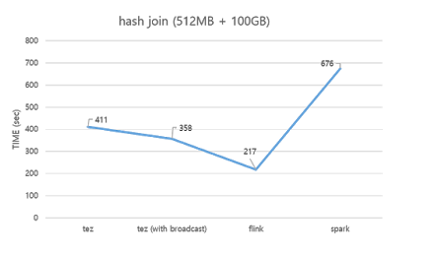
6.3 Hash join on Tez 0.7, Spark 1.4, and Flink 0.9 http://goo.gl/a0d6RR
On July 14th 2015, Flink 0.9 shows the best performance compared to MapReduce 2.6, Tez 0.7, Spark 1.4.
91

Slide 92
6.4. Benchmark between Storm 0.9.3 and Flink 0.9
See for example: ‘High-throughput, low-latency, and exactly-once stream processing with Apache Flink’ by Kostas Tzoumas, August 5th 2015:
http://data-artisans.com/high-throughput-low-latency-and-exactly-once-stream-processing-with-apache-flink/
clocking Flink to a throughputs of millions of records per second per core
latencies well below 50 milliseconds going to the 1 millisecond range
92

Slide 93
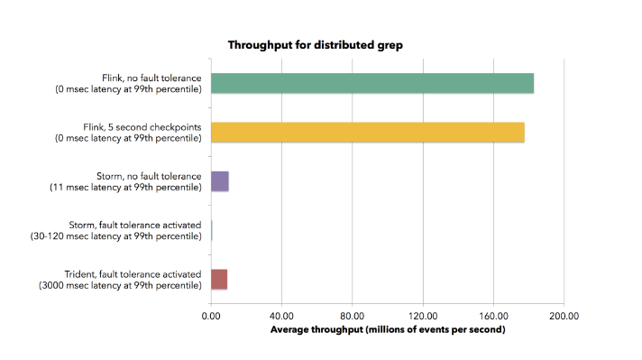
6.4. Benchmark between Storm 0.9.3 and Flink 0.9
93
Notes:
Oct 07, 2014; 5:30pm Márton Balassi
Actually quite recently we had a presentation at Ericsson Hungary. We only have formal comparison with Storm.
As with Storm depending on the size of the tuples our throughput is 2-4 time higher then Storm's.

Slide 94
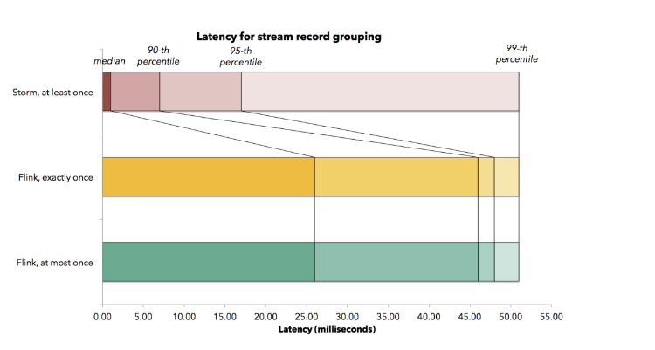
6.4. Benchmark between Storm 0.9.3 and Flink 0.9
94
Notes:
Oct 07, 2014; 5:30pm Márton Balassi
Actually quite recently we had a presentation at Ericsson Hungary. We only have formal comparison with Storm.
As with Storm depending on the size of the tuples our throughput is 2-4 time higher then Storm's.

Slide 95
6.5 More benchmarks being planned!
Towards Benchmarking Modern Distributed Streaming Systems (Slides, Video Recording), Grace Huang Intel
https://spark-summit.org/2015/events/towards-benchmarking-modern-distributed-streaming-systems/
Flink is being added to the BigDataBench project http://prof.ict.ac.cn/BigDataBench/ an open source Big Data benchmark suite which uses real-world data sets and many workloads.
Big Data Benchmark for BigBench might add Flink!?https://github.com/intel-hadoop/Big-Data-Benchmark-for-Big-Bench
95

Slide 96
Agenda
What is Apache Flink stack and how it fits into the Big Data ecosystem?
Why Apache Flink is the 4G (4th Generation) of Big Data Analytics Frameworks?
If you like Apache Flink now, what to do next?
96

Slide 97
III. If you like Apache Flink, what can you do next?
Who is using Apache Flink?
How to get started quickly with Apache Flink?
Where to learn more about Apache Flink?
How to contribute to Apache Flink?
Is there an upcoming Flink conference?
What are some Key Takeaways?
97

Slide 98
1. Who is using Apache Flink?
You might like what you saw so far about Apache Flink and still reluctant to give it a try!
You might wonder: Is there anybody using Flink in pre-production or production environment?
I asked this question to our friend ‘Google’ and I came with a short list in the next slide!
We’ll probably hear more about who is using Flink in production at the upcoming Flink Forward conference on October 12-13, 2015 in Berlin, Germany! http://flink-forward.org/
98

Slide 99









1. Who is using Apache Flink?
99

Slide 100
2. How to get started quickly with Apache Flink?
2.1 Setup and configure a single machine and run a Flink example thru CLI
2.2 Play with Flink’s interactive Scala Shell
2.3 Interact with Flink using Zeppelin Notebook
100

Slide 101
2.1 Local (on a single machine)
Flink runs on Linux, OS X and Windows.
In order to execute a program on a running Flink instance (and not from within your IDE) you need to install Flink on your machine.
The following steps will be detailed for both Unix-Like (Linux, OS X) as well as Windows environments:
2.1.1 Verify requirements
2.1.2 Download
2.1.3 Unpack
2.1.4 Check the unpacked archive
2.1.5 Start a local Flink instance
2.1.6 Validate Flink is running
2.1.7 Run a Flink example
2.1.8 Stop the local Flink instance
101
Notes:
The following steps assume a UNIX-like environment. For Windows, see Flink on Windows: https://ci.apache.org/projects/flink/flink-docs-master/setup/local_setup.html#flink-on-windows

Slide 102
2.1 Local (on a single machine)
2.1.1 Verify requirements
The machine that Flink will run on must have Java 1.6.x or higher installed.
In Unix-like environment, the $JAVA_HOME environment variable must be set. Check the correct installation of Java by issuing the following commands: java –version and also check if $Java-Home is set by issuing: echo $JAVA_HOME. If needed, follow the instructions for installing Java and Setting JAVA_HOME here: http://docs.oracle.com/cd/E19182-01/820-7851/inst_cli_jdk_javahome_t/index.html
102
Notes:
The following steps assume a UNIX-like environment. For Windows, see Flink on Windows: https://ci.apache.org/projects/flink/flink-docs-master/setup/local_setup.html#flink-on-windows

Slide 103
2.1 Local (on a single machine)
In Windows environment, check the correct installation of Java by issuing the following commands: java –version. Also, the bin folder of your Java Runtime Environment must be included in Window’s %PATH% variable. If needed, follow this guide to add Java to the path variable. http://www.java.com/en/download/help/path.xml
2.1.2 Download the latest stable release of Apache Flink from http://flink.apache.org/downloads.html
For example: In Linux-Like environment, run the following command:
wget https://www.apache.org/dist/flink/flink-0.9.0/flink-0.9.0-bin-hadoop2.tgz
103
Notes:
For Windows, see Flink on Windows: https://ci.apache.org/projects/flink/flink-docs-master/setup/local_setup.html#flink-on-windows

Slide 104
2.1 Local (on a single machine)
2.1.3 Unpack the downloaded .tgz archive
Example:
$ cd ~/Downloads # Go to download directory
$ tar -xvzf flink-*.tgz # Unpack the downloaded archive
2.1.4. Check the unpacked archive
$ cd flink-0.9.0
The resulting folder contains a Flink setup that can be locally executed without any further configuration.
flink-conf.yaml under flink-0.9.0/conf contains the default configuration parameters that allow Flink to run out-of-the-box in single node setups.
104

Slide 105
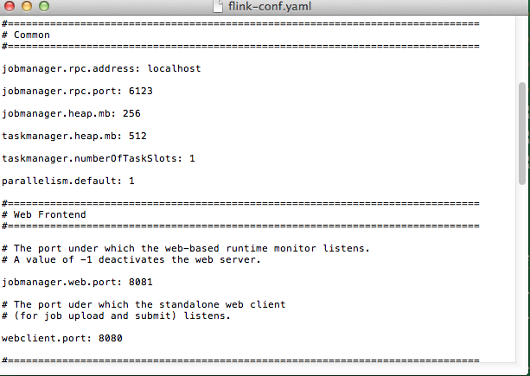
2.1 Local (on a single machine)
105

Slide 106
2.1 Local (on a single machine)
2.1.5. Start a local Flink instance:
Given that you have a local Flink installation, you can start a Flink instance that runs a master and a worker process on your local machine in a single JVM.
This execution mode is useful for local testing.
On UNIX-Like system you can start a Flink instance as follows:
cd /to/your/flink/installation
./bin/start-local.sh
106

Slide 107
2.1 Local (on a single machine)
2.1.5. Start a local Flink instance:
On Windows you can either start with:
Windows Batch Files by running the following commands
cd C:\to\your\flink\installation
.\bin\start-local.bat
or with Cygwin and Unix Scripts: start the Cygwin terminal, navigate to your Flink directory and run the start-local.sh script
$ cd /cydrive/c
cd flink
$ bin/start-local.sh
107

Slide 108
2.1 Local (on a single machine)
The JobManager (the master of the distributed system) automatically starts a web interface to observe program execution. In runs on port 8081 by default (configured in conf/flink-config.yml). http://localhost:8081/
2.1.6 Validate that Flink is running
You can validate that a local Flink instance is running by:
Issuing the following command: $jps
jps: java virtual machine process status tool
Looking at the log files in ./log/
$tail log/flink-*-jobmanager-*.log
Opening the JobManager’s web interface at
http://localhost:8081
108

Slide 109
2.1 Local (on a single machine)
2.1.7 Run a Flink example
On UNIX-Like system you can run a Flink example as follows:
cd /to/your/flink/installation
./bin/flink run ./examples/flink-java-examples-0.9.0-WordCount.jar
On Windows Batch Files, open a second terminal and run the following commands”
cd C:\to\your\flink\installation
.\bin\flink.bat run .\examples\flink-java-examples-0.9.0-WordCount.jar
2.1.8 Stop local Flink instance
On UNIX you call ./bin/stop-local.sh
On Windows you quit the running process with Ctrl+C
109

Slide 110
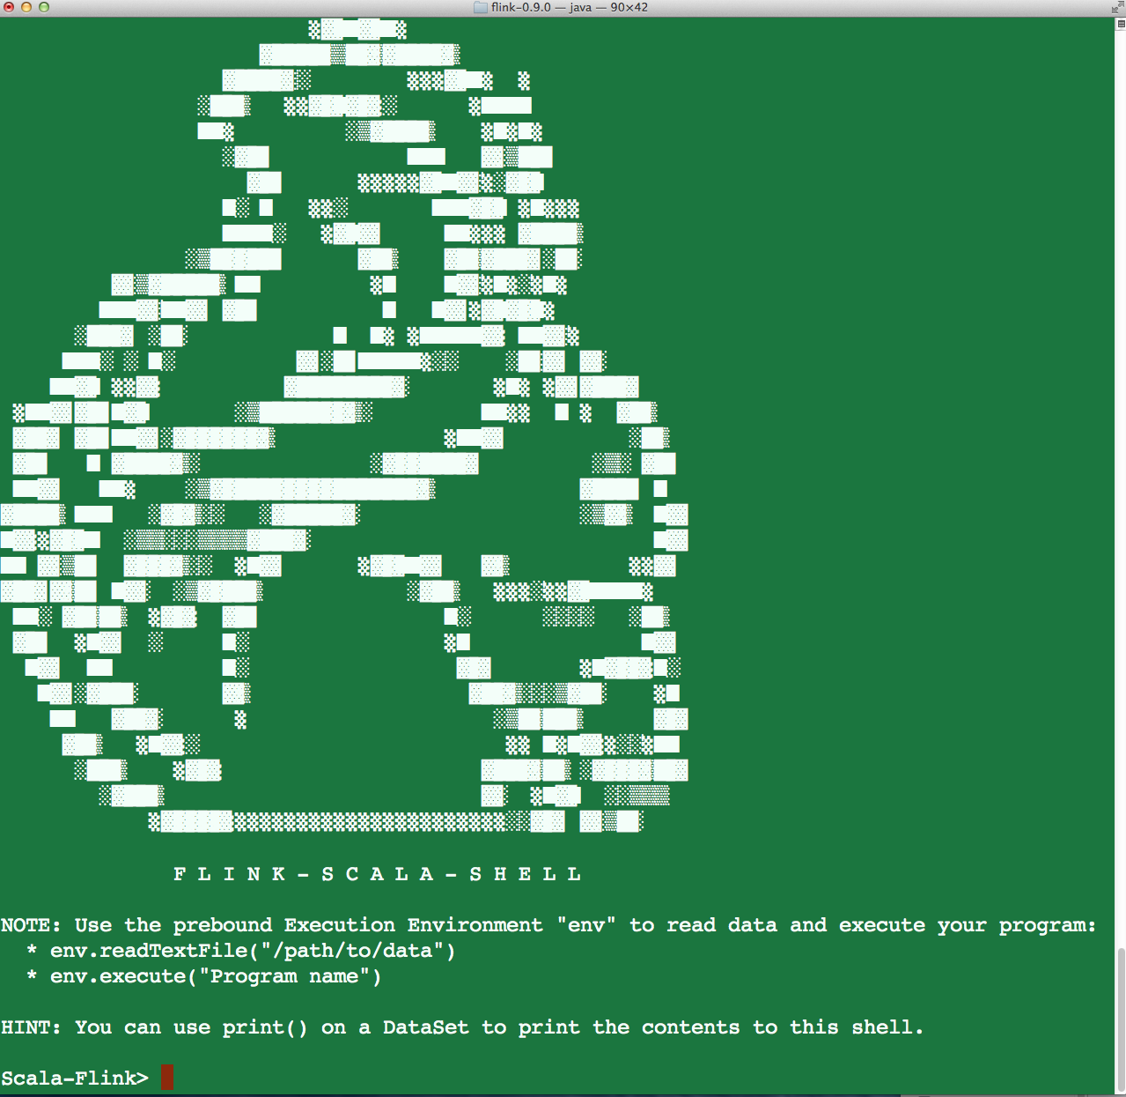
2.2 Interactive Scala Shell bin/start-scala-shell.sh --host localhost --port 6123
110

Slide 111
2.2 Interactive Scala Shell
Example 1:
Scala-Flink> val input = env.fromElements(1,2,3,4)
Scala-Flink> val doubleInput = input.map(_ *2)
Scala-Flink> doubleInput.print()
Example 2:
Scala-Flink> val text = env.fromElements( "To be, or not to be,--that is the question:--", "Whether 'tis nobler in the mind to suffer", "The slings and arrows of outrageous fortune", "Or to take arms against a sea of troubles,")
Scala-Flink> val counts = text.flatMap { _.toLowerCase.split("\\W+") }.map { (_, 1) }.groupBy(0).sum(1)
Scala-Flink> counts.print()
111

Slide 112
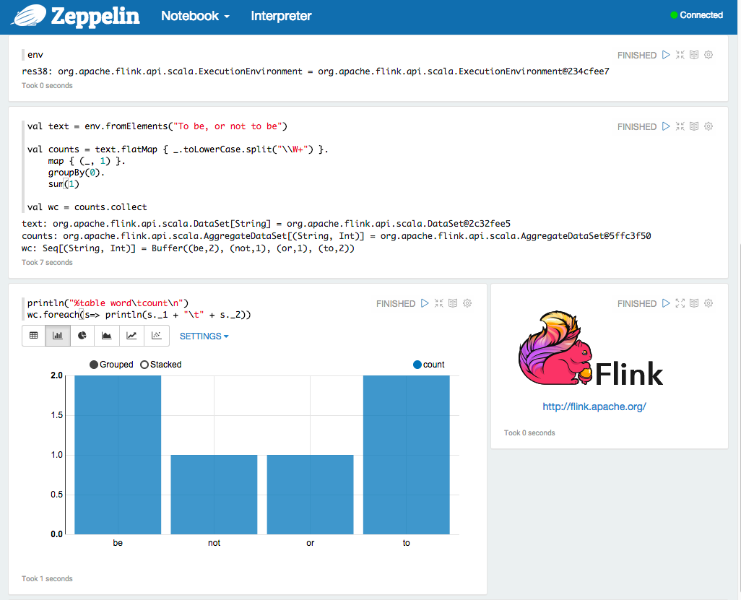
2.3 Zeppelin Notebook
http://localhost:8080/
112

Slide 113







3. Where to learn more about Flink?
Flink at the Apache Software Foundation: flink.apache.org/
data-artisans.com
@ApacheFlink, #ApacheFlink, #Flink
apache-flink.meetup.com
github.com/apache/flink
user@flink.apache.org dev@flink.apache.org
Flink Knowledge Base http://sparkbigdata.com/component/tags/tag/27-flink
113

Slide 114
3. Where to learn more about Flink?
To get started with your first Flink project:
Apache Flink Crash Course
http://www.slideshare.net/sbaltagi/apache-flinkcrashcoursebyslimbaltagiandsrinipalthepu
Free training from Data Artisans
http://dataartisans.github.io/flink-training/
114

Slide 115
4. How to contribute to Apache Flink?
Contributions to the Flink project can be in the form of:
Code
Tests
Documentation
Community participation: discussions, questions, meetups, …
How to contribute guide ( also contains a list of simple “starter issues”)
http://flink.apache.org/how-to-contribute.html
http://flink.apache.org/coding-guidelines.html (coding guidelines)
115

Slide 116

5. Is there an upcoming Flink conference?
25% off Discount Code: FFScalaByTheBay25
Consider attending the first dedicated Apache Flink conference on October 12-13, 2015 in Berlin, Germany! http://flink-forward.org/
Two parallel tracks:
Talks: Presentations and use cases
Trainings: 2 days of hands on training workshops by the Flink committers
116

Slide 117
6. What are some key takeaways?
Although most of the current buzz is about Spark, Flink offers the only hybrid (Real-Time Streaming + Batch) open source distributed data processing engine natively supporting many use cases.
I foresee more maturity of Apache Flink and more adoption especially in use cases with Real-Time stream processing and also fast iterative machine learning or graph processing.
I foresee Flink embedded in major Hadoop distributions and supported!
Apache Spark and Apache Flink will both have their sweet spots despite their “Me Too Syndrome”!
117

Slide 118
Thanks!
To all of you for attending!
To Alexy Khrabov from Nitro for inviting me to talk at this Big Data Scala conference.
To Data Artisans for allowing me to use some of their materials for my slide deck.
To Capital One for giving me time to prepare and give this talk. Yes, we are hiring for our San Francisco Labs and our other locations! Drop me a note at sbaltagi@gmail.com if you’re interested.
118

