Slide 1


A Reliable Memory-Centric Distributed Storage System a Haoyuan Li October 16 @ Strata & Hadoop World NYC Website: tachyon-project.org Meetup: www.meetup.com/Tachyon
UC Berkeley

Slide 2
Outline
Overview
Feature 1: Memory Centric Storage Architecture
Feature 2: Lineage in Storage
Open Source
Roadmap

Slide 3
Outline
Overview
Feature 1: Memory Centric Storage Architecture
Feature 2: Lineage in Storage
Open Source
Roadmap

Slide 4


Projects
UC Berkeley
Design next generation data analytics stack: Berkeley Data Analytics Stack (BDAS)
a cluster manager making it easy to write and deploy distributed applications.
a parallel computing system supporting general and efficient in-memory execution.
a reliable distributed memory-centric storage enabling memory-speed data sharing.

Slide 5
Why Tachyon?

Slide 6
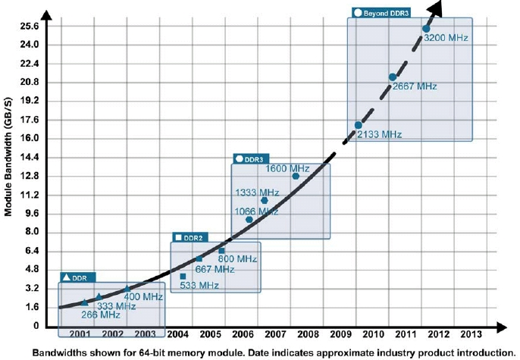
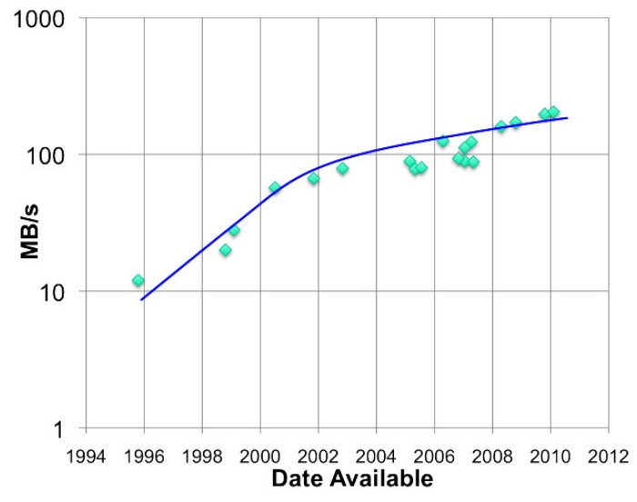
Memory is King
RAM throughput increasing exponentially
Disk throughput increasing slowly
Memory-locality key to interactive response time

Slide 7

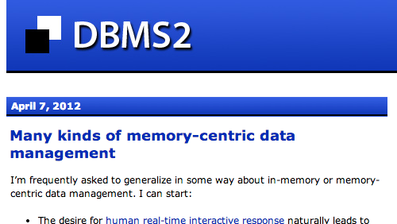
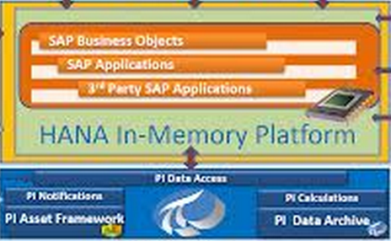

Realized by many…
Frameworks already leverage memory

Slide 8
Problem solved?

Slide 9
Missing a Solution for Storage Layer

Slide 10

An Example: -
Fast in-memory data processing framework
Keep one in-memory copy inside JVM
Track lineage of operations used to derive data
Upon failure, use lineage to recompute data
Lineage Tracking
map
join
reduce
filter
map

Slide 11
Issue 1
Data Sharing is the bottleneck in analytics pipeline: Slow writes to disk
storage engine &
execution engine
same process
(slow writes)
Spark Task
Spark Task
Spark mem
block manager
Spark mem
block manager
block 1
block 3
block 3
block 1
HDFS / Amazon S3
block 1
block 2
block 3
block 4

Slide 12
Issue 1
Data Sharing is the bottleneck in analytics pipeline: Slow writes to disk
storage engine &
execution engine
same process
(slow writes)
Spark Task
Hadoop MR
Spark mem
block manager
YARN
block 1
block 3
HDFS / Amazon S3
block 1
block 2
block 3
block 4

Slide 13
Issue 2
Cache loss when process crashes.
Spark Task
execution engine & storage engine
same process
Spark memory
block manager
block 1
block 3
HDFS / Amazon S3
block 1
block 2
block 3
block 4

Slide 14
Issue 2
Cache loss when process crashes.
crash
execution engine & storage engine
same process
Spark memory
block manager
block 1
block 3
HDFS / Amazon S3
block 1
block 2
block 3
block 4

Slide 15
Issue 2
Cache loss when process crashes.
crash
execution engine & storage engine
same process
HDFS / Amazon S3
block 1
block 2
block 3
block 4

Slide 16
Issue 3
In-memory Data Duplication &
Java Garbage Collection
execution engine & storage engine
same process
(duplication & GC)
Spark Task
Spark Task
Spark mem
block manager
Spark mem
block manager
block 1
block 3
block 3
block 1
HDFS / Amazon S3
block 1
block 2
block 3
block 4

Slide 17
Tachyon
Reliable data sharing at memory-speed within and across cluster frameworks/jobs

Slide 18
Solution Overview
Basic idea
Feature 1: memory-centric storage architecture
Feature 2: push lineage down to storage layer
Facts
One data copy in memory
Recomputation for fault-tolerance

Slide 19
Stack
Computation Frameworks (Spark, MapReduce, Impala, H2O, …)
Tachyon
Existing Storage Systems (HDFS, S3, GlusterFS, …)

Slide 20
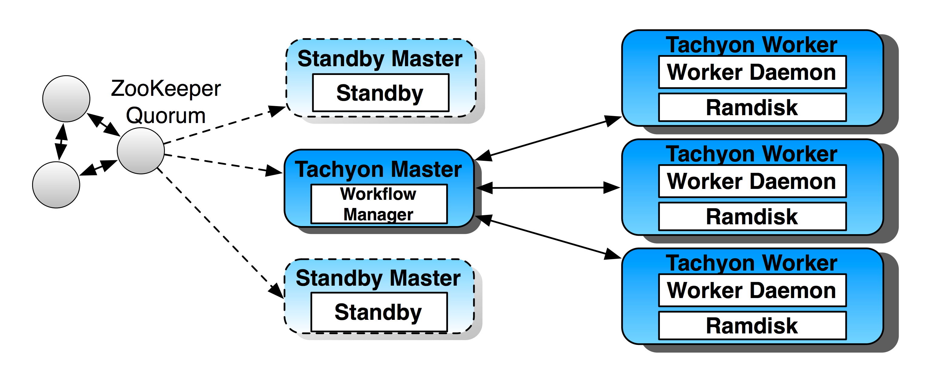
Memory-Centric Storage Architecture

Slide 21
Issue 1 revisited
Memory-speed data sharing among jobs in different frameworks
execution engine & storage engine
same process
(fast writes)
Spark Task
Hadoop MR
Spark mem
YARN
block 1
HDFS
disk
Tachyon in-memory
block 1
block 1
block 2
block 3
block 3
block 4
block 4
HDFS / Amazon S3
block 1
block 2
block 3
block 4

Slide 22
Issue 2 revisited
Keep in-memory data safe, even when a job crashes.
Spark Task
execution engine & storage engine
same process
Spark memory
block manager
block 1
Tachyon in-memory
HDFS / Amazon S3
block 1
block 1
block 2
block 3
block 4
block 3
block 4

Slide 23
Issue 2 revisited
Keep in-memory data safe, even when a job crashes.
crash
execution engine & storage engine
same process
Spark memory
block manager
HDFS
disk
Tachyon in-memory
block 1
block 1
block 2
block 3
block 3
block 4
block 4
HDFS / Amazon S3
block 1
block 2
block 3
block 4

Slide 24
Issue 2 revisited
Keep in-memory data safe, even when a job crashes.
crash
execution engine & storage engine
same process
HDFS
disk
Tachyon in-memory
block 1
block 1
block 2
block 3
block 3
block 4
block 4
HDFS / Amazon S3
block 1
block 2
block 3
block 4

Slide 25
Issue 3 revisited
No in-memory data duplication, much less GC
execution engine & storage engine
same process
(no duplication & GC)
Spark Task
Spark Task
Spark mem
Spark mem
HDFS
disk
Tachyon in-memory
block 1
block 1
block 2
block 3
block 3
block 4
block 4
HDFS / Amazon S3
block 1
block 2
block 3
block 4

Slide 26
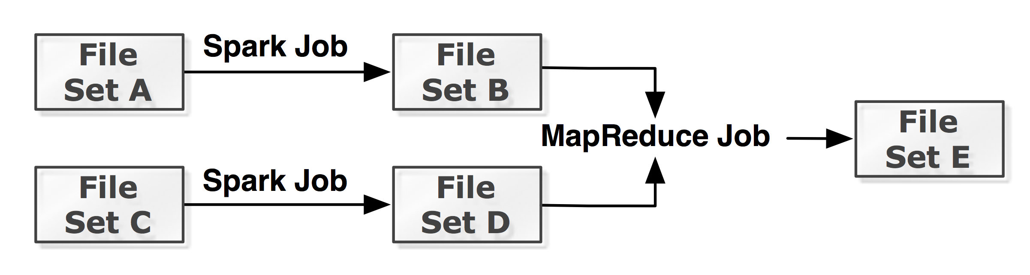
Lineage in Storage (alpha)

Slide 27
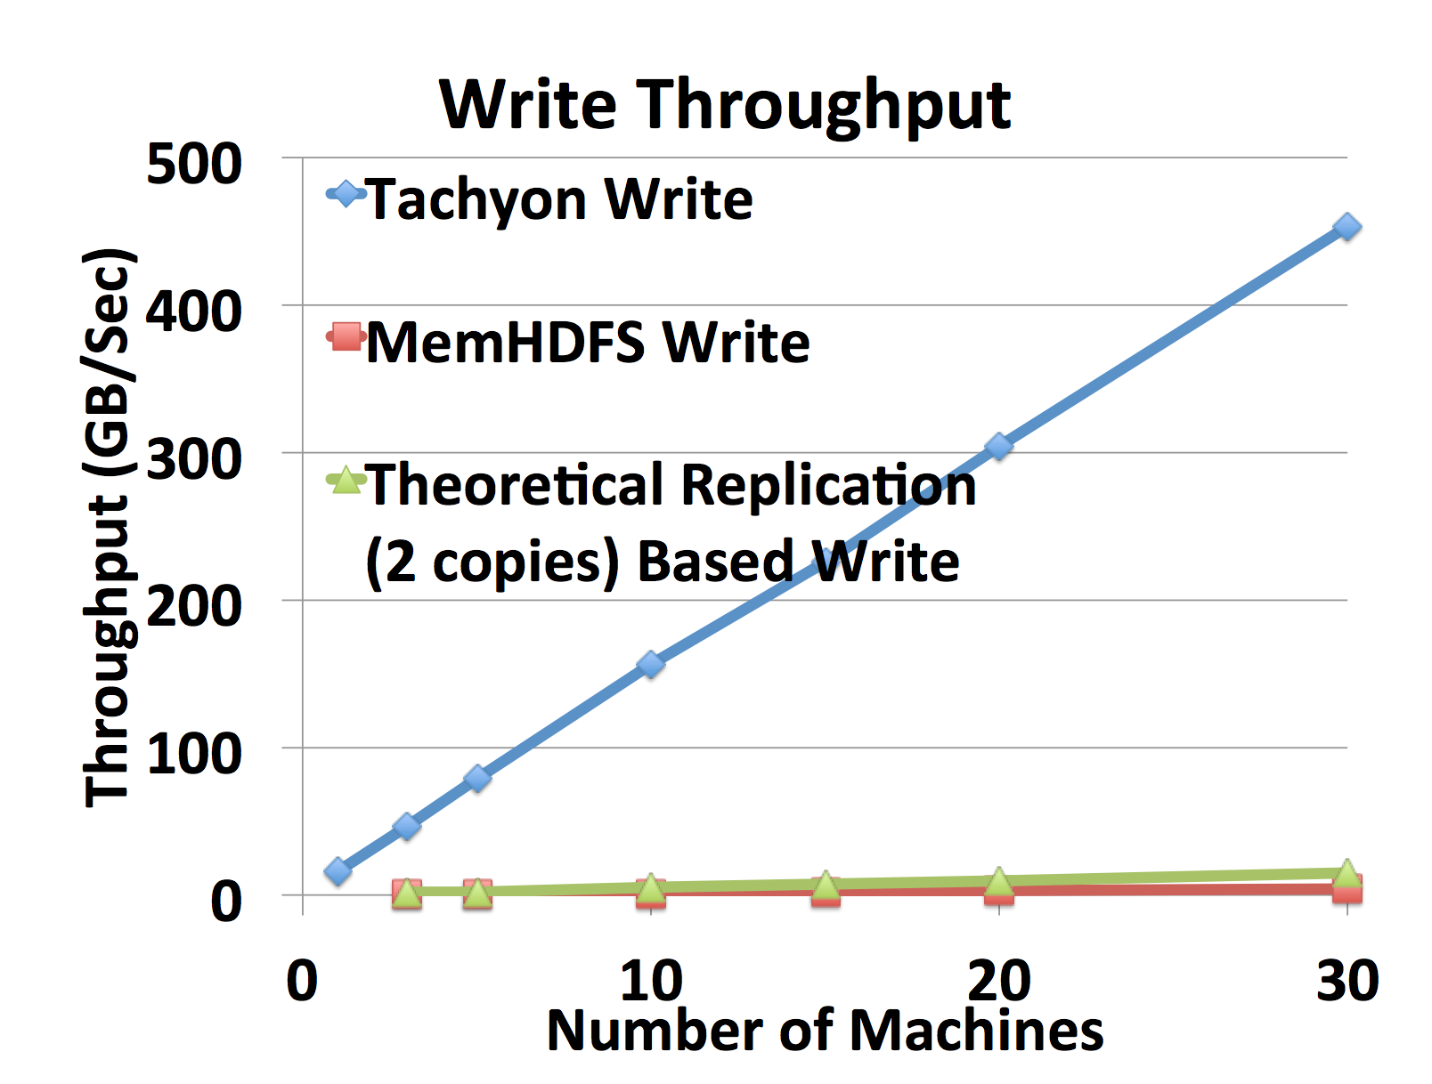
Comparison with in Memory HDFS

Slide 28
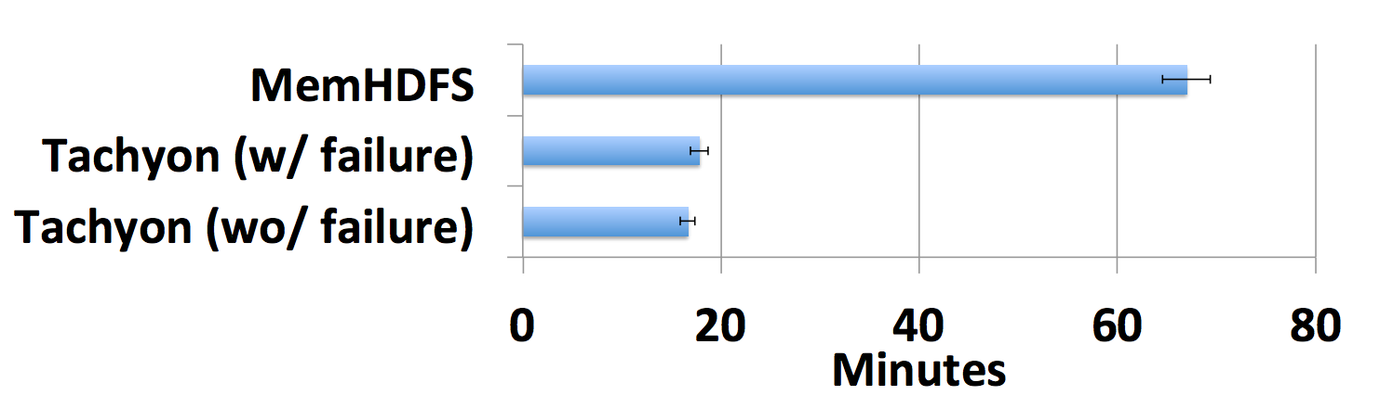
Workflow Improvement
Performance comparison for realistic workflow. The workflow ran 4x faster on Tachyon than on MemHDFS. In case of node failure, applications in Tachyon still finishes 3.8x faster.

Slide 29
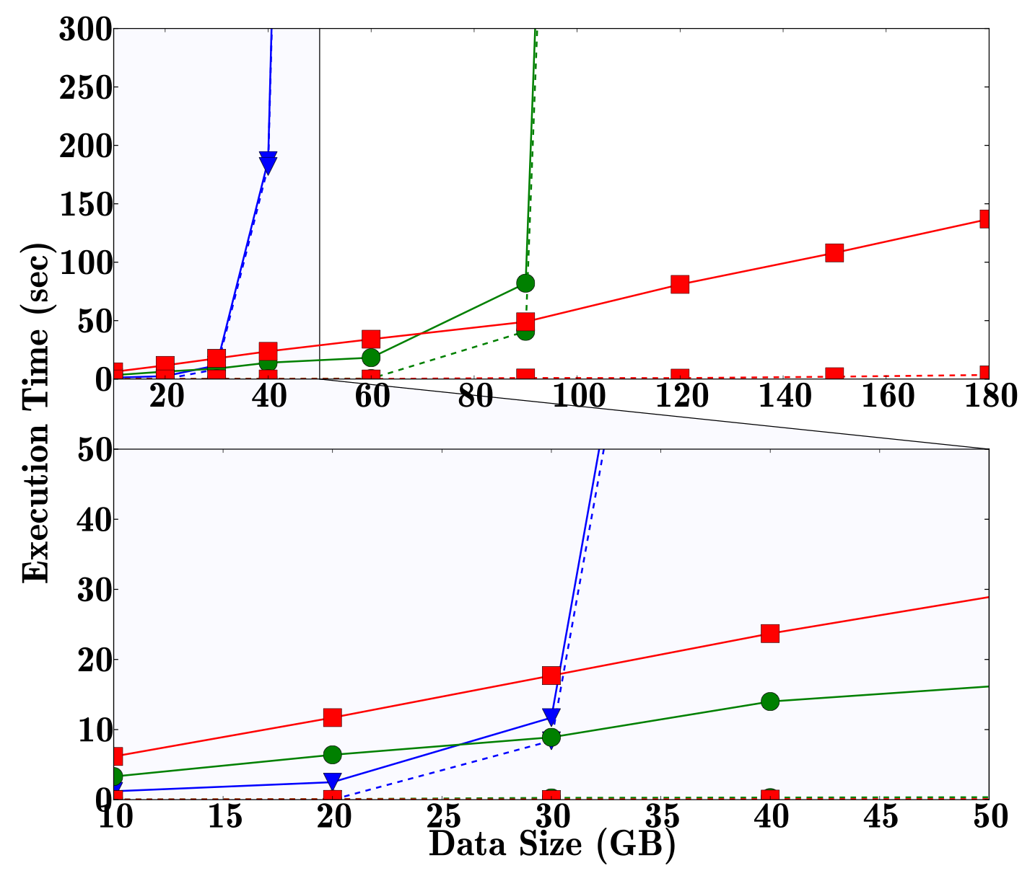
Further Improve Spark’s Performance
Grep
Program
Notes:
BLOW UP

Slide 30
How easy / hard to use Tachyon?

Slide 31
Spark/MapReduce/Shark without Tachyon
Spark
val file = sc.textFile(“hdfs://ip:port/path”)
Hadoop MapReduce
hadoop jar hadoop-examples-1.0.4.jar wordcount hdfs://localhost:19998/input hdfs://localhost:19998/output
Shark
CREATE TABLE orders_cached AS SELECT * FROM orders;

Slide 32
Spark/MapReduce/Shark with Tachyon
Spark
val file = sc.textFile(“tachyon://ip:port/path”)
Hadoop MapReduce
hadoop jar hadoop-examples-1.0.4.jar wordcount tachyon://localhost:19998/input tachyon://localhost:19998/output
Shark
CREATE TABLE orders_tachyon AS SELECT * FROM orders;

Slide 33
Spark on Tachyon
./bin/spark-shell
sc.hadoopConfiguration.set("fs.tachyon.impl", "tachyon.hadoop.TFS")
// Load input from Tachyon
val file = sc.textFile("tachyon://localhost:19998/LICENSE")
file.count() ; file.take(10);
// Store RDD OFF_HEAP in Tachyon
import org.apache.spark.storage.StorageLevel;
file.persist(StorageLevel.OFF_HEAP)
file.count(); file.take(10);
// Save output to Tachyon
file.flatMap(line => line.split(" ")).map(s => (s, 1)).reduceByKey((a, b) => a + b).saveAsTextFile("tachyon://localhost:19998/LICENSE_WC")

Slide 34
Outline
Overview
Feature 1: Memory Centric Storage Architecture
Feature 2: Lineage in Storage
Open Source
Roadmap

Slide 35





History
Started at UC Berkeley AMPLab from the summer of 2012
Reliable, Memory Speed Storage for Cluster Computing Frameworks (UC Berkeley EECS Tech Report)
Haoyuan Li, Ali Ghodsi, Matei Zaharia, Ion Stoica, Scott Shenker

Slide 36


A Open Source Status
Apache License 2.0, Version 0.5.0 (July 2014)
Deployed at tens of companies
20+ Companies Contributing
Spark and MapReduce applications can run without any code change

Slide 37
Release Growth
Tachyon 0.1:
-1 contributor
Dec ‘12

Slide 38
Release Growth
Tachyon 0.2:
3 contributors
Tachyon 0.1:
-1 contributor
Dec ‘12
Apr ‘13

Slide 39
Release Growth
Tachyon 0.3:
15 contributors
Tachyon 0.2:
3 contributors
Tachyon 0.1:
-1 contributor
Dec ‘12
Apr ‘13
Oct‘13

Slide 40
Release Growth
Tachyon 0.4:
30 contributors
Tachyon 0.3:
15 contributors
Tachyon 0.2:
3 contributors
Tachyon 0.1:
-1 contributor
Dec ‘12
Apr ‘13
Oct‘13
Feb ‘14

Slide 41
Release Growth
Tachyon 0.5:
46 contributors
Tachyon 0.4:
30 contributors
Tachyon 0.3:
15 contributors
Tachyon 0.2:
3 contributors
Tachyon 0.1:
-1 contributor
Dec ‘12
Apr ‘13
Oct‘13
Feb ‘14
July ‘14

Slide 42
Open Community

Slide 43
















Thanks to our Code Contributors!
Aaron Davidson
Achal Soni
Ali Ghodsi
Andrew Ash
Anurag Khandelwal
Aslan Bekirov
Bill Zhao
Brad Childs
Calvin Jia
Chao Chen
Cheng Chang
Cheng Hao
Colin Patrick McCabe
David Capwell
David Zhu
Du Li
Fei Wang
Gerald Zhang
Grace Huang
Haoyuan Li
Henry Saputra
Hobin Yoon
Huamin Chen
Jey Kottalam
Joseph Tang
Juan Zhou
Jun Aoki
Lin Xing
Lukasz Jastrzebski
Manu Goyal
Mark Hamstra
Mingfei Shi
Mubarak Seyed
Nick Lanham
Orcun Simsek
Pengfei Xuan
Qianhao Dong
Qifan Pu
Raymond Liu
Reynold Xin
Robert Metzger
Rong Gu
Sean Zhong
Seonghwan Moon
Siyuan He
Shivaram Venkataraman
Srinivas Parayya
Tao Wang
Timothy St. Clair
Thu Kyaw
Vamsi Chitters
Xi Liu
Xiang Zhong
Xiaomin Zhang
Zhao Zhang

Slide 44

Thanks to Redhat!

Slide 45

Commercially supported
by x
and running in dozens of their customers’ clusters
Thanks to Redhat!

Slide 46
Tachyon is the Default Off-Heap Storage Solution for .
Thanks to Redhat!

Slide 47
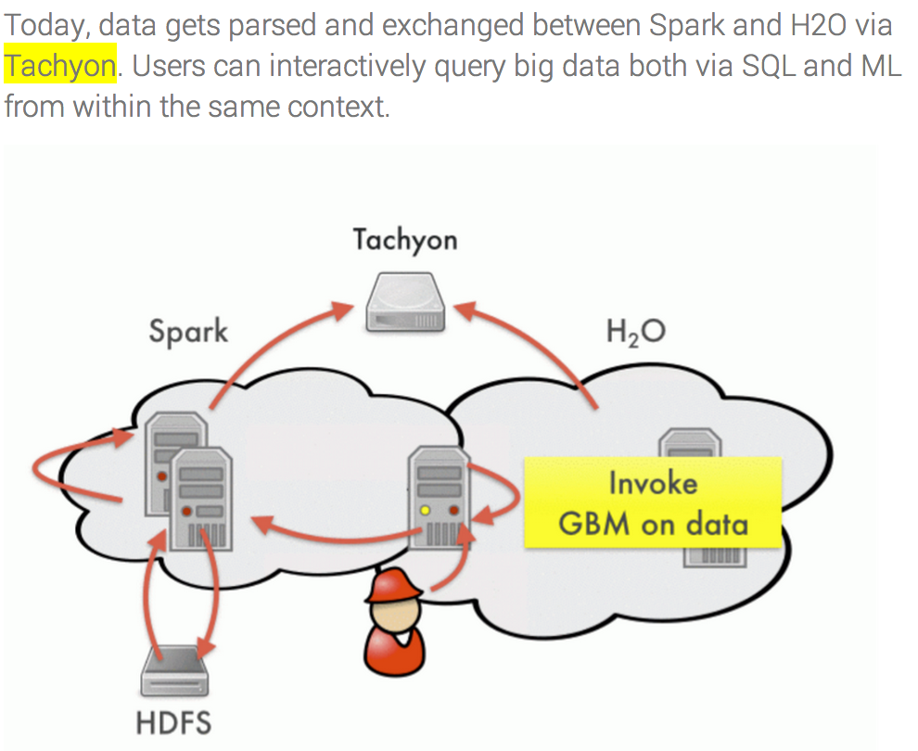
Exchange Data Between Spark and H20

Slide 48




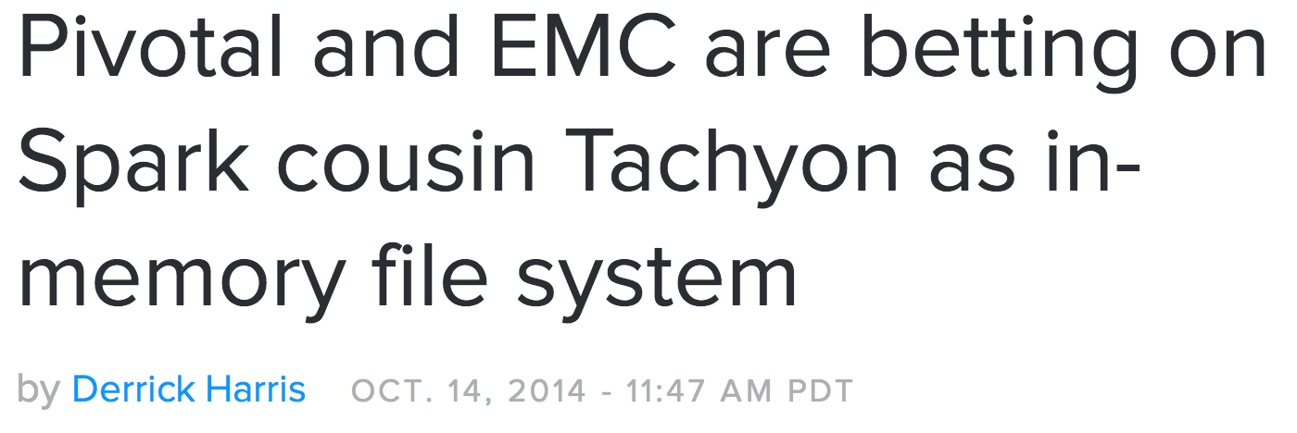



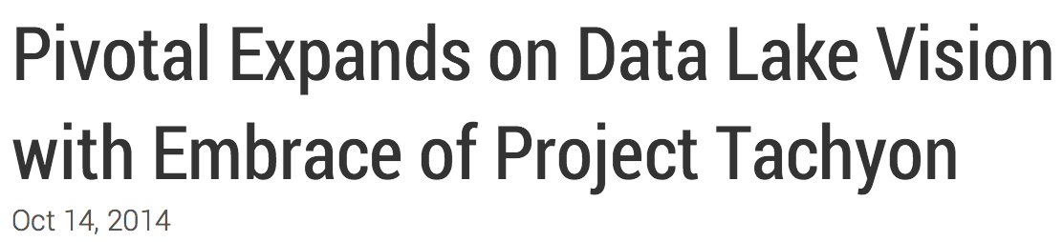
Belief from Industry

Slide 49
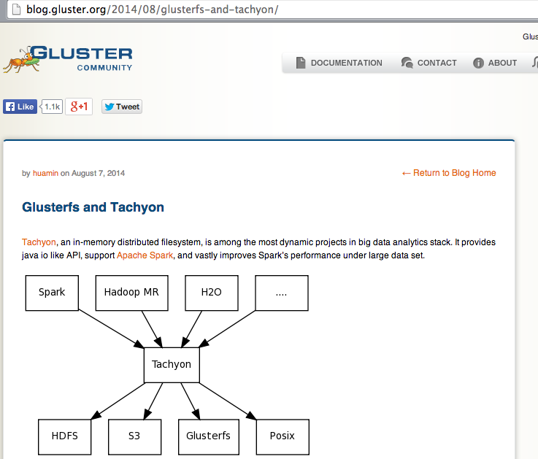
Reaching wider communities: e.g. GlusterFS

Slide 50



Under Filesystem Choices
(Big Data, Cloud, HPC, Enterprise)
Notes:
This means that people can run Tachyon for Big Data, on Cloud, in HPC, and even for enterprise.

Slide 51



Under Filesystem Choices
(Big Data, Cloud, HPC, Enterprise)
Notes:
This means that people can run Tachyon for Big Data, on Cloud, in HPC, and for enterprise.

Slide 52
Outline
Overview
Feature 1: Memory Centric Storage Architecture
Feature 2: Lineage in Storage
Open Source
Roadmap

Slide 53
Features
Memory Centric Storage Architecture
Lineage in Storage (alpha)
Hierarchical Local Storage
Data Serving
Different hardware
More…
Your Requirements?

Slide 54
Short Term Roadmap (0.6 Release)
Ceph Integration (Ceph Community, Redhat)
Hierarchical Local Storage (Intel)
Performance Improvement (Yahoo)
Multi-tenancy (AMPLab)
Mesos Integration (Mesos Community, Mesosphere)
Network Sub-system Improvement (Pivotal)
Many more from AMPLab and Industry Contributors

Slide 55
Goal?

Slide 56
Better Assist Other Components
Spark
MapReduce
H2O
Spark SQL
GraphX
Impala
……
Tachyon
HDFS
S3
GlusterFS
OrangeFS
NFS
Ceph
……
Welcome Collaboration!
Notes:
Keeping in mind, the potential for tachyon to work in different areas beyond big data, such as cloud, HPC, and enterprise. With that, I would like to welcome any and all collaborations!

Slide 57
Thanks! Questions?
More Information:
Website: http://tachyon-project.org
Github: https://github.com/amplab/tachyon
Meetup: http://www.meetup.com/Tachyon
Email: haoyuan@cs.berkeley.edu

Slide 58
Release Growth
Tachyon 0.5:
46 contributors
Tachyon 0.4:
30 contributors
Tachyon 0.3:
15 contributors
Tachyon 0.2:
3 contributors
Tachyon 0.1:
-1 contributor
Dec ‘12
Apr ‘13
Oct‘13
Feb ‘14
July ‘14

