Slide 1
Scheduling in Cloud
Presented by: Abdullah Al Mahmud
Course: Cloud Computing(Fall 2012)

Slide 2
Papers
Quincy: Fair Scheduling for Distributed Computing Clusters
Michael Isard, Vijayan Prabhakaran, Jon Currey, Udi Wieder, Kunal Talwar, Andrew Goldberg @ MSR Silicon Valley
Optimized Resource Allocation & Task Scheduling Challenges in Cloud Computing Environments
Dominique A. Heger, DHTechnologies (DHT)

Slide 3
Quincy: Fair Scheduling for Distributed Computing Clusters
Michael Isard, Vijayan Prabhakaran, Jon Currey, Udi Wieder, Kunal Talwar, and Andrew Goldberg
Modified version of www.sigops.org/sosp/sosp09/slides/quincy/QuincyTestPage.html

Slide 4
Problem Setting
Homogenous Cluster
Fine grain resource sharing (multiplex all computers in the cluster between all jobs)
Independent tasks(less costly to kill a task and restart the task)

Slide 5
Goal of Quincy
Fair Sharing and Data Locality
N computers, J concurrent jobs
-Each job gets at least N/J computers
-Place tasks near data to avoid network bottlenecks
-Joint optimization of fairness and data locality

Slide 6
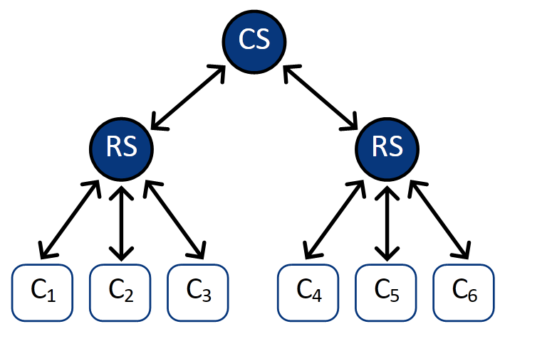
Cluster Architecture
Notes:
CS-> Core Switch
RS-> Rack Switch
Ci->Cores

Slide 7
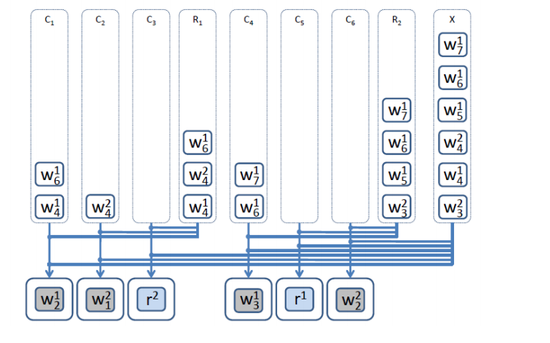
Baseline: Queue Based Scheduler

Slide 8
Baseline: Queue Based Scheduler
Greedy: Running the first available job in the queue
Simple Greedy Fairness: Starving a job that submits large number of workers
Fairness with preemption: Killing workers from a job that already have submitted large number of workers.

Slide 9
Flow Based Scheduler: Quincy
Construct a graph based on scheduling constraint and cluster architecture
Finding a matching in the graph is equivalent to finding a feasible schedule.
Can assign a cost to any matching
Fairness constraints: number of tasks that are scheduled
Goal: Minimize matching cost while obeying fairness constraints

Slide 10
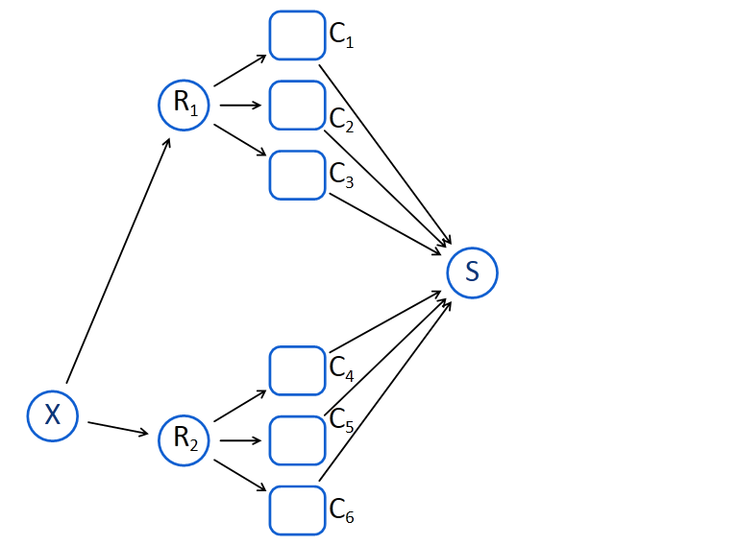
Graph Construction
Start with a directed graph representation of the cluster architecture

Slide 11
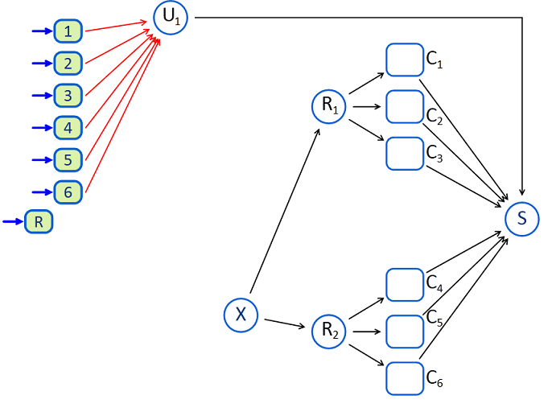
Graph Construction (2)

Slide 12
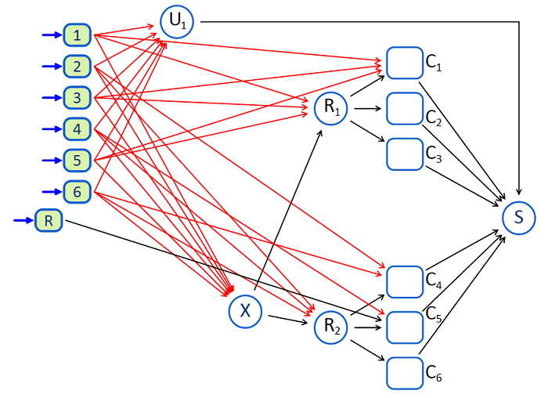
Graph Construction (3)

Slide 13
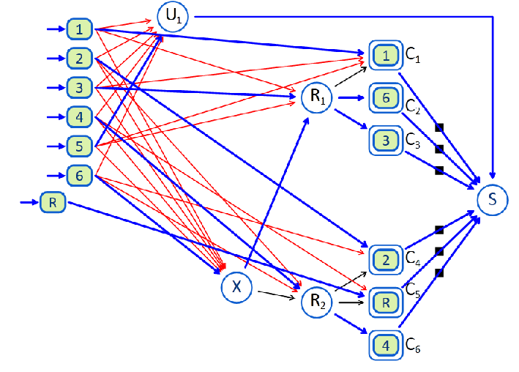
A Feasible Matching

Slide 14
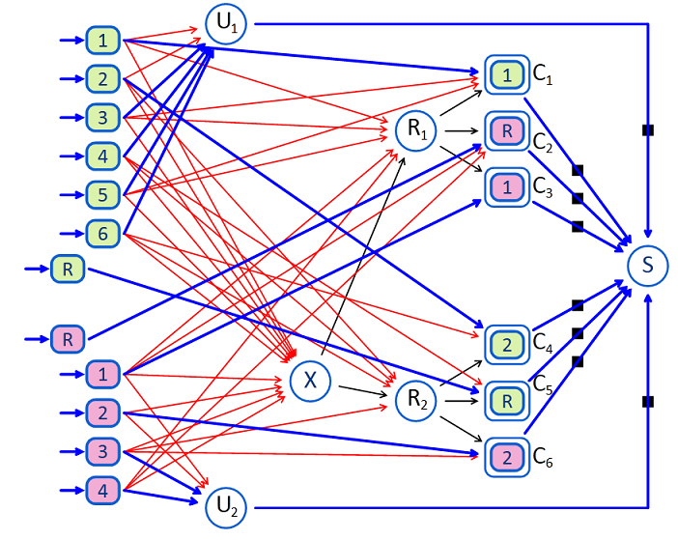
Final Graph

Slide 15
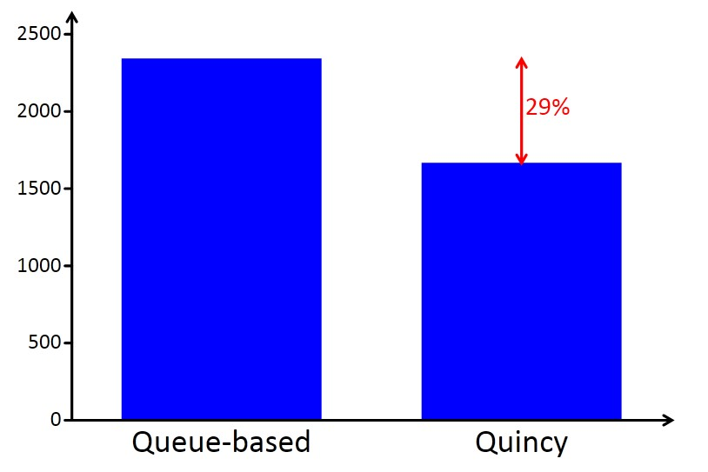
Result: Makespan when network is bottleneck(s)

Slide 16
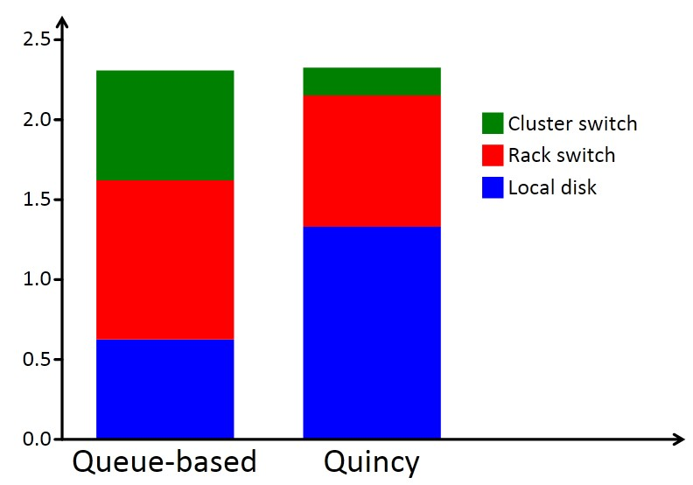
Result: Data Transfer (TB)

Slide 17
Conclusion
New computational model for data intensive computing
Elegant mapping of scheduling to min-cost flow/matching problem

Slide 18
Optimized Resource Allocation & Task Scheduling Challenges in Cloud Computing Environments
Dominique A. Heger

Slide 19
Resource Allocation in the Cloud
Each task's resource demand can be described via a multi-dimensional vector such as that the task i requires x processing cores, y GB of memory, and z GB of storage.
Classical Bin Packing instance(Three Dimensional) which is a well known NP Complete problem

Slide 20
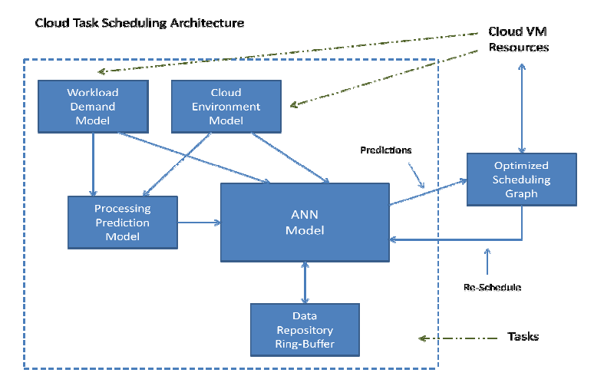
ANN Based Task Scheduling

Slide 21
Conclusion
This paper discusses some theoretical aspects of Task Scheduling and Resource Allocation

Slide 22
Question?

Slide 23
Thank You

