Slide 1
Declarative Networking
Boon Thau Loo, Tyson Condie, Minos Garofalakis, David E. Gay, Joseph M. Hellerstein, Petros Maniatis, Raghu Ramakrishnan, Timothy Roscoe, and Ion Stoica
CACM 52(11), Nov 2009
Presented By
Hash Vardhan and Sandeep Joshi

Slide 2
Agenda
Datalog and Recursive Query Processing
Motivation to Declarative Networking
NDLog : Extensions to Datalog
Execution Plan generation
Incremental Maintenance
Use cases
Conclusion and References

Slide 3
Datalog
Introduction to datalog and recursive query processing

Slide 4
Datalog
Declarative Paradigm
Give only what, and not how
Used extensively in SQL, functional programming
Easy and more natural to state
Datalog
Non procedural query language
Based on Prolog
V1(A,B) :- account (A, “Mumbai”, B), B> 700
This gives account numbers and balances for accounts in Mumbai with balance greater than 700

Slide 5
Datalog
A simple Datalog rule
p :- q₁, q₂, …, q_{n}
“q₁ and q₂ and … and q_{n} implies p.”
p : head
q₁..q_{n} : body, consists of predicates or functions

Slide 6
Datalog
Program consists of rules
Many rules can be used to define a relation
Order of defining rules does not matter
Predicates(relations) and matched (joined) to produce head
interest_rate(A,10) :- account(A,N,B), B >= 10000
interest_rate(A,5) :-account(A,N,B) , B < 10000
interest(A,I) :- account(A, ”Mumbai”, B), interest_rate(A,R),I = B*I/100
This is an example of non-recursive datalog program

Slide 7
Datalog
Recursive datalog program
Consider a program to give all paths between nodes of a graph
path(src,Dest,path,Cost) :- link(src,Dest,Cost), path=f_init(src,Dest). path(src,Dest,path,Cost) :- link(src,nxt,Cost1), path(nxt,Dest,path2,Cost2), Cost=Cost1+Cost2, path=f_concatpath(src,path2)
Recursive programs use fixpoint evaluation
Tuples produced in each iteration are added to the relation
Duplicate tuples are removed
Repeated until no new tuples are produces, i.e. “fixpoint” is reached

Slide 8
Semi Naïve Evaluation
New tuples that are generated for the first time in the current iteration are then used in the next iteration.
This is repeated until a fixpoint is achieved (i.e., no new tuples are produced).

Slide 9
Declarative Networking: Motivation

Slide 10
Motivation
Routing?
Gathering local network state : Base Data
Deriving forwarding tables : Derived Data
Enforcing constraints : Constraints
Recursive Query processing
Using derived data again in query processing

Slide 11
Language
NDLog, Datalog extended for networking

Slide 12
Language
Simple example to find path between two nodes
Paths in fully connected network:
sp1 path(src,Dest,path,Cost) :- link(src,Dest,Cost), path=f_init(src,Dest).
To get paths in a general network, we need to add one more rule
sp2 path(src,Dest,path,Cost) :- link(src,nxt,Cost1), path(nxt,Dest,path2,Cost2), Cost=Cost1+Cost2, path=f_concatpath(src,path2), f_inPath(src,path2)=false

Slide 13
Language
Aggregation
To get the cost of the shortest path we can use aggregation
min, max, avg all can be obtained in the same way
sp3 spCost(src,Dest,min<Cost>) :- path(src,Dest,path,Cost).

Slide 14
Language
Location Specifiers (@)
Extension to datalog for networking
Specifies the location of data
Captures data partitioning
Enables distributed computations necessary for network protocols
Hides low level dataflow details
sp1 path(@src,Dest,path,Cost) :- link(@src,Dest,Cost), path=f_init(src,Dest).
sp2 path(@src,Dest,path,Cost) :- link(@src,nxt,Cost1), path(@nxt,Dest,path2,Cost2), Cost=Cost1+Cost2, path=f_concatpath(src,path2), f_inPath(src,path2)=false

Slide 15
Language
Link Restricted Rules
Models physical network where full connectivity is not available
One link predicate in each rule
There is exactly one link predicate in the body and rule is either..
Local rule or
All other predicates (including the head predicate)have their location specifier set to either the first (source) or second (destination) field of the link predicate.
p(@Dest,...):- link(@Src,Dest...),p₁(@Src,...),…,p_{n}(@Src,...).
sp2 path(@src,Dest,path,Cost) :- link(@src,nxt,Cost1), path(@nxt,Dest,path2,Cost2), Cost=Cost1+Cost2, path=f_concatpath(src,path2),f_inPath(src,path2)=false

Slide 16
Language
sp1 path(@src,Dest,path,Cost) :- link(@src,Dest,Cost), path=f_init(src,Dest).
sp2 path(@src,Dest,path,Cost) :- link(@src,nxt,Cost1), path(@nxt,Dest,path2,Cost2), Cost=Cost1+Cost2, path=f_concatpath(src,path2), f_inPath(src,path2)=false
sp3 spCost(@src,Dest,min<Cost>) :- path(@src,Dest,path,Cost).
sp4 shortestpath(@src,Dest,path,Cost) :- spCost(@src,Dest,Cost),path(@src,Dest,path,Cost).
Query shortestpath(@src,Dest,path,Cost).

Slide 17
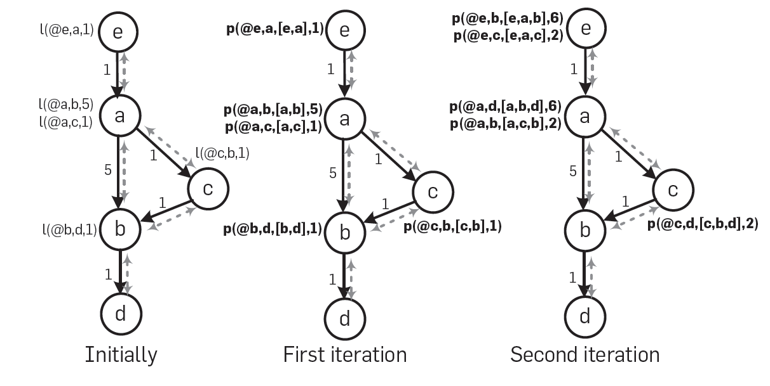
Language

Slide 18
Execution Plan generation

Slide 19
Execution Plan Generation
Network Protocols : State machines
NDlog : Developed as Distributed dataflow execution engines
Recursive flows and the asynchronous communication difficult to handle
Two types : Centralized / Distributed

Slide 20
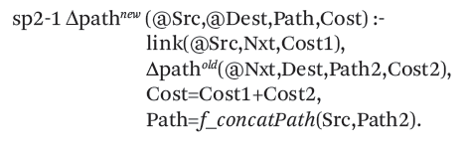
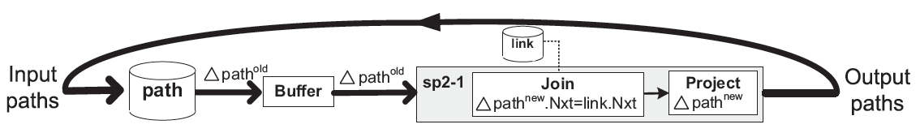
Centralized Evaluation

Slide 21
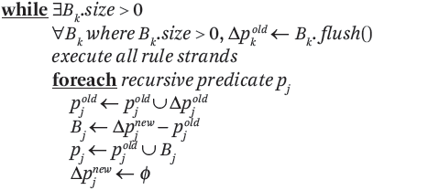
Centralized Evaluation

Slide 22
Distributed Plan Generation

Slide 23
Localization Rewrite
Rules may have body predicates at different locations:
R2: path(@S,D,P) ← link(@S,Z), path(@Z,D,P₂), P=S•P₂.
Matching variable Z = “Join”
Rewritten rules:
sp2a: linkD(S,@D) ← link(@S,D)
sp2b: path(@S,D,P) ← linkD(S,@Z), path(@Z,D,P₂), P=S•P₂.
Matching variable Z = “Join”

Slide 24
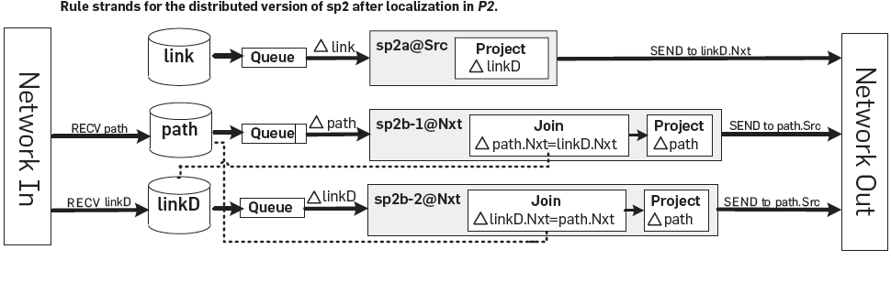
Distributed Plan Generation
Rule sp2a@Src sends links to dest. add with as linkD tuples.
Rule sp2b-2@Nxt takes linkD and performs join with path tuple.

Slide 25
Recursive Query Evaluation
Semi-naïve evaluation:
Iterations (rounds) of synchronous computation
Results from iteration i^{th} used in (i+1)^{th}
10
9
9
3-hop
7
8
5
7
4
1
2
10
6
8
0
5
2-hop
4
3
3
2
1-hop
6
1
Link Table
Path Table
Network
Problem: Unpredictable delays and failures

Slide 26
Pipelined Semi-naïve (PSN)
Fully-asynchronous evaluation:
Computed tuples in any iteration pipelined to next iteration
Natural for distributed dataflows
9
10
7
9
5
6
4
1
2
10
3
Relaxation of semi-naïve
8
8
0
5
3
2
7
6
4
1
Link Table
Path Table
Network

Slide 27
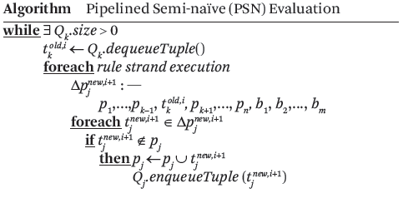
Pipelined Semi-naïve (PSN)
Node receiving new tuple can immediately process the tuple without waiting for local iteration to complete.

Slide 28
Incremental Maintenance

Slide 29
Semantics in Dynamic Network
Underlying Network Changes.
Use Bursty update model for re-computations
Three types of changes:
Insertion : Tuple can be inserted at any stage , handled by pipelined Evaluation.
Deletion : Deletion of base tuple leads to deletion of tuples derived from base tuple.
Update : Treated as deletion followed by insertion. Updating base tuple leads to more updates propagated further.

Slide 30
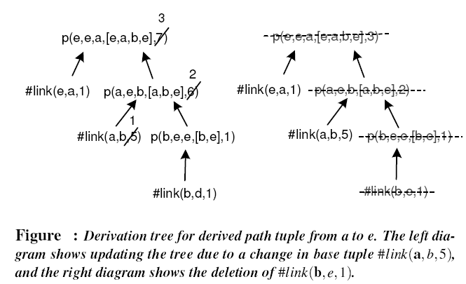
Semantics in Dynamic Network

Slide 31
Semantics in Dynamic network
Use of Count Algorithm for multiple derivations
Standard view maintenance technique for aggregates
Ensures that tuples no longer derivable are deleted on deletes/updates.
Example : Calculate 2 hop paths for given link set
Link={(a,b),(b,c),(b,e),(a,d),(d,c)}
Evaluates to {[(a,c)-2],[(a,e)-1]}
We keep count with both paths
If link (a,b) is deleted, algo uses stored count to reevaluate hop to {(a,c)}

Slide 32
Use Cases
Use Cases of Declarative Networking

Slide 33
Declarative Routing
Routing Protocol is implemented by writing query in NDlog
Queries executed in distributed fashion on nodes
Static analysis tests for termination of query in NDlog
NDlog can express variety of routing protocols such as distance vector, path vector ,dynamic source routing easily

Slide 34
Distance Vector Routing
At each node, save next hop each destination with the cost
Nodes exchange this information to get knowledge about complete network state
A
 | A | C | D
1 | 1,A | 1,C | --
2 | 1,A | 1,C | 2,A
 | B | C | D
1 | 1,B | 1,C | 1,B
B
D
C

Slide 35
Distance Vector Routing
DV1: path(@S,D,D,C) :- link(@S,D,C).
DV2: path(@S,D,Z,C) :- link(@S,Z,C1), path(@Z,D,W,C2), C = C1 + C2
DV3: shortestCost(@S,D,min<C>) :- path(@S,D,Z,C).
DV4: nextHop(@S,D,Z,C) :- path(@S,D,Z,C), . shortestCost(@S,D,C).
Query: nextHop(S,D,Z,C).

Slide 36
Distance Vector Routing
At each node, save next hop each destination with the cost
Nodes exchange this information to get knowledge about complete network state
A
 | A | C | D
1 | 1,A | 1,C | --
2 | 1,A | 1,C | 2,A
3 | 1,A | 1,C | 4,A
 | A | C | D
1 | 1,A | 1,C | --
2 | 1,A | 1,C | 2,A
 | B | C | D
1 | 1,B | 1,C | 1,B
2 | 1,A | 1,C | 3,B
3 | 1,A | 1,C | 5,B
 | B | C | D
1 | 1,B | 1,C | 1,B
B
D
C

Slide 37
Distance Vector Routing
DV1: path(@S,D,D,C) :- link(@S,D,C).
DV2: path(@S,D,Z,C) :- link(@S,Z,C1), path(@Z,D,W,C2), C = C1 + C2
DV3: shortestCost(@S,D,min<C>) :- path(@S,D,Z,C).
DV4: nextHop(@S,D,Z,C) :- path(@S,D,Z,C), . shortestCost(@S,D,C).
Query: nextHop(S,D,Z,C).
Count to Infinity problem?
DV2: path(@S,D,Z,C) :- link(@S,Z,C1), path(@Z,D,W,C2), C = C1 + C2, W != S
DV5: path(@S,D,Z,∞) :- link(@S,Z,C1), path(@Z,D,S,C2)

Slide 38
Policy Based Routing
Some of the policies
Node Utilization
Link Utilization
Security issues
Transit- Peer relationships
PBR1: invalidPath(@S,D,P,C) :- path(@S,D,P,C), excludeNode(@S,W), f_inPath(P,W) = true.
PBR2: permitPath(@S,D,P,C) :- path(@S,D,P,C), not invalidPath(@S,D,P,C)
Query: permitPath(@S,D,P,C).
excludeNode(@S,W) : this says that node W can not carry any traffic for node S

Slide 39
Declarative Overlays
Overlay network : Virtual nodes built on top of internet
To provide services that are not available in existing network.
Overlay
Internet
Overlog declarative language an extension on NDlog.
Soft-state is introduced on Overlog

Slide 40
Soft State
Stored data has associated Time-to-live(TTL)
Soft state dataum needs to be periodically refreshed
If more time than TTL passes without datum being refreshed, that datum is deleted.
Soft State is favored in networking implementations since it provides eventual consistency.
Eventual values are obtained in case of transient errors such as reordered messages, node disconnection.
In case of persistent failure no coordination is required, since any data provided by failed node would be forgotten.

Slide 41
Soft State
In Overlog use materialized keyword
materialized(link, {1,2}, 10) , this specifies link tuple has a life time of ten seconds
If TTL set to infinity : Hard State
If predicate has no materialized keyword it is treated as event predicate ( TTL =0)
Event predicates are transient tables and use to trigger rules periodically or case of network events
ping(@Y, X) :- periodic(@X, 10) , link(@X, Y)

Slide 42
Conclusion
Ease of programming:
Compact and high-level representation of protocols
Orders of magnitude reduction in code size
Easy customization
Safety:
Queries are “sandboxed” within query processor
Potential for static analysis techniques on safety
What about efficiency?
No fundamental overhead when executing standard routing protocols
Application of well-studied query optimizations

Slide 43
References
Declarative Networking, Boon Thau Loo, Tyson Condie, Minos Garofalakis, David E. Gay, Joseph M. Hellerstein, Petros Maniatis, Raghu Ramakrishnan, Timothy Roscoe, and Ion Stoica CACM 52(11), Nov 2009
Declarative Networking: Language, Execution and Optimization Boon Thau Loo , Tyson Condie , Minos Garofalakis , David E. Gay , Joseph M. Hellerstein , Petros Maniatis , Raghu Ramakrishnan , Timothy Roscoe , Ion Stoica, SIGMOD-2006
Declarative Routing:Extensible Routing with Declarative Queries, Boon Thau Loo, Joseph M. Hellerstein, Ion Stoica, Raghu Ramakrishnan, SIGCOMM-2005
Database Systems and Concepts, Avi Silberschatz, Henry F. Korth, S. Sudarshan, 4th Edition
Design and Implementaion of Declarative Networks, Boon Thau Loo, powerpoint presentation, available online, URL : www.cis.upenn.edu/~boonloo/research/talks/dn-sigmod07.ppt

Slide 44
Thank you

