Slide 1
Incorporating Partitioning & Parallel Plans into the SCOPE Optimizer
Jingren Zhou, Per-Ake Larson, Ronnie Chaiken
ICDE 2010
Talk by S. Sudarshan, IIT Bombay
Some slides from original talk by Zhou et al.

Slide 2
Incorporating partitioning & parallel plans into optimizer
Optimizer need to reason about partitioning & its interaction with sorting & grouping.
HashAgg
R.a S.c
SELECT R.a, S.c COUNT(*) AS count FROM R JOIN S ON R.a = S.a and R.b = S.b GROUP BY R.a, S.c
Repartition
R.a, S.c
Partition (R.a) => Partition (R.a, S.c)
HashAgg
R.a, S.c
HashJoin
R.a=S.a & R.b=S.b
HashJoin
R.a=S.a & R.b=S.b
Repartition
R.a, R.b
Repartition
S.a, S.b
Repartition
R.a
Repartition
S.a
R
S
Partition (R.a) => Partition on (R.a, R.b)
R
S

Slide 3
Incorporating partitioning & parallel plans into optimizer
Partitioning is a physical property.
So, the logical operator DAG in Volcano optimizer will remain unchanged.
In Physical DAG of volcano optimizer:
For single machine plans we considered only 2 physical properties – sorting & indexing.
To incorporate parallel plans we need to add partitioning & grouping property as well in list of physical properties of each node in physical operator DAG.

Slide 4
Partitioning scheme
Takes one input stream and generates multiple output streams
Hash Partitioning
Range Partitioning
Non-deterministic (round robin) partitioning
Broadcasting

Slide 5
Merging Schemes
It combines data from same bucket of multiple input streams into a single output stream.
Random merge – randomly pulls data from different input stream.
Sort merge – If input is sorted on some columns (may not be the partition column), combine using sort merge to preserve the sorting property.
Concat merge – concatenate multiple input stream into one.
Sort-Concat merge – Concatenate input in the order of their first rows.

Slide 6
Examples:
To get Sort (A) & Partition (B)
Sort each input (A), then hash partition on (B), then Sort merge each partition on (A).
Hash partition (B), Random merge, Sort each partition on (A).
Similar for range partition.

Slide 7
Merge Schemes: Exchange topology
Initial Partitioning
Re-partitioning
Full merge
Partial repartitioning
Partial merge

Slide 9
Inferring Functional Dependencies
Column equality constraints: A selection or join with a predicate Ri = Sk implies that the functional dependencies {Ri} → {Sk} and {Sk} → {Ri} hold in the result.
Constant constraints: After a selection with a predicate Ri = constant all rows in the result have the same value for column Ri. This can be viewed as a functional dependency which we denote by ∅ → Ri.
Grouping columns: After a group-by with grouping columns R, R is a key of the result and, thus, functionally determines all other columns in the result.

Slide 10
Structural properties
Grouping: A sequence of rows is said to be grouped on a set of columns C = {C₁, C₂,…, C_{n}} if rows with same value of these columns grouped together. It is denoted by C^{g}.
Sorting: A sequence of rows sorted on a list of columns C is denoted as Cº.
Partitioning: A relation R is set to be partitioned on set of columns C = {C₁, C₂,…, C_{n}} if rows with same value of C belong to same partition (note that it may not be grouped together on C in that partition).
Non-ordered : hash
Ordered: range
Note: We need to add enforcer operators for all physical properties.

Slide 11
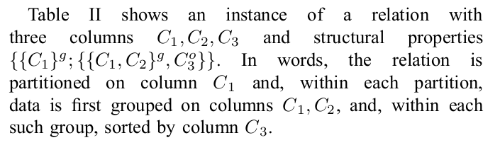
Structural properties
Structural property of each node in DAG can be represented as list of global & local structural properties:
Global structural properties: applies to whole relation
E.g. Partitioning
Local structural properties – Properties like grouping and sorting which apply within each partition
{ P^{g}; { A₁, A₂,…, A_{n} } }
Partition1 | Partition2 | Partition3
{1,4,2} | {4,1,5} | {6,2,1}
{1,4,5} | {3,7,8} | {6,2,9}
{7,1,2} | {3,7,9}
{{C₁}^{g}, { {C₁, C₂} ^{g}, C₃º}}

Slide 12
Inference rules
Partition (A) => Partition (A, B)
Sort (A, B) => Sort (A)
Sort (A) => Grouped (A)
Now, using the inference rules while generating all possible rewriting, we need to consider all possible required physical properties.
Example: Parallel Join (A, B, C)
Partition (A, B, C) or Partition (A, B) or Partition(A, C)
or Partition (B, C) or Partition (A) or Partition (B) or
Partition (C)
So the number of possible rewriting is 2^{|c|}

Slide 13
Example
SELECT R.a, S.c COUNT(*) AS count FROM R JOIN S ON R.a = S.a and R.b = S.b GROUP BY R.a, S.c
Assume repartitioning cost is 10
Agg
R.a , S.c
Agg
R.a , S.c
HashAgg
R.a, S.c
10
20
Partition(A)
Partition(C)
20
Partition(A, C)
HashJoin
R.a=S.a & R.b=S.b
Repartition
S.c
Repartition
R.a, S.c
10
10
Join
R.a=S.a & R.b=S.b
Join
R.a=S.a & R.b=S.b
Join
R.a=S.a & R.b=S.b
Join
R.a=S.a & R.b=S.b
Repartition
R.a
Repartition
S.a
10
10
10
10
Partition(A)
R
S
Partition(A, B)
Partition(A)
Partition(A, B)
Repartition
R.a
Repartition
S.a
Repartition
R.a, R.b
Repartition
S.a, S.b
R
S
R
S
R
S
Logical DAG
Physical DAG

Slide 14
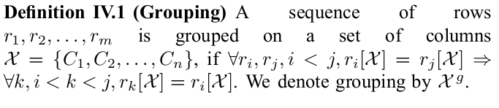

Structural Properties: Notation

Slide 15
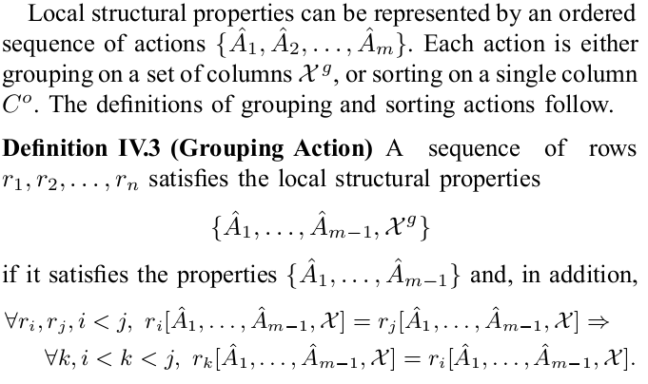
Structural Properties: Notation

Slide 16
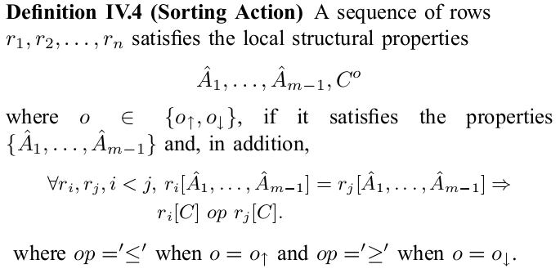
Structural Properties: Notation

Slide 17
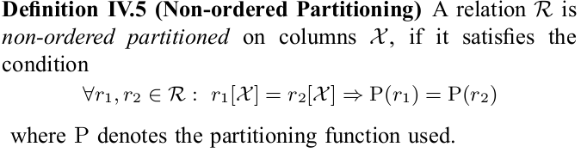
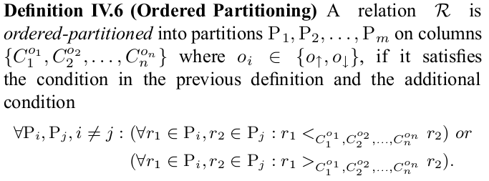
Structural Properties: Notation

Slide 18
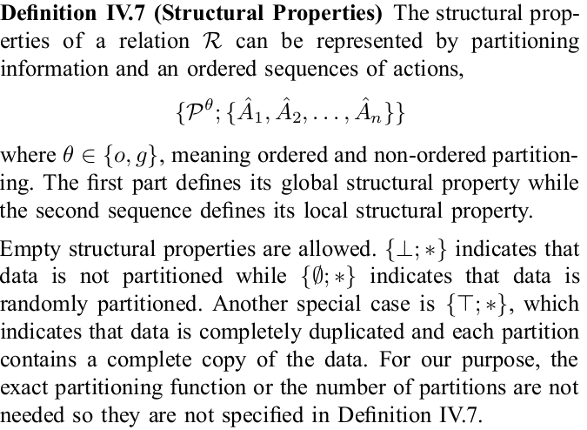
Structural Properties: Notation

Slide 19
Inference Rules

Slide 20
Deriving Structural Properties

Slide 21
Structural Properties after Merge
.

Slide 22
Properties after repartitioning
.

Slide 23
Required Properties: Example
.

Slide 24
Required Properties
.

Slide 25
Required Properties for Operators
.

Slide 26
Property Matching
Matching of structural properties can be done by matching global and local properties separately.
Normalization
in each partitioning, sorting, grouping property, and functional dependency, replace each column with the representative column in its equivalence class, then
in each partitioning, sorting and grouping property, remove columns that are functionally determined by some other columns.

Slide 27
Enforcer Rules
For each logical operator, consider both non- partitioned and partitioned implementations, as long as they can ever satisfy their requirements.
Rely on a series of enforcer rules to modify requirements for structural properties
E.g. from non-partitioned to partitioned, or from sorted to non- sorted, etc.
Data exchange operators are enforcers of structural properties.

Slide 28
Enforce Data Exchange Algorithm
.

Slide 29
Example plans
.

Slide 30
Conclusions
SCOPE: a new scripting language for large-scale analysis
Strong resemblance to SQL: easy to learn and port existing applications
High-level declarative language
Implementation details (including parallelism, system complexity) are transparent to users
Allows sophisticated optimization
Future work
Multi-query optimization (with parallel properties, optimization opportunities have been increased).
Columnar storage & more efficient data placement.

Slide 31
The End

Slide 32
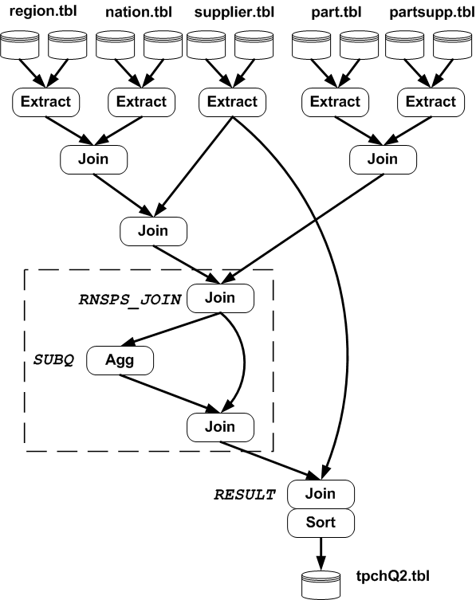
TPC-H Query 2
// Extract region, nation, supplier, partsupp, part …
RNS_JOIN = SELECT s_suppkey, n_name FROM region, nation, supplier WHERE r_regionkey == n_regionkey AND n_nationkey == s_nationkey;
RNSPS_JOIN = SELECT p_partkey, ps_supplycost, ps_suppkey, p_mfgr, n_name FROM part, partsupp, rns_join WHERE p_partkey == ps_partkey AND s_suppkey == ps_suppkey;
SUBQ = SELECT p_partkey AS subq_partkey,
MIN(ps_supplycost) AS min_cost FROM rnsps_join GROUP BY p_partkey;
RESULT = SELECT s_acctbal, s_name, p_partkey, p_mfgr, s_address, s_phone, s_comment FROM rnsps_join AS lo, subq AS sq, supplier AS s WHERE lo.p_partkey == sq.subq_partkey AND lo.ps_supplycost == min_cost AND lo.ps_suppkey == s.s_suppkey ORDER BY acctbal DESC, n_name, s_name, partkey;
OUTPUT RESULT TO "tpchQ2.tbl";

Slide 33
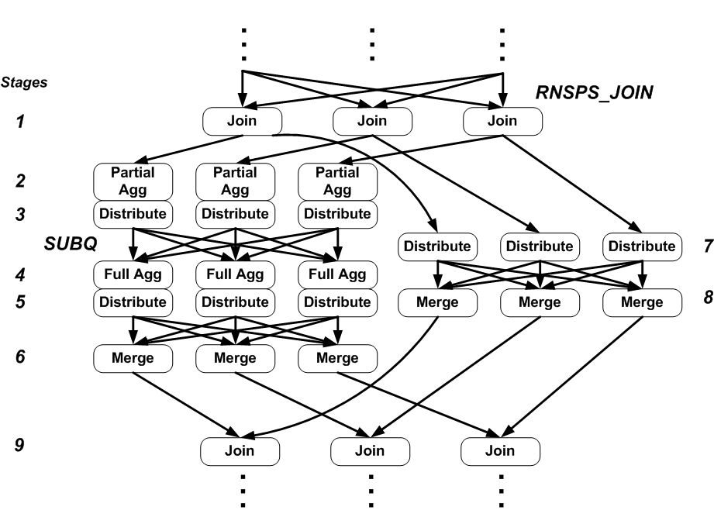
Sub Execution Plan to TPCH Q2
Join on suppkey
Partially aggregate at the rack level
Partition on group-by column
Fully aggregate
Partition on partkey
Merge corresponding partitions
Partition on partkey
Merge corresponding partitions
Perform join

Slide 34
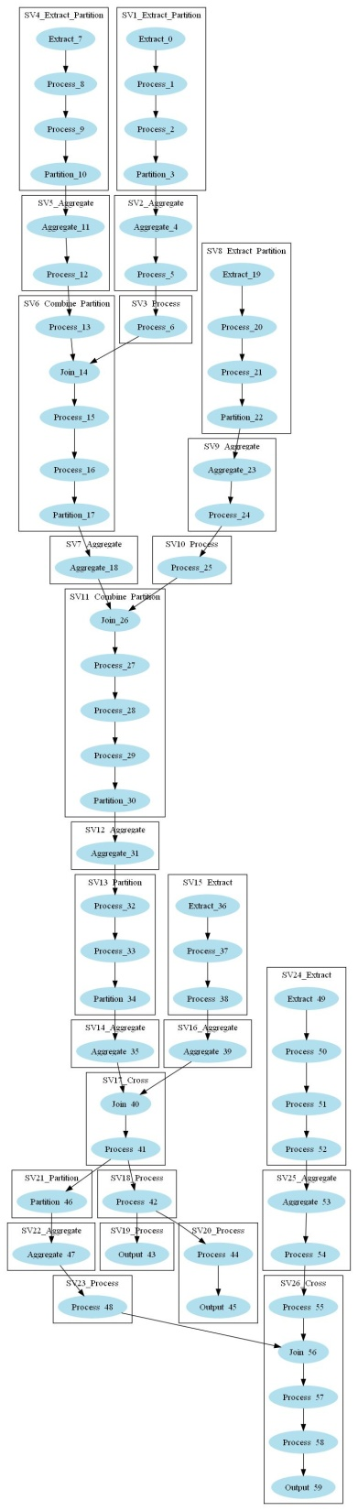
A Real Example

