Slide 1
Pregel: A System for Large-Scale Graph Processing
Grzegorz Malewicz, Matthew Austern, Aart Bik, James Dehnert, Ilan Horn, Naty Leiser, Grzegorz Czajkowski (Google, Inc.)
SIGMOD 2010
Presented by : Aishwarya G, Subhasish Saha
Guided by : Prof. S. Sudarshan

Slide 2
MOTIVATION

Slide 3
Motivation
Many practical computing problems concern large graphs (web graph, social networks, transportation network).
Example :
Shortest Path
Clustering
Page Rank
Minimum Cut
Connected Components
Notes:
Social networks are graphs that describe relationships among people. Transportation routes create a graph of physical connections among geographical locations. Paths of disease outbreaks form a graph, as do games among soccer teams, computer network topologies. Perhaps the most pervasive graph is the web itself, where documents are vertices and links are edges.
The scale of these graphs, in some cases billions of vertices, trillions of edges poses challenges to their effcient processing

Slide 4
Graph algorithms: Challenges [1]
Very little computation work required per vertex.
Changing degree of parallelism over the course of execution.
Munagala and Ranade [2] showed the lower bounds I/O Complexity for Graph algorithms

Slide 5
Motivation
Alternatives :
Create distributed infrastructure for every new algorithm
Map Reduce
Inter-stage communication overhead
Single computer graph library
does not scale
Other parallel graph systems
no fault-tolerance
Need for a scalable distributed solution
Notes:
Despite differences in structure and origin, many graphs out there have two things in common: each of them keeps growing in size, and there is a seemingly endless number of facts and details people would like to know about each one. Take, for example, geographic locations. A relatively simple analysis of a standard map (a graph!) can provide the shortest route between two cities. But progressively more sophisticated analysis could be applied to richer information such as speed limits, expected traffic jams, roadworks and even weather conditions. In addition to the shortest route, measured as sheer distance, you could learn about the most scenic route, or the most fuel-efficient one, or the one which has the most rest areas. All these options, and more, can all be extracted from the graph and made useful — provided you have the right tools and inputs. The web graph is similar. The web contains billions of documents, and that number increases daily. To help you find what you need from that vast amount of information, Google extracts more than 200 signals from the web graph, ranging from the language of a webpage to the number and quality of other pages pointing to it. In order to achieve that, we need a scalable infrastructure to mine a wide range of graphs

Slide 6
Pregel
Scalable and Fault-tolerant platform
API with flexibility to express arbitrary algorithm
Inspired by Valiant’s Bulk Synchronous Parallel model^{[4]}
Vertex centric computation (Think like a vertex)
Notes:
The name Pregel honors Leonard Euler. The Bridges of of Konigsberg, which inspired his famous theorem, spanned the Pregel river.

Slide 7
COMPUTATION MODEL

Slide 8
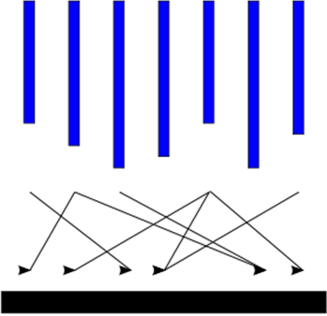
Computation Model (1/4)
Input
Supersteps
(a sequence of iterations)
Output
Source: http://en.wikipedia.org/wiki/Bulk_synchronous_parallel

Slide 9
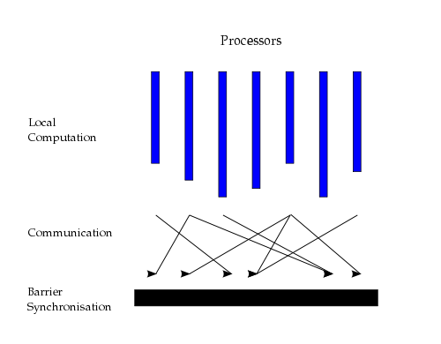
Computation Model (2/4)
Source: http://en.wikipedia.org/wiki/Bulk_synchronous_parallel
Notes:
A BSP computer consists of processors connected by a communication network. Each processor has a fast local memory, and may follow different threads of computation. A BSP computation proceeds in a series of global supersteps. A superstep consists of three components:
Concurrent computation: Several computations take place on every participating processor. Each process only uses values stored in the local memory of the processor. The computations are independent in the sense that they occur asynchronously of all the others.
Communication: The processes exchange data between themselves. This exchange takes the form of one-sided put and get calls, rather than two-sided send andreceive calls.
Barrier synchronisation: When a process reaches this point (the barrier), it waits until all other processes have finished their communication actions.
The computation and communication actions do not have to be ordered in time. The barrier synchronization concludes the superstep.

Slide 10
Computation Model (3/4)
Concurrent computation and Communication need not be ordered in time
Communication through message passing
Each vertex
Receives messages sent in the previous superstep
Executes the same user-defined function
Modifies its value or that of its outgoing edges
Sends messages to other vertices (to be received in the next superstep)
Mutates the topology of the graph
Votes to halt if it has no further work to do

Slide 11
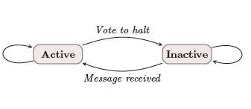
Computation Model (4/4)
State machine for a vertex
Termination condition
All vertices are simultaneously inactive
There are no messages in transit
Notes:
Only active vertices

Slide 12
Example
Single Source Shortest Path
Find shortest path from a source node to all target nodes
Example taken from talk by Taewhi Lee ,2010
http://zhenxiao.com/read/Pregel.ppt

Slide 13
Example: SSSP – Parallel BFS in Pregel
∞
∞
1
10
0
2
3
9
4
6
Inactive Vertex
Active Vertex
5
7
x
Edge weight
∞
∞
x
Message
2

Slide 14
Example: SSSP – Parallel BFS in Pregel
∞
∞
∞
1
10
10
∞
∞
∞
0
Inactive Vertex
∞
2
3
9
4
6
Active Vertex
x
Edge weight
5
∞
7
∞
x
Message
5
∞
∞
2
∞

Slide 15
Example: SSSP – Parallel BFS in Pregel
10
∞
1
10
0
Inactive Vertex
2
3
9
4
6
Active Vertex
x
Edge weight
5
7
x
Message
5
∞
2

Slide 16
Example: SSSP – Parallel BFS in Pregel
10
11
∞
1
14
10
8
0
Inactive Vertex
2
3
9
4
6
Active Vertex
x
Edge weight
5
12
7
x
Message
5
∞
2
7

Slide 17
Example: SSSP – Parallel BFS in Pregel
8
11
1
10
0
Inactive Vertex
2
3
9
4
6
Active Vertex
x
Edge weight
5
7
x
Message
5
7
2

Slide 18
Example: SSSP – Parallel BFS in Pregel
8
9
11
1
10
13
0
Inactive Vertex
14
2
3
9
4
6
Active Vertex
x
Edge weight
5
7
15
x
Message
5
7
2

Slide 19
Example: SSSP – Parallel BFS in Pregel
8
9
1
10
0
Inactive Vertex
2
3
9
4
6
Active Vertex
x
Edge weight
5
7
x
Message
5
7
2

Slide 20
Example: SSSP – Parallel BFS in Pregel
8
9
1
10
0
Inactive Vertex
2
3
9
4
6
Active Vertex
x
Edge weight
5
7
13
x
Message
5
7
2

Slide 21
Example: SSSP – Parallel BFS in Pregel
8
9
1
10
0
Inactive Vertex
2
3
9
4
6
Active Vertex
x
Edge weight
5
7
x
Message
5
7
2

Slide 22
Differences from MapReduce
Graph algorithms can be written as a series of chained MapReduce invocation
Pregel
Keeps vertices & edges on the machine that performs computation
Uses network transfers only for messages
MapReduce
Passes the entire state of the graph from one stage to the next
Needs to coordinate the steps of a chained MapReduce

Slide 23
THE API

Slide 24
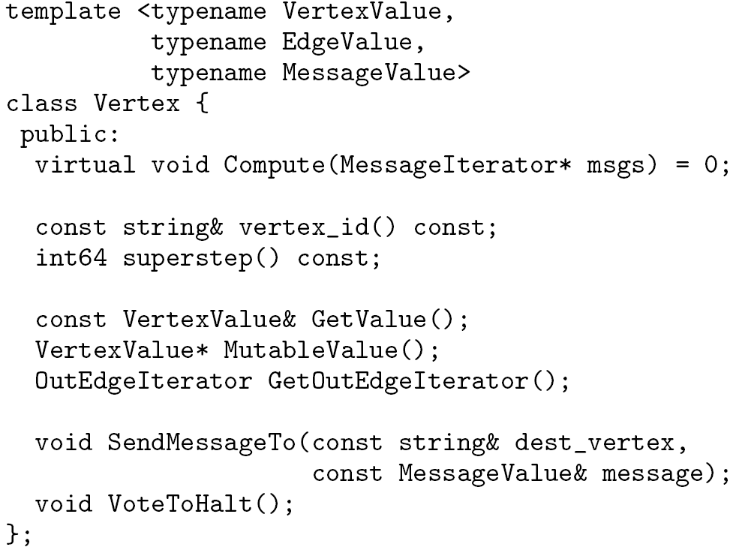
Writing a Pregel program
Subclassing the predefined Vertex class
Override this!
in msgs
Modify vertex value
out msg

Slide 25
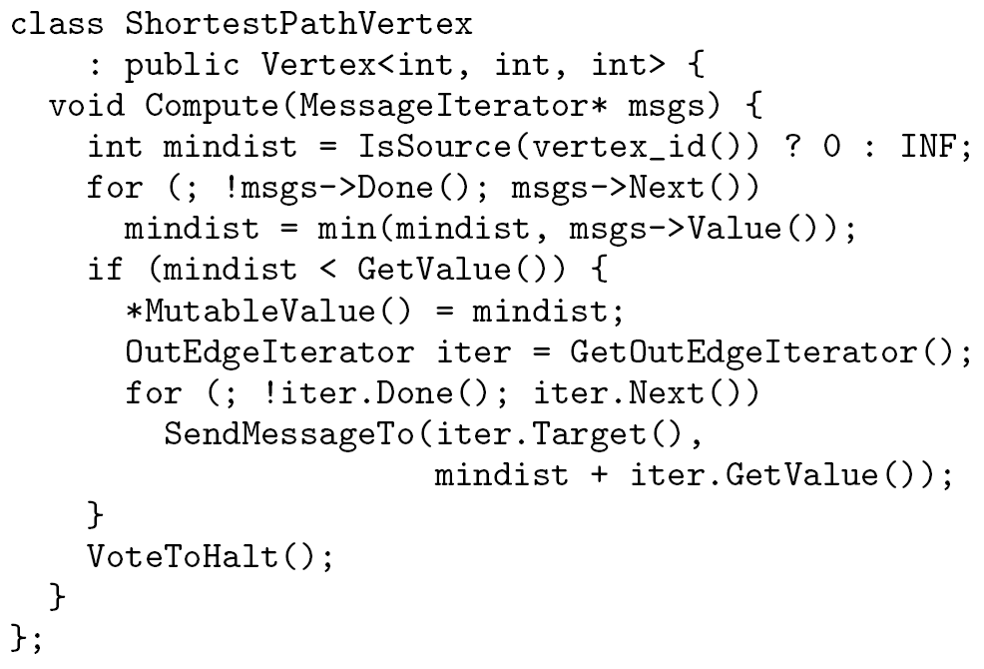
Example: Vertex Class for SSSP

Slide 26
SYSTEM ARCHITECTURE

Slide 27
System Architecture
Pregel system also uses the master/worker model
Master
Coordinates worker
Recovers faults of workers
Worker
Processes its task
Communicates with the other workers
Persistent data is in distributed storage system (such as GFS or BigTable)
Temporary data is stored on local disk
Notes:
Google cluster architecture consists of thousands of commodity PCs organized into racks with high intra-rack bandwidth. Clusters are interconnected but distributed geographically.

Slide 28
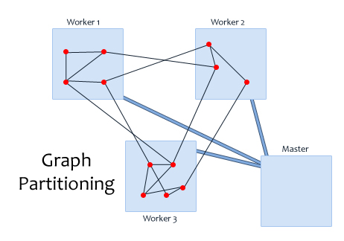
Pregel Execution (1/4)
Many copies of the program begin executing on a cluster of machines
Master partitions the graph and assigns one or more partitions to each worker
Master also assigns a partition of the input to each worker
Each worker loads the vertices and marks them as active

Slide 29
Pregel Execution (2/4)
The master instructs each worker to perform a superstep
Each worker loops through its active vertices & computes for each vertex
Messages are sent asynchronously, but are delivered before the end of the superstep
This step is repeated as long as any vertices are active, or any messages are in transit
After the computation halts, the master may instruct each worker to save its portion of the graph

Slide 30
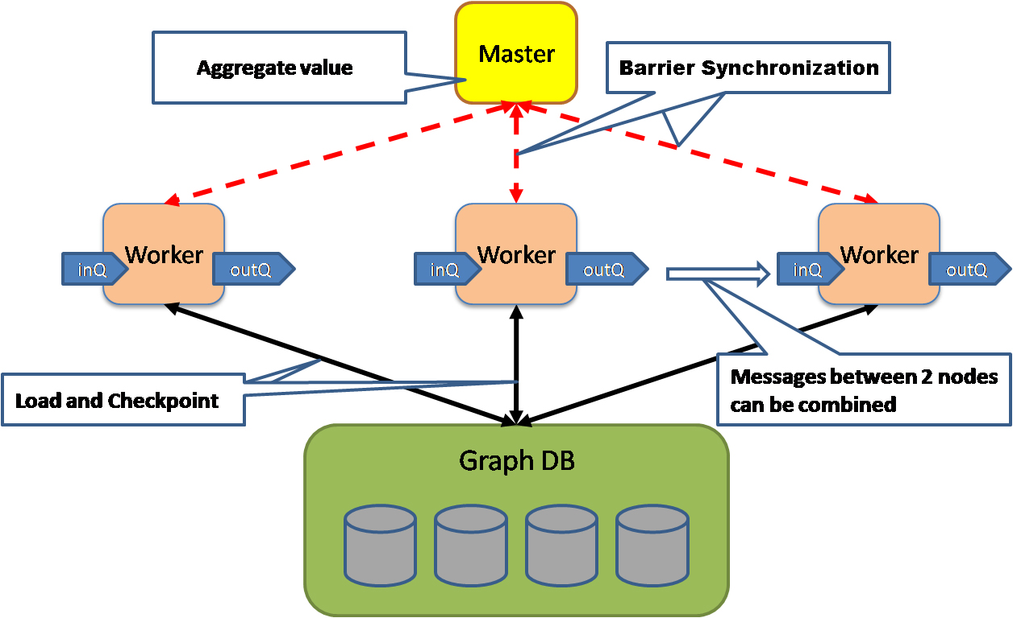
Pregel Execution (3/4)
http://java.dzone.com/news/google-pregel-graph-processing
Notes:
Messages are sent asynchronously, to enable overlapping of computation, communication and batching.
This step is repeated as long as any vertices are active or any messages are in transit.
After the computation halts, the master may instruct each worker to save its portion of the graph.

Slide 31
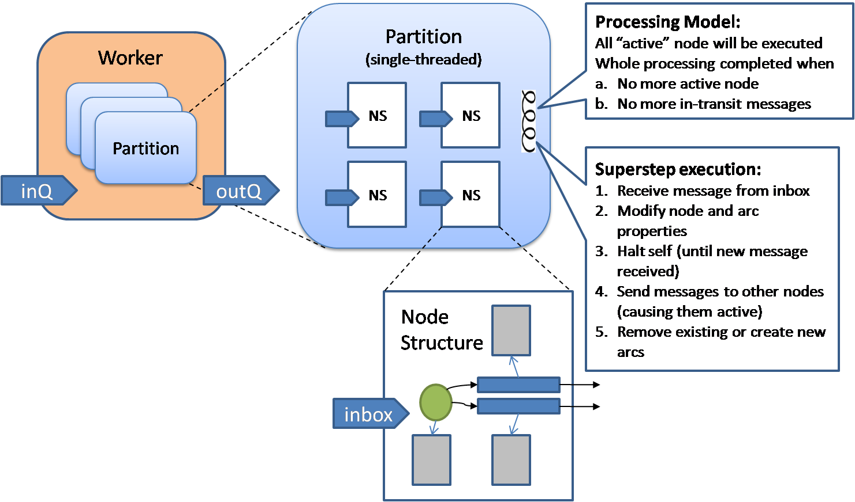
Pregel Execution (4/4)
http://java.dzone.com/news/google-pregel-graph-processing
Notes:
Messages are sent asynchronously, to enable overlapping of computation, communication and batching.
This step is repeated as long as any vertices are active or any messages are in transit.
After the computation halts, the master may instruct each worker to save its portion of the graph.

Slide 32
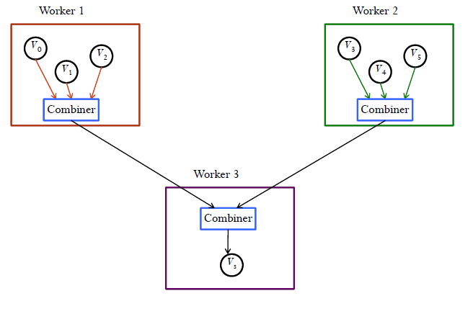
Combiner
Worker can combine messages reported by its vertices and send out one single message
Reduce message traffic and disk space
http://web.engr.illinois.edu/~pzhao4/

Slide 33
Combiner in SSSP
Min Combiner
class MinIntCombiner : public Combiner<int> {
virtual void Combine(MessageIterator* msgs) {
int mindist = INF;
for (; !msgs->Done(); msgs->Next())
mindist = min(mindist, msgs->Value());
Output("combined_source", mindist);
}
};

Slide 34
Aggregator
Used for global communication, global data and monitoring
Compute aggregate statistics from vertex-reported values
During a superstep, each worker aggregates values from its vertices to form a partially aggregated value
At the end of a superstep, partially aggregated values from each worker are aggregated in a tree structure
Tree structure allows parallelization
Global aggregate is sent to the master
Notes:
Included in later version of pregel

Slide 35
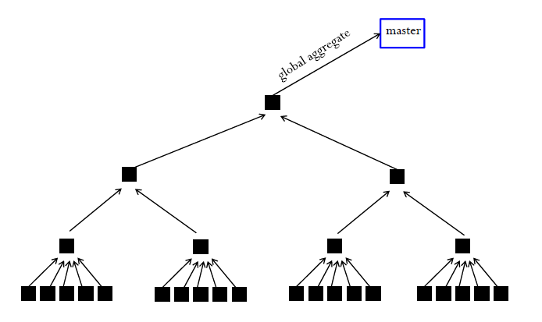
Aggregator
http://web.engr.illinois.edu/~pzhao4/

Slide 36
Topology Mutations
Needed for clustering applications
Ordering of mutations:
deletions taking place before additions,
deletion of edges before vertices and
addition of vertices before edges
Resolves rest of the conflicts by user-defined handlers.
Notes:
Example
Clusters can be reduced to a single node
In a minimum spanning tree algorithm, edges can be removed.
Requests for adding vertices and edges can also be made.

Slide 37
Fault Tolerance (1/2)
Checkpointing
The master periodically instructs the workers to save the state of their partitions to persistent storage
e.g., Vertex values, edge values, incoming messages
Failure detection
Using regular “ping” messages
Notes:
s/w failure : premption by high priority jobs

Slide 38
Fault Tolerance (2/2)
Recovery
The master reassigns graph partitions to the currently available workers
All workers reload their partition state from most recent available checkpoint
Confined Recovery
Log outgoing messages
Involves only the recovering partition
Notes:
Once you have out msg, system can compute the states of recovering partition. No need to execute other partitions.

Slide 39
APPLICATIONS
PageRank

Slide 40
PageRank
Used to determine the importance of a document based on the number of references to it and the importance of the source documents themselves
A = A given page
T₁ …. T_{n} = Pages that point to page A (citations)
d = Damping factor between 0 and 1 (usually kept as 0.85)
C(T) = number of links going out of T
PR(A) = the PageRank of page A
Notes:
Sum of all PageRanks = Number of pages

Slide 41
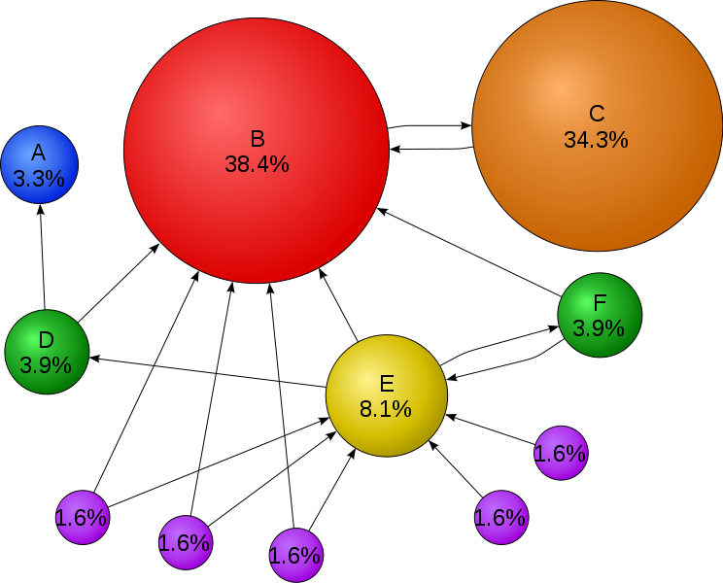
PageRank
Courtesy: Wikipedia
Notes:
Sum of all PageRanks = 1

Slide 42
PageRank
Iterative loop till convergence
Initial value of PageRank of all pages = 1.0;
While ( sum of PageRank of all pages – numPages > epsilon) {
for each Page Pi in list {
PageRank(Pi) = (1-d);
for each page Pj linking to page Pi {
PageRank(Pi) += d × (PageRank(Pj)/numOutLinks(Pj));
}
}
}
Notes:
Sum of all PageRanks = 1

Slide 43
PageRank in Pregel
Superstep 0: Value of each vertex is 1/NumVertices()
virtual void Compute(MessageIterator* msgs) {
if (superstep() >= 1) {
double sum = 0;
for (; !msgs->done(); msgs->Next())
sum += msgs->Value();
*MutableValue() = 0.15 + 0.85 * sum;
}
if (supersteps() < 30) {
const int64 n = GetOutEdgeIterator().size();
SendMessageToAllNeighbors(GetValue() / n); } else {
VoteToHalt();
}
}

Slide 44
APPLICATIONS
Bipartite Matching

Slide 45
Bipartite Matching
Input : 2 distinct sets of vertices with edges only between the sets
Output : subset of edges with no common endpoints
Pregel implementation :
randomized maximal matching algorithm
The vertex value is a tuple of 2 values:
a flag indicating which set the vertex is in (L or R)
name of its matched vertex once it is known.

Slide 46
Bipartite Matching
Cycles of 4 phases
Phase 1: Each left vertex not yet matched sends a message to each of its neighbors to request a match, and then unconditionally votes to halt.
Phase 2: Each right vertex not yet matched randomly chooses one of the messages it receives, sends a message granting that request and sends messages to other requestors denying it. Then it unconditionally votes to halt.
Phase 3: Each left vertex not yet matched chooses one of the grants it receives and sends an acceptance message.
Phase 4: Unmatched right vertex receives at most one acceptance message. It notes the matched node and unconditionally votes to halt.

Slide 47
Bipartite Matching in Pregel (1/2)
Class BipartiteMatchingVertex
: public Vertex<tuple<position, int>, void, boolean> {
public:
virtual void Compute(MessageIterator* msgs) {
switch (superstep() % 4) {
case 0: if (GetValue().first == ‘L’) {
SendMessageToAllNeighbors(1);
VoteToHalt();
}
case 1: if (GetValue().first == ‘R’) {
Rand myRand = new Rand(Time());
for ( ; !msgs->Done(); msgs->Next()) {
if (myRand.nextBoolean()) {
SendMessageTo(msgs->Source, 1);
break;
}
}
VoteToHalt(); }

Slide 48
Bipartite Matching in Pregel (2/2)
case 2:
if (GetValue().first == ‘L’) {
Rand myRand = new Rand(Time());
for ( ; !msgs->Done(); msgs->Next) {
if (myRand.nextBoolean()) {
*MutableValue().second = msgs->Source());
SendMessageTo(msgs->Source(), 1);
break;
}
}
VoteToHalt(); }
case 3:
if (GetValue().first == ‘R’) {
msgs->Next();
*MutableValue().second = msgs->Source();
}
VoteToHalt();
}}};

Slide 49
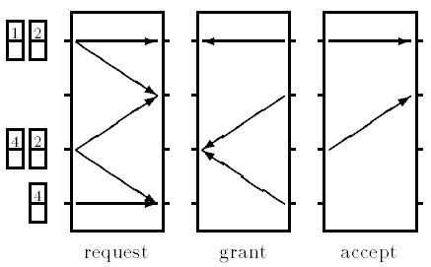
Bipartite Matching : Cycle 1
Execution of a cycle (A cycle consists of 4 supersteps)

Slide 50
EXPERIMENTS

Slide 51
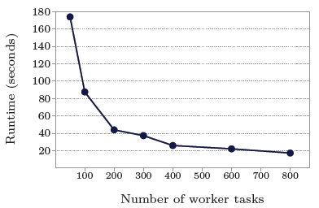
Experiments
1 billion vertex binary tree: varying number of worker tasks

Slide 52
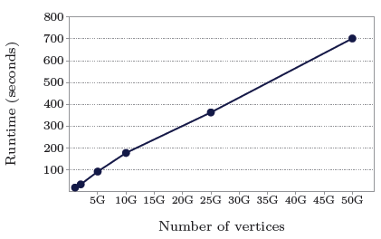
Experiments
binary trees: varying graph sizes on 800 worker tasks

Slide 53
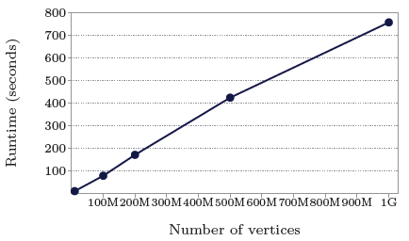
Experiments
log-normal random graphs, mean out-degree 127.1 (thus over 127 billion edges in the largest case): varying graph sizes on 800 worker tasks

Slide 54
Conclusion
“Think like a vertex” computation model
Master – single point of failure ?
Combiner, Aggregator, topology mutation enables more algorithms to be transformed into Pregel

Slide 55
THANK YOU ANY QUESTIONS?

Slide 56
References
[1] Andrew Lumsdaine, Douglas Gregor, Bruce Hendrickson, and Jonathan W. Berry, Challenges in Parallel Graph Processing. Parallel Processing Letters 17, 2007, 5-20.
[2] Kameshwar Munagala and Abhiram Ranade, I/O-complexity of graph algorithms. in Proc. 10th Annual ACM-SIAM Symp. on Discrete Algorithms, 1999, 687-694.
[3] Grzegorz Malewicz , Matthew H. Austern , Aart J.C Bik , James C. Dehnert , Ilan Horn , Naty Leiser , Grzegorz Czajkowski, Pregel: a system for large-scale graph processing, Proceedings of the 2010 international conference on Management of data, 2010
[4] Leslie G. Valiant, A Bridging Model for Parallel Computation. Comm. ACM 33(8), 1990, 103-111.

