Slide 1

Open-Source Physical Design Flows for Monolithic and Heterogeneous 3D ICs using OpenROAD
Instructors: Alberto Garcia-Ortiz, George Goudroumanis & Maria Pantazi
International Conference on Electronics, Circuits and Systems 2026
8 November 2026

Slide 2
Presentation Overview
1
Foundations of 3D Physical Design with OpenROAD
20 min
2
Monolithic 3D Tutorial Flow
20 min
3
Heterogeneous 3D Tutorial Flow
20 min
4
Hands-on Demonstration
50 min
5
Discussion, Future Directions and Q&A
10 min

Slide 3
Foundations of 3D Physical Design with OpenROAD
Alberto Garcia-Ortiz

Slide 4
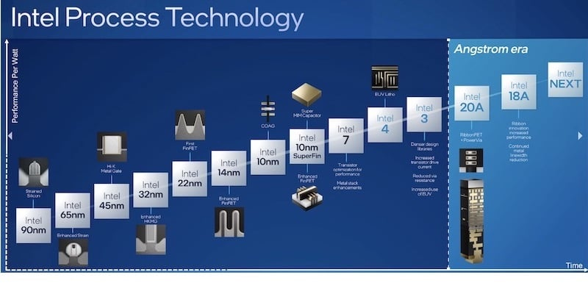

Motivation: Extremely large number of devices
The number of transistors on an integrated circuit will double every two years with minimal rise in cost.

Slide 5
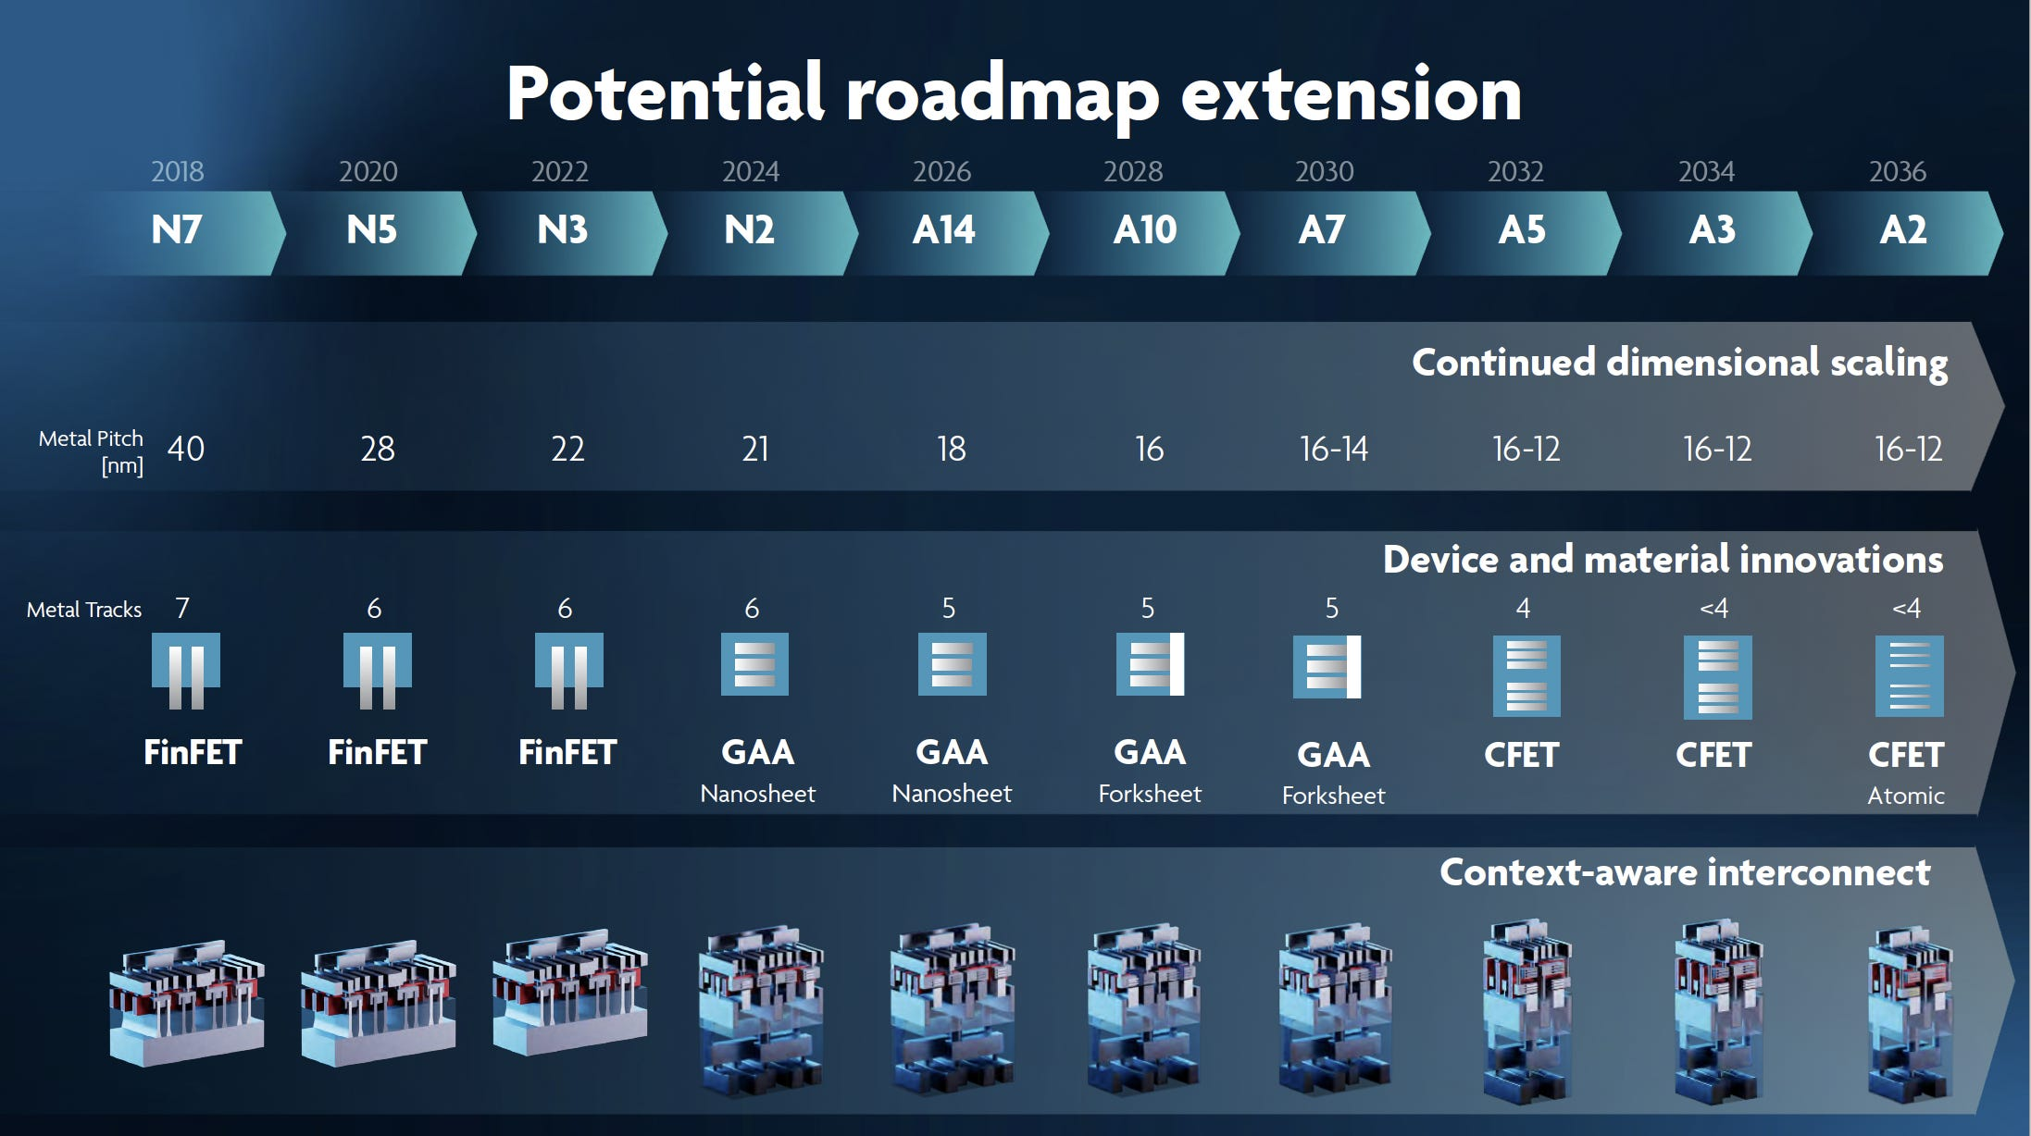

Motivation: Extremely large number of devices
The number of transistors on an integrated circuit will double every two years with minimal rise in cost.

Slide 6
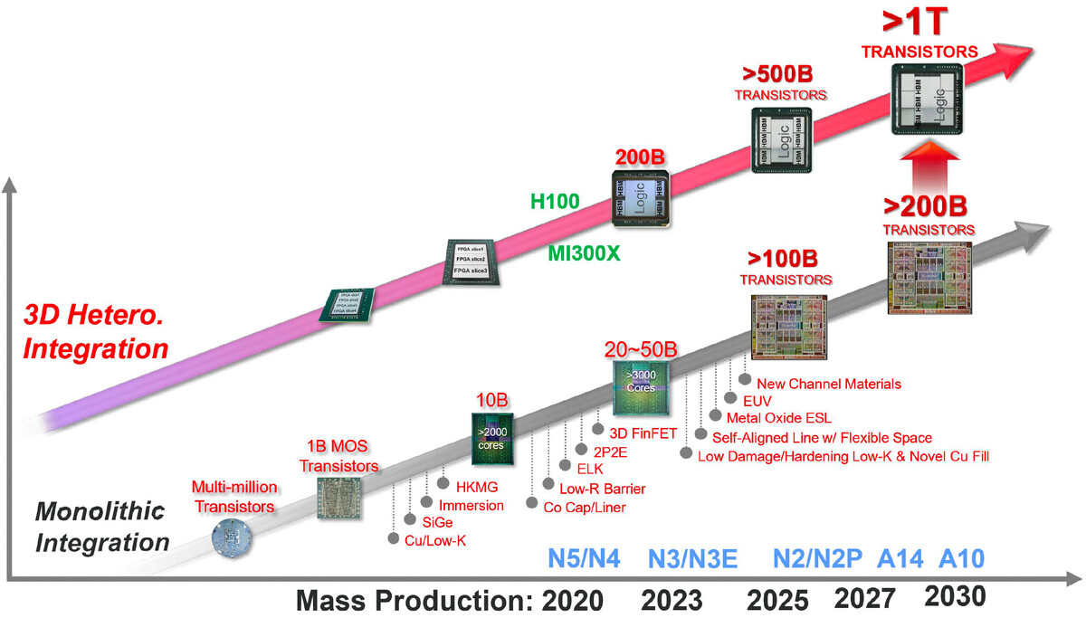

Motivation: Extremely large number of devices
The number of transistors on an integrated circuit will double every two years with minimal rise in cost.

Slide 7
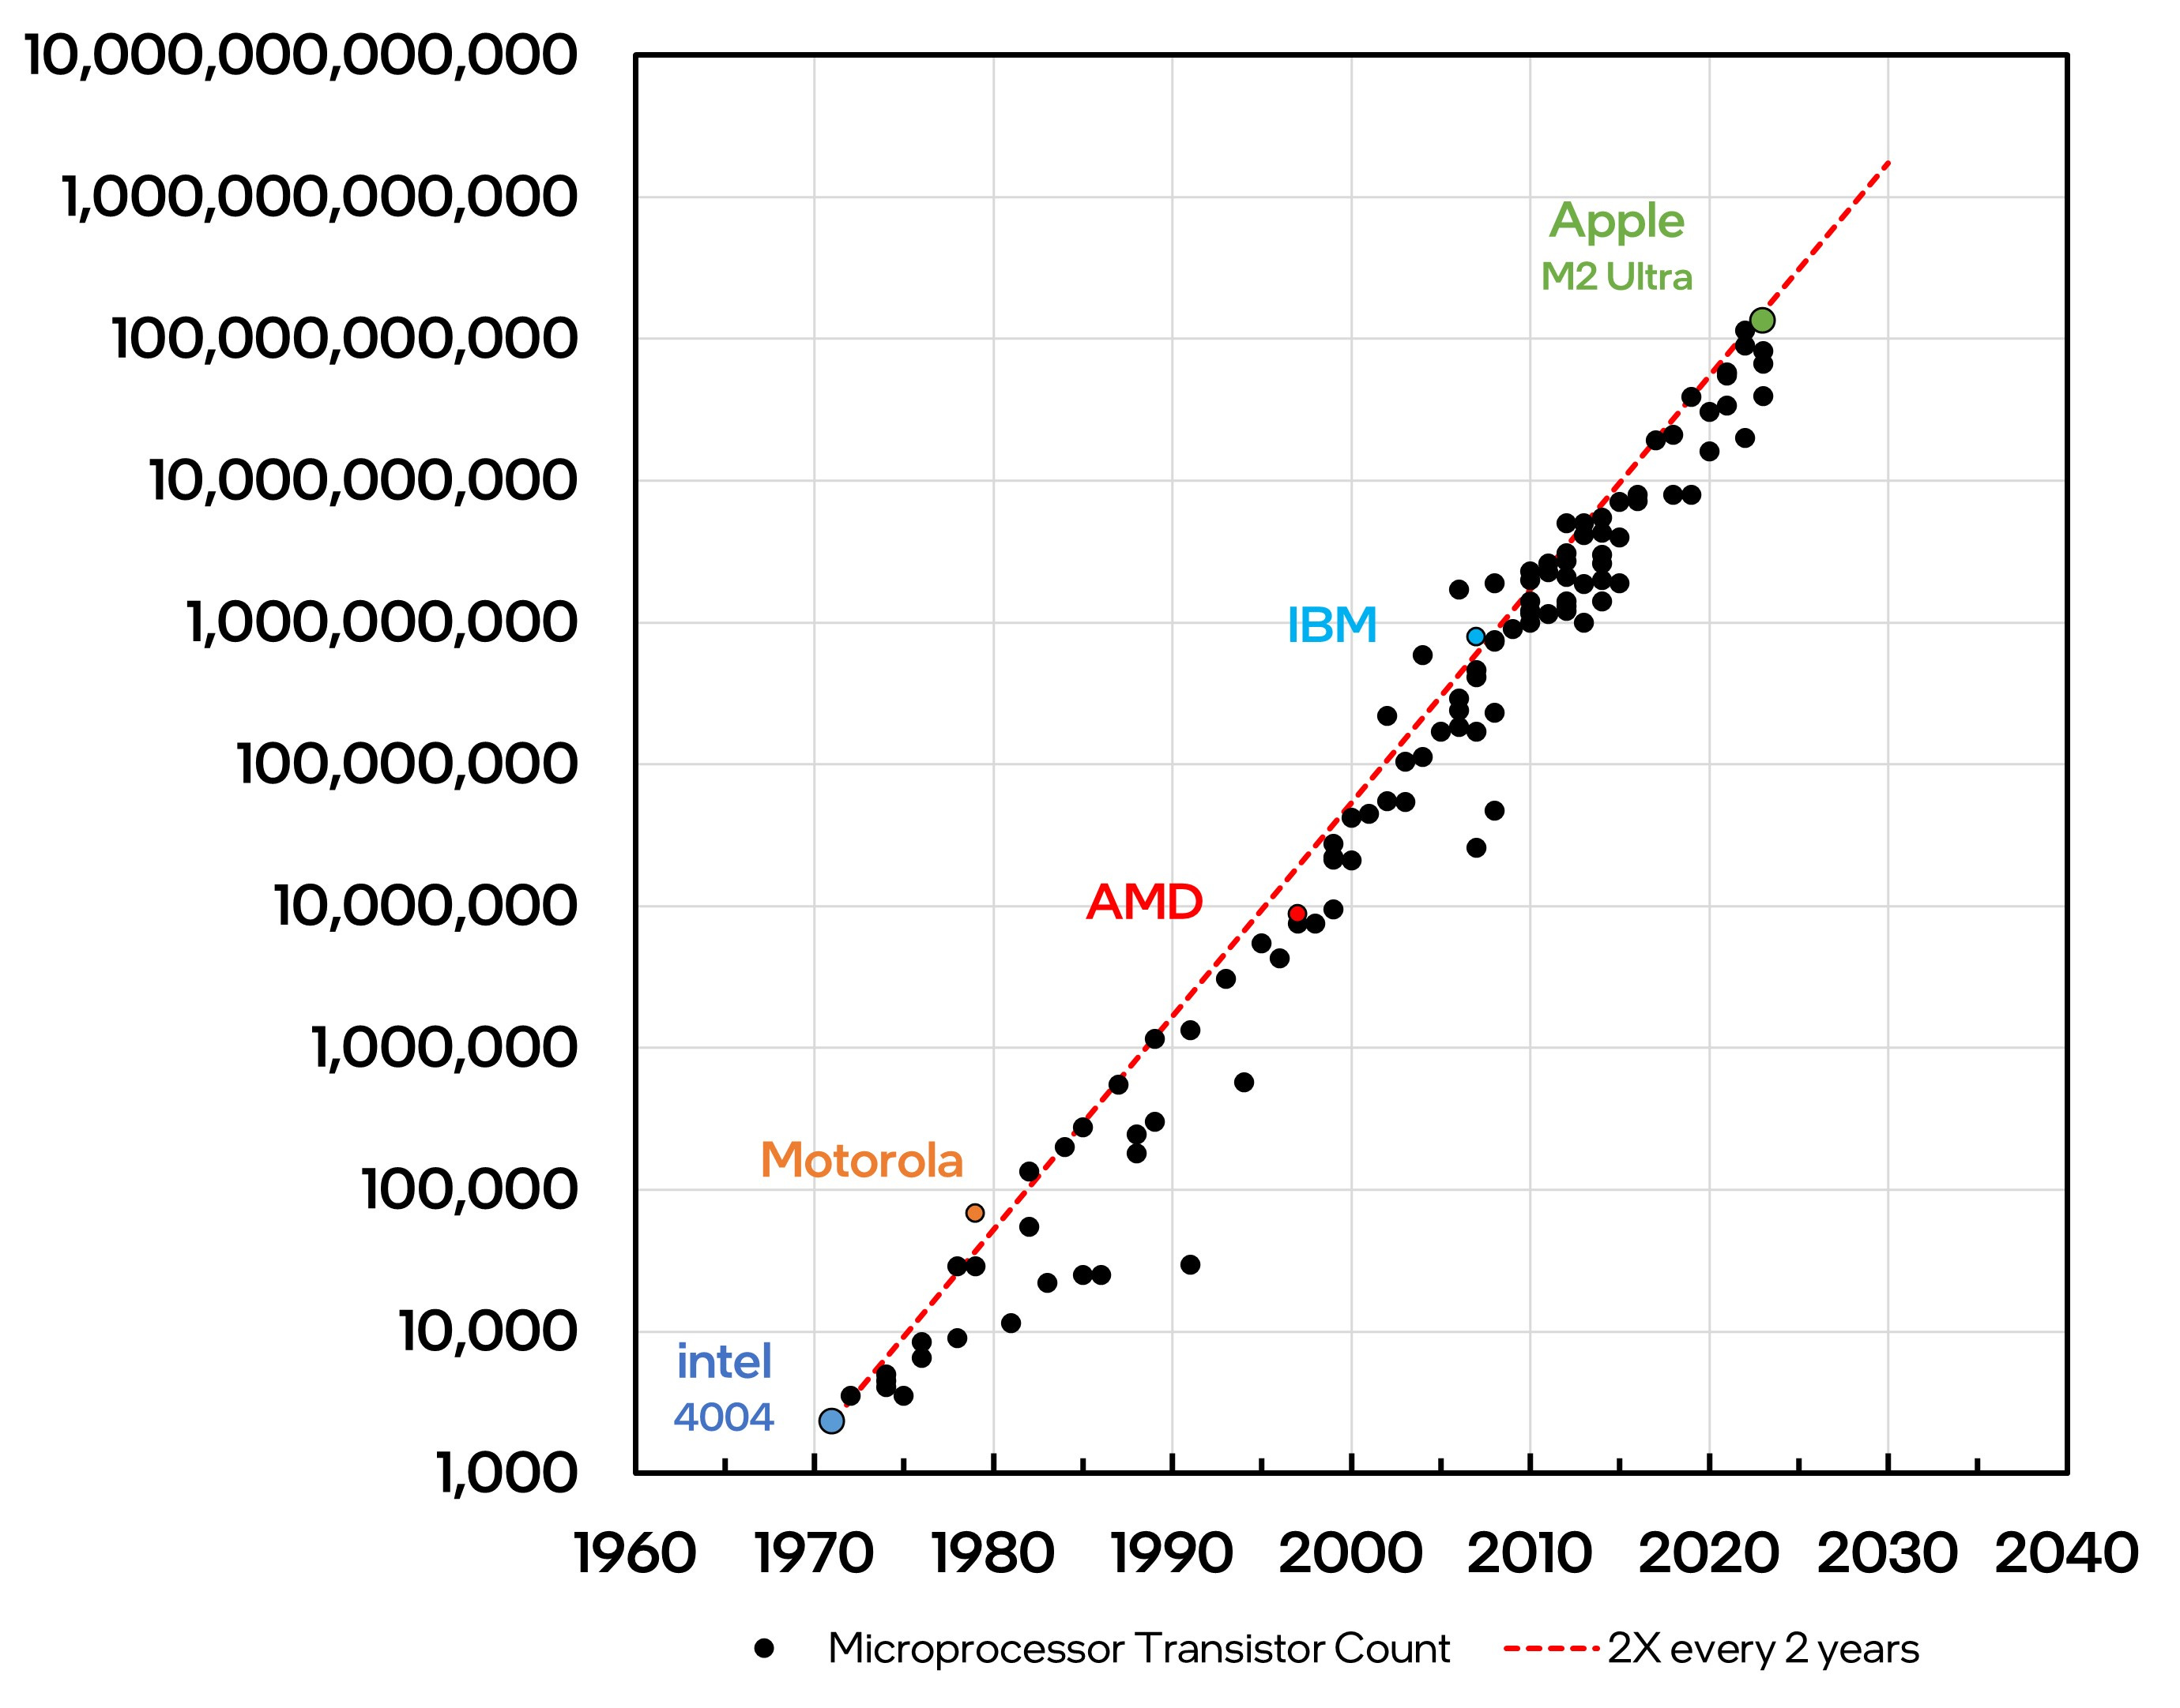

Motivation: Extremely large number of devices
The number of transistors on an integrated circuit will double every two years with minimal rise in cost.

Slide 8
Why Go 3D? The Limits of 2D Scaling
Scaling slows
Wires dominate
3D brings
Each new node costs more and gives smaller gains
Very large dies have low yield and are close to reticle limits
More cores do not help if data cannot reach them
Global wires do not shrink with transistors
Interconnect sets delay and dynamic power
The memory wall: off-chip bandwidth and energy per bit
Shorter wires: stacking replaces long horizontal paths
Massive vertical bandwidth between tiers
Smaller footprint and mixed technologies
Going vertical shortens the critical distance, not just the transistor

Slide 9
What Does 3D Buy? Published Results
Commercial tools · Pin-3D
Open source · Open3DBench
18–38% less wirelength
8–30% less power
Monolithic 3D vs 2D in a commercial 28 nm node: two industry processors plus the LDPC and Netcard benchmarks
51% area
24% wirelength
31% timing
5.7% power
3D vs 2D improvements, flow built on OpenROAD-flow-scripts
Shorter wires do not automatically mean better PPA: the physical design flow decides
Pentapati et al., Pin-3D, ICCAD 2020 · Shi et al., Open3DBench, arXiv:2503.12946, 2025 · 3DPX (this tutorial)

Slide 10
3D Integration Technologies
TSV-based stacking
Hybrid bonding
Monolithic 3D (M3D)
Dies fabricated separately, joined with through-silicon vias and micro-bumps
Direct Cu–Cu bonding of two wafers or dies face to face
Tiers fabricated sequentially on one wafer, connected by monolithic inter-tier vias (MIVs)
Vertical pitch: ~10 µm and above
Block-level partitioning
Mature: HBM, image sensors
Vertical pitch: ~1–10 µm
Block- or fine-grain partitioning
Emerging in logic-on-memory
Vertical pitch: sub-µm (MIV)
Gate-level partitioning
Research: thermal budget of top tier
Higher vertical density → finer partitioning → more pressure on the physical design flow

Slide 11
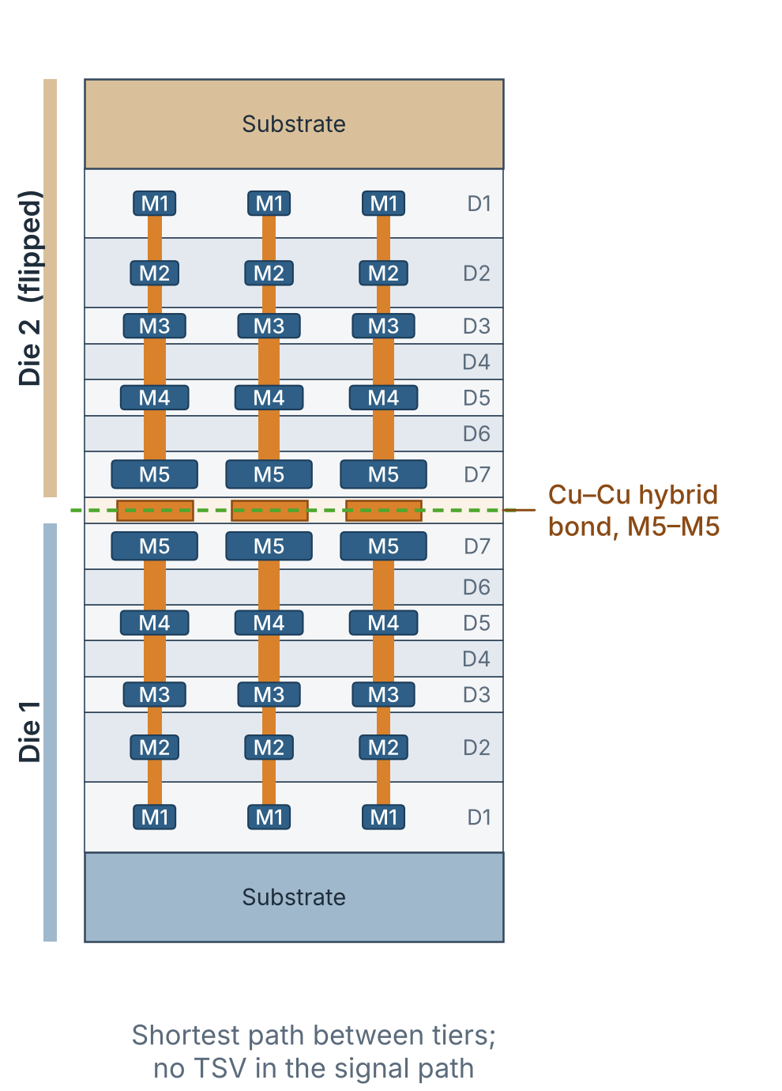
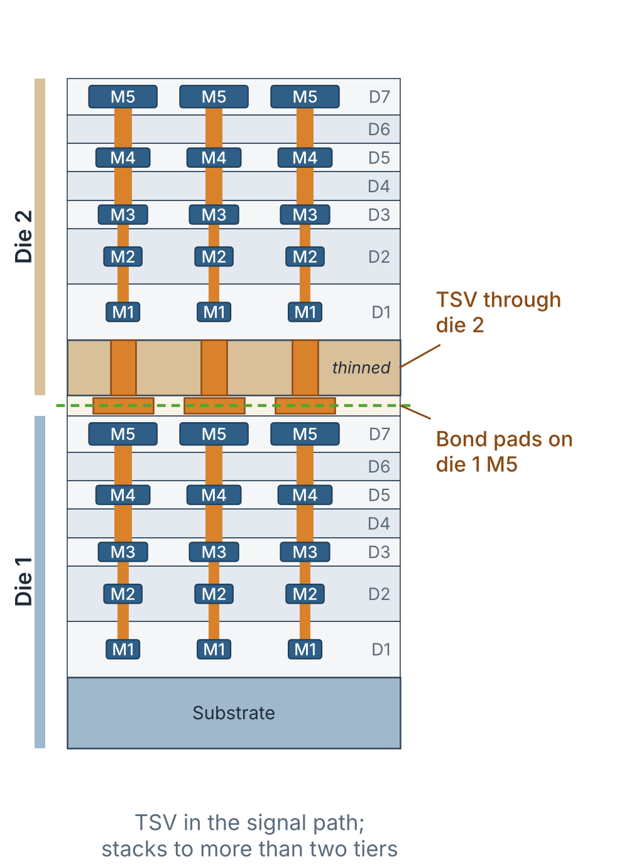
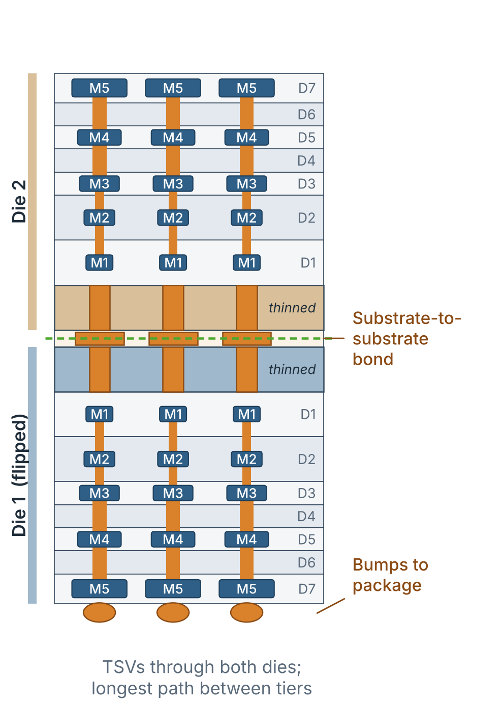
3D Integration Bonding Technologies
Face-to-Face (F2F)
Face-to-Back (F2B)
Back-to-Back (B2B)

Slide 12
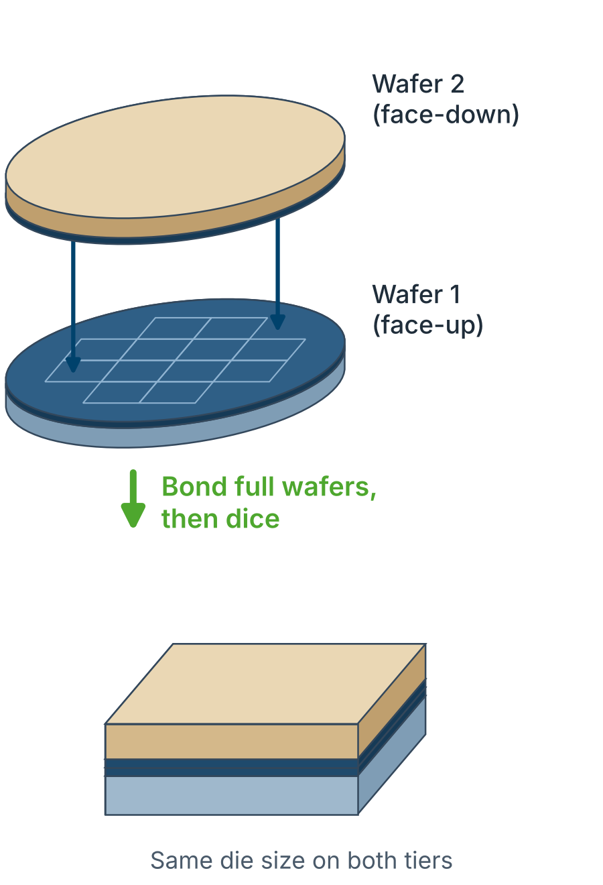
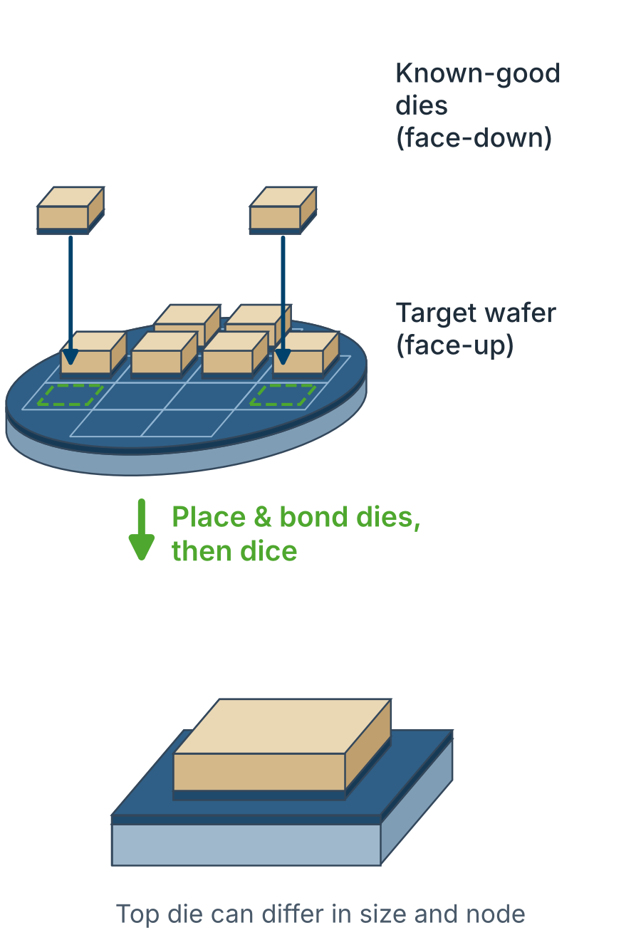
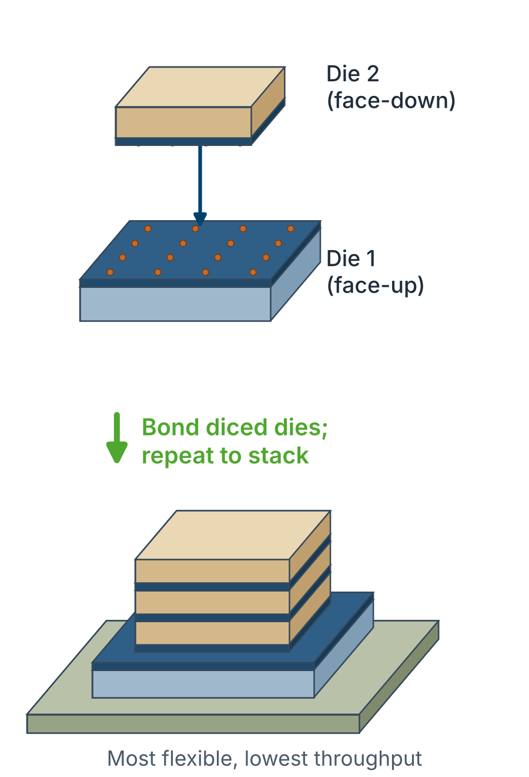
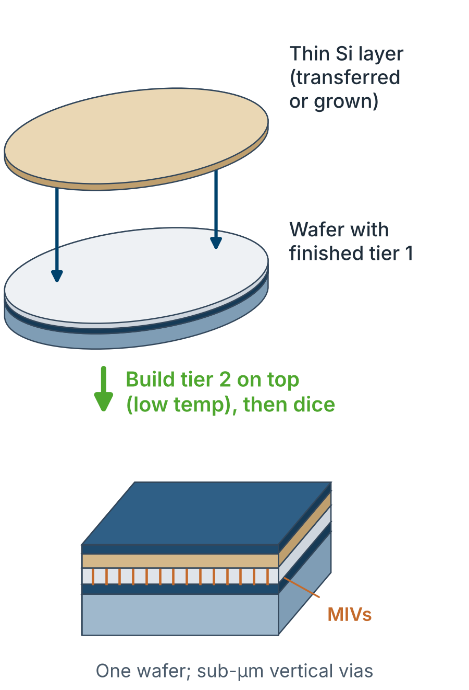
3D Integration Stacking Technologies
Wafer-to-Wafer (W2W)
Chip-to-Wafer (C2W)
Chip-to-Chip (C2C)
Monolithic 3D (M3D)

Slide 13
Stacking Technologies: Pros and Cons
Wafer-to-Wafer (W2W)
Chip-to-Wafer (C2W)
Chip-to-Chip (C2C)
Monolithic 3D (M3D)
+ Pros
Highest throughput: one bond per wafer pair
Finest bonded pitch, best alignment
Lowest cost per stack at volume
+ Pros
Only known-good dies stacked: better yield
Mixes die sizes, nodes and wafer sizes
Balance of flexibility and throughput
+ Pros
Both dies tested before stacking
Any size, node or vendor; multi-die stacks
Mature micro-bump assembly flow
+ Pros
Highest vertical density: sub-µm MIVs
Gate-level partitioning: largest wirelength gains
Tiers aligned by lithography, no bonding
– Cons
No known-good-die selection: yields multiply
Same die size and wafer size on both tiers
Limited mixing of technologies
– Cons
Slower than W2W: die-by-die placement
Die cleanliness and alignment harder for hybrid bonding
Pitch usually coarser than W2W
– Cons
Lowest throughput, highest assembly cost
Micro-bumps: coarsest vertical pitch
Thin-die handling and warpage
– Cons
Top-tier thermal budget limits device quality
No known-good-die selection: yields multiply
Heat removal and EDA support still immature
Used in: Stacked image sensors, 3D NAND
Used in: AMD 3D V-Cache (TSMC SoIC)
Used in: Prototypes, low-volume and multi-vendor stacks
Used in: Research (e.g. CEA-Leti CoolCube)
Heterogeneous 3D
Any of these can stack tiers in different technologies.
Part 3 shows how to place such heterogeneous designs.

Slide 14
3D Integration in Production
2.5D vs 3D
Product | What is stacked | How it is joined
HBM memory | DRAM dies on a base logic die | TSVs and micro-bumps
Stacked image sensors | Pixel wafer on logic wafer | W2W, Cu–Cu hybrid bonding
3D NAND with bonded CMOS | Memory-array wafer on CMOS wafer | W2W bonding (e.g. YMTC Xtacking)
AMD 3D V-Cache | SRAM die on CPU die | C2W hybrid bonding (TSMC SoIC)
Intel Foveros | Compute tiles on a base die | F2F micro-bumps
Monolithic 3D | Sequential tiers on one wafer | Research only (e.g. CEA-Leti CoolCube)
Die 1
Die 2
Interposer
2.5D: side by side
Dies joined through an interposer or bridge (e.g. TSMC CoWoS, Intel EMIB)
Die 2
Die 1
3D: stacked
Dies joined vertically; the focus of this tutorial
Stacking already ships in volume; open design flows for it are what is missing

Slide 15
Monolithic vs Heterogeneous 3D ICs
Monolithic (homogeneous) 3D Part 2
Heterogeneous 3D Part 3
Tiers
Same technology on every tier
Tiers
Different nodes or functions per tier
Cells
One library, duplicated for each tier
Cells
Different libraries, sites and pin layers
Rows
Same row height and site on every tier
Rows
Different row heights per tier
Partitioning
Fine-grain, gate-level
Partitioning
Technology-aware, area-balanced
Goal
Wirelength, timing, footprint
Goal
Cost–performance, system optimization
Same goal, same tool: both must look like a valid 2D problem to OpenROAD

Slide 16
Physical Design Challenges in 3D
1
Tier partitioning
2
3D placement
3
Inter-tier vias
Which cell goes to which tier? Balance area, cut and timing.
Many placement layers, overlap allowed only between tiers.
MIV / bond-pad pitch, keep-outs, count and position.
4
Clock & power delivery
5
Thermal and reliability
6
Timing and sign-off
CTS and PDN that cross tiers; IR drop in the upper tier.
Buried tiers heat up; EM and IR margins shrink.
Cross-tier parasitics and library corners; no 3D-aware STA.
Covered in this tutorial: 1–3 in depth. Open problems: 4–6, discussed at the end.

Slide 17
OpenROAD in a Nutshell
Synthesis
Yosys / ABC
Floorplan
rows, IO, PDN
Global place
RePlAce (gpl)
Detailed place
OpenDP (dpl)
CTS
TritonCTS
Routing
FastRoute, TritonRoute
Analysis
OpenSTA, PDNSim
OpenDB: one shared in-memory database • Tcl and Python API • LEF / DEF / Liberty / Verilog / SDC
Why OpenROAD for 3D research
What we rely on
Open source (BSD): every stage can be inspected and modified
Scriptable: stages can be split, reordered and re-entered
No license barrier for teaching and reproducibility
Stock placement, legalization and routing engines
Standard exchange formats between stages
Highlighted stages (green) are the ones we adapt most

Slide 18
Why OpenROAD Is Not 3D-Ready
Built-in assumption
What 2D means
What 3D needs
One placement plane
Cells may not overlap anywhere
Cells on different tiers may overlap in x-y
One metal stack
M1 … Mn above a single device layer
Two stacks plus inter-tier vias
One site and row height
Uniform rows from one library
Different sites and heights per tier (heterogeneous)
2D density model
Spreads cells over one area
Must respect the capacity of each tier
Tier-unaware analysis
STA and RC with one technology
Corners and parasitics differ per tier
Options: rewrite the engines (costly), or change the inputs so the 3D design looks like 2D (this tutorial).

Slide 19
Related Work: 3D Physical Design Flows
Pseudo-3D
Flow | Venue | Key idea | Tools
Shrunk-2D | ISLPED 2014 | Shrink cells and wires so both tiers fit one 2D footprint | Commercial
Cascade-2D | ICCAD 2016 | Tiers side by side in one 2D layout; inter-tier vias as anchor cells | Commercial
Compact-2D | ISPD 2018 | Place in a larger 2D canvas, then compact to the 3D footprint (F2F) | Commercial
Pin-3D | ICCAD 2020 | Pin projection; tier-by-tier optimisation with both tiers' pins visible | Commercial
Open3DBench | arXiv 2025 | 3D partitioning, placement, routing and thermal on OpenROAD-flow-scripts | Open source
Pin-3D reference flow | ISPD 2026 | Open RTL-to-GDS flow for F2F hybrid bonding (ASAP7-based 3D PDK) | Open source
This tutorial | ICECS 2026 | Monolithic and heterogeneous 3D in stock OpenROAD; virtual rows for mixed row heights | Open source
Map the 3D problem onto a 2D one and reuse mature 2D engines
True-3D
Optimise directly in x, y and tier; needs new 3D-aware algorithms
Same pseudo-3D idea, in stock OpenROAD, extended to heterogeneous tiers
Pin-3D: Pentapati et al., ICCAD 2020 · Open3DBench: Shi et al., arXiv:2503.12946 · Jiang, Kahng, Wang, Zheng, ISPD 2026

Slide 20
Key Idea: 3D as an Enriched 2D Problem
Top tier
Placed design
mapped back to tiers
inter-tier vias
Bottom tier
encode in
LEF/DEF/Liberty
stock
OpenROAD
Physical 3D design
Virtual 2D canvas
3D result
Benefits
Price to pay
Reuse mature, validated 2D engines
Changes stay in data files and scripts
The abstraction must be kept consistent with the real 3D layout
Some 3D effects stay invisible to the 2D engines

Slide 21
Common 3D Infrastructure
.lef
Tech LEF
.lef
Cell LEF
One merged stack: bottom metals → inter-tier via layer → mirrored top metals; one site per tier
Masters duplicated with _bottom_tier / _top_tier suffixes, pins on that tier's metal layers
.lib
Liberty
.def
Rows / floorplan
Matching tier-suffixed cells, so timing and power stay per technology
Tier-specific rows or virtual row patterns inside one 2D die area
.v
Netlist
Tcl / Py
Scripts
Each instance re-mapped to a tier master (partitioning step)
Fix or unfix tiers between stages, rewrite DEF, generate rows and LEFs
OpenROAD reads standard files only, so every 3D concept must fit into them

Slide 22
One Methodology, Two Flows
Part 2 · Monolithic 3D
Same library on both tiers
Floorplan → place → CTS → PDN → route
Synthesized RISC-V netlist
(2D baseline)
Common 3D infrastructure
LEF / DEF / Liberty
Part 3 · Heterogeneous 3D
Two libraries, two row heights
Partition → virtual rows → place
Hands-on: reproduce the flows with the open-source scripts and libraries in the tutorial repository

Slide 23
Learning Goals and Setup
After this tutorial you can
Before the hands-on
Compare the main 3D integration and bonding options
Encode a 3D design in LEF / DEF / Liberty so stock OpenROAD can place it
Run the monolithic 3D flow end to end
Partition, build virtual rows and place a heterogeneous CVA6 design
Judge what the 2D abstraction covers and what it misses
Clone the tutorial repository: <repository URL>
Python 3 for the partitioning and floorplan scripts
Libraries: Nangate 15 nm (bottom tier) and 45 nm (top tier)
Quick check: ./flow/run.sh prepare finishes without errors
Start the setup now: the hands-on session follows Parts 2 and 3

Slide 24
Monolithic 3D Tutorial Flow
George Goudroumanis

Slide 25
The 3DPX Methodology
1 · 3D PDK
2 · Placement
3 · Exploration
4 · Timing & power
Tier-specific LEF and Liberty for F2F, F2B and monolithic stacks
COVER cells: optimise one tier while the other stays fixed
Cores first, then the full chip; dual- and quad-core RISC-V, ~53–56% smaller
Tier-aware sizing, CTS and routing; 5 benchmarks up to 426k cells, three PVT corners
One methodology on stock OpenROAD, from area exploration to timing and power

Slide 26
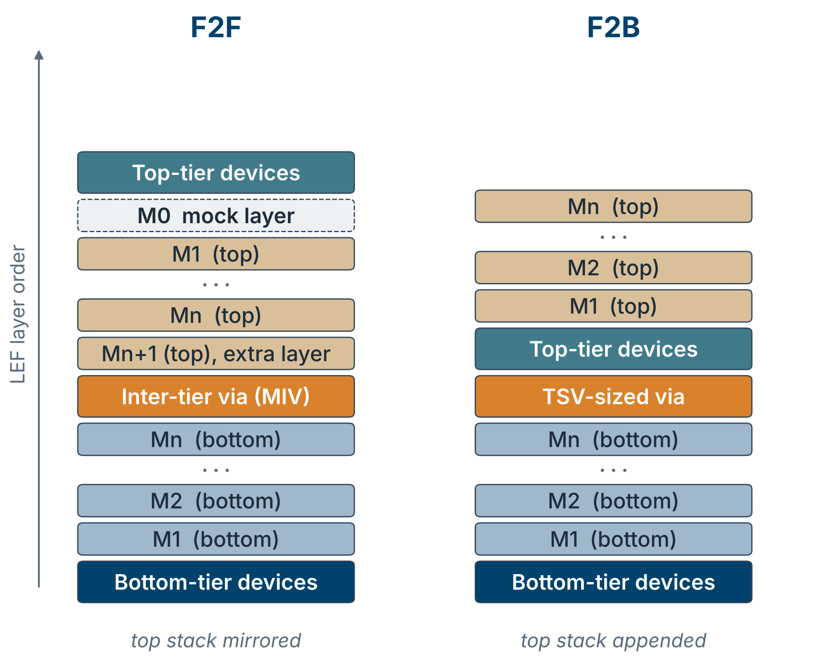
From a 2D PDK to a 3D PDK
What changes in the tech LEF
Layer order is physical order: choose the stacking style first
Copy the metal stack: mirrored for F2F, appended for F2B; keep only the layers you need
Add the inter-tier via: layer, VIA and VIARULE definitions, spacing tables
F2F fixes for the router: one extra top layer so directions alternate; a mock M0 above top-tier M1, with M1 set as the top routing layer
The 3DPX PDK tool generates these files for one PDK (homogeneous) or two (heterogeneous).

Slide 27
One Cell, Several Views
View | Cell size | Pins | Used in
Bottom-tier cell (NAND2_X1_bottom_tier) | Native | Bottom-tier metal layers | Placement, CTS, timing and routing of the bottom tier
Top-tier cell (NAND2_X1_top_tier) | Native | Top-tier metal layers | The same steps for the top tier
Shrunk view | One SITE | Original positions | Global placement; the fixed tier during incremental placement
Half-size model | Scaled-down area | Original positions | Floorplan at about half the 2D footprint; global placement
Liberty is duplicated per tier, so each tier keeps its own timing and power

Slide 28
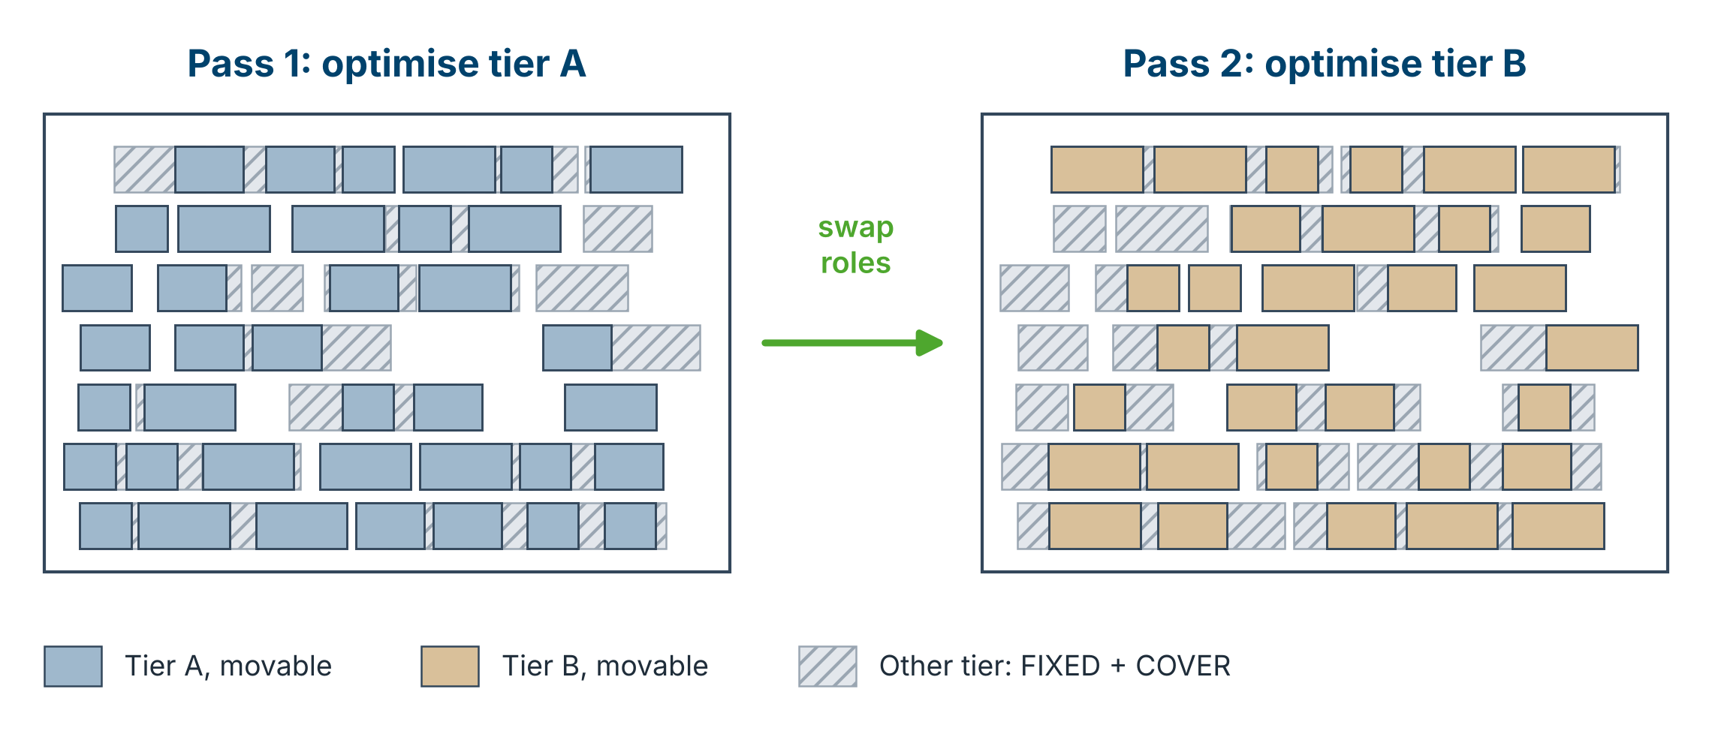
The Key Trick: COVER Cells
Used after global placement, after CTS and after timing repair; the other tier keeps its nets and timing, so optimisation stays 3D-aware
No new placer: 3D legality comes from telling the 2D placer which overlaps to ignore

Slide 29
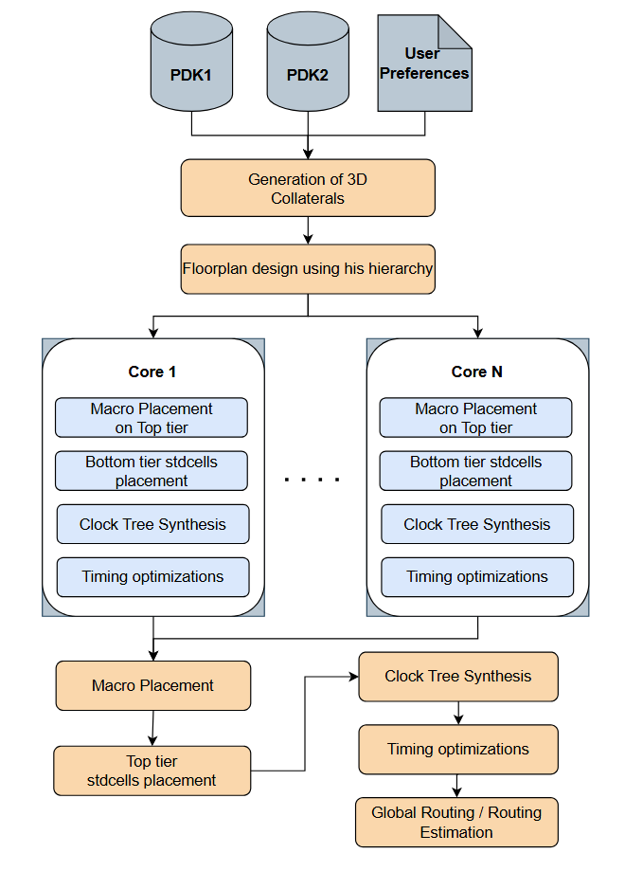
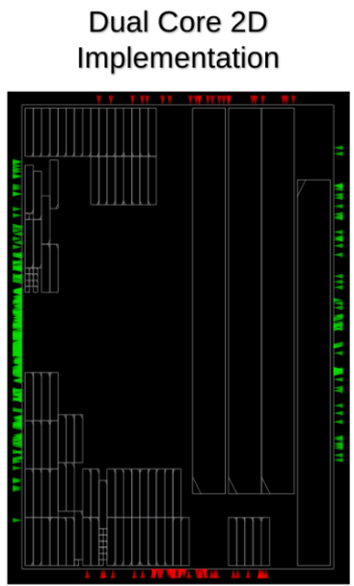
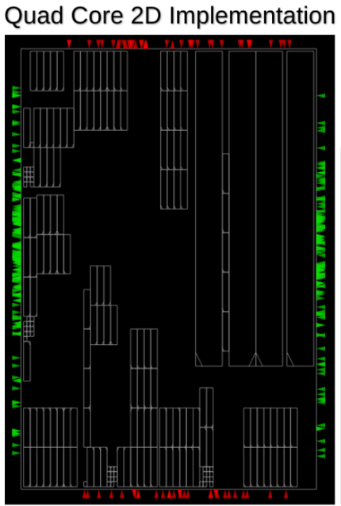
3DPX: Hierarchical P&R Flow

Slide 30
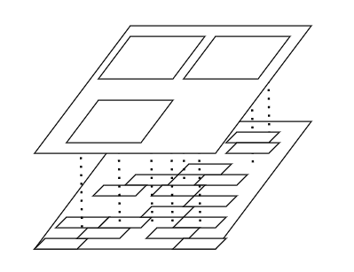
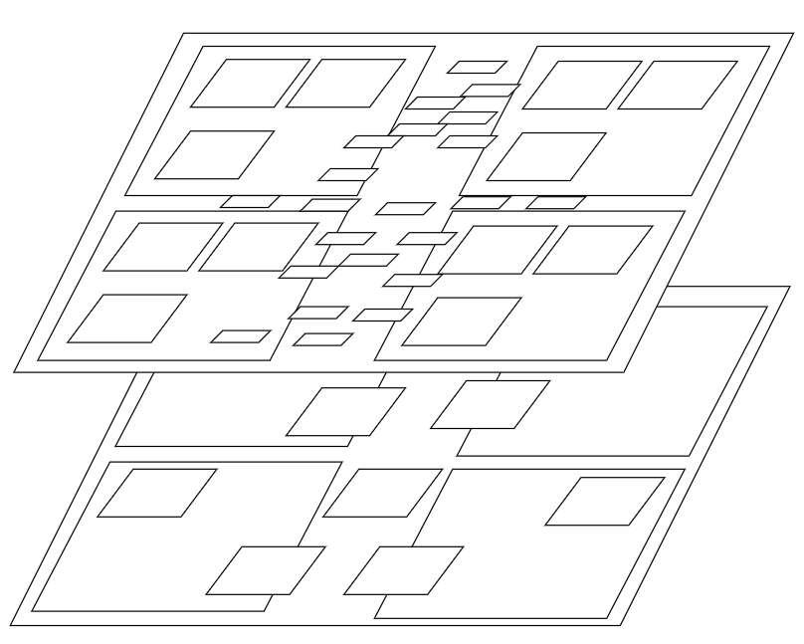
3DPX: From Cores to Full Chip
Cores Integration
Core 1
Top Level Chip Integration
Core 1
Core 3
Core 2
Core 4
Core n

Slide 31
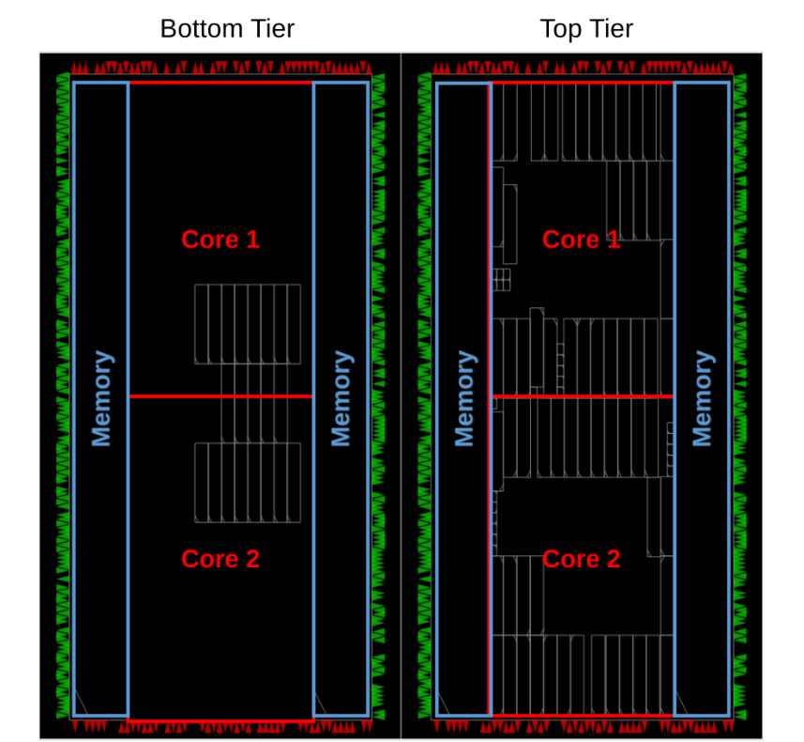
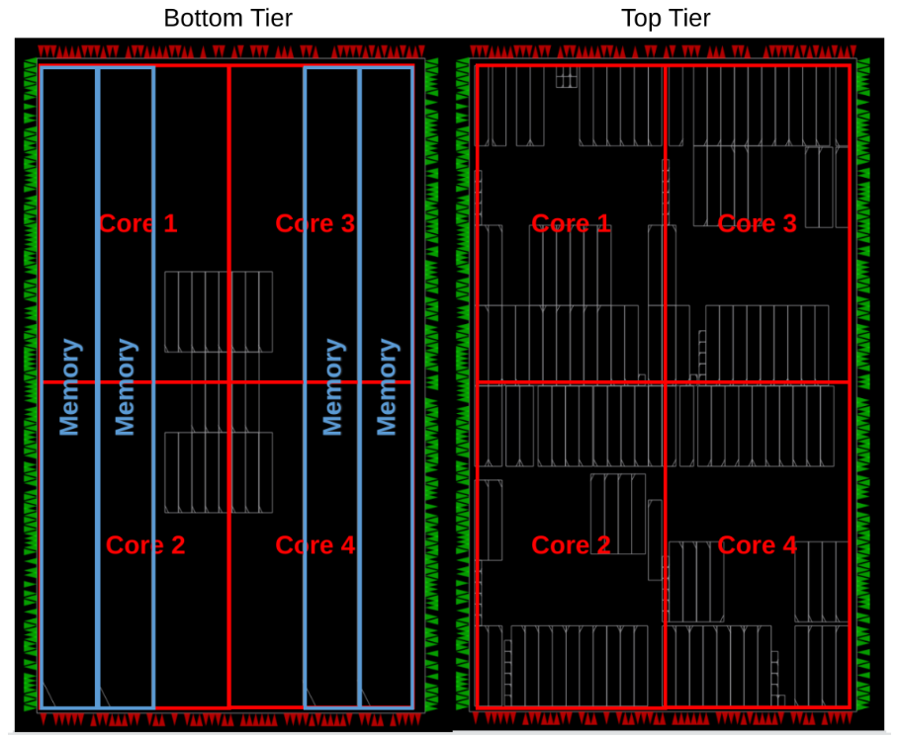
3DPX: Tier Floorplans

Slide 32
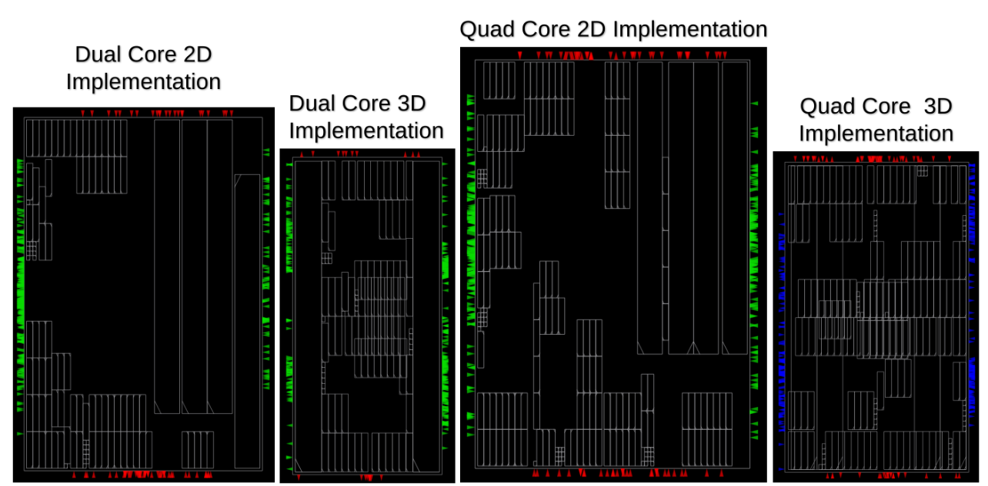
3DPX: Area Results
~56% area reduction
~53% area reduction

Slide 33
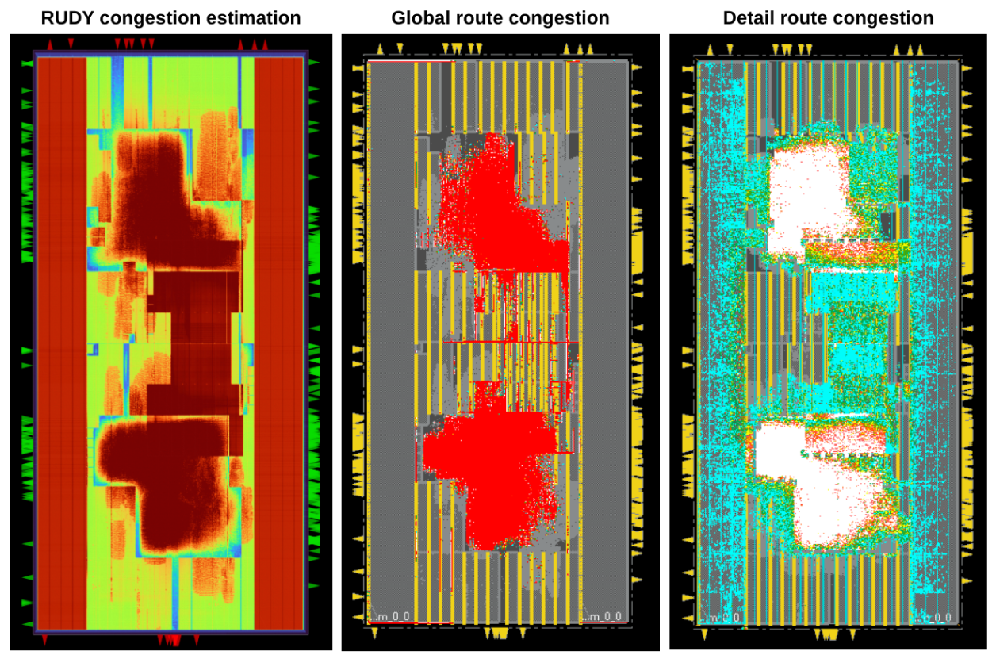
3DPX: Congestion vs Golden Tool
The generated LEF/LIB file has been successfully loaded in the golden standard evaluation tool
Golden standard tool reports only
legality DRCs
Detail Routing can be performed
within reasonable time and all efforts activated (Timing, Power)
All known analysis can be performed
RUDY global routing congestion estimator is very close to the global and post detail routing congestion reported from golden standard

Slide 34
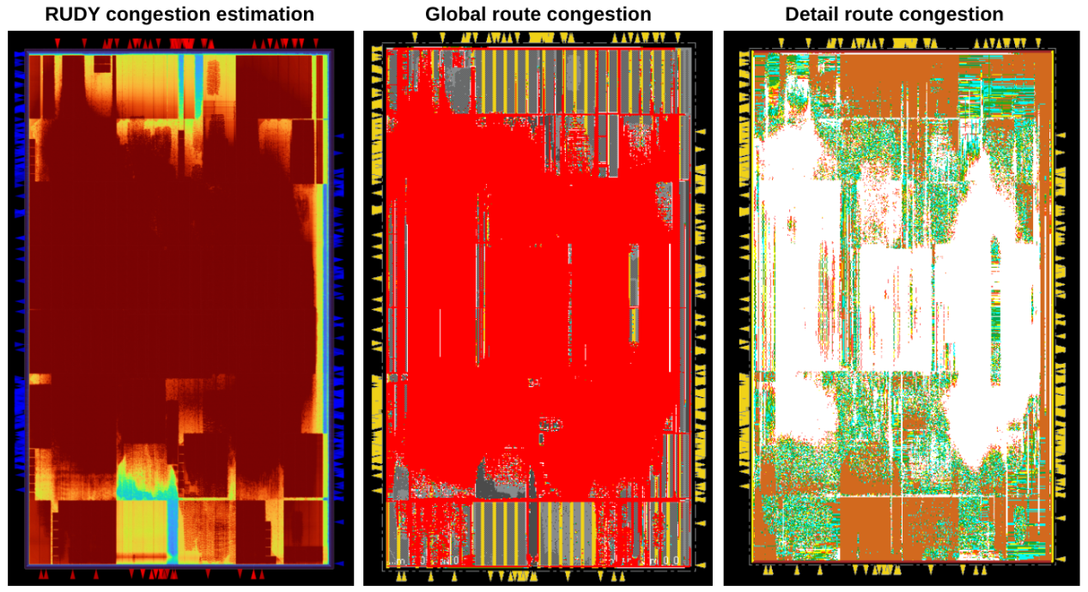
3DPX: Congestion vs Golden Tool

Slide 35
3DPX: Timing- and Power-Aware Flow
1 PDK preparation
Tier-specific LEF and Liberty views
2 Partitioning
FM min-cut, area-balanced; room kept for CTS buffers
3 Floorplan
Half-size model: about ½ of the 2D footprint
4 Global placement
Timing- and routability-driven; IO pins optimised
5 Per-tier placement
COVER cells, one tier at a time
6 Design repair
Max capacitance and slew, ideal clock
7 CTS + legalize
Only on the lower-utilization tier; per-tier legalization
8 Timing & power
Same-tier sizing, cloning and Vt swap; re-legalize
9 Routing
Tier-aware global routing and pin access; one detailed-routing pass
10 Post-route analysis
Parasitics, timing and power at three PVT corners
An early-estimate flow: one detailed-routing pass and three PVT corners, not sign-off

Slide 36
Making OpenROAD Tier-Aware
1 · Equivalent cells
2 · Global routing
3 · Pin access
Problem Resizing could swap a cell for an equivalent from the other tier.
Fix Compare tier suffixes first and reject cross-tier pairs; then run the usual port, logic and timing checks.
Problem In F2F, the two tiers reach their metal layers from opposite sides.
Fix Nets mostly on the top tier use top-tier layers in descending order; others use the normal ascending order. F2B keeps the original order.
Problem Cells on each tier are reached from opposite sides; a cell's own obstruction triggers false violations.
Fix Pick the second access layer by tier (below for bottom, above for top); ignore only own-cell markers.
Small, local changes: the rest of OpenROAD runs unchanged

Slide 37
Part 2 Takeaways
1
A 3D PDK in standard files
Tier-specific LEF and Liberty views let stock OpenROAD read F2F, F2B and monolithic stacks.
2
COVER cells make tiers overlap
Each tier is optimised with full knowledge of the other; no new placer is needed.
3
Area shrinks, timing holds
Up to ~56% smaller on RISC-V; 39% smaller on average over five benchmarks; WNS and TNS improve.
4
Power needs tier-aware care
Leakage rises everywhere; buffering, CTS and power recovery are the next targets.

Slide 38
Heterogeneous 3D Tutorial Flow
Maria Pantazi

Slide 39
Proposed Flow
Input tier libraries
Build stage-specific LEF models
Generate area-balanced tier netlist
Create initial OpenROAD DEF
Build compact virtual heterogeneous floorplan
Run OpenROAD placement and evaluate results

Slide 40
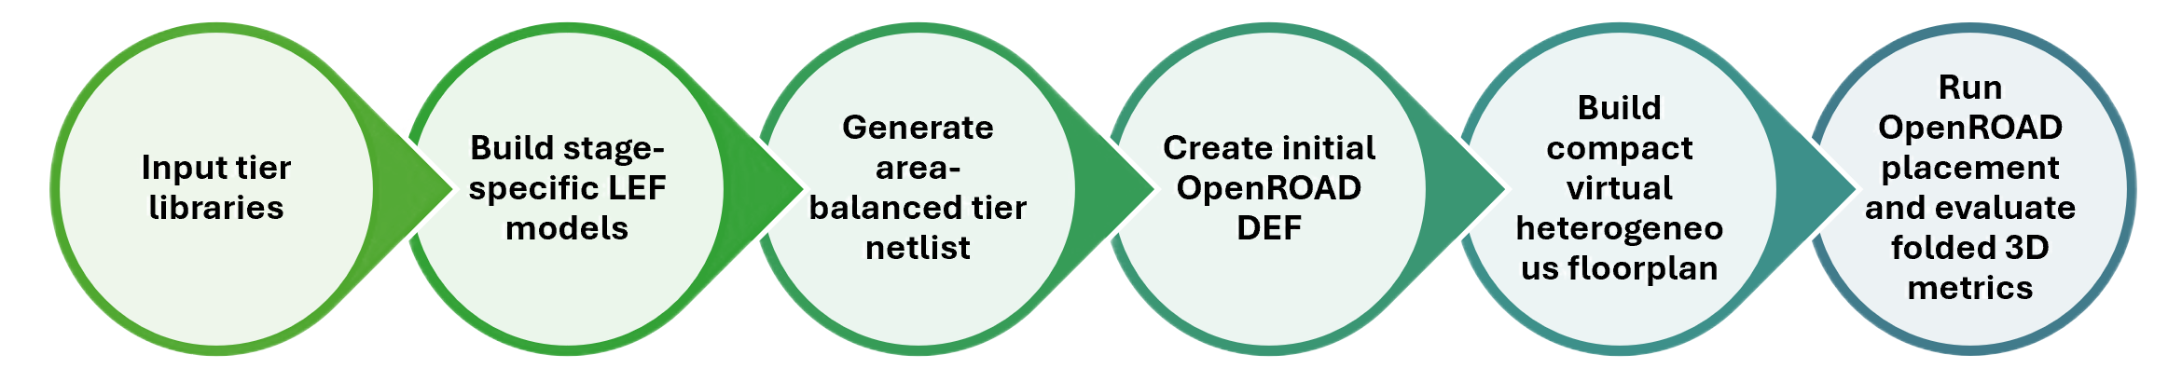
Library Preparation
Standard Cell LEF
Liberty (.lib)
Tech LEF
.lef
.lib
.lef
Cell names
Cell dimensions
Metal layers’ names
Cell names
Metal layers
Via definitions
Manufacturing grid
Site definitions

Slide 41
Heterogeneous Netlist Generation
RTL Design
Genus synthesis with OpenROAD-compatible libraries
Reference mapping to obtain real cell areas
Area-balanced assignment to top/bottom tiers
Pair compatible cells, same function, pins and sequential behaviour
TOP TIER
e.g. (fewer, larger cells)
BOTTOM TIER
e.g. (more, smaller cells)
Post-map rewrite to _top_tier / _bottom_tier cell masters

Slide 42
Area-Balanced Tier Assignment Example
Mapped Cell Groups
Tier Selection
Final Allocation
Algorithm
TOP TIER
Group B
Take next mapped group
Estimate TOP effective area
Estimate BOTTOM effective area
Assign to improve area balance
Repeat
Group A | area = 12
Group B | area = 17
Group C | area = 2
BOTTOM TIER
Group A, Group C, Group D
Example
Group A -> BOTTOM
Group B -> TOP
Group C -> BOTTOM
Group D -> BOTTOM
Group D | area = 5

Slide 43
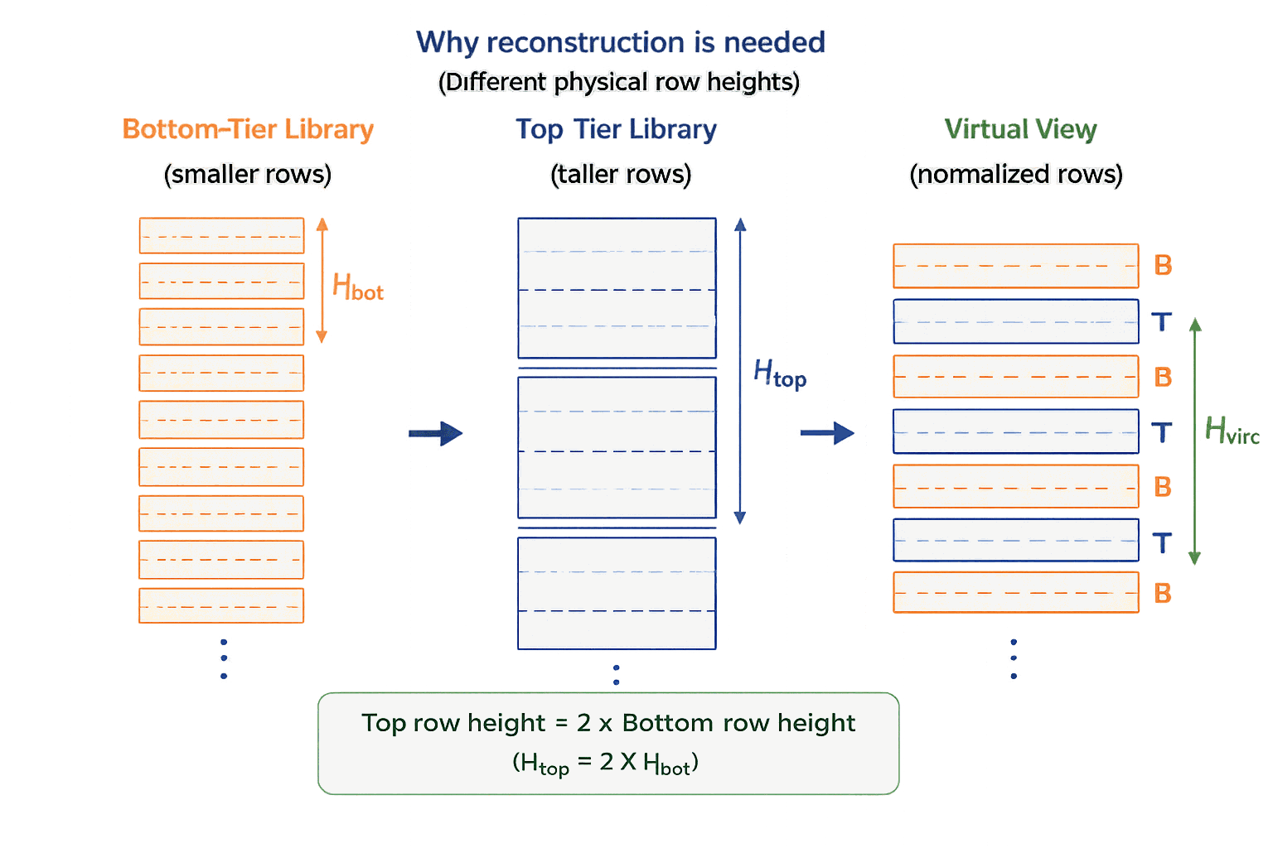
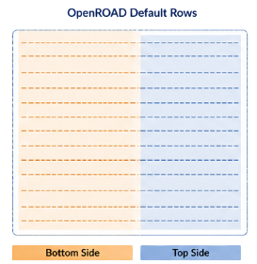
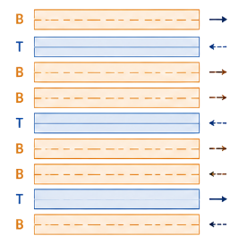
Virtual Row Pattern for Mixed Libraries
Default rows from OpenROAD
Reconstruct Custom Row Pattern
Define floorplan with the two sites
OpenROAD creates overlapping rows
Use the exported def to build a tier-aware row pattern with x2 of the original height

Slide 44
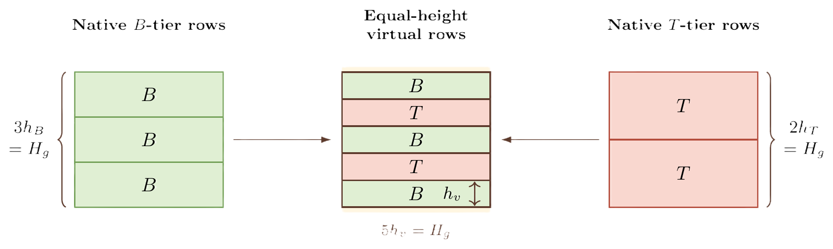

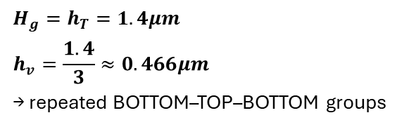
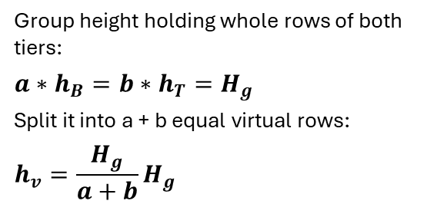
Virtual Row Height: General Rule
General case (example: 3 bottom rows ↔ 2 top rows)
Rule
Group height holding whole rows of both tiers:
$$a∗h_{B}=b∗h_{T}=H_{g}$$
Split it into a + b equal virtual rows:
$$h_{v}=\frac{H_{g}}{a+b}H_{g}$$
This work: $h_{T}≈2∗h_{T}→a=2, b=1$
Native bottom rows
Virtual rows
Native top row
Numbers used
B
B
T
T
$$H_{g}$$
$$H_{g}=h_{T}=1.4μm$$
$$h_{v}=\frac{1.4}{3}≈0.466μm$$
→ repeated BOTTOM–TOP–BOTTOM groups
B
B

Slide 45

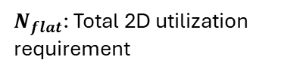


Compact Capacity Calculation
Compute Tier Demand
From cell area and target utilization:
Determine Final Capacity
Ensure the floorplan satisfies the total 2D utilization requirement and a minimum group count. Take the maximum.
Convert to B-T-B Groups
- required top rows: $N_{top_rows}$
- required top rows: 𝑁_(𝑡𝑜𝑝_𝑟𝑜𝑤𝑠)
- required bottom rows: $N_{bottom_rows}$
- required bottom rows: 𝑁_(𝑏𝑜𝑡𝑡𝑜𝑚_𝑟𝑜𝑤𝑠)
Each B-T-B group provides:
1 top row + 2 bottom rows
$$N_{top_groups}=N_{top_rows}$$
$$N_{bottom_groups}=ceil(\frac{N_{bottom_rows}}{2})$$
$$N_{tier}=\max{(N_{top_groups},N_{bottom_groups})}$$
$$N_{final}=\max{(N_{tier},N_{flat},N_{min})}$$
The virtual floorplan is sized from actual placement demand and target utilization, not by simply doubling the original floorplan height.
$N_{flat}$: Total 2D utilization requirement

Slide 46
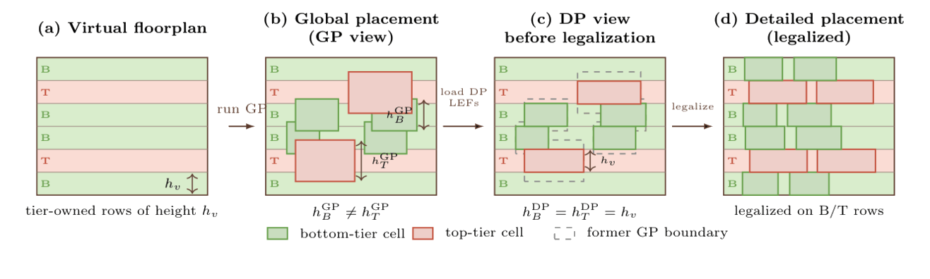
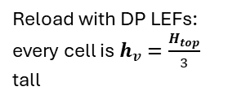
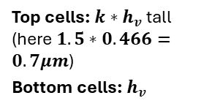
Density-preserving Placement & Legalization
1
Size-aware GP view
2
Global placement
3
Save placement DEF
4
Normalize cell heights
5
Legalization
Top cells: ${k∗h}_{v}$ tall (here $1.5∗0.466=0.7μm$)
Bottom cells: $h_{v}$
Place all cells in the virtual B/T/B rows; top cells occupy more space
Export the DEF after global placement
Reload with DP LEFs: every cell is $h_{v}=\frac{H_{top}}{3}$ tall
Detailed placement legalizes cells on the B/T rows

Slide 47
Part 3 Takeaways
1
Abstraction over modification
Heterogeneous tiers become one virtual 2D canvas that OpenROAD can place.
2
Area, not counts
Partition by native physical area; the two libraries have very different cell sizes.
3
Rows encode the tiers
Repeated BOTTOM–TOP–BOTTOM rows with decoupled GP / DP cell heights.
4
Know the limits
Placement is solid; CTS, PDN, 3D routing and sign-off remain open work.

Slide 48
Hands-on Demonstration, Discussion, and Future Directions
George Goudroumanis & Maria Pantazi

Slide 49
Hands-on Roadmap
Part A · Monolithic 3D
Part B · Heterogeneous 3D
1 · Core-level P&R
Shrunk-cell floorplan + macros
Std cells on the top tier
Example
CVA6
15 + 45 nm
Partition
area
balance
Floorplan
virtual
Group rows
Heights
GP / DP
LEF views
Place
GP → DP
Results
layout +
metrics
2 · Chip integration
Merge cores; macros on top tier
Optimize tiers using covers
Format
Scripts & key lines
Prepared results (full CVA6 takes hours)
All material released after the tutorial
3 · Optimize & analyze
Optimize PDN, CTS
Timing & power, 3 corners

Slide 50
Part A: Monolithic 3D Hands-on
Cores Integration
Core 1
Top Level Chip Integration
Core 1
Core 3
Core 2
Core 4
Core n

Slide 51
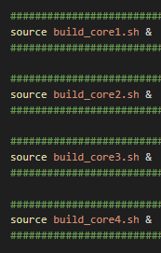
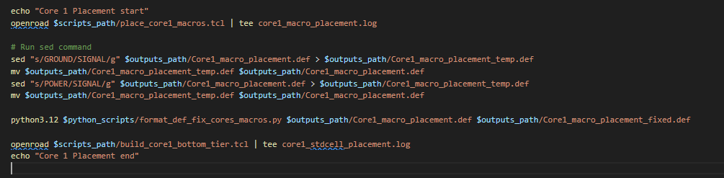
P&R Flow presentation
Initialize Core predefined floorplan
using shrinked size SDT CELS
(cell size is 1 site)
Place Hard macros
Fix Power Nets in DEF
Mark all the Hard
Macros as fixed and
COVERS
Load the modified PDK with shrinked Macros and place
the standard cells of the core in the bottom tier

Slide 52
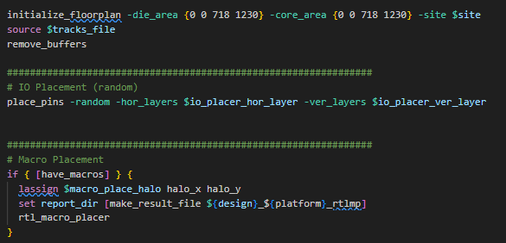
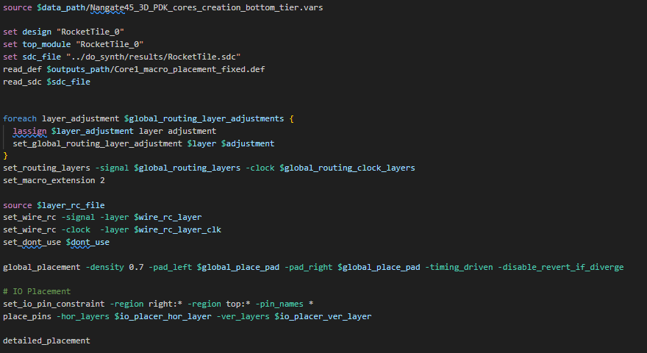
P&R Flow presentation
Floorplan Initialization
Random IO Pins
placement
Hard macros Placement
PDK loading and technology
layers routing adjustments
Technology layers RC reference
Global Placement
Placement optimization

Slide 53
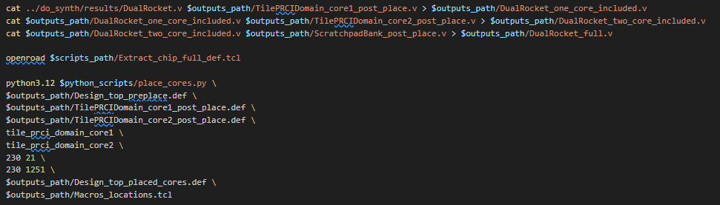
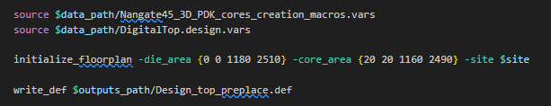
P&R Flow presentation
Combine cores Verilog files
to one Verilog file
Extract DEF with
top level chip Floorplan
Move cores’ STD cells from
top level chip DEF according
to their post placement DEF

Slide 54
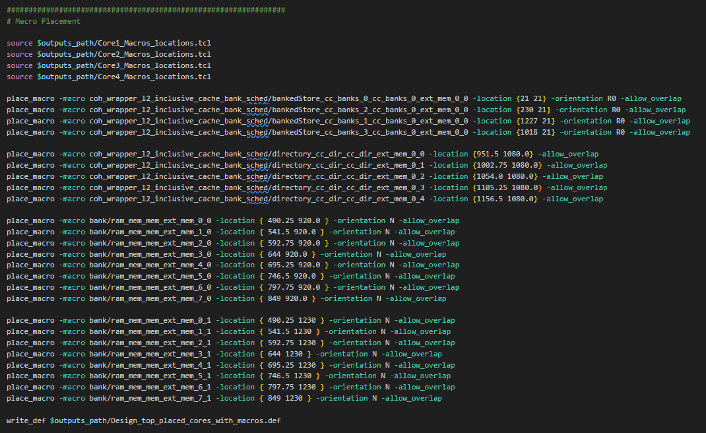
P&R Flow presentation
Reposition Cores Hard macros
based on their obtained positions
(Positioned in top tier)
Place by hand remaining
top level cores
(Positioned in bottom tier)

Slide 55
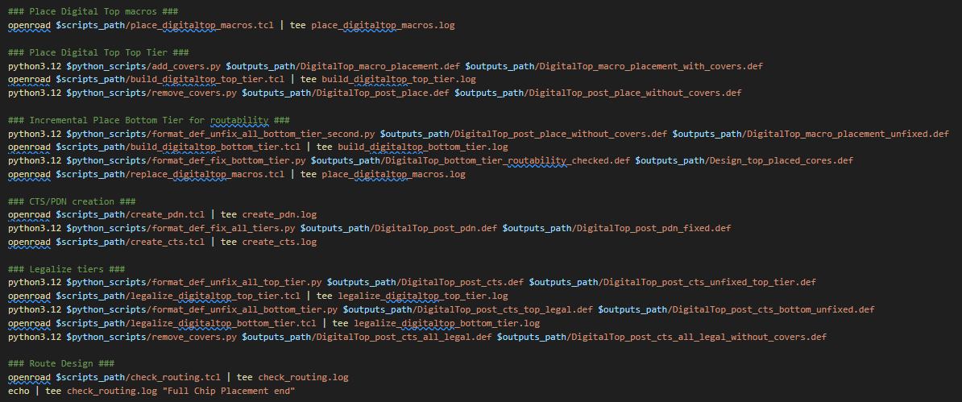
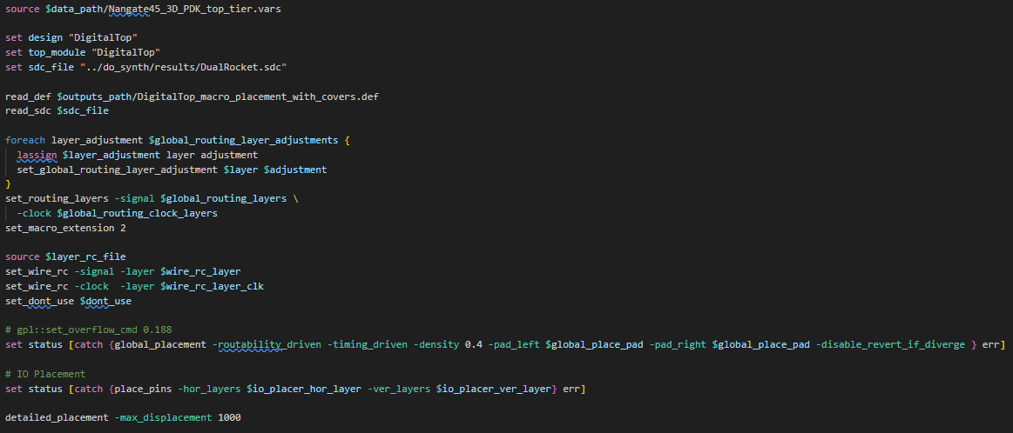
P&R Flow presentation
Add covers to the placed cells
and Macros of the Bottom Tier
Place Top tier cells
Remove covers from the placed cells
and Macros of the Bottom Tier

Slide 56
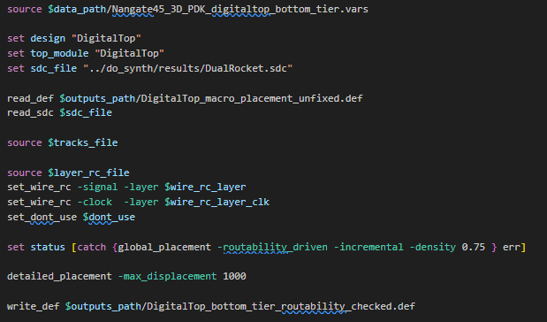
P&R Flow presentation
Routability driven optimization of the bottom Tier
Make all top tier cells and macros Fixed and add covers
Make all bottom tier cells movable
Optimize bottom Tier placement
Fix into positions all cells
Replace Macros to maintain accurate positions

Slide 57
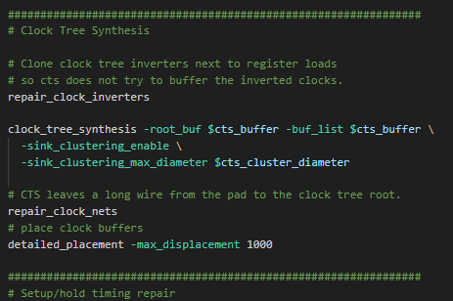
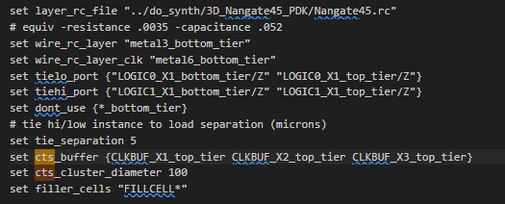
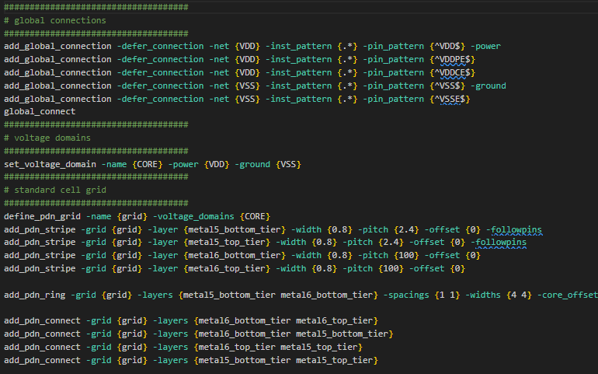
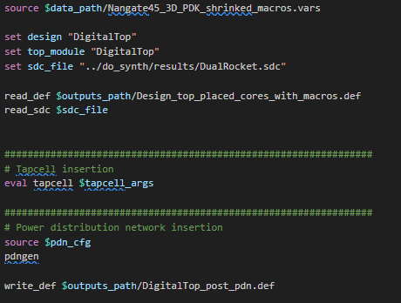
P&R Flow presentation
Insert Rings and rails like 2D flow
Make all the cells of the design fixed
Create CTS network

Slide 58
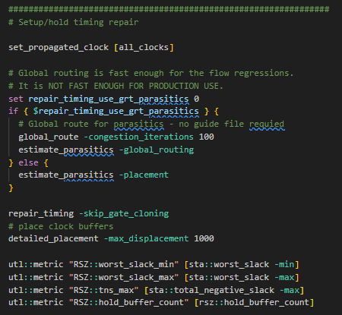
P&R Flow presentation
After CTS analyze the design and
estimate parasitics RC
Repair Setup/Hold violation
Optimize clock buffer positions

Slide 59
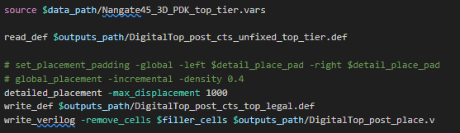

P&R Flow presentation
Fix the positions of all bottom tier cells
Make all top tier cells movable
Optimize top tier placement
Fix the positions of all top tier cells
Make all bottom tier cells movable
Optimize bottom tier placement

Slide 60


P&R Flow presentation
Re-extract parasitics estimation
Compute Timing variables
Perform pin accessing
Get Global Routing Estimation /
Global Routing Results

Slide 61
Experiments

Slide 62

P&R Flow presentation
Worst hold and setup slack, and TNS
Power at typical, fast and slow corners
CVA6 in 3D: setup WNS −0.707 ns, TNS −17,544 ns, hold WNS +0.029 ns
Total power 239 / 402 / 176 mW (typical / fast / slow)

Slide 63
Benchmarks for Timing and Power
Setup
Design | Source | Cells | Nets | Cell types | Primary pins | 2D core util.
vga_lcd | OpenCores | 60,635 | 60,724 | 72 | 198 | 74.7%
b19 | ISPD 2012 | 79,507 | 79,758 | 123 | 47 | 72.7%
cva6 | CVA6 repository | 222,201 | 243,424 | 128 | 5,294 | 85.3%
netcard | ISPD 2012 | 368,296 | 370,132 | 77 | 1,846 | 89.6%
leon3mp | ISPD 2012 | 425,471 | 425,735 | 75 | 333 | 88.5%
Mock imec N2 PDK with two identical tiers: same library, cell area and timing
2D baseline: same netlist, PDK and synthesis
F2B routing stack
Δ = (2D − 3D) / 2D: positive means 3D is better

Slide 64
3DPX: Area, Wirelength, Timing
Design | Die area | Wirelength | WNS | TNS
vga_lcd | +33.9% | +14.7% | +31.8% | +17.3%
b19 | +34.6% | −0.9% | −10.7% | +11.7%
cva6 | +30.6% | −2.6% | +57.0% | +66.4%
netcard | +57.0% | −22.4% | +3.8% | ~100%
leon3mp | +40.2% | −3.9% | −2.1% | ~100%
Average | +39.2% | −3.0% | +16.0% | +59.1%
Δ = (2D − 3D)/2D; positive = 3D better
Die 39% smaller on average; wirelength near 2D; timing better on average

Slide 65
3DPX: Power
Design | Total typ. | Total fast | Total slow | Leakage typ.
vga_lcd | −5.0% | −6.3% | −3.0% | −66.7%
b19 | −108% | −159% | −73.9% | −132%
cva6 | +1.6% | +9.7% | −9.3% | −159%
netcard | −54.2% | −95.6% | −21.2% | −280%
leon3mp | −37.2% | −65.4% | −17.9% | −184%
Δ = (2D − 3D)/2D; negative = 3D uses more power
Why: extra buffers from per-tier repair and one-tier CTS, plus tier-specific cell views; neither exists in the 2D flow
Leakage rises in every design; only CVA6 saves total power (1.6% typical, 9.7% fast)

Slide 66
What Does 3D Buy? Published Results
Commercial tools · Pin-3D
Open source · Open3DBench
Our flow · 3DPX
18–38% less wirelength
8–30% less power
Monolithic 3D vs 2D in a commercial 28 nm node: two industry processors plus the LDPC and Netcard benchmarks
51% area
24% wirelength
31% timing
5.7% power
3D vs 2D improvements, flow built on OpenROAD-flow-scripts
56% smaller die (avg)
15% wirelength (avg)
57% better WNS (avg)
~100% better TNS (avg)
10% less power
5 designs, imec N2, two tiers. Total power; leakage rises in all designs
Shorter wires do not automatically mean better PPA: the physical design flow decides
Pentapati et al., Pin-3D, ICCAD 2020 · Shi et al., Open3DBench, arXiv:2503.12946, 2025 · 3DPX (this tutorial)

Slide 67
Part B: The Example (CVA6)
Design: CVA6 RISC-V core, cv64a6_imafdc_sv39
Bottom tier: Nangate 15 nm (0.466 µm rows)
Top tier: Nangate 45 nm (1.4 µm rows)
Input: all-bottom mapped netlist (caches mapped to std cells)
Partitioner
Pairs cells by Liberty function, pin direction and sequential behaviour
Greedily balances native LEF area (≤ 2% imbalance)
Unsupported pairs stay on the bottom tier
2.49 M
513,073
1,979,972
50 / 50
cells in total
top-tier cells (45 nm)
bottom-tier cells (15 nm)
native area split (≈652,317 µm² each)
Equal area, unequal counts: fewer but larger 45 nm cells balance many small 15 nm cells

Slide 68
Part B Flow at a Glance
flow/run.sh
Partition
cva6_heterogeneous.v
./flow/run.sh prepare # partition + libs
./flow/run.sh generate # floorplans v2..v5
./flow/run.sh place v2 # GP, then DP
./flow/run.sh gui v2 # inspect layout
# key settings (flow/run.sh)
TOP_GP_HEIGHT=0.700 # top cells in GP
TOP_DP_HEIGHT=0.466 # top cells in DP
VIRTUAL_ROW_HEIGHT=0.466 # virtual site
ORIENTATION_PATTERN=N,N,FS,N,FS,FS
GP_DENSITY=0.70
FLOORPLAN_UTILIZATION=70
Initial floorplan
initial DEF
Virtual B–T–B rows
compact_v2.def
Global placement
postGP_compact_v2.def
Detailed placement
postDP_compact_v2.def
■ highlighted lines = key steps

Slide 69
Step 1: Area-Balanced Tier Assignment
GREEDY AREA BALANCING (simplified)
partition.rpt
# partition/rewrite_mapped_netlist_tiers.py
ordered = sorted(instances,
key=lambda i: -sortable_area(i))
for inst in movable:
d_top = abs((top + inst.top_area) - bottom)
d_bot = abs(top - (bottom + inst.bottom_area))
if d_top <= d_bot:
top_indices.add(inst.index)
top += inst.top_area
else:
bottom += inst.bottom_area
total_instances: 2493045
assigned_top: 513073
assigned_bottom: 1979972
top_area: 652317.12
bottom_area: 652317.36
top_area_pct: 50.000
Balance native area, not cell count: one 45 nm cell ≈ several 15 nm cells
■ highlighted lines = key steps

Slide 70
Step 2: Virtual B–T–B Floorplan
ROW GENERATION (simplified)
Two groups, with orientations
# python_scripts/create_virtual_btb_floorplan.py
req_bot = required_rows(area['BOTTOM'], ...)
req_top = required_rows(area['TOP'], ...)
N = max(req_top, ceil(req_bot / 2))
n_groups = ceil(N * capacity_scale) # v2..v5
for _ in range(n_groups):
seq += ['BOTTOM', 'TOP', 'BOTTOM']
# output DEF: only DIEAREA + ROW lines change
BOTTOM
N
TOP
N
BOTTOM
FS
BOTTOM
N
TOP
FS
BOTTOM
FS
Variant | v2 | v3 | v4 | v5
Capacity × | 1.0 (compact) | 1.2 | 1.3 | 1.5 (most whitespace)
■ highlighted lines = key steps

Slide 71
Step 3: Decoupled Cell Heights
flow/placement.sh
1.4 µm
python3 python_scripts/make_dp_rowheight_lef.py \
--input-lef nangate_stdcell_top_tier.lef \
--output-lef top_gp.lef \
--target-height 0.700 \
--site-height 0.466
0.7 µm
0.466 µm
TOP LEF VIEWS
MACRO NAND2_X1_top_tier
SIZE 0.57 BY 1.4 ; # native
SIZE 0.57 BY 0.7 ; # GP view
SIZE 0.57 BY 0.466 ; # DP view
Native
GP view
DP view
Bottom 15 nm cells stay at 0.466 µm in every view
■ highlighted lines = key steps

Slide 72
Step 4: Global and Detailed Placement
GLOBAL PLACEMENT
DETAILED PLACEMENT
set std_cell_lef bottom_tier.lef
set extra_lef top_gp.lef ;# 0.700
read_libraries
read_def compact_v2.def
read_verilog cva6_heterogeneous.v
read_sdc cva6.sdc
place_pins -ver_layers metal1_bottom_tier \
-hor_layers metal2_bottom_tier
global_placement -density 0.70
write_def postGP_compact_v2.def
set std_cell_lef bottom_tier.lef
set extra_lef top_dp.lef ;# 0.466
read_libraries
read_def postGP_compact_v2.def
read_verilog cva6_heterogeneous.v
read_sdc cva6.sdc
detailed_placement -max_displacement 3000
check_placement -verbose
write_def postDP_compact_v2.def
No new placement algorithm: the abstraction lives in the LEF views and the rows
■ highlighted lines = key steps

Slide 73
Optional: Virtual Routing Experiment
ROUTE-ONLY VIEW + ROUTING
Read with care
python3 python_scripts/map_lef_layers.py \
--input-lef top_dp.lef \
--output-lef top_route.lef \
--map metal1_top_tier=metal1_bottom_tier
global_route ... ;# bottom M1-M6
detailed_route -output_drc drc.rpt
Top M1 pins mapped onto bottom M1
Single metal stack: not true 3D routing
Check the DRC summary, not the exit code
Placement is the validated result; routing is an open research step
■ highlighted lines = key steps

Slide 74
Placement Results: CVA6 (v2)
35.25 M µm
38.07 M µm
+8%
1.0 µm
HPWL after global placement
HPWL after legalization
HPWL increase from legalization
average displacement (max 170.3 µm)
Capacity sweep: generated floorplans
Takeaways
Variant | Capacity × | Interpretation
v2 | 1.0 | Baseline compact floorplan
v3 | 1.2 | More row capacity
v4 | 1.3 | More row capacity
v5 | 1.5 | Most whitespace
All 2,493,045 cells legally placed in mixed-height rows
Small average displacement: GP solution preserved
More whitespace eases legalization at the cost of footprint and wirelength

Slide 75



Placement Example

Slide 76
Discussion and Future Directions
Automated partitioning
Tech-aware optimization
Cross-tier timing / power
Timing- and thermal-aware tier assignment beyond area balance
Placement and sizing that know which tier a cell sits on
3D-aware STA, CTS and PDN across stacks
True 3D routing
Sign-off in the loop
Architecture ↔ layout
Both metal stacks plus inter-tier via planning
Early thermal, IR-drop and EM analysis
Co-design of system partitioning and physical design
Questions? Material released after the tutorial: github.com/COIN3D-Project/ICECS_3D_Tutorial

Slide 77

Thank you!

