Slide 1


petulant-moo
Scheduler Connectivity ACK Results Challenges
https://goo.gl/LKBqPJ
Pre-determined TDMA scheduling.
An efficient multihop routing algorithm for low power high data yield in static topologies.
https://github.com/gubser/petulant-moo

Slide 2
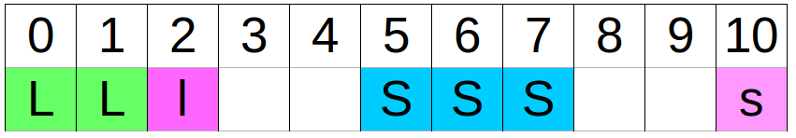
Scheduler
Scheduler Connectivity ACK Results Challenges
Idea: Low duty cycle with pre-determined TDMA.
State machine on every node executing its given schedule:
LISTEN_ON=0
SEND_ON=5
SEND_DONE=8
LISTEN_ACK=2
SEND_ACK=9
LISTEN_OFF=3
SEND_OFF=10

Slide 3
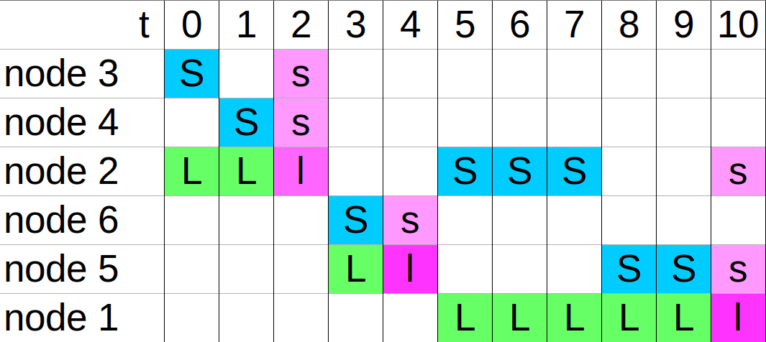
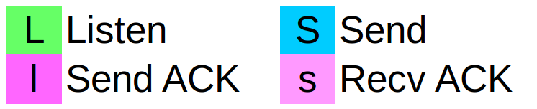
Scheduler
Scheduler Connectivity ACK Results Challenges
Schedule for each node pre-computed based on selected topology:
1
6
5
2
4
3
Python script:
mote2 = M(2, [M(3), M(4)])
mote5 = M(5, [M(6)])
sink = M(1, [mote2, mote5])
sink.calculate()
→ C code output
Legend
E: Concept + Scheduler +
F: Time sync packet (function) => Bad performance + Connectivity + new topology
E: Can ACK concept improve the results
F: Results (graphs)
E/F: Problems

Slide 4
Connectivity
Scheduler Connectivity ACK Results Challenges
CC2420TimeSyncMessageC
sync_remaining=800ms
553ms
206ms
2-3ms Jitter (Cooja)
sink
node x
START
node y
node z
sync_recvTime
startOneShot(TIMESYNC_DELAY(TOS_NODE_ID))
startOneShot(sync_remaining - (tnow - sync_recvTime))

Slide 5
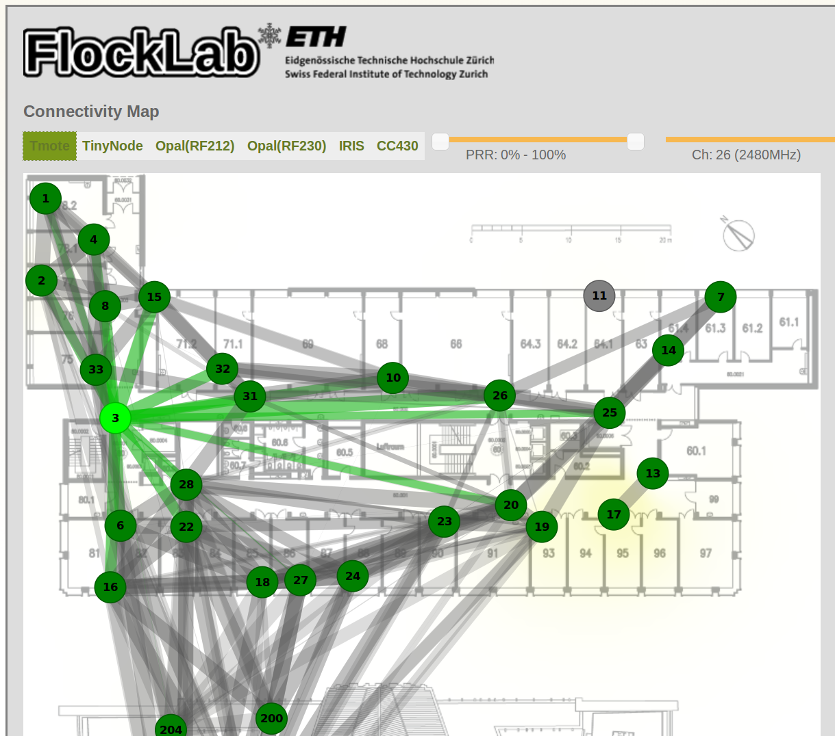
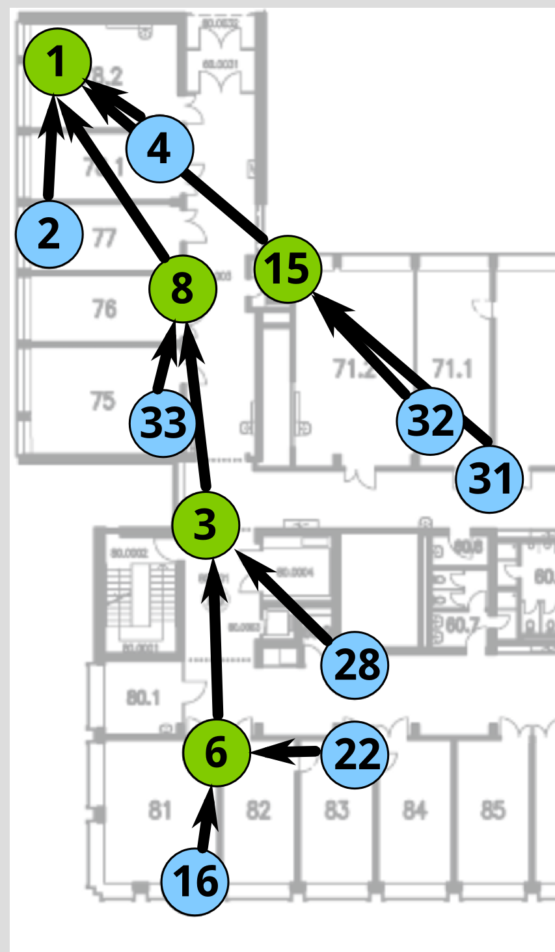
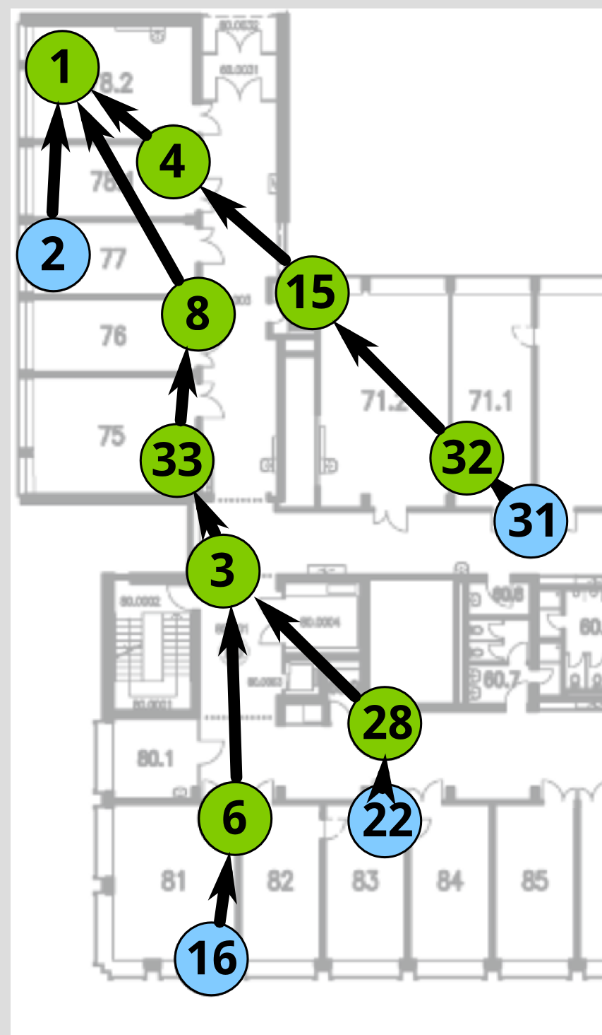
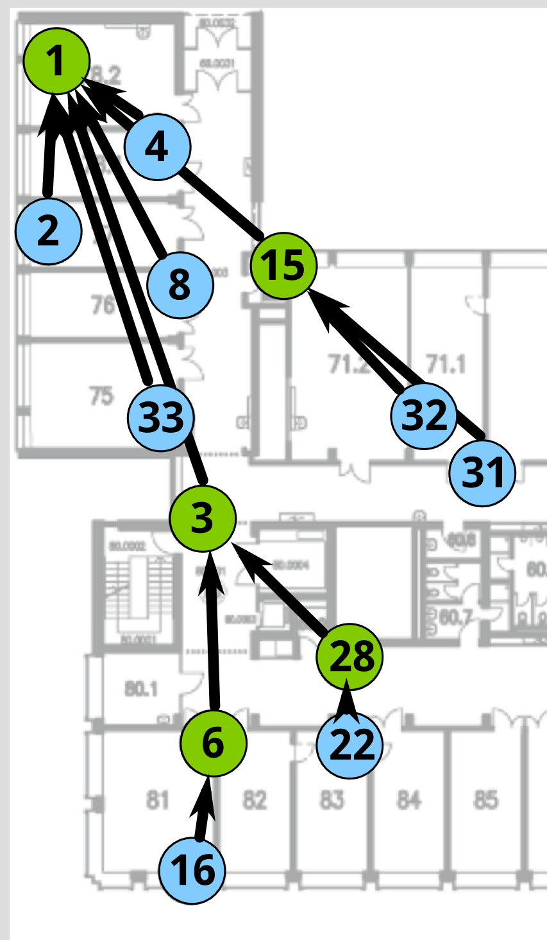
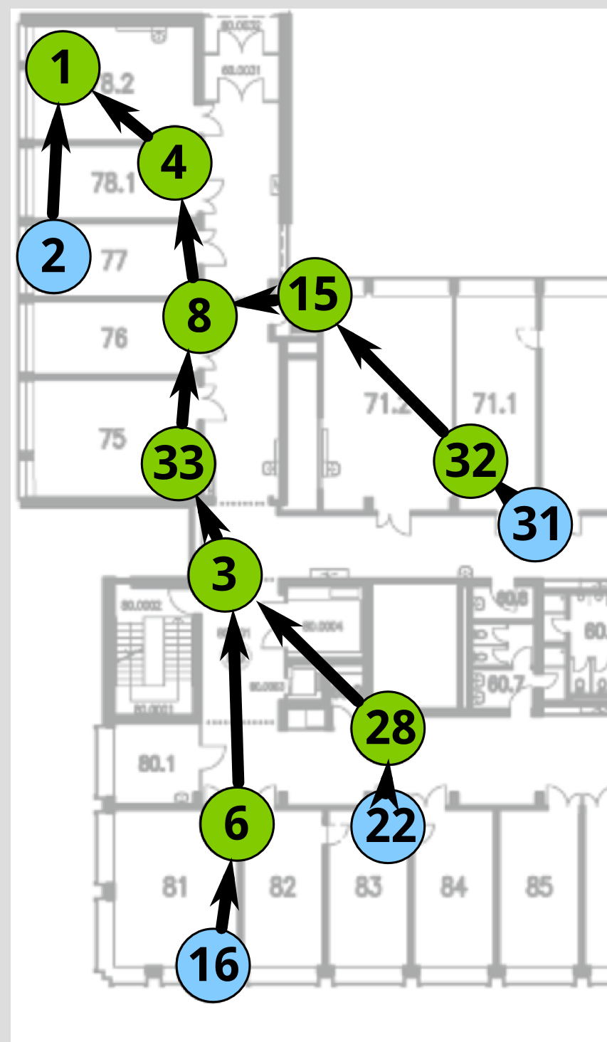
Connectivity
Scheduler Connectivity ACK Results Challenges
Low current consumption thanks to scheduler.
But not full data yield. How is the connectivity?
Topology improvement by:
  connectivity map
  test runs
Example 10Pkt/s:
DY: 72.69%
I_avg: 0.55mA (0.98)
KPI: 85%
DY: 87.65%
I_avg: 0.87mA (0.97)
KPI: 92%
DY: 100.00%
I_avg: 0.76mA (0.97)
KPI: 98%
DY: 99.62%
I_avg: 0.61mA (0.98)
KPI: 99%

Slide 6
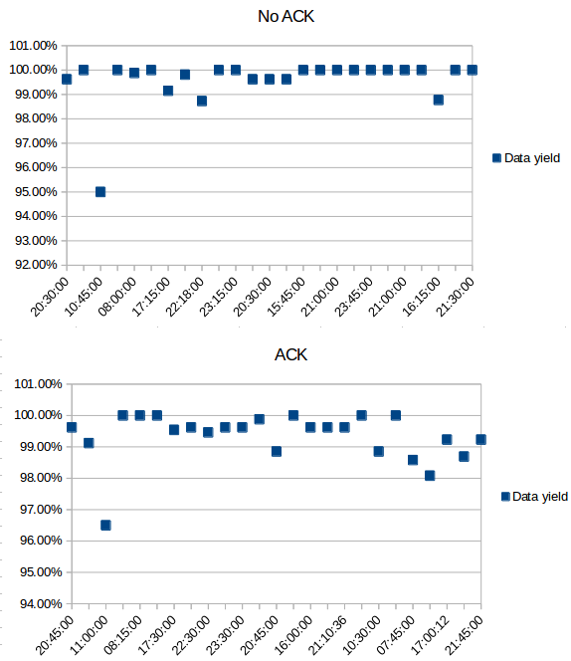
(Simple) ACK
Scheduler Connectivity ACK Results Challenges
Can ACK improve the results?
Can better data yield compensate worser power performance?
Idea: Is any data received?
  Yes: Clear sent packets in buffer
  No: Keep packets in buffer
Problem:
  Jitter: TDMA not working properly
  More packets losses in good environment

Slide 7
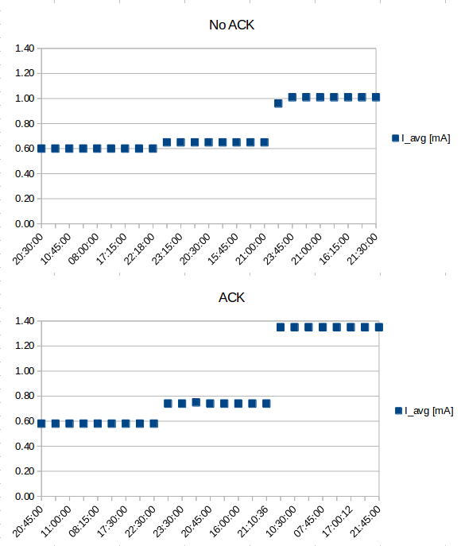
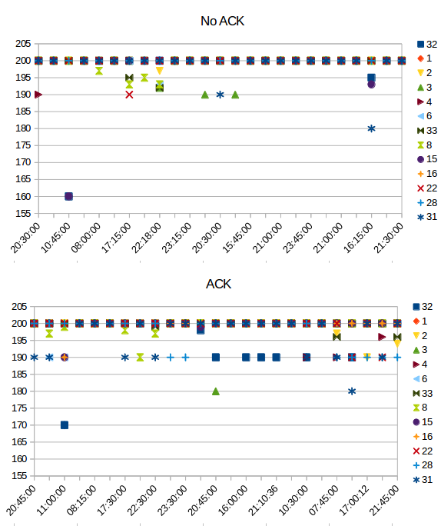
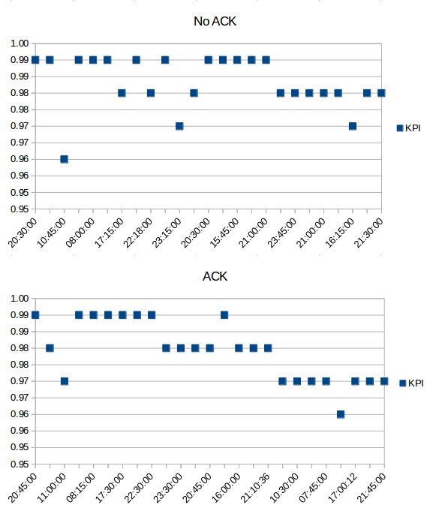
Results
Scheduler Connectivity ACK Results Challenges
50 test runs from 2nd December to 5th December
NO ACK:
Data yield: 99.59%
I_avg: 0.75mA
KPI: 98%
ACK:
Data yield: 99.33%
I_avg: 0.88mA
KPI: 98%

Slide 8

Challenges
Scheduler Connectivity ACK Results Challenges
Reduce number of packets by bundling 10 data packets into one:
typedef nx_struct group_bulk_msg {
nx_am_addr_t source;
nx_uint8_t seq_no;
nx_uint16_t data[BULK_SIZE];
} group_bulk_msg_t;
CC2420 TinyOS implementation not suitable for TDMA. Jitter → Packet Loss
“Volunteers are needed to redo this architecture […] to build other types of channel sharing mechanisms (i.e. TDMA).” [1]
Due to very short channel occupancy, we are lucky most of the time.
~5ms
[1] http://tinyos.stanford.edu/tinyos-wiki/index.php/CC2420_Layer_Descriptions

Slide 9
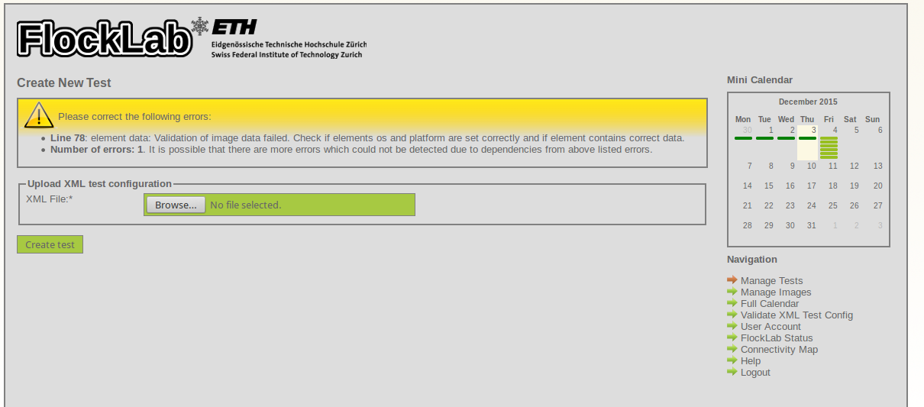

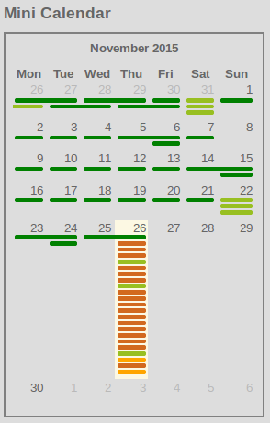
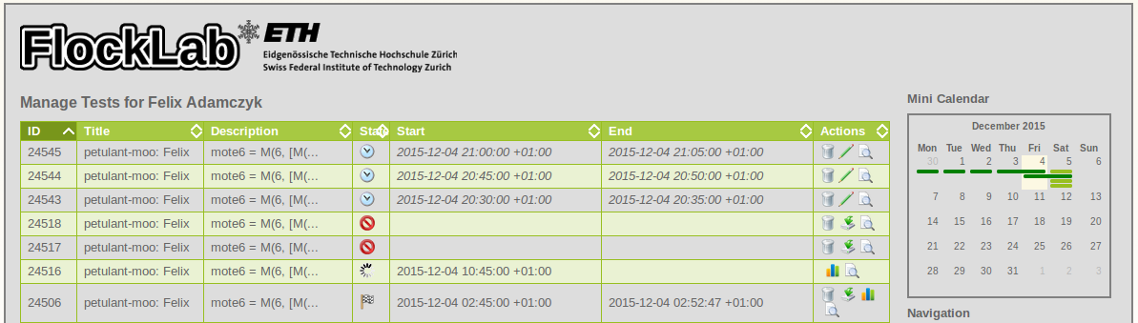
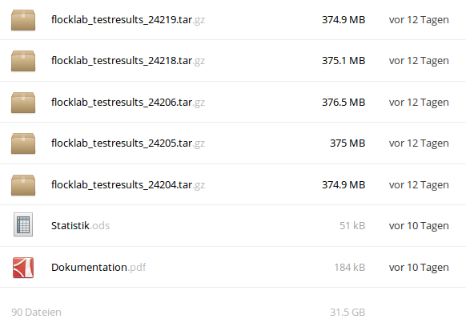
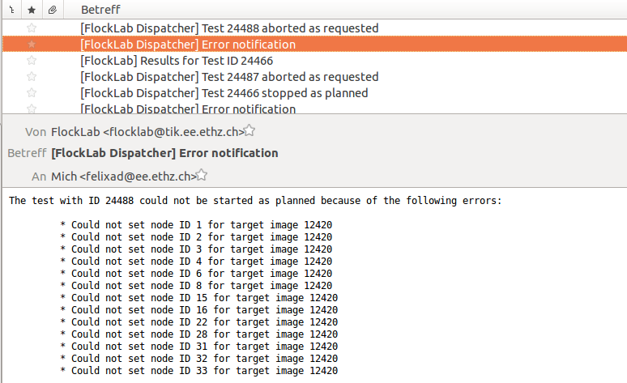
Challenges
Scheduler Connectivity ACK Results Challenges
Intensively testing

