Slide 1
R TOOLKIT · WT1 PROXIMITY-LABELING INTERACTOME
A Consensus, Dual-Branch Pipeline for Calling
Proximity-Labeling Interactors
Seven differential-enrichment methods and an independent spectral-count model,
fused into one confidence-scored interactor list.
Xin Wang xin.wang@nationwidechildrens.org Nationwide Children's Hospital

Slide 2
PROXLABTOOLKIT
METHODS SUMMARY · AUG 2026
1
OVERVIEW
The WT1 project previously re-implemented the same differential-enrichment analysis from scratch for every bait-vs-control comparison — ten near-identical scripts differing only in hard-coded sample names. ProxLabToolkit replaces them with one parameterized pipeline: a single comparison is scored by seven independent statistical methods on MaxLFQ intensity, cross-checked against an independent model of raw spectral counts, and reduced to one ranked, evidence-tagged list of interactors.
Comparison unit | 1 bait vs. 1 matched control
DEA methods, intensity branch | 7 — Limma, DEqMS, Wilcoxon, ROTS, DEP, proDA, MSstats
Evidence branches | 2 — MaxLFQ intensity; raw spectral count
Legacy scripts consolidated | 10 → 1
Validated against | WT1(−)KTS proximity-labeling dataset

Slide 3
PROXLABTOOLKIT
METHODS SUMMARY · AUG 2026
2
PIPELINE ARCHITECTURE
Every comparison passes through load / normalize / impute once, then the two branches run in parallel on the same six samples before fusing into a single call.
INTENSITY BRANCH
Limma · DEqMS · Wilcoxon · ROTS
DEP · proDA · MSstats
Load & clean
Normalize & impute
7 methods, shared matrix
FUSION
combined_protein.csv
knn (MAR) / MinProb (MNAR)
corrected-Fisher p, vote count,
naive-Bayes posterior fusion
Final DEP list
COUNT BRANCH
High / Standard / Count-only
SAINT-style EM mixture,
raw spectral counts
independent of MaxLFQ
Figure 1. Pipeline architecture. The count branch and fusion step run only under run_pl_interactome(); run_pl_dea() alone returns the intensity-only consensus.

Slide 4
PROXLABTOOLKIT
METHODS SUMMARY · AUG 2026
3
METHODOLOGICAL ADVANCES
Each item traces to a specific, verified problem in the prior per-comparison scripts — not a hypothetical improvement.
# | Advance | Problem addressed | Evidence
1 | Correlation-corrected consensus | Fisher/Tippett/Stouffer assume independent tests; 6 of 7 methods share one imputed matrix. | Plain Fisher: 879 DEPs vs. 226 corrected
2 | MAR/MNAR-matched imputation | DEP's own impute(fun="mixed") mis-orients the matrix for small MNAR subsets. | Known-MNAR proteins impute near the floor
3 | Three-criterion DEP calling | No single p-value or effect-size cutoff is robust alone at small replicate numbers. | Requires p, |log₂FC|, and ≥3/7 methods jointly
4 | Independent count branch | MaxLFQ is unreliable for proteins identified only from shared peptides. | SAINT-style EM mixture, no MaxLFQ dependency
5 | Interpretable fusion | A single fused score can't be sanity-checked from a legend alone. | Tagged Both / Count_only / Intensity_only / Neither
6 | comparison_spec() parameterization | 10 × ~1,800-line scripts, one hard-coded per bait. | One script now serves every WT1 comparison

Slide 5
PROXLABTOOLKIT
METHODS SUMMARY · AUG 2026
4
PRELIMINARY RESULTS
Both branches were run end to end on the WT1(−)KTS proximity-labeling dataset (induced bait vs. induced mock control, 3 replicates each).
Proteins retained after ≤3-of-6 missing-value filter | 2,119
Classified MNAR (absent in a whole condition) | ~120
DEA methods completing without error | 7 / 7
Combination strategy | DEPs called
Plain Fisher | 879
Correlation-corrected Fisher | 226
Vote, ≥3 of 7 methods | 490
Table. n = 2,119 proteins post-filter, NegKTSwt(−)KTS vs. mock, induced. Uncorrected Fisher combination calls roughly 4× as many DEPs as the corrected version.

Slide 6
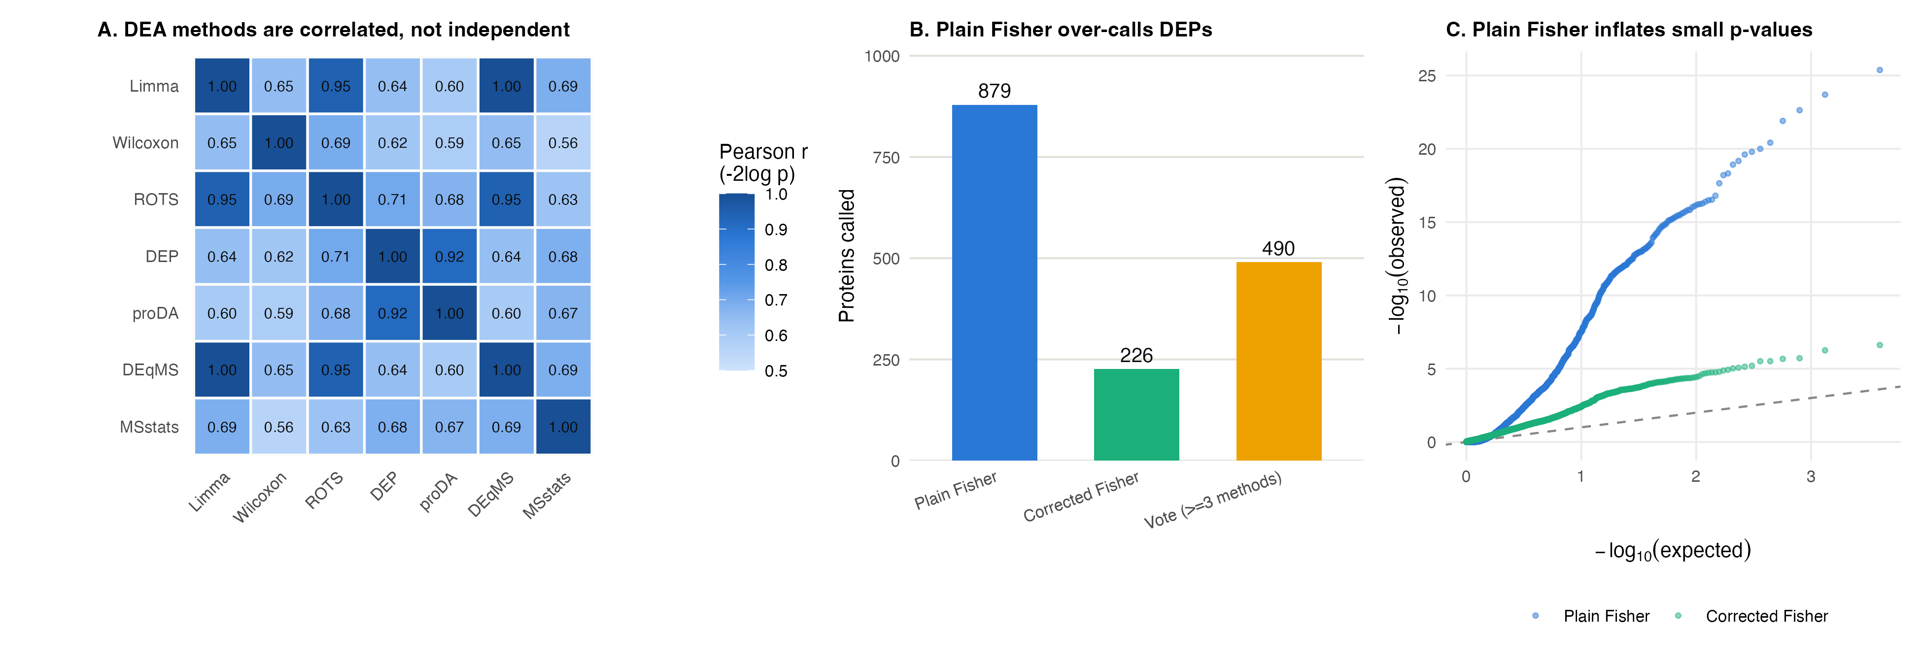
PROXLABTOOLKIT
METHODS SUMMARY · AUG 2026
4
PRELIMINARY RESULTS — FIGURE 2
Figure 2. Consensus validation. (A) Pairwise correlation among the seven methods' −2log(p) statistics — Limma/ROTS/DEqMS share r = 0.95–1.00. (B) DEPs called under three combination strategies. (C) QQ plot: plain Fisher sits well above the null diagonal; the corrected version tracks it closely.

Slide 7
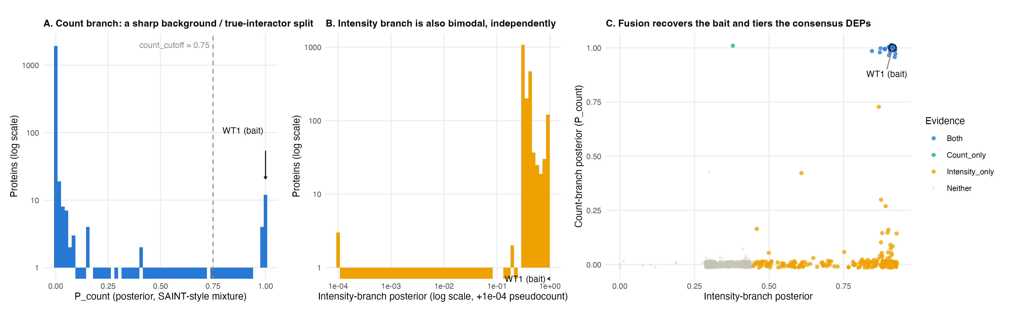
PROXLABTOOLKIT
METHODS SUMMARY · AUG 2026
4
PRELIMINARY RESULTS — FIGURE 3
Figure 3. Dual-branch fusion. (A–B) Each branch is independently bimodal — a clean background / true-interactor split. (C) Each point is one protein, colored by which branch(es) called it; WT1, the bait itself, lands at the top-right corner (both posteriors ≈ 1) — the pipeline recovers its own bait as the top hit without being told to.
Imputation spot-check: ABRAXAS2 ≈ 22, AGO3 ≈ 22 — known-MNAR proteins impute near the population floor.

Slide 8
PROXLABTOOLKIT
METHODS SUMMARY · AUG 2026
5
STATUS & NEXT STEPS
The toolkit is plain sourced R (no package install) and reproduces the already-validated manual R467W-vs-Mock run end to end.
Entry point | Produces
run_pl_dea() | Intensity branch only — 7-method ensemble, consensus scoring, *_DEPs.csv.
run_pl_interactome() | Adds the count branch and fusion — *_FusedInteractomeScore.csv and a confidence-tiered *_DEPs.csv.
Limitations
• Not yet ported: the volcano / heatmap / GO-enrichment figure generation from the original per-comparison Rmds.
• Contaminant filtering ships with a small placeholder list (keratins, trypsin, albumin); a real CRAPome export should replace it before production calls.

Slide 9
PROXLABTOOLKIT
METHODS SUMMARY · AUG 2026
A
APPENDIX — CONSENSUS STATISTICS, IN FORMULA
Plain Fisher combination
χ² = −2 Σ ln(pᵢ), df = 2k (k = number of methods testing this protein)
Assumes the k p-values are independent. Six of seven methods here share one imputed matrix, so they are positively correlated — the null distribution above is too optimistic, and p-values come out too small.
Correlation-corrected Fisher (Kost & McDermott, 2002)
r̄ = mean pairwise correlation of each method's −2ln(p) across all proteins
c = Var(χ²) / (2 E[χ²]), f = 2 E[χ²]² / Var(χ²), where Var(χ²) = 4k + 2·C(k,2)·cov(r̄)
corrected p = P( χ²_f > χ²_observed / c )
The observed statistic is rescaled by its own inflated variance before its p-value is read off a chi-square with fewer effective degrees of freedom — shrinking it back toward what k truly-independent tests would have produced.
Vote counting (independence-free check)
hitᵢ = 1[ pᵢ ≤ 0.05 AND |log₂FCᵢ| > 0.25 ], n_methods_hit = Σᵢ hitᵢ
Final call requires all three, jointly: corrected p ≤ 0.05 AND |max log₂FC| > 0.25 AND n_methods_hit ≥ 3.

Slide 10
PROXLABTOOLKIT
METHODS SUMMARY · AUG 2026
A
APPENDIX — MISSING DATA & ORTHOGONAL EVIDENCE, IN FORMULA
Missing data — MAR vs. MNAR classification
protein is MNAR ⇔ ∃ condition group g : all replicates in g are NA
MAR values (scattered dropout) → k-nearest-neighbors imputation.
MNAR values (whole group absent) → imputeLCMD MinProb: draws from the left tail of the protein's own intensity distribution (quantile q = 0.01), on the full matrix at correct orientation.
Count branch — SAINT-style two-component mixture
bait_sumᵢ ~ π · NB(μ = expectedᵢ · FC₁, φ₁) + (1−π) · NB(μ = expectedᵢ, φ₀)
P_countᵢ = Pr( protein i is the “true interactor” component | bait_sumᵢ )
π, FC₁, φ₀, φ₁ are fit jointly across all proteins by EM — a “background” component (FC fixed at 1) and a “true-interactor” component (FC₁ > 1, shared, EM-estimated), each with its own dispersion.
Fusion — naive-Bayes posterior combination
odds(p) = p / (1−p)
fused_odds = odds(P_count) × odds(P_intensity) Fused_Score = fused_odds / (1 + fused_odds)
Multiplying odds is the naive-Bayes combination rule: valid evidence-pooling if the two branches are independent given true-interactor status — reasonable here, since count and MaxLFQ intensity are different measurements of the same peptides.

