Slide 1
Mass Shootings in America
A look at mass shootings using D3 and leaflet

Slide 2
Agenda
What is considered a Mass Shooting?
Back End Development
Front End Development
Appendix

Slide 3
Mass Shootings

Slide 4
How do you define a mass shooting?
Four or more shot and/or killed in an single event (incident) at the same general time and location not including the shooter
Gun Violence describes the results of all incidents of death or injury or threat with firearms without pejorative judgment within the definition. Violence is defined without intent or consequence as a consideration. To that end a shooting of a victim by a subject/suspect is considered gun violence as is a defensive use or an officer involved shooting. The act itself, no matter the reason is violent in nature.

Slide 5
Back End Development

Slide 6
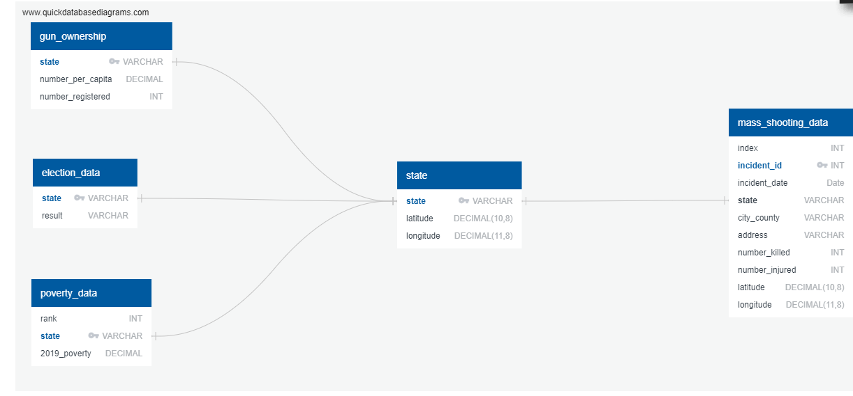
CSV to Sqlite
Cleaned CSV data was converted to sqlite db using sqlalchemy
Five classes were defined and added to a main “shootings.sqlite” database

Slide 7
Flask App Routes
Flask was used to tie together sqlite data and html rendering
Each Flask route returned a jsonfied dictionary of applicable data
Six flask routes were used to import data from the sqlite db:
Home (“/”)
Mass Shooting Data: (“/msa”)
Gun Ownership per State (per capita): (“/guns”)
State Poverty Rate: (“/poverty”)
Election Results: (“/election”)
State Coordinates: (“/state”)

Slide 8
Front End Development

Slide 9
Web Development
HTML/CSS
JavaScript
D3
Plotly
Leaflet
Geojson
*Show Webpage

Slide 10
Questions?

Slide 11
Appendix

Slide 12
Sources
Web Scrape used to gather gun violence data from 2016 - 2021
Gun ownership (2017 per capita) data from Kaggle
Poverty Data
Election Results Data

