Slide 1
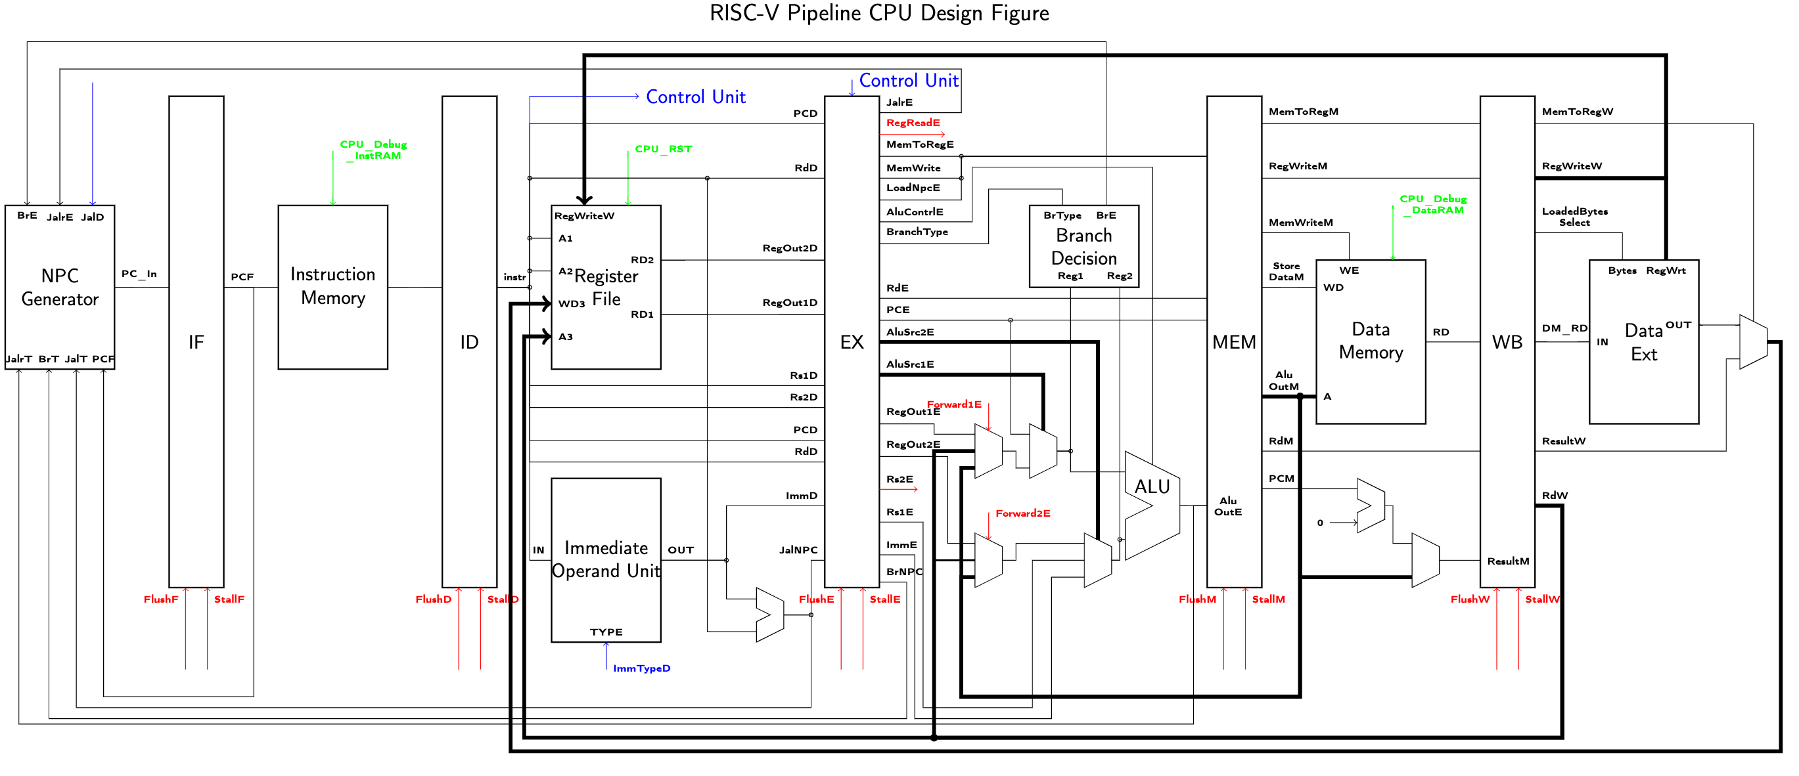
CSR
Register
File
Extend
CRegOutE
CRegOutM
CRegOutW
csr (instr[31:20])
CSRRead
CSRegWriteE
CSRegWriteM
CSRegWriteW
CSRWrite
CSRdD
CSRdE
CSRdM

