Slide 1
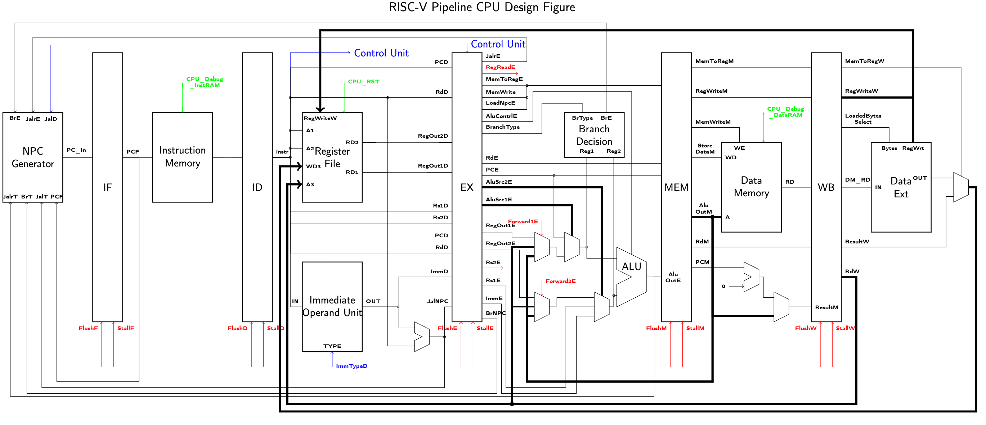
csr (instr[31:20])
CSR
Register
File
CRegOutD
CRegOutE
CRegOutM
CRegOutW
CSRegWriteE
CSRegWriteM
CSRegWriteW
CSRdD
CSRdE
CSRdM

