Slide 1

Core Decomposition
2022.9
Notes:
Font
Bree Serif = http://www.fontsquirrel.com/fonts/bree-serif?q%5Bterm%5D=bree+serif&q%5Bsearch_check%5D=Y
Montserrat = http://www.fontsquirrel.com/fonts/montserrat?q%5Bterm%5D=Montserrat&q%5Bsearch_check%5D=Y
Hand Shake Icon = http://thenounproject.com/term/hand-shake/60140/
Once you insert the picture, make sure you send the picture to the back by click on Arrange button on the menu bar > send to the back

Slide 2
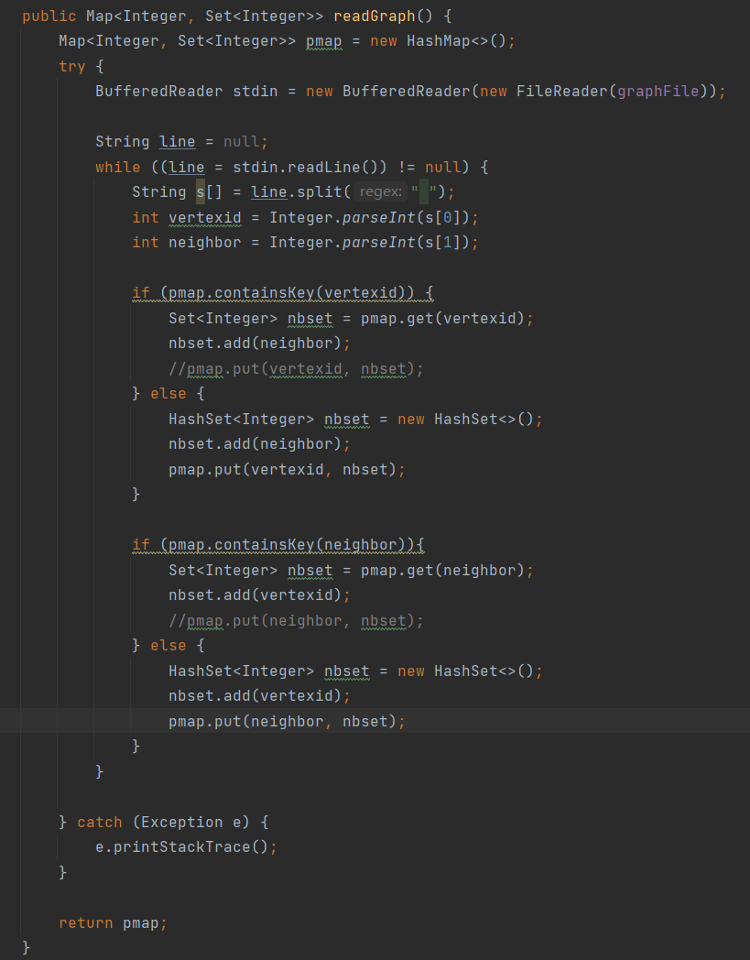
DataReader
图类型：无向图
图数据结构：Map<Integer, Set<Integer>>

Slide 3
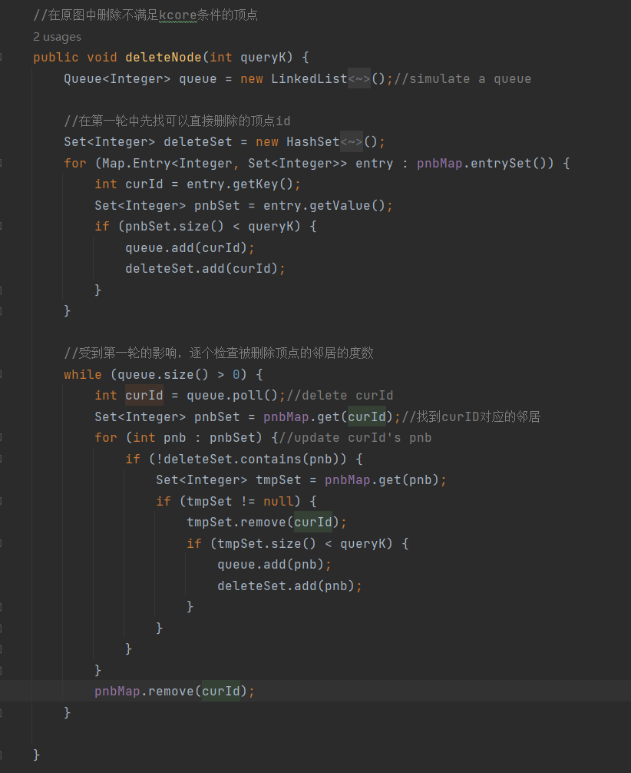
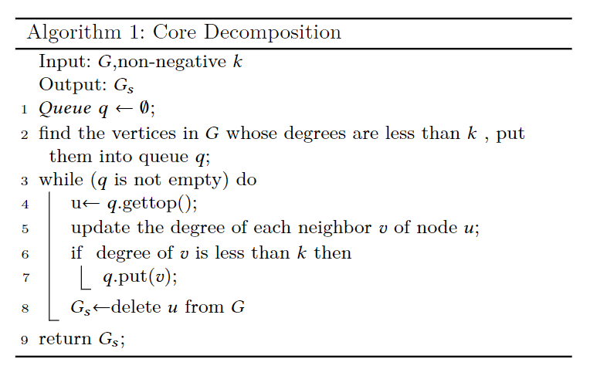
Core Decomposition
curid
a
b
a
curid
c

Slide 4
没有deleteset保护的情况
1
3
4
2

Slide 5
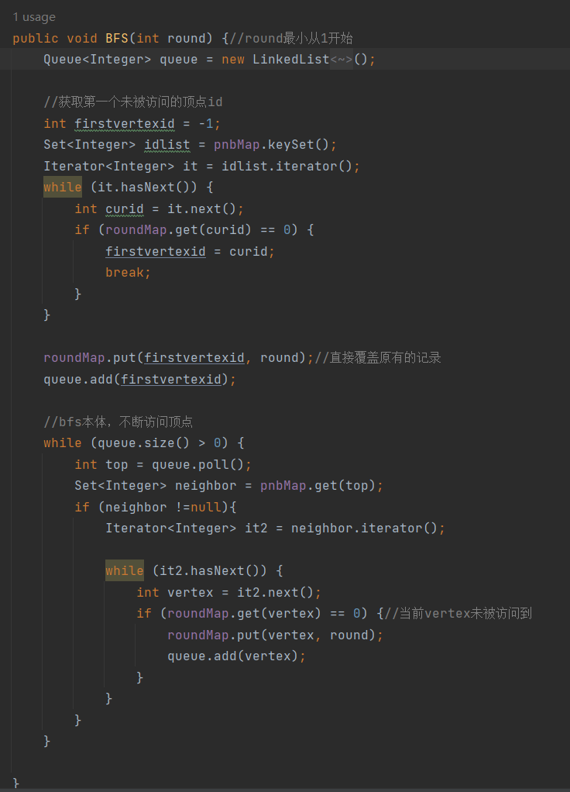
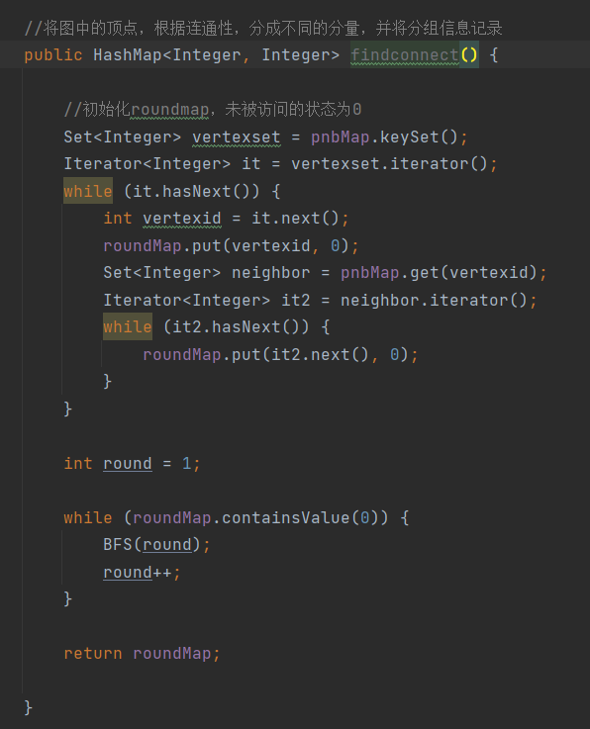
Find connected component

