Slide 1
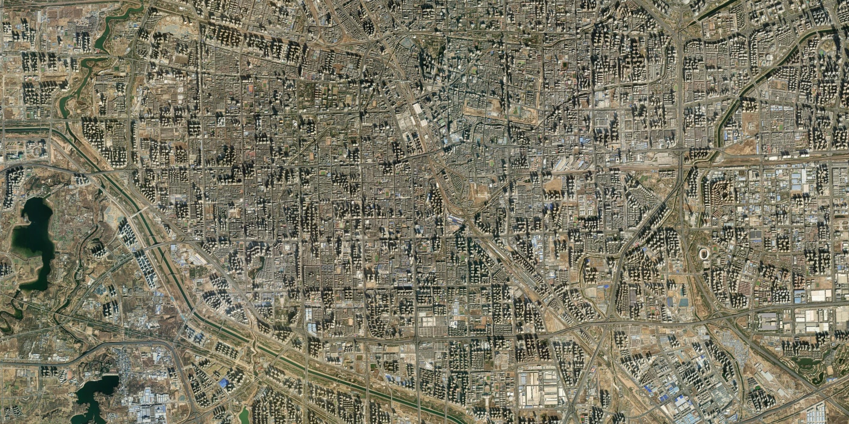
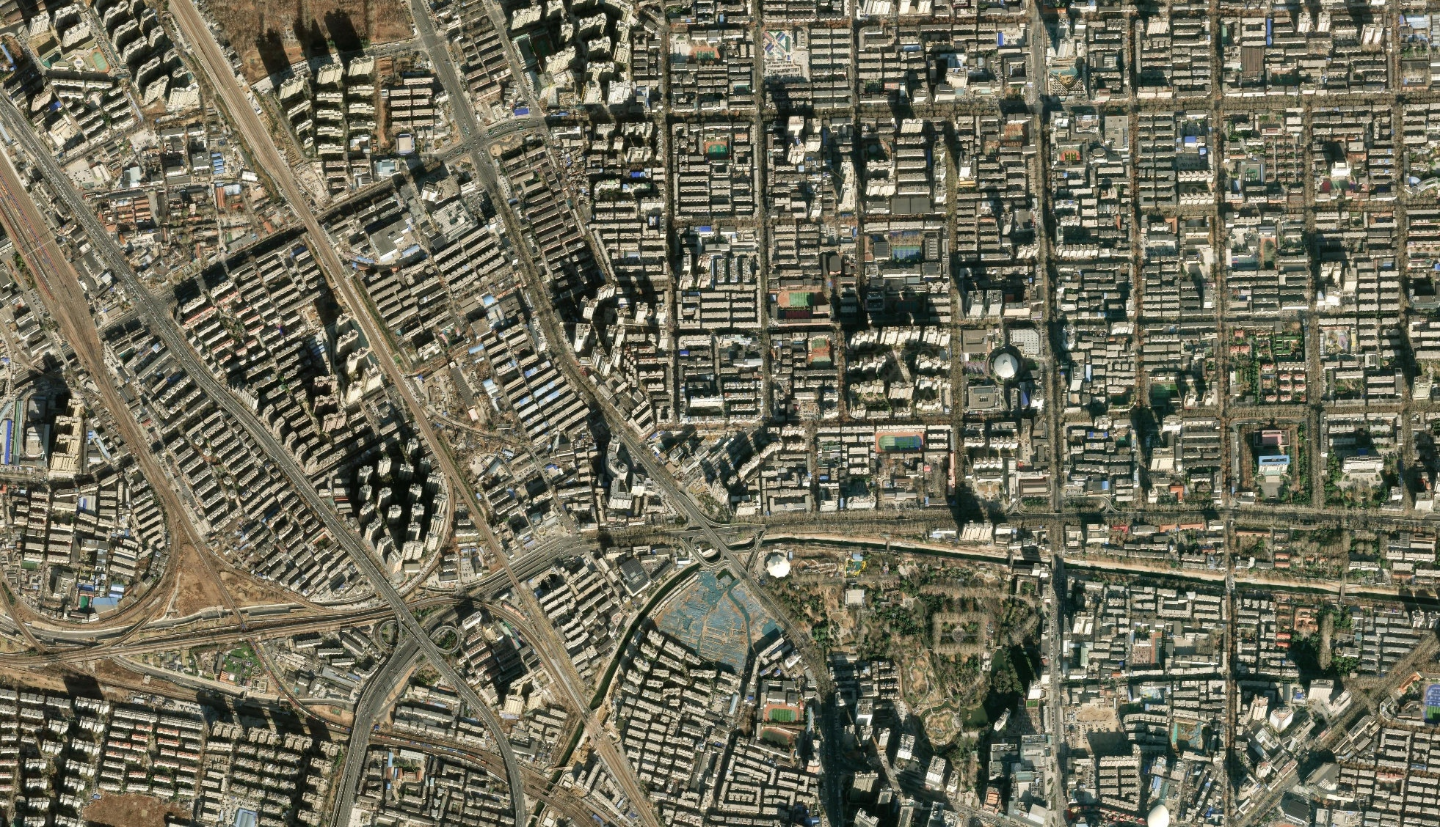
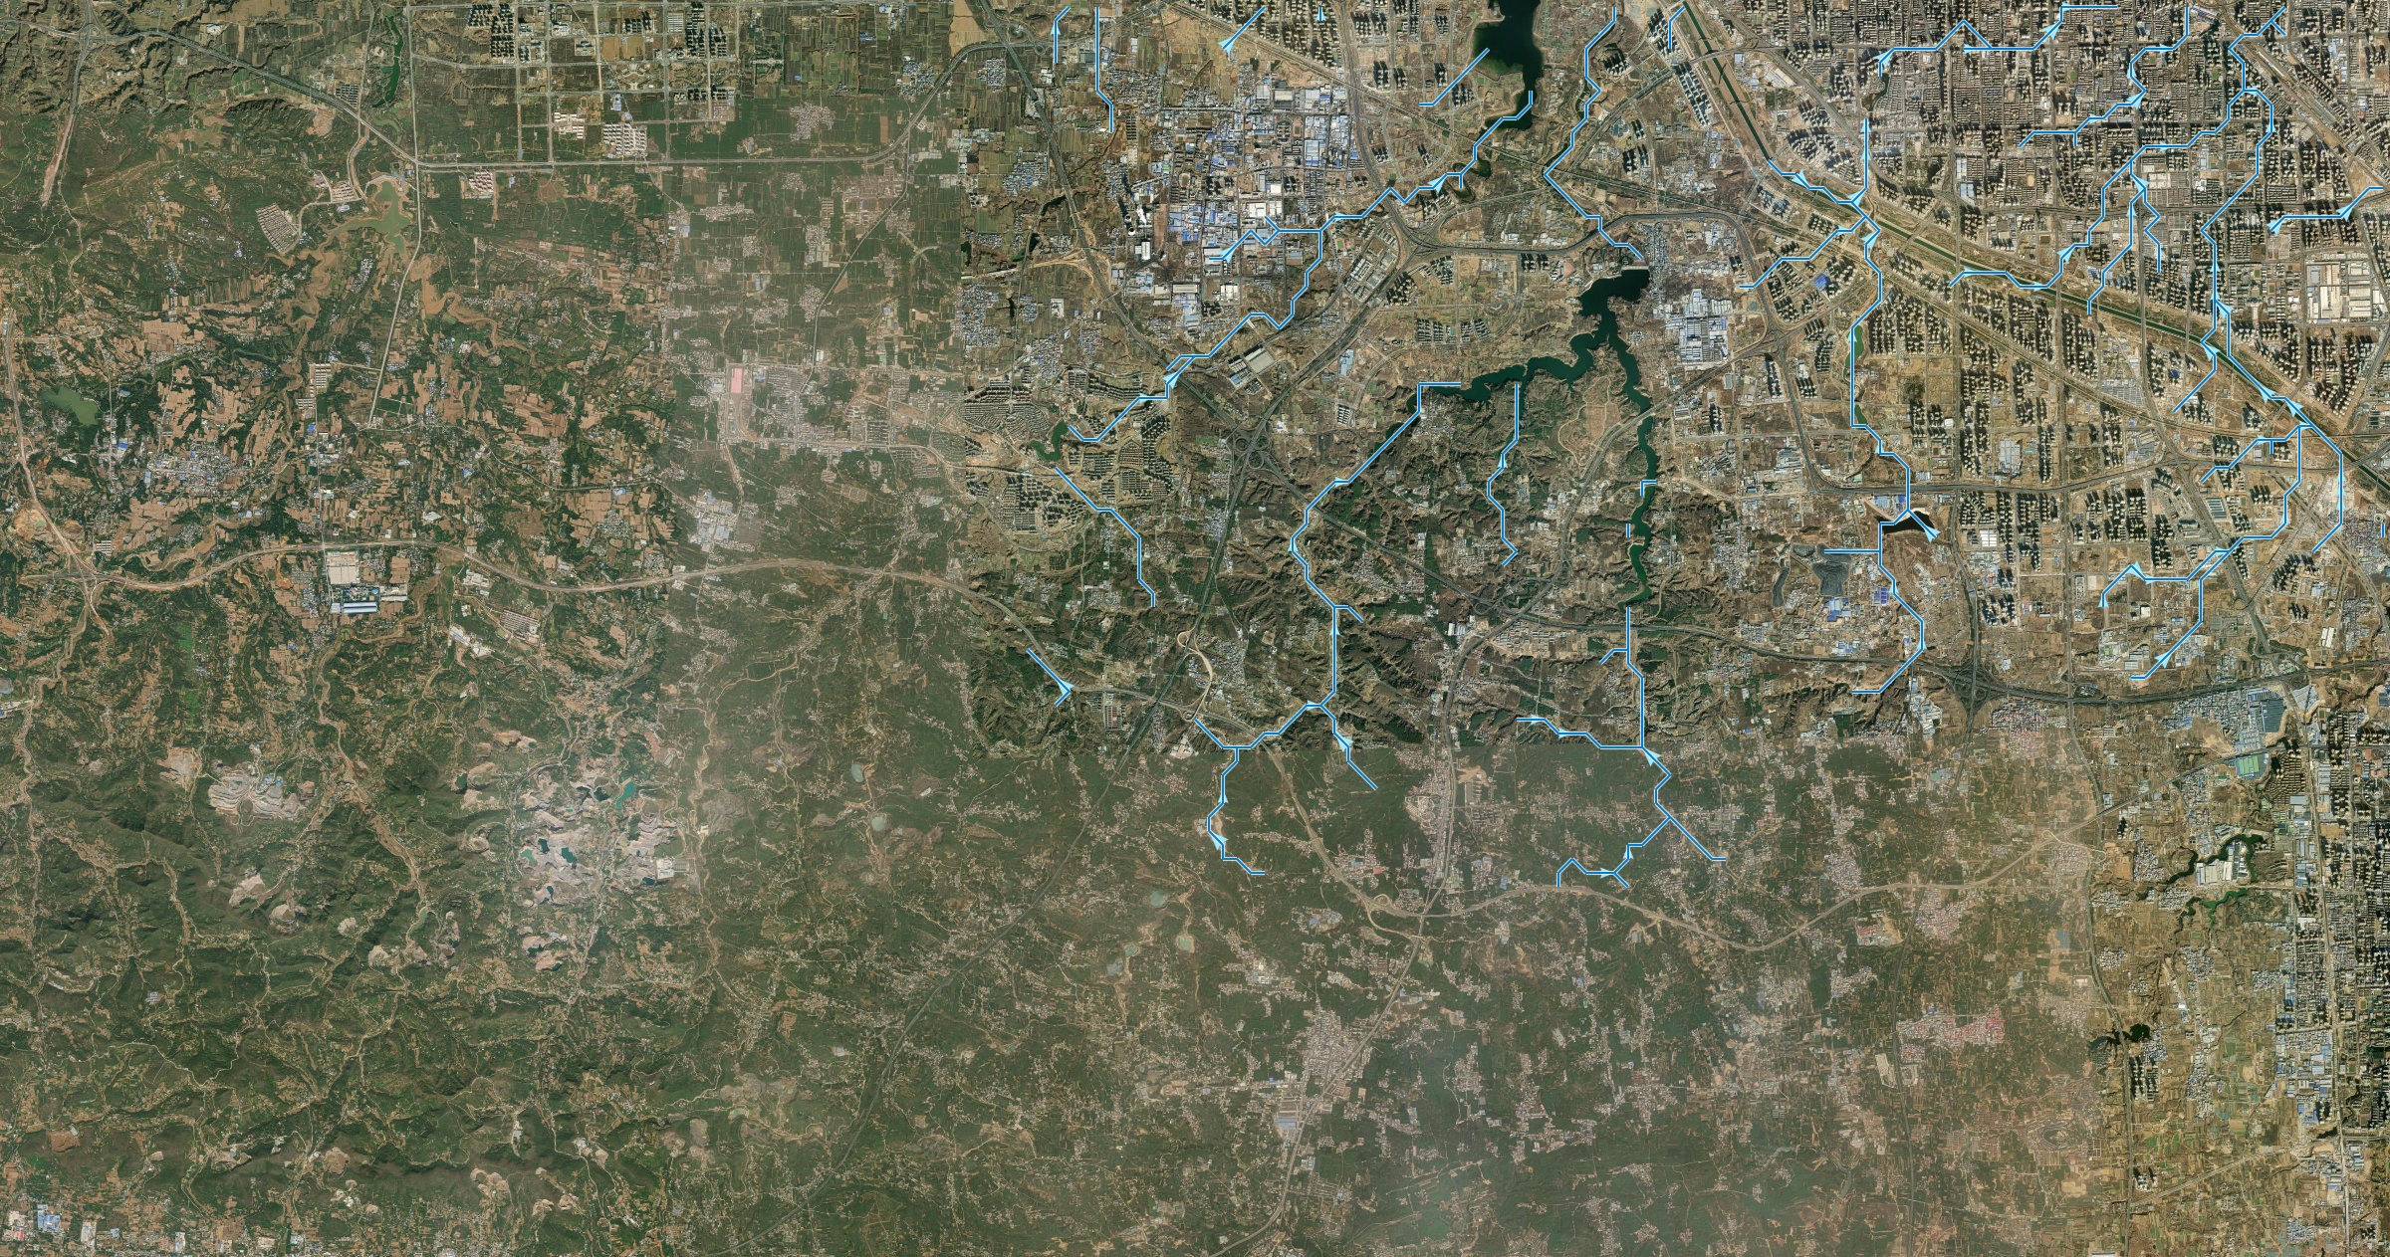
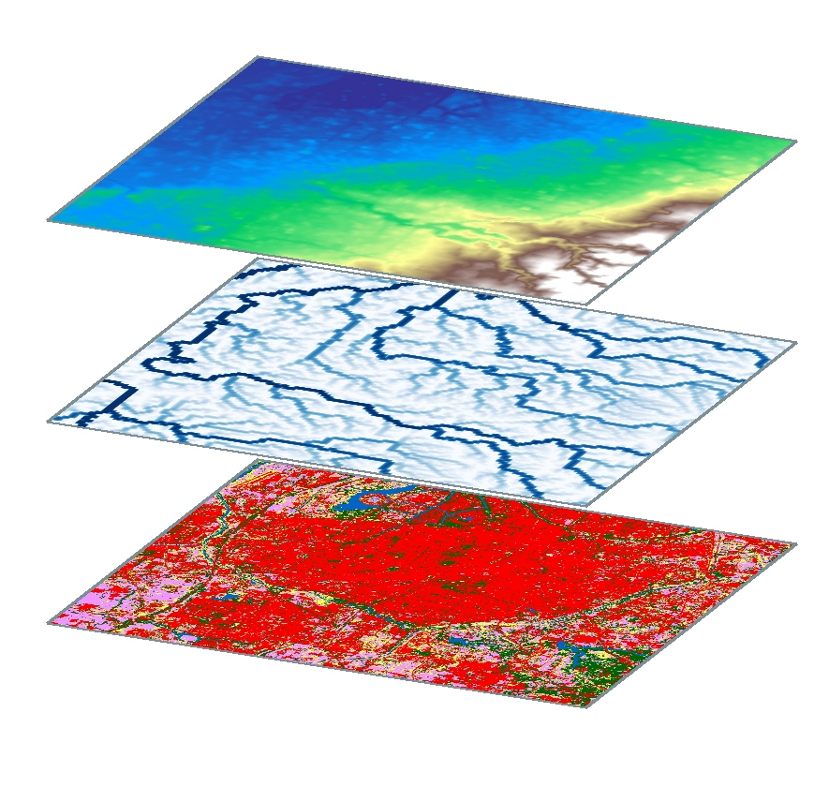
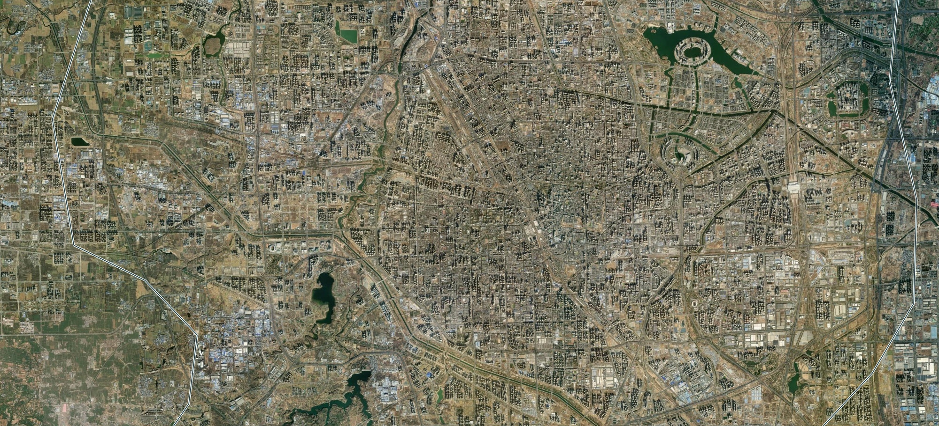
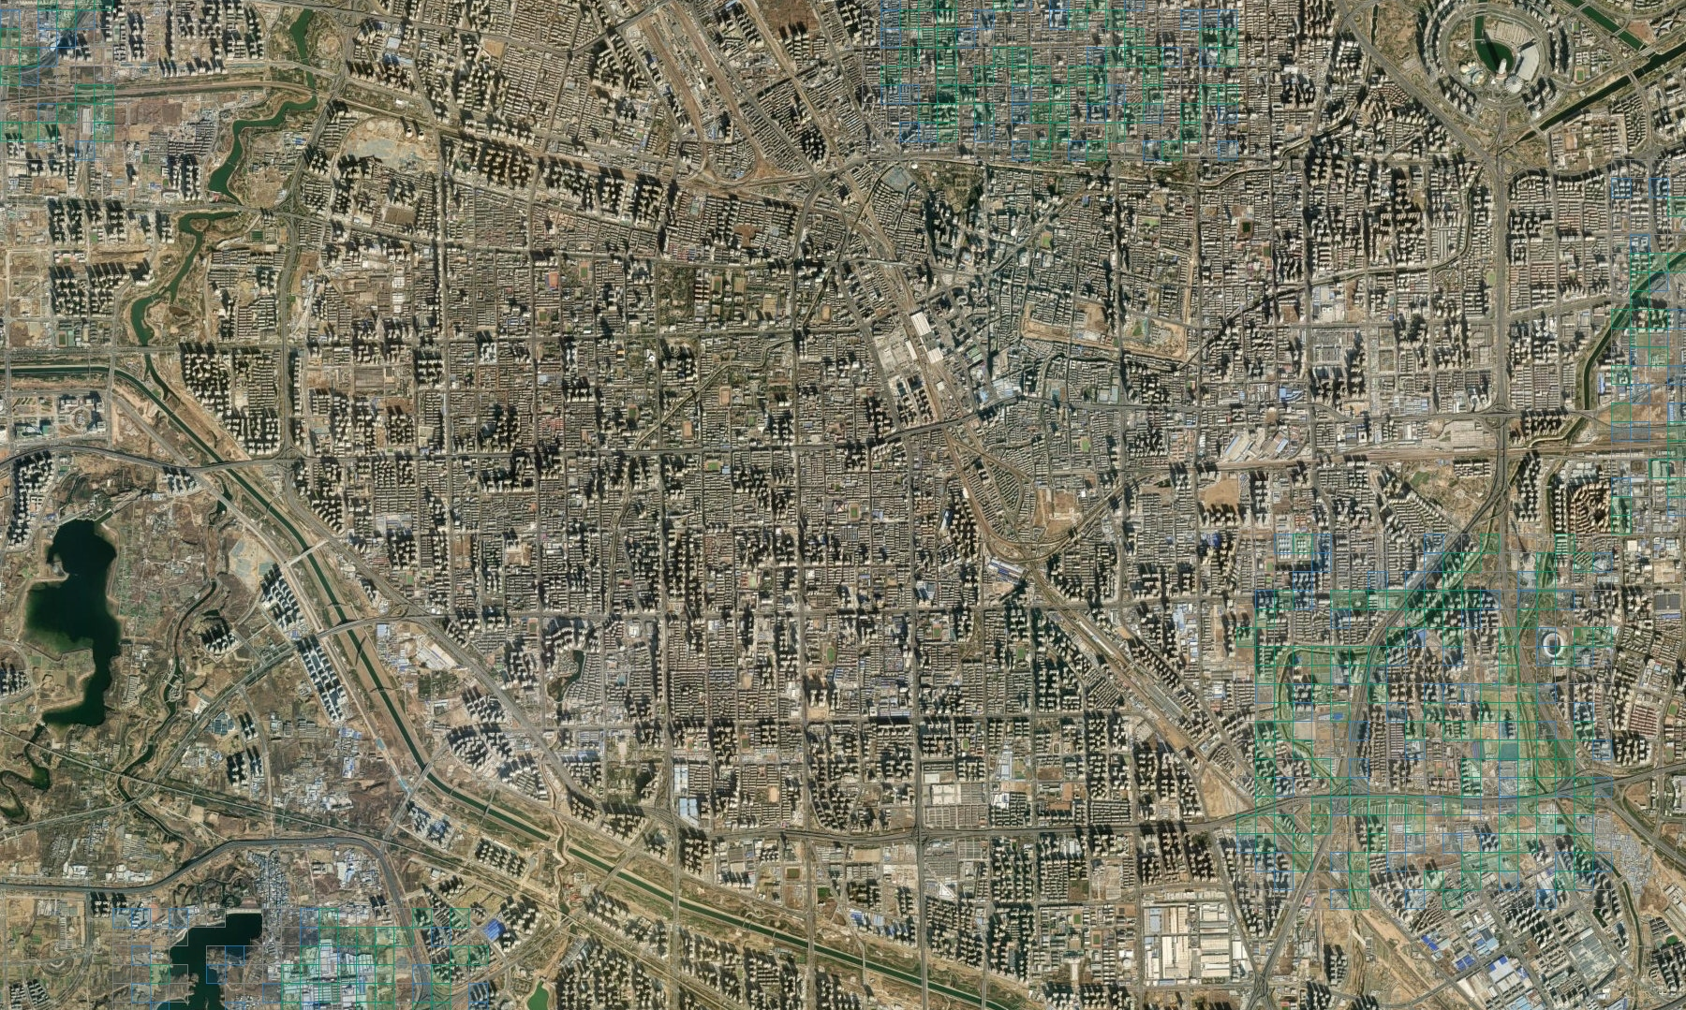
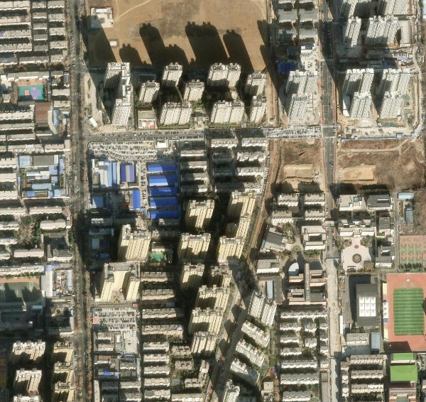
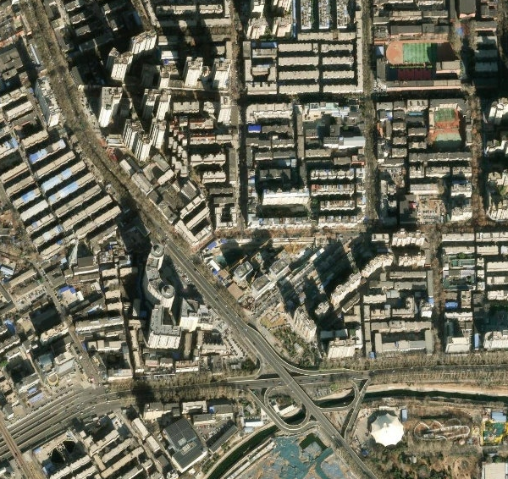
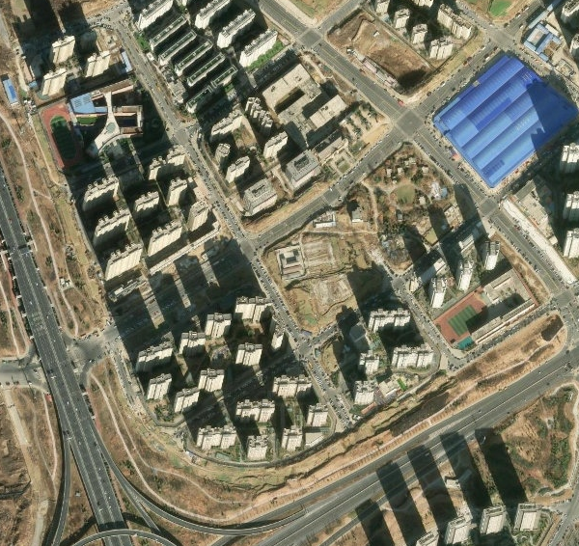
1
Establish matched
comparisons
Own attributes (no graph)
Ordinary adjacency (undirected)
Domain-informed graph (D8, terrain flow)
Zhengzhou
Zhengzhou · 200 m grid
Southwestern Zhengzhou
D8
Beyond own attributes
and ordinary adjacency?
200 m
grid
0
N
N
N
5 km
0
1 km
0
5 km
Each location uses only its own attributes
Information from local neighbouring locations
Upstream-to-downstream information from terrain flow
2
Examine information
conditions
Attribute availability
Training-positive budget
Predictor and receptive field
Topographic attributes
Zhengzhou
Fixed propagation
GraphSAGE
(one step + FFN)
(one or two layers)
Which information and
predictor conditions matter?
Hydrological attributes
Self
Self
Land use attributes
1-hop
1-hop
Socio-environmental attributes
N
Illustrative training positives
2-hop
18 / 16 / 14 attributes
0
10 km
100 or all available
Attribute × budget series: Zhengzhou, two-layer GraphSAGE
3
Locate gains
and losses
Upstream-support groups on a terrain surface
Group contributions to the overall AP change
Background-relative rank change
Zhengzhou
No upstream
One hop only
Two or more hops
Recorded positives relative to the background
No upstream
Lower rank
Higher rank
Where do graph gains
and losses arise?
One hop only
Two or more hops
0
N
Held-out graph
(test fold 3)
200 m
200 m
200 m
Recorded flood cell
5 km
Group contributions sum to the total AP change
4
Assess stability
Evaluation metrics
Alternative evaluation settings
Sampled AP
Full-domain AP
Reweighted AP
Background weight
Inspection capacity
(three fixed 1:10 samples)
(all eligible test cells)
(same cells and scores)
Do judgments persist
across evaluation choices?
Recorded positive
w = 1
w = 10M/|B|
Unlabelled background
Unit weight or reweighted
unlabelled background
Top-scoring 10% per test fold
Sample background
Retain all background
Change background weight
Same fitted predictions
Recall of recorded positives
Notes:
Figure 2. Four diagnostic dimensions. Real Zhengzhou geography edition, 2026-10-30. The reference composition and editable text are retained, with white left columns and short questions. No AI-generated or AI-enhanced map imagery is embedded.
Content follows paper.pdf Methods 3.1–3.5 and supplementary.pdf S2. Own-attribute, ordinary eight-neighbour and D8 graph references are compared under matched predictors. D8 denotes upstream-to-downstream terrain-based information. Attribute-budget experiments use 18, 16 and 14 attributes, and 100 versus all training positives, specifically in Zhengzhou two-layer GraphSAGE. The 16-attribute set removes log flow accumulation and topographic wetness index; the 14-attribute set additionally removes relative elevation and local relief. Fixed propagation is one step followed by an FFN, not a one-layer graph neural network; GraphSAGE uses one or two layers. The receptive-field panels are illustrative incoming-neighbour supports rather than isotropic spatial footprints.
Structural groups are defined on the held-out graph: no incoming edge; one-hop support without a two-hop path; and a path of two or more hops. AP contributions allocate the paired full-domain AP difference and sum to that difference. Mean background-relative rank changes concern recorded flood cells relative to the unlabelled background, are not additive, and are not edge-specific causal effects.
Evaluation uses the same fitted scores without refitting or selection: sampled AP averages three fixed samples with ten background cells per recorded positive; full-domain AP uses all eligible test candidates and background weight 1; reweighted full-domain AP keeps those cells and scores with w=10M/|B|, where M is the number of test recorded positives and B the unlabelled background. It does not correct spatial reporting bias. The per-fold inspection criterion is recorded-positive recall among the highest-scoring 10% of test cells. Candidate squares and the rank-change illustration show methods, not measured results.
GEOGRAPHIC SOURCES AND INTERPRETATION
{
"crs": "EPSG:32649",
"imagery_credits": "Esri, Vantor, Earthstar Geographics, and the GIS User Community",
"retrieval_date": "2026-10-30",
"source_note": "All maps use actual geographic imagery or project rasters; no AI generation, no label or prediction records accessed. Imagery acquisition dates unspecified. D8 derives from project terrain, not imagery interpretation."
}
Imagery service: https://server.arcgisonline.com/ArcGIS/rest/services/World_Imagery/MapServer . Credits: Esri, Vantor, Earthstar Geographics, and the GIS User Community. Retrieval date 2026-10-30. Imagery acquisition dates unspecified; these are geographic backdrops, not imagery of a specific flood event.
Copernicus DEM GLO-30 2024_1 DOI: 10.5270/ESA-c5d3d65. D8 directions and support examples are computed on the project depression-filled 200 m grid. High output image dimensions do not imply a finer terrain resolution. ESA WorldCover 2021 v200 provides the land-cover layer.
All support groups use the complete G2 held-out test graph, outer fold 3, before display cropping. Cells outside that test partition are uncolored. Selected local examples are structural cells, not asserted recorded flood positives. The red training dots are schematic positions and are explicitly labeled illustrative; no observed flood-label coordinates or predictions were read or exported.
Native overlays: the adjacency panel shows true 200 m cells around a selected Zhengzhou grid center; its eight surrounding cells illustrate ordinary adjacency. Local support panels show true 200 m cells and true source-to-target D8 edges. The overview callout locations match those examples.
Map extents in EPSG:32649:
urban: {"path": "D:\\CEUS\\outputs\\figure2_real_hd_20261030\\.build\\assets\\urban.jpg", "bbox": [733000, 3841000, 753000, 3851000], "width": 2000, "height": 1000, "source_url": "https://server.arcgisonline.com/ArcGIS/rest/services/World_Imagery/MapServer/export?bbox=733000%2C3841000%2C753000%2C3851000&bboxSR=32649&imageSR=32649&size=2000%2C1000&format=jpg&f=image", "place": "Zhengzhou, China", "crs": "EPSG:32649", "scale_m_per_pixel": 10.0}
training_base: {"path": "D:\\CEUS\\outputs\\figure2_real_hd_20261030\\.build\\assets\\training_base.jpg", "bbox": [720000, 3832000, 760000, 3872000], "width": 2000, "height": 2000, "source_url": "https://server.arcgisonline.com/ArcGIS/rest/services/World_Imagery/MapServer/export?bbox=720000%2C3832000%2C760000%2C3872000&bboxSR=32649&imageSR=32649&size=2000%2C2000&format=jpg&f=image", "place": "Zhengzhou, China", "crs": "EPSG:32649", "scale_m_per_pixel": 20.0}
support_base: {"path": "D:\\CEUS\\outputs\\figure2_real_hd_20261030\\.build\\assets\\support_base.jpg", "bbox": [733000, 3840000, 751000, 3858000], "width": 1800, "height": 1800, "source_url": "https://server.arcgisonline.com/ArcGIS/rest/services/World_Imagery/MapServer/export?bbox=733000%2C3840000%2C751000%2C3858000&bboxSR=32649&imageSR=32649&size=1800%2C1800&format=jpg&f=image", "place": "Zhengzhou, China", "crs": "EPSG:32649", "scale_m_per_pixel": 10.0}
group_none: {"path": "D:\\CEUS\\outputs\\figure2_real_hd_20261030\\.build\\assets\\group_none.jpg", "bbox": [745300.0, 3845100.0, 747300.0, 3847100.0], "width": 1200, "height": 1200, "source_url": "https://server.arcgisonline.com/ArcGIS/rest/services/World_Imagery/MapServer/export?bbox=745300.0%2C3845100.0%2C747300.0%2C3847100.0&bboxSR=32649&imageSR=32649&size=1200%2C1200&format=jpg&f=image", "place": "Zhengzhou, China", "crs": "EPSG:32649", "scale_m_per_pixel": 1.6666666666666667, "focus": {"id": "zhengzhou-r000120-c000120", "xy": [746300.0, 3846100.0], "uv": [0.5, 0.5], "bbox_uv": [0.45, 0.45, 0.1, 0.1]}, "support_class": 0, "graph": "G2 held-out test fold 3", "note": "Support computed on complete test graph before cropping. Focus is an illustrative structural cell, not asserted flood record."}
group_one: {"path": "D:\\CEUS\\outputs\\figure2_real_hd_20261030\\.build\\assets\\group_one.jpg", "bbox": [741700.0, 3849500.0, 743700.0, 3851500.0], "width": 1200, "height": 1200, "source_url": "https://server.arcgisonline.com/ArcGIS/rest/services/World_Imagery/MapServer/export?bbox=741700.0%2C3849500.0%2C743700.0%2C3851500.0&bboxSR=32649&imageSR=32649&size=1200%2C1200&format=jpg&f=image", "place": "Zhengzhou, China", "crs": "EPSG:32649", "scale_m_per_pixel": 1.6666666666666667, "focus": {"id": "zhengzhou-r000098-c000102", "xy": [742700.0, 3850500.0], "uv": [0.5, 0.5], "bbox_uv": [0.45, 0.45, 0.1, 0.1]}, "support_class": 1, "graph": "G2 held-out test fold 3", "note": "Support computed on complete test graph before cropping. Focus is an illustrative structural cell, not asserted flood record."}
group_multi: {"path": "D:\\CEUS\\outputs\\figure2_real_hd_20261030\\.build\\assets\\group_multi.jpg", "bbox": [737100.0, 3840700.0, 739100.0, 3842700.0], "width": 1200, "height": 1200, "source_url": "https://server.arcgisonline.com/ArcGIS/rest/services/World_Imagery/MapServer/export?bbox=737100.0%2C3840700.0%2C739100.0%2C3842700.0&bboxSR=32649&imageSR=32649&size=1200%2C1200&format=jpg&f=image", "place": "Zhengzhou, China", "crs": "EPSG:32649", "scale_m_per_pixel": 1.6666666666666667, "focus": {"id": "zhengzhou-r000142-c000079", "xy": [738100.0, 3841700.0], "uv": [0.5, 0.5], "bbox_uv": [0.45, 0.45, 0.1, 0.1]}, "support_class": 2, "graph": "G2 held-out test fold 3", "note": "Support computed on complete test graph before cropping. Focus is an illustrative structural cell, not asserted flood record."}
training: {"path": "D:\\CEUS\\outputs\\figure2_real_hd_20261030\\.build\\assets\\training.jpg", "bbox": [720000, 3832000, 760000, 3872000], "width": 2000, "height": 2000, "crs": "EPSG:32649", "place": "Zhengzhou, China", "scale_m_per_pixel": 20.0, "source": "Esri World Imagery + project admin_aoi.parquet", "outline": "Zhengzhou administrative AOI, not inferred flood extent"}
support: {"path": "D:\\CEUS\\outputs\\figure2_real_hd_20261030\\.build\\assets\\support.jpg", "bbox": [733000, 3840000, 751000, 3858000], "width": 1800, "height": 1800, "crs": "EPSG:32649", "place": "Zhengzhou, China", "scale_m_per_pixel": 10.0, "source": "Esri imagery + held-out fold 3 G2 test edges", "flow_accumulation_threshold_cells": 10}
terrain: {"path": "D:\\CEUS\\outputs\\figure2_real_hd_20261030\\.build\\assets\\terrain.jpg", "bbox": [712200, 3828000, 746400, 3846000], "width": 1900, "height": 1000, "crs": "EPSG:32649", "place": "Zhengzhou, China", "scale_m_per_pixel": 18.0, "source": "Copernicus DEM GLO-30 2024_1, project depression-filled 200 m DSM; actual project D8 edges", "elevation_range_m": [104.61357503845458, 585.4616631692919], "flow_accumulation_threshold_cells": 40, "terrain_note": "Western and southwestern Zhengzhou; hillshade is scientific rendering, not RGB imagery. Native terrain resolution 200 m, rendered at high output resolution.", "colormap": "Custom land hypsometry, light green to brown/cream; no water color implied"}
layer_elevation: {"path": "D:\\CEUS\\outputs\\figure2_real_hd_20261030\\.build\\assets\\layer_elevation.jpg", "bbox": [728200, 3838000, 752200, 3862000], "width": 1000, "height": 1000, "crs": "EPSG:32649", "place": "Zhengzhou, China", "scale_m_per_pixel": 24.0, "source": "D:\\CEUS\\data\\interim\\zhengzhou\\filled_dsm_200m_float64.tif", "transform": "none", "native_resolution_m": 200}
layer_flow: {"path": "D:\\CEUS\\outputs\\figure2_real_hd_20261030\\.build\\assets\\layer_flow.jpg", "bbox": [728200, 3838000, 752200, 3862000], "width": 1000, "height": 1000, "crs": "EPSG:32649", "place": "Zhengzhou, China", "scale_m_per_pixel": 24.0, "source": "D:\\CEUS\\data\\interim\\zhengzhou\\flow_accumulation_200m_int64.tif", "transform": "log1p", "native_resolution_m": 200}
layer_landcover: {"path": "D:\\CEUS\\outputs\\figure2_real_hd_20261030\\.build\\assets\\layer_landcover.jpg", "bbox": [728200, 3838000, 752200, 3862000], "width": 1000, "height": 1000, "crs": "EPSG:32649", "place": "Zhengzhou, China", "scale_m_per_pixel": 24.0, "source": "D:\\CEUS\\data\\interim\\zhengzhou\\worldcover_10m.tif", "transform": "none", "native_resolution_m": 10}
terrain_satellite: {"path": "D:\\CEUS\\outputs\\figure2_real_hd_20261030\\.build\\assets\\terrain_satellite.jpg", "bbox": [712200, 3828000, 746400, 3846000], "width": 2400, "height": 1263, "crs": "EPSG:32649", "place": "Zhengzhou, China", "scale_m_per_pixel": 14.25, "source": "Esri World Imagery geographic backdrop; D8 flow routes from project depression-filled DSM at 200 m", "elevation_range_m": [104.61357503845458, 585.4616631692919], "flow_accumulation_threshold_cells": 40, "terrain_note": "Western and southwestern Zhengzhou; hillshade is scientific rendering, not RGB imagery. Native terrain resolution 200 m, rendered at high output resolution.", "colormap": "Custom land hypsometry, light green to brown/cream; no water color implied", "source_url": "https://server.arcgisonline.com/ArcGIS/rest/services/World_Imagery/MapServer/export?bbox=712200%2C3828000%2C746400%2C3846000&bboxSR=32649&imageSR=32649&size=2400%2C1263&format=jpg&f=image", "native_d8_resolution_m": 200, "imagery_note": "Actual satellite/aerial mosaic. Image acquisition date unspecified. No generated pixels or elevation color overlay.", "rendering": "Real D8 routes as blue linework with white halo, no text"}
support_groups: {"path": "D:\\CEUS\\outputs\\figure2_real_hd_20261030\\.build\\assets\\support_groups.jpg", "bbox": [733000, 3840000, 751000, 3858000], "width": 1800, "height": 1800, "source_url": "https://server.arcgisonline.com/ArcGIS/rest/services/World_Imagery/MapServer/export?bbox=733000%2C3840000%2C751000%2C3858000&bboxSR=32649&imageSR=32649&size=1800%2C1800&format=jpg&f=image", "place": "Zhengzhou, China", "crs": "EPSG:32649", "scale_m_per_pixel": 10.0, "source": "Esri World Imagery and complete held-out fold 3 G2 test graph", "class_colors": {"0": "#878787", "1": "#267DC0", "2": "#03966B"}, "visible_cell_counts": {"0": 881, "1": 257, "2": 440}, "native_grid_m": 200, "group_definition": "0 no incoming support; 1 incoming support without a two-hop path; 2 path of at least two hops. Computed on full test graph before crop.", "rendering": "Actual 200 m cell borders at 0.45pt, 15% fill opacity; no labels, no prediction results."}
adjacency_real: {"bbox": [740600, 3849400, 744600, 3851700], "width": 1962, "height": 1128, "place": "Zhengzhou, China", "source_url": "https://server.arcgisonline.com/ArcGIS/rest/services/World_Imagery/MapServer/export?bbox=740600%2C3849400%2C744600%2C3851700&bboxSR=32649&imageSR=32649&size=1962%2C1128&format=jpg&f=image", "crs": "EPSG:32649", "native_overlay_grid_m": 200, "focus_xy": [742700, 3850500]}
Updated figure caption (bottom summary banner removed at the user's request):
Figure 2. Four-dimensional diagnostic framework for evaluating domain-informed graphs in urban flood identification. (1) Matched comparisons assess terrain-derived D8 connections against own-attribute and ordinary eight-neighbour references within the same predictor family. (2) Information conditions comprise attribute availability, training-positive budget and predictor choice. Fixed propagation supplies a feed-forward network (FFN) with own attributes and one-step neighbourhood averages; GraphSAGE uses one or two layers. The 18-, 16- and 14-attribute sets and the 100-positive versus all-positive budgets refer to the Zhengzhou two-layer GraphSAGE series. (3) Structural diagnosis distinguishes no incoming support, one-hop support without a two-hop path, and support through a path of at least two hops in the held-out graph. Computed against the complete test ranking, group contributions sum to the full-domain average-precision (AP) difference. Group mean background-relative rank changes describe how recorded flood cells move relative to the unlabelled background and are not additive. (4) Evaluation diagnosis compares sampled, full-domain and reweighted AP, together with recorded-positive recall within the top-scoring 10% of each test fold, using the same fitted predictions without further fitting or selection. For reweighted AP, the background weight is w = 10M/|B|, where M is the number of recorded flood cells in the test fold and B is its unlabelled background. Geographic examples show Zhengzhou, with structural overlays based on the 200 m analysis grid. D8 arrows indicate terrain-derived information flow. Red training markers and evaluation symbols are schematic.
Imagery: Esri, Vantor, Earthstar Geographics, and the GIS User Community. Terrain: Copernicus DEM. Land cover: ESA WorldCover.

