Slide 1
Decision Tree and Random Forest
Tisana wanwarn

Slide 2
Content
1.Simple Decision Tree
2.Complex Decision Tree
3.Random Forest

Slide 3
1.Simple Decision Tree
Machine learning model that learn decision rules from training dataset and use these learned rules for prediction in test dataset
e.g. predicting the weather according to the temperature
Temperature
>30 ℃
<30 ℃
HOT
COLD

Slide 4
1.Simple Decision Tree
Decision rule can be learned by trying different split and select the best one (splitting criteria will be discuss soon!)
Can be classified based on 2 characteristics:
Type of input (independent variable x): continuous and categorical x
Type of output (dependent variable y): continuous and categorical y

Slide 5
Type of input (independent variable x)
Categorical x and Continuous x
Affect the process of splitting
Categorical x: split according to the category of input data such as hot and cold weather
Continuous x: split according to < and > sign such as temperature is more than 30 ℃ or less than 30 ℃

Slide 6
Type of output (dependent variable y)
CART (Classification And Regression Tree)
Classification Tree: categorical y
Regression Tree: continuous y
Affect the splitting criteria: the process of selecting the best split

Slide 7
Summary of all types of Decision Tree
Categorical input
Regression Tree
Continuous input
Decision Tree
Categorical input
Classification
Tree
Continuous input

Slide 8
How to determine the best split?

Slide 9
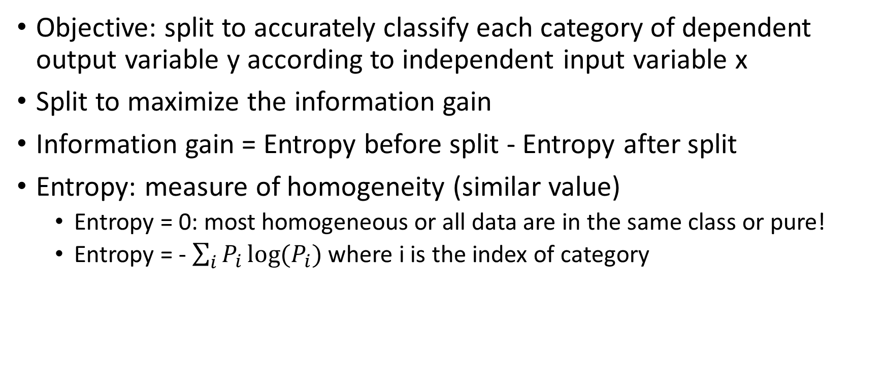
Classification Tree
Objective: split to accurately classify each category of dependent output variable y according to independent input variable x
Split to maximize the information gain
Information gain = Entropy before split - Entropy after split
Entropy: measure of homogeneity (similar value)
Entropy = 0: most homogeneous or all data are in the same class or pure!
Entropy = - $\sum_{i}{P_{i}\log{(P_{i})}}$ where i is the index of category

Slide 10
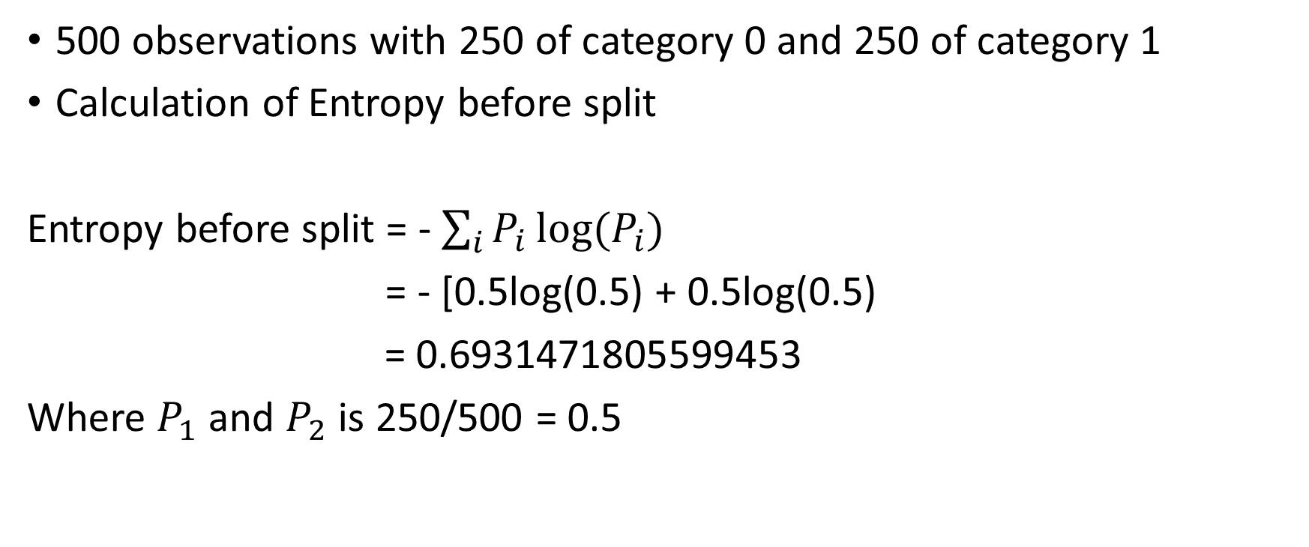
Classification Tree: Examples
500 observations with 250 of category 0 and 250 of category 1
Calculation of Entropy before split
Entropy before split = - $\sum_{i}{P_{i}\log{(P_{i})}}$
= - [0.5log(0.5) + 0.5log(0.5)
= 0.6931471805599453
Where $P_{1}$ and $P_{2}$is 250/500 = 0.5

Slide 11
Classification Tree: Examples
Consider BEST split scenario where
250 y=0
250 y=1
Entropy before split = 0.6931471805599453
BEST split
250 y=0
0 y=1
0 y=0
250 y=1
Information Gain = 0.6931471805599453
Y=0
Y=1
Entropy left branch = 0
Entropy right branch = 0

Slide 12
Classification Tree: Examples
Consider WORST split scenario where
250 y=0
250 y=1
Entropy before split = 0.6931471805599453
WORST split
125 y=0
125 y=1
125 y=0
125 y=1
Information Gain = 0.0
Y=0
Y=1
Entropy left branch = 0.6931471805599453
Entropy right branch = 0.6931471805599453

Slide 13
Classification Tree: Examples
Consider BEST split scenario where
250 y=0
250 y=1
Entropy before split = 0.6931471805599453
BEST split
0 y=0
250 y=1
250 y=0
0 y=1
Information Gain = 0.6931471805599453
250 y=0
250 y=1
Y=0
250 y=0
250 y=1
Y=1
Entropy left branch = 0
Entropy right branch = 0

Slide 14
Consider WORST split scenario where
250 y=0
250 y=1
WORST split
125 y=0
125 y=1
125 y=0
125 y=1
250 y=0
250 y=1
Y=0
250 y=0
250 y=1
Y=1

