Slide 1
Decision Tree and Random Forest
Tisana wanwarn

Slide 2
Content
Decision Tree
Types of input and output
Entropy and Information Gain
Simulation
Complex decision tree and example
Pseudocode
Random Forest
Ensemble learning
Bootstrapping
Bagging
Pseudocode

Slide 3
What is Decision Tree?

Slide 4
1.Decision Tree
Machine learning model that learn decision rules from training dataset and use these learned rules for prediction in test dataset
e.g. predicting the weather according to the temperature
Temperature
>30 ℃
<30 ℃
HOT
COLD

Slide 5
1.Decision Tree
Decision rule can be learned by trying different split and select the best one (splitting criteria will be discuss soon!)
Temperature
>30 ℃
<30 ℃
HOT
COLD

Slide 6
1.Decision Tree
Can be classified based on 2 characteristics:
Type of input (independent variable x): continuous and categorical x
Type of output (dependent variable y): continuous and categorical y

Slide 7
Type of input (independent variable x)
Categorical x and Continuous x

Slide 8
Type of input (independent variable x)
Categorical x: split according to the category of input data such as Yes or No
Exercise
YES
NO
Fit
Unfit

Slide 9
Type of input (independent variable x)
Continuous x: split according to < and > sign such as temperature is more than 30 ℃ or less than 30 ℃
Temperature
>30 ℃
<30 ℃
HOT
COLD

Slide 10
Type of input (independent variable x)
Temperature
Exercise
>30 ℃
<30 ℃
YES
NO
Continuous
Catergorical
HOT
COLD
Fit
Unfit

Slide 11
Type of output (dependent variable y)
CART (Classification And Regression Tree)
Affect the splitting criteria: the process of selecting the best split

Slide 12
Type of output (dependent variable y)
Classification Tree: categorical y
Exercise
YES
NO
Fit
Unfit

Slide 13



Type of output (dependent variable y)
Regression Tree: continuous y
$$X_{1}$$
$X_{1}$>3.3
$X_{1}$<=3.3
Y=4.34
Y=3.45

Slide 14
Summary of all types of Decision Tree
Categorical input
Regression Tree
Continuous input
Decision Tree
Categorical input
Classification
Tree
Continuous input

Slide 15
How to determine the best split?

Slide 16
Classification Tree
Objective: split to accurately classify each category of dependent output variable y according to independent input variable x

Slide 17
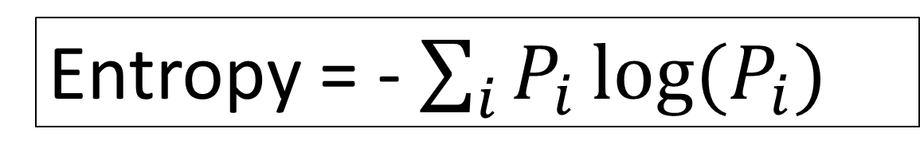
Classification Tree: Entropy
Entropy: measure of homogeneity (similar value)
Entropy = 0: most homogeneous or all data are in the same class or pure!
Entropy = - $\sum_{i}{P_{i}\log{(P_{i})}}$
where i is the index of category

Slide 18
Classification Tree: Information Gain
Split to maximize the information gain
Information gain = Entropy before split - Entropy after split

Slide 19
Lets do some simulation

Slide 20
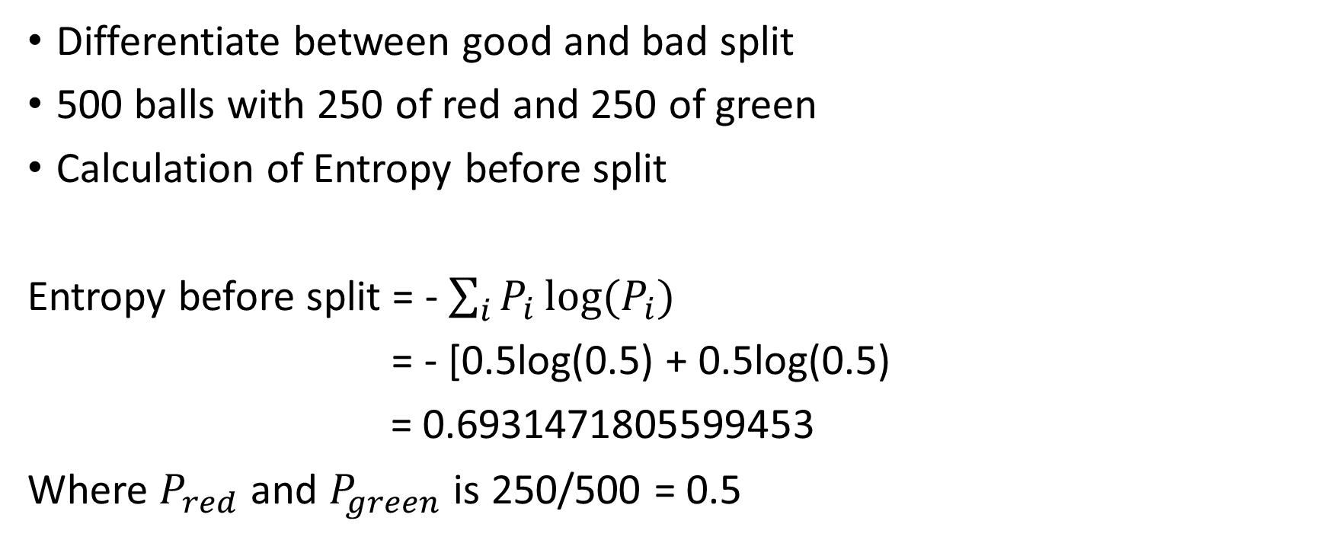
Classification Tree: Simulation
Differentiate between good and bad split
500 balls with 250 of red and 250 of green
Calculation of Entropy before split
Entropy before split = - $\sum_{i}{P_{i}\log{(P_{i})}}$
= - [0.5log(0.5) + 0.5log(0.5)
= 0.6931471805599453
Where $P_{red}$ and $P_{green}$is 250/500 = 0.5
250 red
250 green

Slide 21
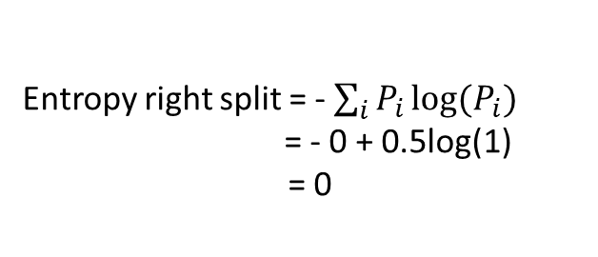
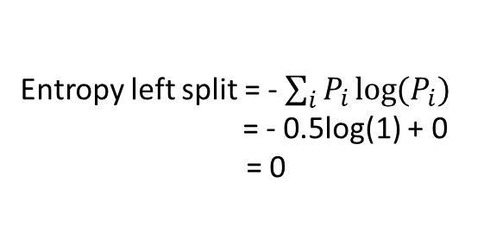
Classification Tree: Simulation
Consider BEST split scenario where
250 red
250 green
Entropy before split = 0.6931471805599453
BEST split
0 red
250 green
250 red
0 green
Information Gain = 0.6931471805599453
250 y=0
250 y=1
Y=0
250 y=0
250 y=1
Y=1
Entropy left split = - $\sum_{i}{P_{i}\log{(P_{i})}}$
= - 0.5log(1) + 0
= 0
Entropy right split = - $\sum_{i}{P_{i}\log{(P_{i})}}$
= - 0 + 0.5log(1) = 0
Entropy left branch = 0
Entropy right branch = 0

Slide 22
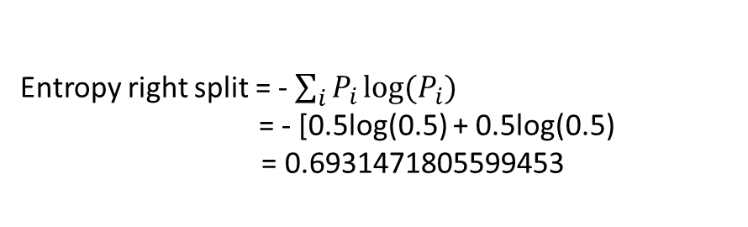
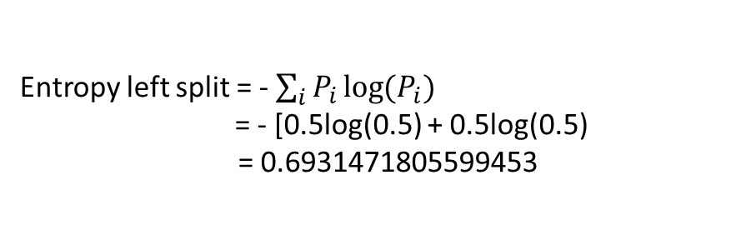
Classification Tree: Simulation
Consider WORST split scenario where
250 red
250 green
Entropy before split = 0.6931471805599453
WORST split
125 red
125 green
125 red
125 green
Information Gain = 0.0
250 y=0
250 y=1
Y=0
250 y=0
250 y=1
Y=1
Entropy left split = - $\sum_{i}{P_{i}\log{(P_{i})}}$
= - [0.5log(0.5) + 0.5log(0.5)
= 0.6931471805599453
Entropy right split = - $\sum_{i}{P_{i}\log{(P_{i})}}$
= - [0.5log(0.5) + 0.5log(0.5)
= 0.6931471805599453
Entropy left branch = 0.6931471805599453
Entropy right branch = 0.6931471805599453

Slide 23
But if we have more than one X?

Slide 24
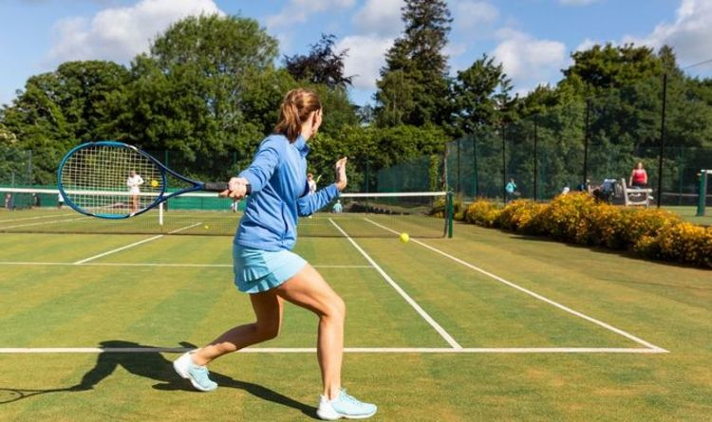
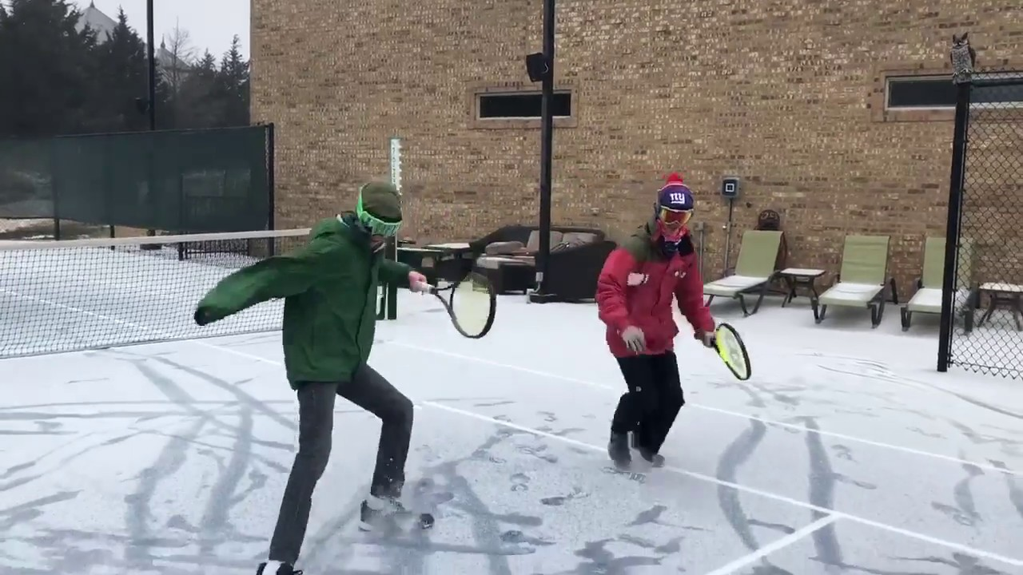
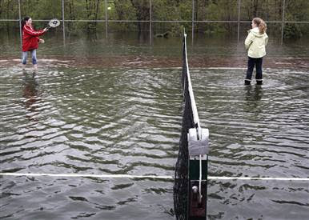
Classification Tree: Example
Predict if I can play tennis on given day
Outlook
Humidity
Wind

Slide 25
Classification Tree: Example
X1
X2
X3
Y
Day | Outlook | Humidity | Wind | Play
D1 | Sunny | High | Weak | NO
D2 | Sunny | High | Strong | NO
D3 | Overcast | High | Weak | YES
D4 | Rain | High | Weak | YES
D5 | Rain | Normal | Weak | YES
D6 | Rain | Normal | Strong | NO
D7 | Overcast | Normal | Strong | YES
D8 | Sunny | High | Weak | NO
D9 | Sunny | Normal | Weak | YES
D10 | Rain | Normal | Weak | YES
D11 | Sunny | Normal | Strong | YES
D12 | Overcast | High | String | YES
D13 | Overcast | Normal | Weak | YES
D14 | Rain | High | Strong | NO
From https://www.youtube.com/watch?v=eKD5gxPPeY0

Slide 26
Start build a tree

Slide 27
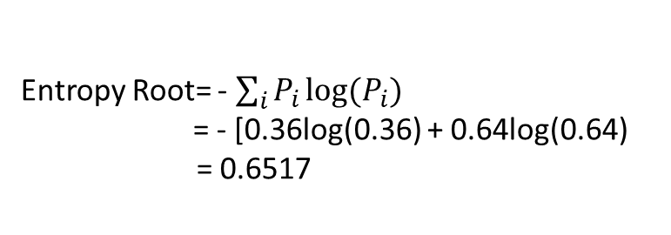
Classification Tree: Example
Root node
9 YES
5 NO
Entropy Root = 0.6517
Day | Outlook | Humidity | Wind | Play
D1 | Sunny | High | Weak | NO
D2 | Sunny | High | Strong | NO
D3 | Overcast | High | Weak | YES
D4 | Rain | High | Weak | YES
D5 | Rain | Normal | Weak | YES
D6 | Rain | Normal | Strong | NO
D7 | Overcast | Normal | Strong | YES
D8 | Sunny | High | Weak | NO
D9 | Sunny | Normal | Weak | YES
D10 | Rain | Normal | Weak | YES
D11 | Sunny | Normal | Strong | YES
D12 | Overcast | High | String | YES
D13 | Overcast | Normal | Weak | YES
D14 | Rain | High | Strong | NO
Entropy Root= - $\sum_{i}{P_{i}\log{(P_{i})}}$
= - [0.36log(0.36) + 0.64log(0.64)
= 0.6517

Slide 28
Classification Tree: Example
Root node
9 YES
5 NO
Try Outlook
Entropy Root = 0.6517
Day | Outlook | Humidity | Wind | Play
D1 | Sunny | High | Weak | NO
D2 | Sunny | High | Strong | NO
D3 | Overcast | High | Weak | YES
D4 | Rain | High | Weak | YES
D5 | Rain | Normal | Weak | YES
D6 | Rain | Normal | Strong | NO
D7 | Overcast | Normal | Strong | YES
D8 | Sunny | High | Weak | NO
D9 | Sunny | Normal | Weak | YES
D10 | Rain | Normal | Weak | YES
D11 | Sunny | Normal | Strong | YES
D12 | Overcast | High | String | YES
D13 | Overcast | Normal | Weak | YES
D14 | Rain | High | Strong | NO
Sunny
2 YES
3 NO
Overcast4 YES
0 NO
Rain
3 YES
2 NO
Entropy Sunny = 0.67301
Entropy Outlook = 0.480721
IG Outlook = 0.17097
Entropy Overcast = 0
Entropy Rain = 0.67301
IG = 0.171

Slide 29
Classification Tree: Example
Root node
9 YES
5 NO
Try Humidity
Entropy Root = 0.6517
Try Wind
Day | Outlook | Humidity | Wind | Play
D1 | Sunny | High | Weak | NO
D2 | Sunny | High | Strong | NO
D3 | Overcast | High | Weak | YES
D4 | Rain | High | Weak | YES
D5 | Rain | Normal | Weak | YES
D6 | Rain | Normal | Strong | NO
D7 | Overcast | Normal | Strong | YES
D8 | Sunny | High | Weak | NO
D9 | Sunny | Normal | Weak | YES
D10 | Rain | Normal | Weak | YES
D11 | Sunny | Normal | Strong | YES
D12 | Overcast | High | String | YES
D13 | Overcast | Normal | Weak | YES
D14 | Rain | High | Strong | NO
Weak
6 YES
2 NO
Strong
3 YES
3 NO
Sunny
2 YES
3 NO
Rain
3 YES
2 NO
High
3 YES
4 NO
Overcast4 YES
0 NO
Normal
6 YES
1 NO
Entropy Humidity =0.546505
IG Humidity = 0.105195
Entropy Outlook = 0.480721
IG Outlook = 0.17097
Entropy Wind =0.618357
IG Wind = 0.0337
IG = 0.171
IG = 0.106
IG = 0.034

Slide 30
Classification Tree: Example
Root node
9 YES
5 NO
Entropy Root = 0.6517
Day | Outlook | Humidity | Wind | Play
D1 | Sunny | High | Weak | NO
D2 | Sunny | High | Strong | NO
D3 | Overcast | High | Weak | YES
D4 | Rain | High | Weak | YES
D5 | Rain | Normal | Weak | YES
D6 | Rain | Normal | Strong | NO
D7 | Overcast | Normal | Strong | YES
D8 | Sunny | High | Weak | NO
D9 | Sunny | Normal | Weak | YES
D10 | Rain | Normal | Weak | YES
D11 | Sunny | Normal | Strong | YES
D12 | Overcast | High | String | YES
D13 | Overcast | Normal | Weak | YES
D14 | Rain | High | Strong | NO
Sunny
2 YES
3 NO
Overcast4 YES
0 NO
Rain
3 YES
2 NO
Entropy Sunny = 0.67301
Entropy Overcast = 0
Entropy Rain = 0.67301
IG = 0.171
IG = 0.106
IG = 0.034

Slide 31
Do it again…..

Slide 32
Classification Tree: Example
Root node
9 YES
5 NO
Entropy Root = 0.6517
Day | Outlook | Humidity | Wind | Play
D1 | Sunny | High | Weak | NO
D2 | Sunny | High | Strong | NO
D3 | Overcast | High | Weak | YES
D4 | Rain | High | Weak | YES
D5 | Rain | Normal | Weak | YES
D6 | Rain | Normal | Strong | NO
D7 | Overcast | Normal | Strong | YES
D8 | Sunny | High | Weak | NO
D9 | Sunny | Normal | Weak | YES
D10 | Rain | Normal | Weak | YES
D11 | Sunny | Normal | Strong | YES
D12 | Overcast | High | String | YES
D13 | Overcast | Normal | Weak | YES
D14 | Rain | High | Strong | NO
Sunny
2 YES
3 NO
Overcast
4 YES
0 NO
Rain
3 YES
2 NO
Entropy Sunny = 0.67301
Entropy Overcast = 0
Entropy Rain = 0.67301
Day | Outlook | Humidity | Wind | Play
D1 | Sunny | High | Weak | NO
D2 | Sunny | High | Strong | NO
D8 | Sunny | High | Weak | NO
D9 | Sunny | Normal | Weak | YES
D11 | Sunny | Normal | Strong | YES
Day | Outlook | Humidity | Wind | Play
D4 | Rain | High | Weak | YES
D5 | Rain | Normal | Weak | YES
D6 | Rain | Normal | Strong | NO
D10 | Rain | Normal | Weak | YES
D14 | Rain | High | Strong | NO

Slide 33
Classification Tree: Example
Root node
9 YES
5 NO
Entropy Root = 0.6517
Sunny
2 YES
3 NO
Overcast
4 YES
0 NO
Rain
3 YES
2 NO
Entropy Sunny = 0.67301
Entropy Overcast = 0
Entropy Rain = 0.67301
Day | Outlook | Humidity | Wind | Play
D1 | Sunny | High | Weak | NO
D2 | Sunny | High | Strong | NO
D8 | Sunny | High | Weak | NO
D9 | Sunny | Normal | Weak | YES
D11 | Sunny | Normal | Strong | YES
Day | Outlook | Humidity | Wind | Play
D4 | Rain | High | Weak | YES
D5 | Rain | Normal | Weak | YES
D6 | Rain | Normal | Strong | NO
D10 | Rain | Normal | Weak | YES
D14 | Rain | High | Strong | NO
High
0 YES
3 NO
Normal
2 YES
0 NO
Weak
3 YES
0 NO
Strong
0 YES
2 NO
Entropy High = 0
Entropy Normal = 0
Entropy Weak = 0
Entropy Strong = 0

Slide 34
Classification Tree: Example
Root node
Root node
9 YES
5 NO
Entropy Root = 0.6517
Internal node
Sunny
2 YES
3 NO
Overcast
4 YES
0 NO
Rain
3 YES
2 NO
Leaf node
Entropy Sunny = 0.67301
Entropy Overcast = 0
Entropy Rain = 0.67301
High
0 YES
3 NO
Normal
2 YES
0 NO
Weak
3 YES
0 NO
Strong
0 YES
2 NO
Entropy High = 0
Entropy Normal = 0
Entropy Weak = 0
Entropy Strong = 0

Slide 35
Classification Tree: Pseudocode
While True
Compute entropy before split
For each attribute (independent variable x)
Compute entropy after split
Compute information gain
Select the attribute that yield highest information gain (best split) to be the current split
If the split result in leaf node
Break the loop

Slide 36
What is Random Forest?

Slide 37
2. Random Forest
Random Forest = Decision Tree + Ensemble learning

Slide 38
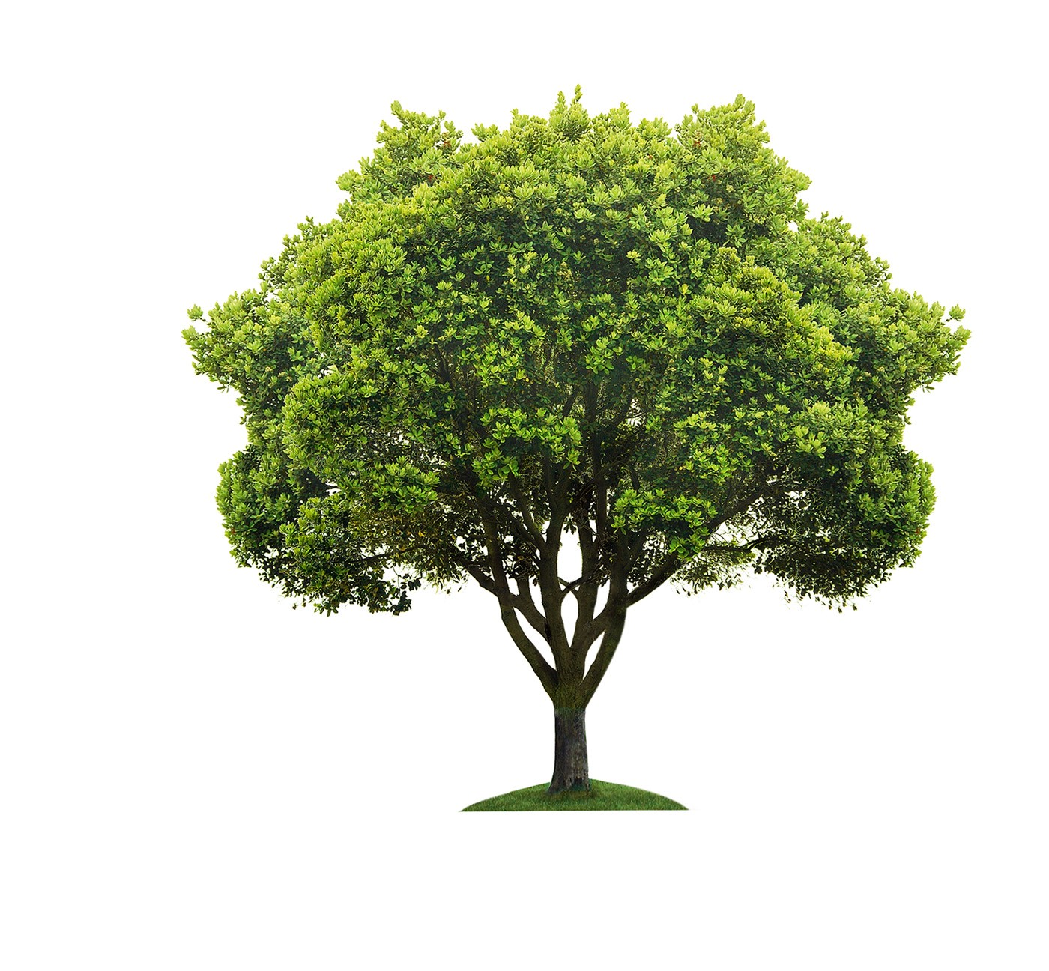
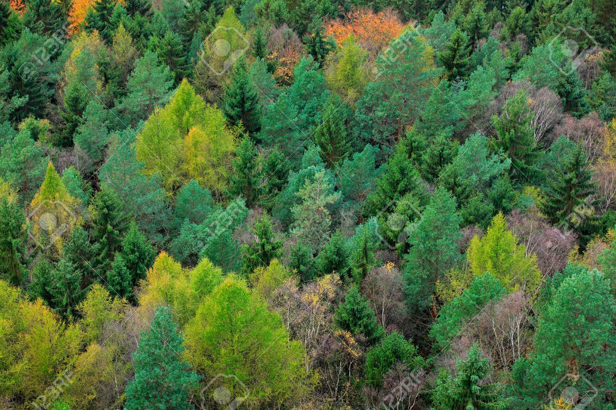
2. Random Forest: Ensemble learning
Decision Tree
Random Forest

Slide 39
2. Random Forest: Ensemble learning
Ensemble learning: process of combining many estimators to reduce bias, variance, and data sensitivity
The more the number of tree (estimator), the more accurate

Slide 40
Problem….

Slide 41
Train 1 tree
Train many tree

Slide 42
What about the dataset?

Slide 43
2. Random Forest: Bootstrapping
Bootstrapping: the process of resampling with replacement to increase the size of dataset without having to collect more
Instead of collecting more data, we fake it!

Slide 44
2. Random Forest: Bootstrapping
Sampling with replacement
3 RED
3 GREEN
Sampling with replacement
5 RED
4 GREEN
4 RED
2 GREEN

Slide 45
2. Random Forest: Bootstrapping
As a result, we can now train each tree in the forest with different dataset!
Train tree 1 with dataset 1
Original dataset
Bootstrapping
Bagging
Train tree 2 with dataset 2
Train tree 3 with dataset 3
. . .
Train tree n with dataset n

Slide 46
2. Random Forest: Bagging
Bagging: one type of ensemble learning that train multiple Decision Tree in parallel each with different partial dataset. Each partial dataset are generated from real dataset using the concept of bootstrapping

Slide 47
Random Forest: Pseudocode for training
Select number of tree in the forest
For each tree in the forest:
Do Decision Tree

Slide 48
Random Forest: Pseudocode for prediction
For each tree:
Make prediction base on each tree
For continuous output (regression problem):
Average, Median, or mode
For categorical output (classification problem):
Voting

