Slide 1

QR CODE GENERATOR
By
GUDDI YADAV,TAMONASH MAJI
(B.Tech 3rd Year, Enrollment No.: 12019002001103,12019002001040 )
Under the Supervision of
Prof. Sibun Parida
Dept. of Computer Science & Engineering
University of Engineering & Management, Jaipur

Slide 2
Outlines
Introduction
Literature Review
Objectives
Proposed Model
Experimental Setup
Result Analysis
Conclusion & Future Scope
Reference
Acknowledgement

Slide 3
Introduction
- This is “QR Code Generator “ Application.
It is basically developed to store a URL to make it easier for you to
open a page on web with just a scan. It develop QR code only for
Employee based on their given details.
- It is purely developed in Python using Visual Studio IDE.

Slide 4
Literature Review
The “QR Code Generator ” project purpose is to putting effort
To provide the QR Code to the employee when any company want to save details of employee in a QR code then it is very useful they just need to fill some details of employee and in the single click it will generate the QR code for employee .
Whenever they want details of employee then they can scan and get details of employee.

Slide 5
Objectives
The main objective of the “QR Code Generator” is to
manage the details of Employee by the QR code generator. This project is basically developed to store a URL to make
it easier for you to open a page on web with just a scan. It develop QR code only for Employee based on their given details.

Slide 6
Proposed Model
The software “QR Code Generator” is mainly focused on basic operations of a QR Code Generator like
Enter employee ID of a employee.
Enter Employee name of a employee.
Enter Department of a Employee.
Enter Designation of a Employee.
Click on “Generate” button and it will generate QR code in the right side.
When we click on “Clear” then it will remove the QR code and every text will be blank.

Slide 7
Experimental Set-up
- We used windows 10 , Visual Studio version 17.0.4., Python

Slide 8
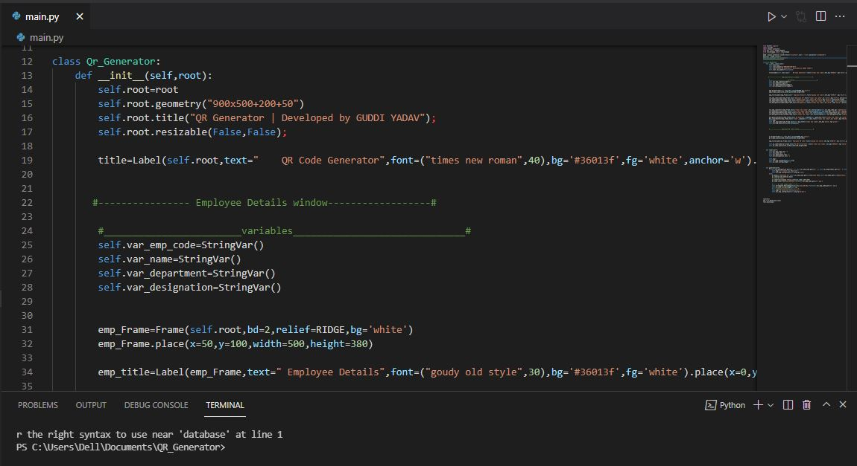
Result: Example

Slide 9
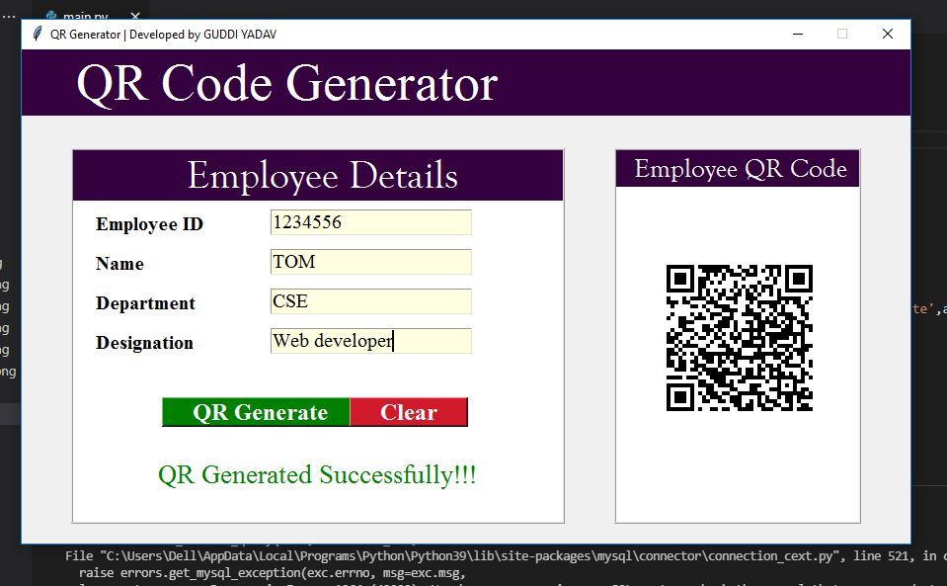

Slide 10
Limitation
These are the Limitation of my Project:-
1.) It only Generate the QR code and can’t scan the QR code.
2.) We can only generate QR code for Employee by giving details of the employee.

Slide 11
Conclusions & Future Scope
Here I conclude my lines of my term paper on the topic ‘QR Code Generator’ with the extreme with the extreme satisfaction and contentment.
Added to this my term and paper contain the basic description of QR Code Generator using Python 3.9,.
QR Code Generator application’s source code can also reusable and later we can extend this project and can add database to save details of all employee also we can add more details of employee in it.

Slide 12
References
Visual Studio version 17.0.4.,
Python 3.9.0

Slide 13
Acknowledgement
We have taken efforts in this project. However, it would not have been possible
without the kind support and help of many individuals and organizations. I
would like to extend my sincere thanks to all of them.
I am highly indebted to (Prof. Sibun Parida) for their guidance and constant
supervision as well as for providing necessary information regarding the project &
also for their support in completing the project.
I would like to express my gratitude towards my parents for their kind
co-operational encouragement which help me in completion of this project.
I would like to express my special gratitude and thanks to industry persons for
giving me such attention and time.
My thanks and appreciations also go to my colleague in developing the project
and people who have willingly helped me out with their ability.

Slide 14

Dept. of CSE, University of Engineering & Management Jaipur

