Slide 1



sales_analytics
View in Power BI
Last data refresh:
22/10/2023 03:21:37 UTC
Downloaded at:
22/10/2023 03:25:10 UTC

Slide 2
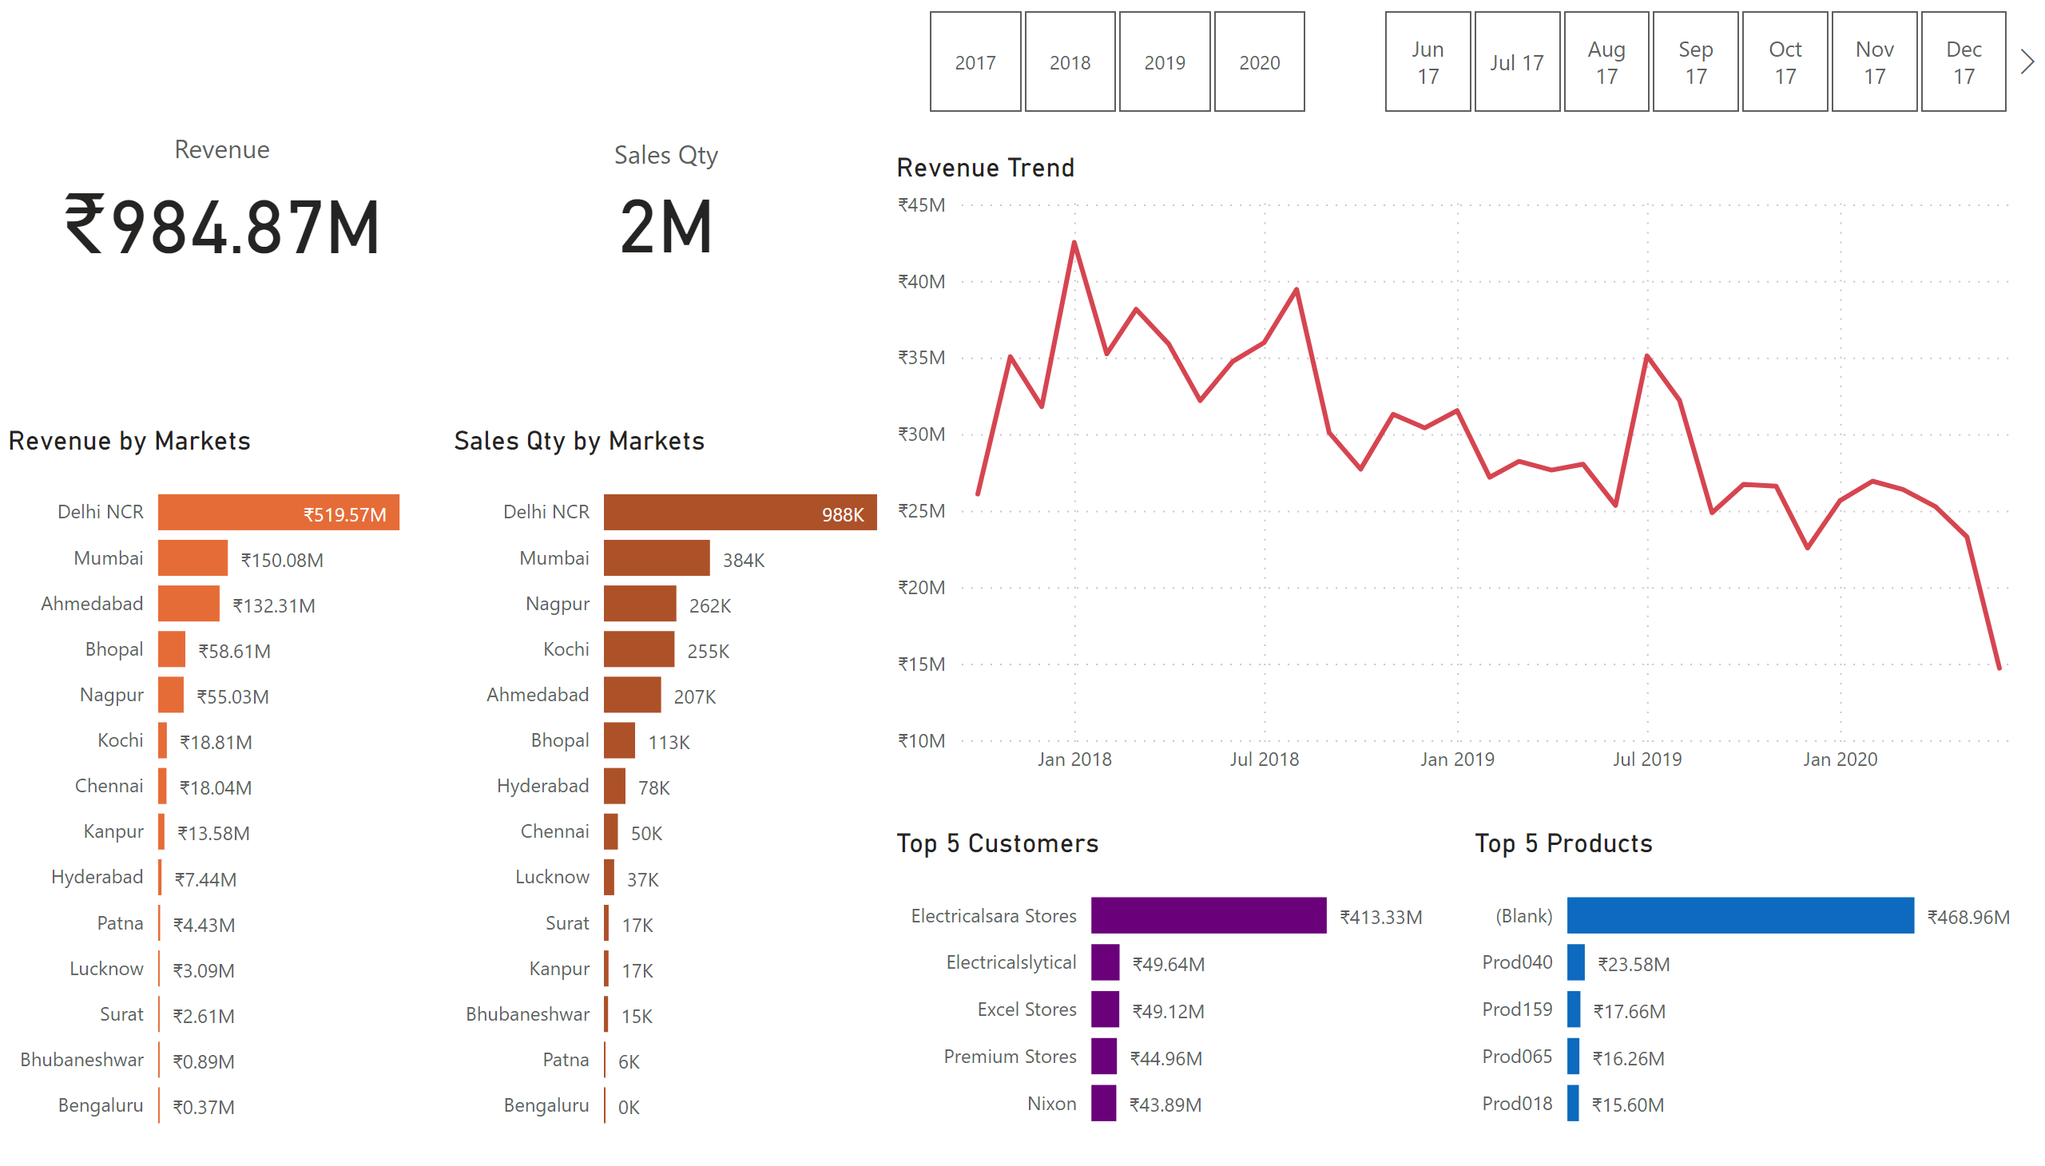
Key Insights
Notes:
cardVisual
No alt text provided
cardVisual
No alt text provided
Revenue by Markets
No alt text provided
Sales Qty by Markets
No alt text provided
slicer
No alt text provided
slicer
No alt text provided
Top 5 Customers
No alt text provided
Top 5 Products
No alt text provided
Revenue Trend
No alt text provided

Slide 3
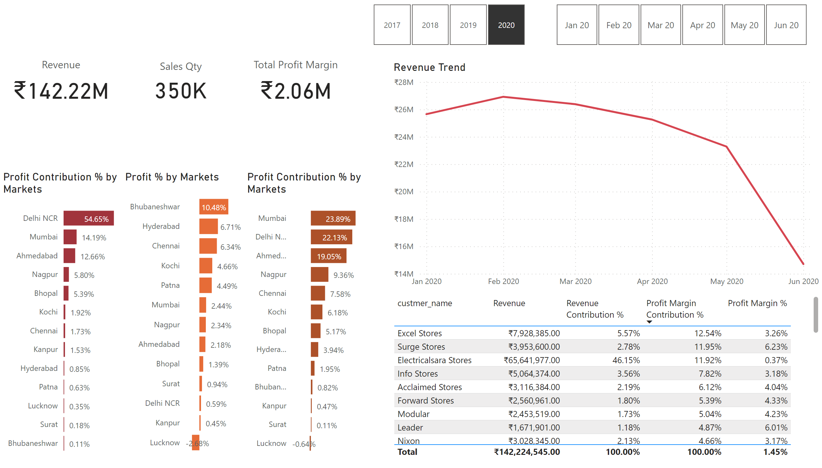
Profit Analysis
Notes:
cardVisual
No alt text provided
cardVisual
No alt text provided
Profit % by Markets
No alt text provided
Profit Contribution % by Markets
No alt text provided
slicer
No alt text provided
slicer
No alt text provided
Top 5 Customers
No alt text provided
Revenue Trend
No alt text provided
cardVisual
No alt text provided
Profit Contribution % by Markets
No alt text provided

Slide 4
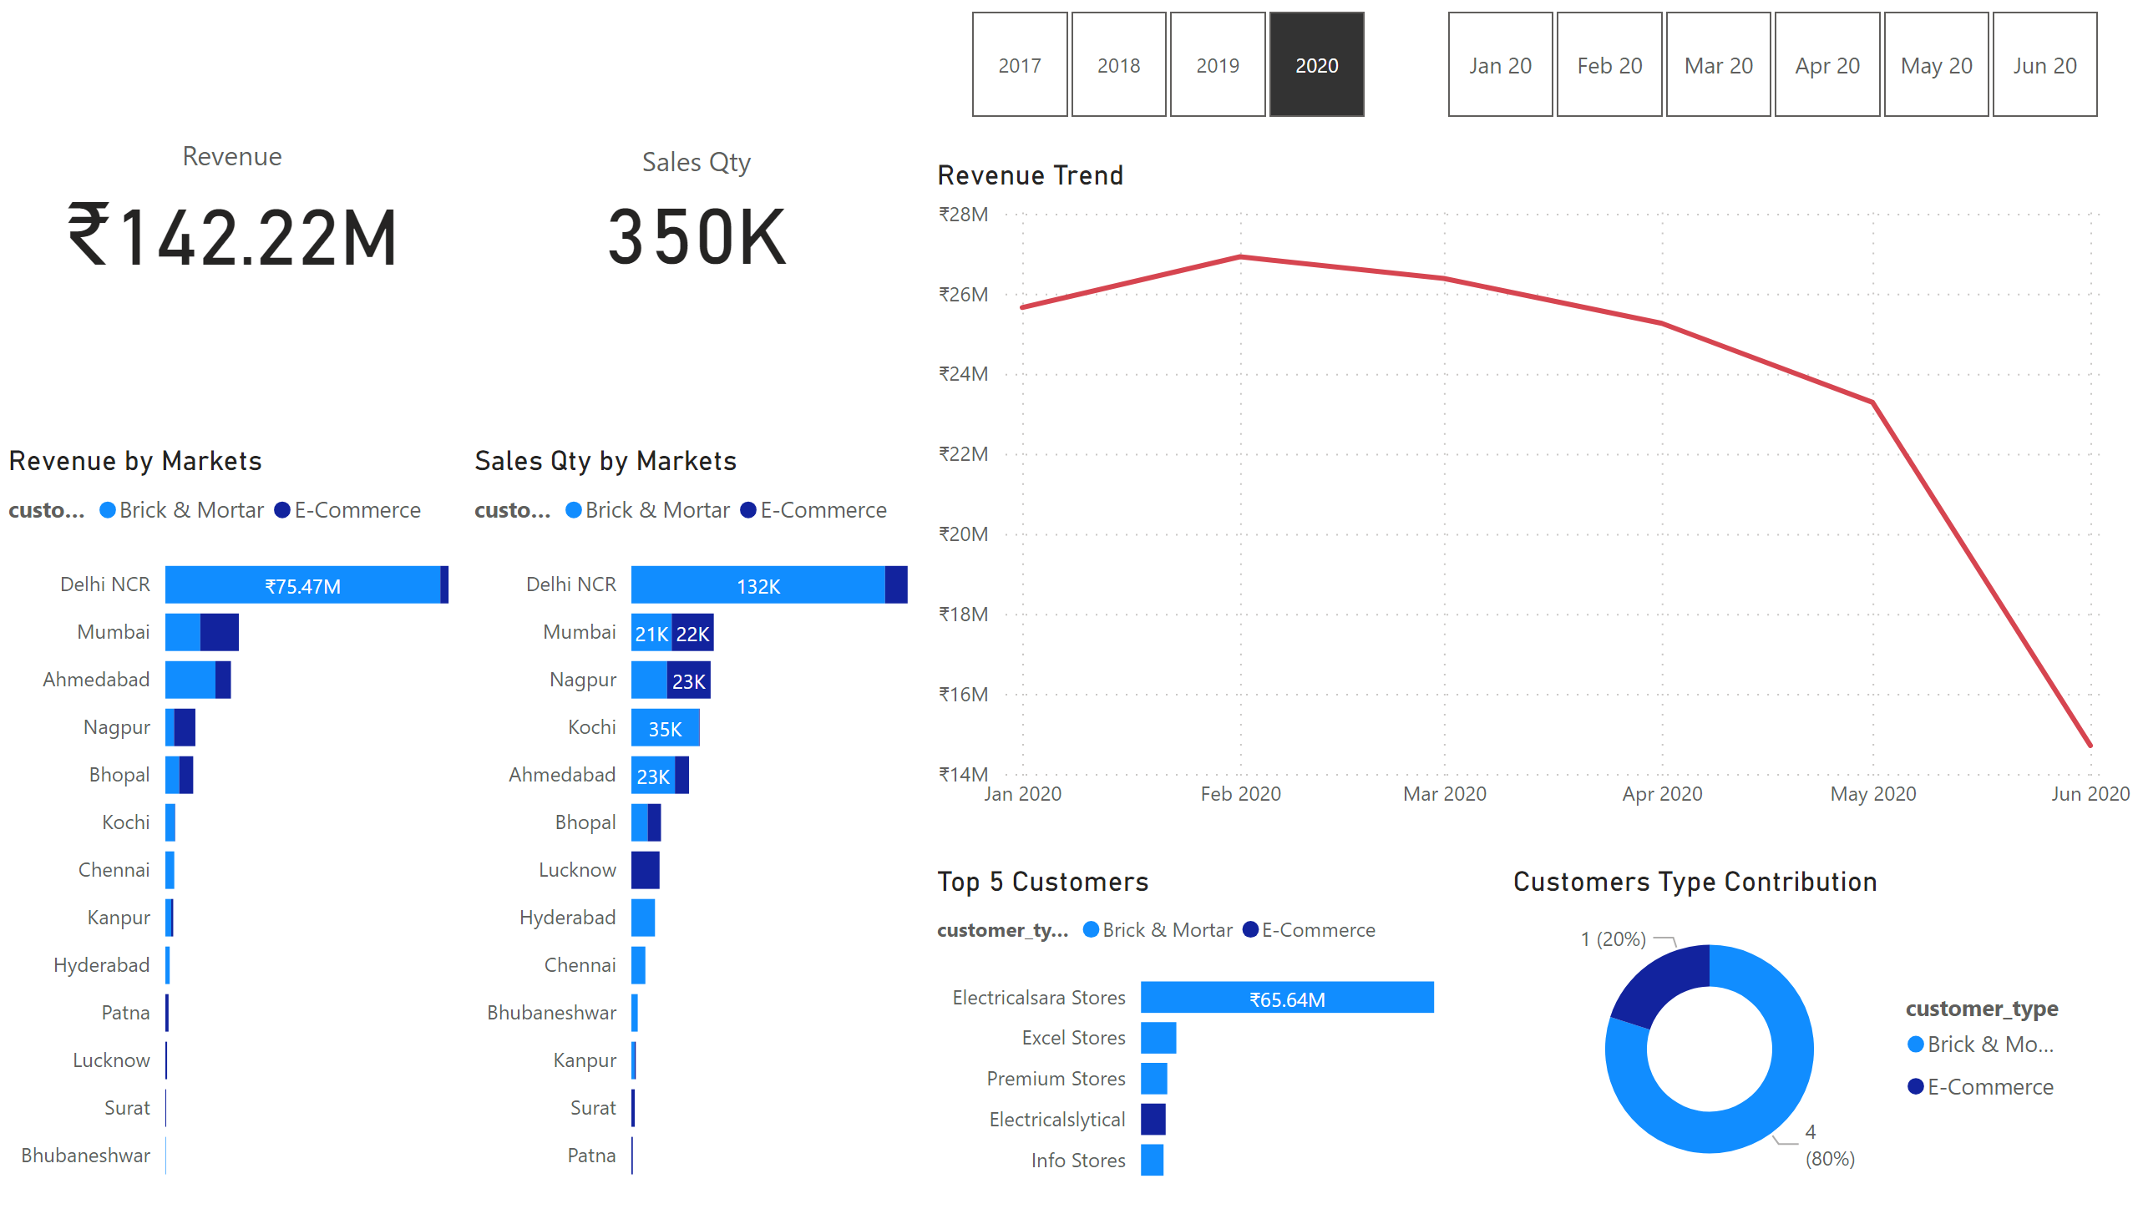
Customers Analysis
Notes:
cardVisual
No alt text provided
cardVisual
No alt text provided
Revenue by Markets
No alt text provided
Sales Qty by Markets
No alt text provided
slicer
No alt text provided
slicer
No alt text provided
Top 5 Customers
No alt text provided
Revenue Trend
No alt text provided
Customers Type Contribution
No alt text provided

Slide 5
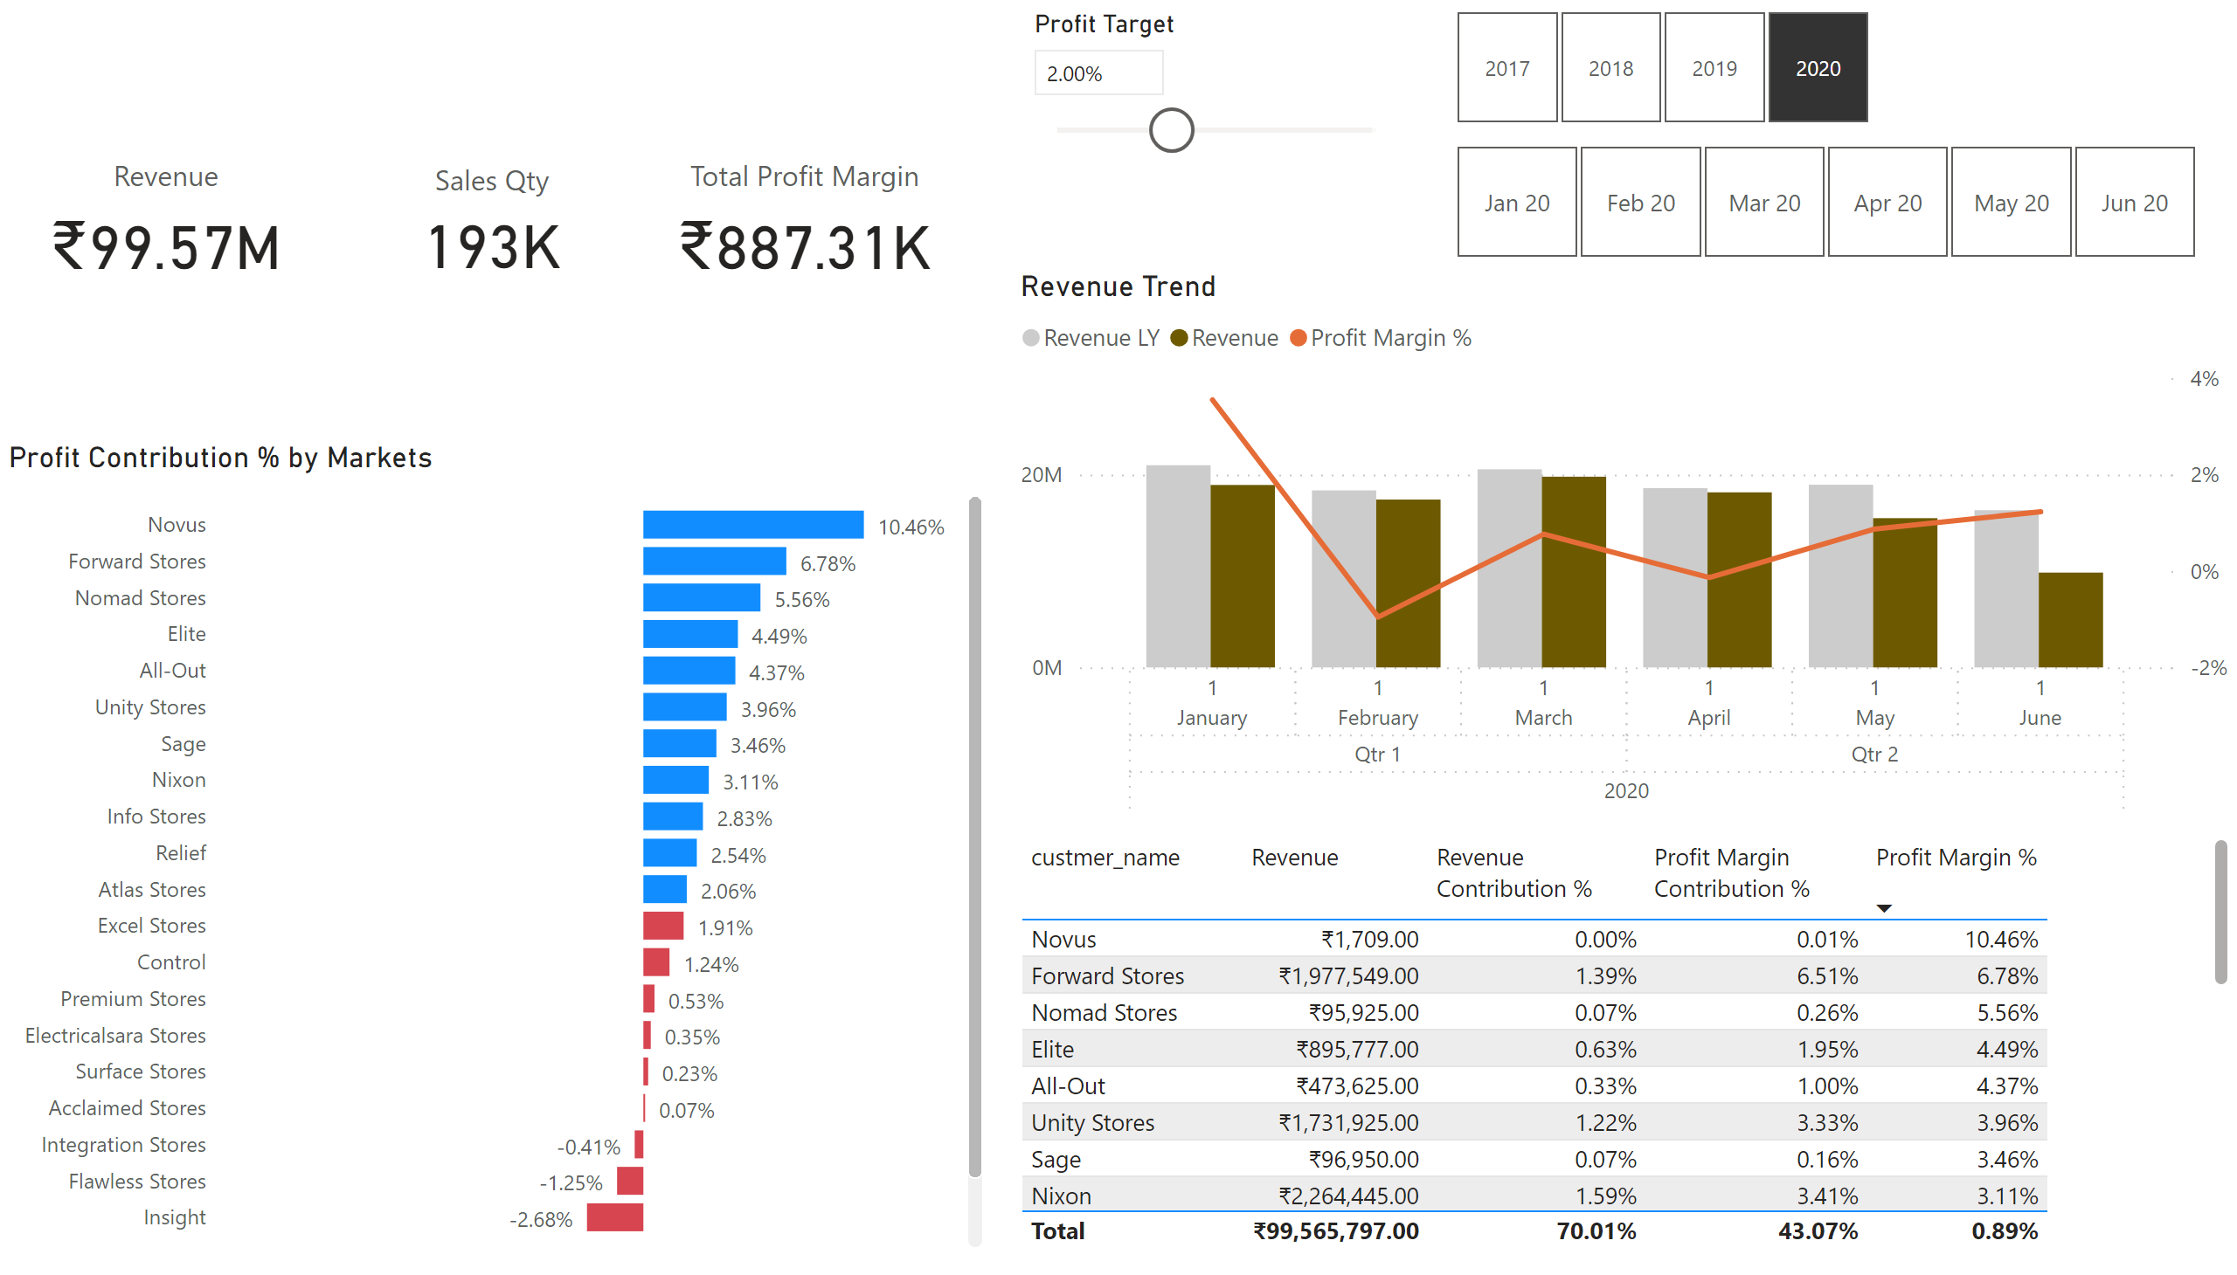
Performance Insights
Notes:
cardVisual
No alt text provided
cardVisual
No alt text provided
slicer
No alt text provided
slicer
No alt text provided
Top 5 Customers
No alt text provided
Revenue Trend
No alt text provided
cardVisual
No alt text provided
Profit Contribution % by Markets
No alt text provided
slicer
No alt text provided

