Slide 1

Movie Recommender System
CS 6513 Big Data Project
Abhin Gude

Slide 2

Motivation
Streaming : Netflix users spent a combined 164 million hours per day watching content in 2019.
Subscribers :There were almost 208 million paying Netflix subscribers in Q1 of 2021.
Revenue : Revenue of Netflix is 25 billion USD in the year 2020.
The backbone for such a successful company is their video content and in a technical person view it’s their recommendation system and the user interaction they provide.

Slide 3
Recommendation Systems
There are many recommendation systems such as Collaborative Recommender system, Content-based recommender system, Demographic based recommender system, Utility based recommender system and Hybrid recommender system.
In this project we use Collaborative Recommender system for recommending movies.
So, What is Collaborative Recommender system ?
Collaborative filtering uses similarities between users and items simultaneously to provide recommendations.
It is collaborative because it recommends an item to user A based on the interests of a similar user B

Slide 4
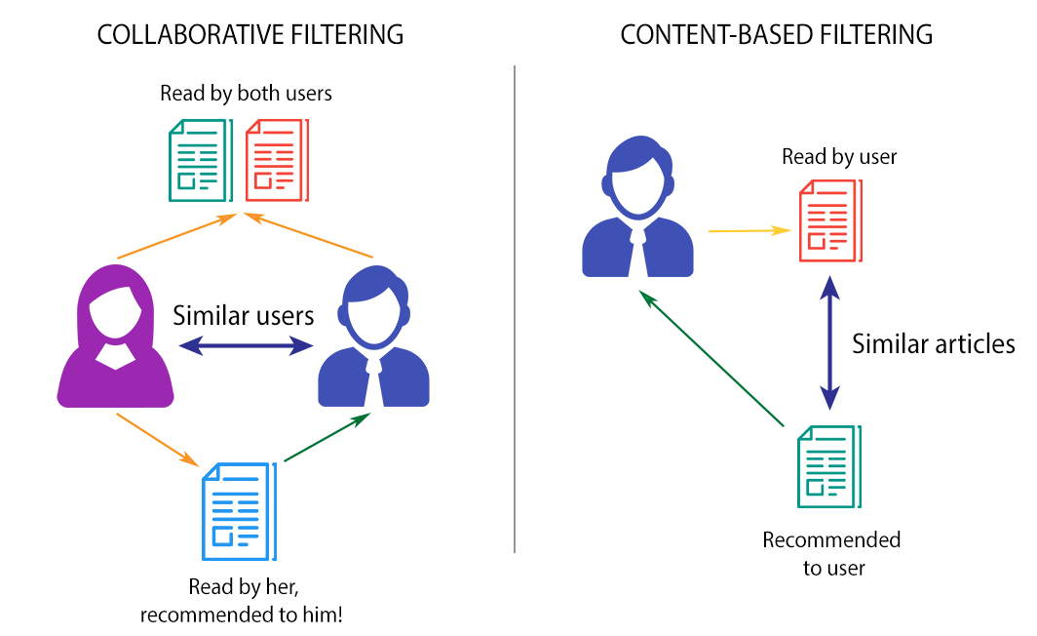
Difference Between Collaborative and Content Based Filtering
Content-based filtering, makes recommendations based on user preferences for product features. Collaborative filtering mimics user-to-user recommendations.
It predicts user’s preferences as a linear, weighted combination of other user preferences.

Slide 5
How Do we implement this system?
Ofcourse the first thing is to have the data. The dataset used for this project contains information about movies and user ratings for movies.
Movies contain information about their name , year of release and their genre whereas user ratings have information about user id, movie id, rating and timestamp.
Data can be visualised as a matrix for better understanding.
This user-movie (or movie-user) interaction matrix contains ratings given by user i for movie j.
In the real world setting, the vast majority of movies receive very few or even no ratings at all by users.
This is called a sparse matrix.

Slide 6
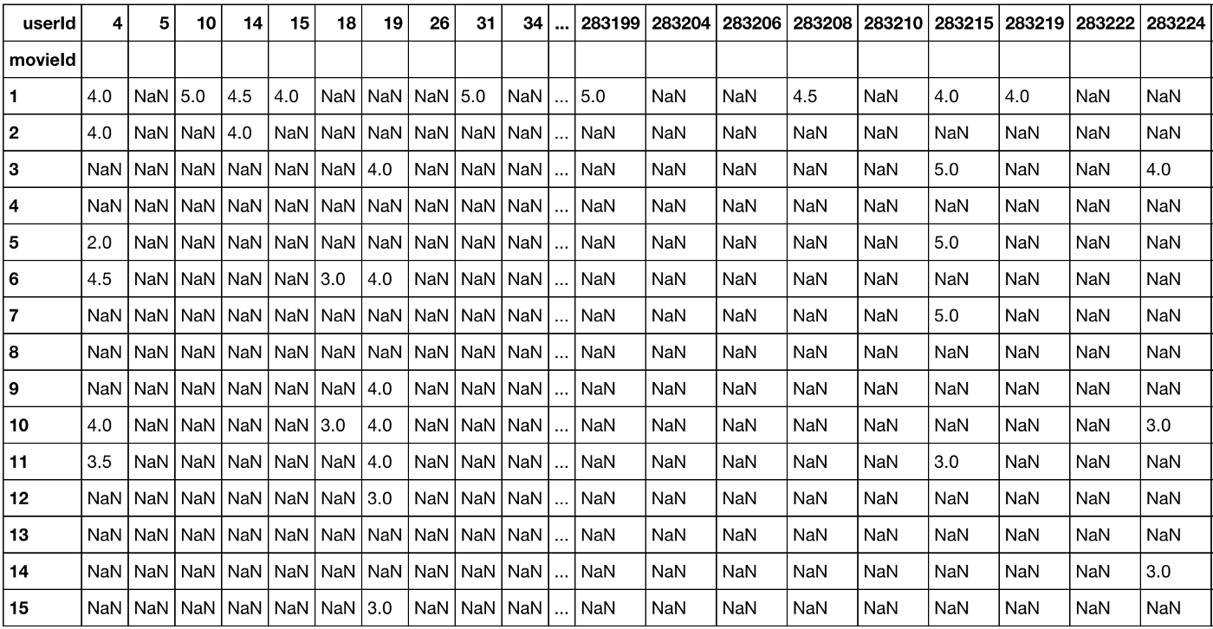
Sparse Matrix Example
This is an example of an extremely sparse matrix with more than 99% of entries are missing values.
With such a sparse matrix, what ML algorithms can be trained and reliable to make inference?

Slide 7
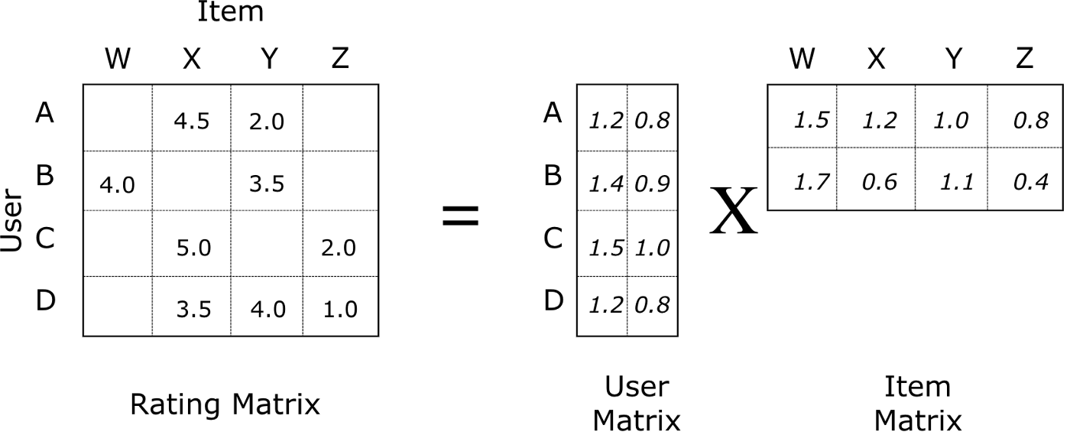
Solution To Sparse Matrix Problem
In collaborative filtering, matrix factorization is the state-of-the-art solution for sparse data problem.
A matrix factorization is a factorization of a matrix into a product of matrices.
In the case of collaborative filtering, matrix factorization algorithms work by decomposing the user-item interaction matrix into the product of two lower dimensionality rectangular matrices.

Slide 8

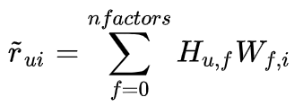
How does matrix factorization solve our problems?
Model learns to factorize rating matrix into user and movie representations, which allows model to predict better personalized movie ratings for users.
With matrix factorization, less-known movies can have rich latent representations as much as popular movies have, which improves recommender’s ability to recommend less-known movies.
In the sparse user-item interaction matrix, the predicted user’s u rating for item i is computed as:

Slide 9
How Do we Model This?
We implement this using an Alternating Least Squares(ALS) Model.
Alternating Least Square (ALS) is a matrix factorization algorithm and it runs itself in a parallel fashion.
ALS is implemented in Apache Spark ML and built for a large-scale collaborative filtering problems.
ALS is doing a pretty good job at solving scalability and sparseness of the Ratings data, and it’s simple and scales well to very large datasets.
Its training routine is different: ALS minimizes two loss functions alternatively; It first holds user matrix fixed and runs gradient descent with item matrix; then it holds item matrix fixed and runs gradient descent with user matrix.
ALS runs its gradient descent in parallel across multiple partitions of the underlying training data from a cluster of machines.

Slide 10
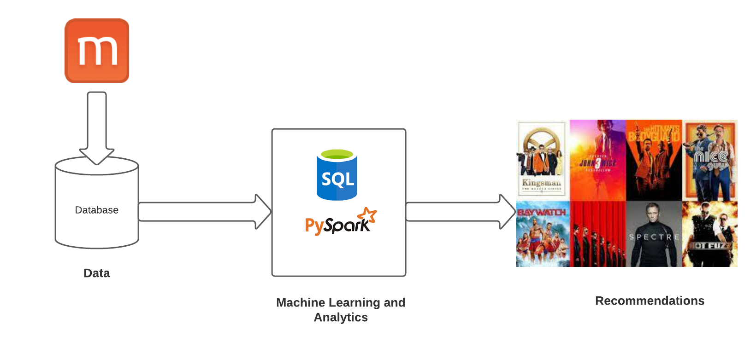
Architecture diagram

Slide 11
Model Parameters and Tuning
ALS is in the ml.recommendation library in Spark.
Just like other machine learning algorithms, ALS has its own set of hyper-parameters. We tune its hyper-parameters via cross-validation.
Most important hyper-params in Alternating Least Square (ALS) are:
maxIter: the maximum number of iterations to run (defaults to 10)
rank: the number of latent factors in the model (defaults to 10)
regParam: the regularization parameter in ALS (defaults to 1.0)
In this project we tuned with a set of values for each parameter and got least RMSE for a model with maxIter : 15, Rank :10, regParam : 0.01 and we consider it as the best model.

Slide 12
Training, Testing And recommendations
After choosing this best model we fit the model using the training data and use the model to transform the test data.
Transforming test data implies that the model adds a column called predicted rating for each row.
We then use the model to give recommendations.

Slide 13
Results and why is this big data?
Recommendations obtained here are of two types since we have both users and movies in the data.
We recommend movies for a particular user and we recommend users for a particular movie.
And this is big data because the size of data is large around 1GB(Volume), it has new data obtained at different speeds for different models(Velocity), and there is different type of data like movies and users (Variety), data is from real world and accurate(Veracity) and it is useful since we saw in the first slide how Netflix generates a huge amount(Value).

Slide 14
Future improvements
We can actually improve this model by defining what similar users mean?
We can add huge amount of data which talks about similar users like their geographic location, type of work people do, demographics and religion.
By adding this data and introducing a similarity metric we can generate better recommendations for the users.

Slide 15


Thank you

