Slide 1
UML DIAGRAMS

Slide 2
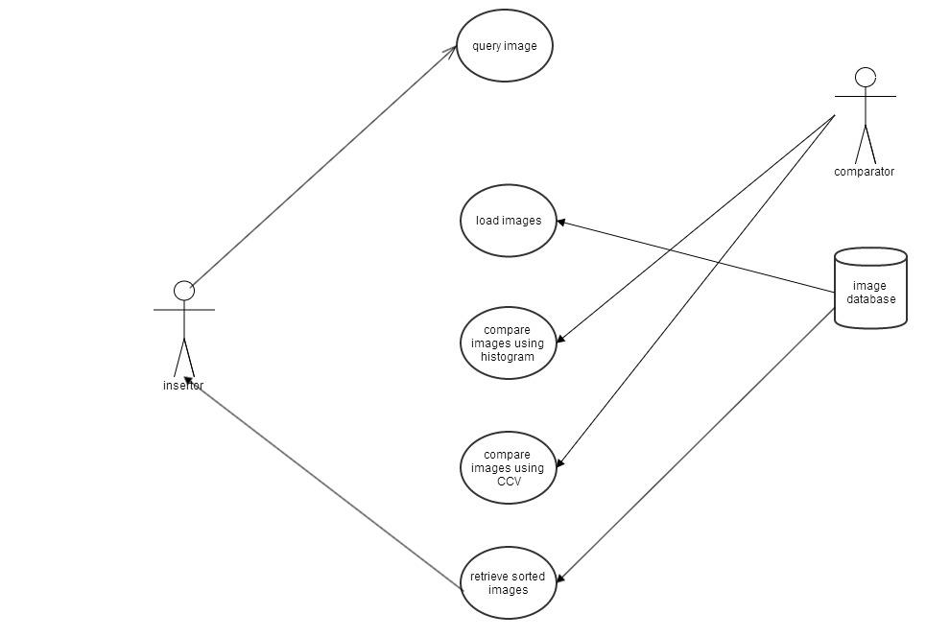
USECASE DIAGRAM FOR CBIR

Slide 3
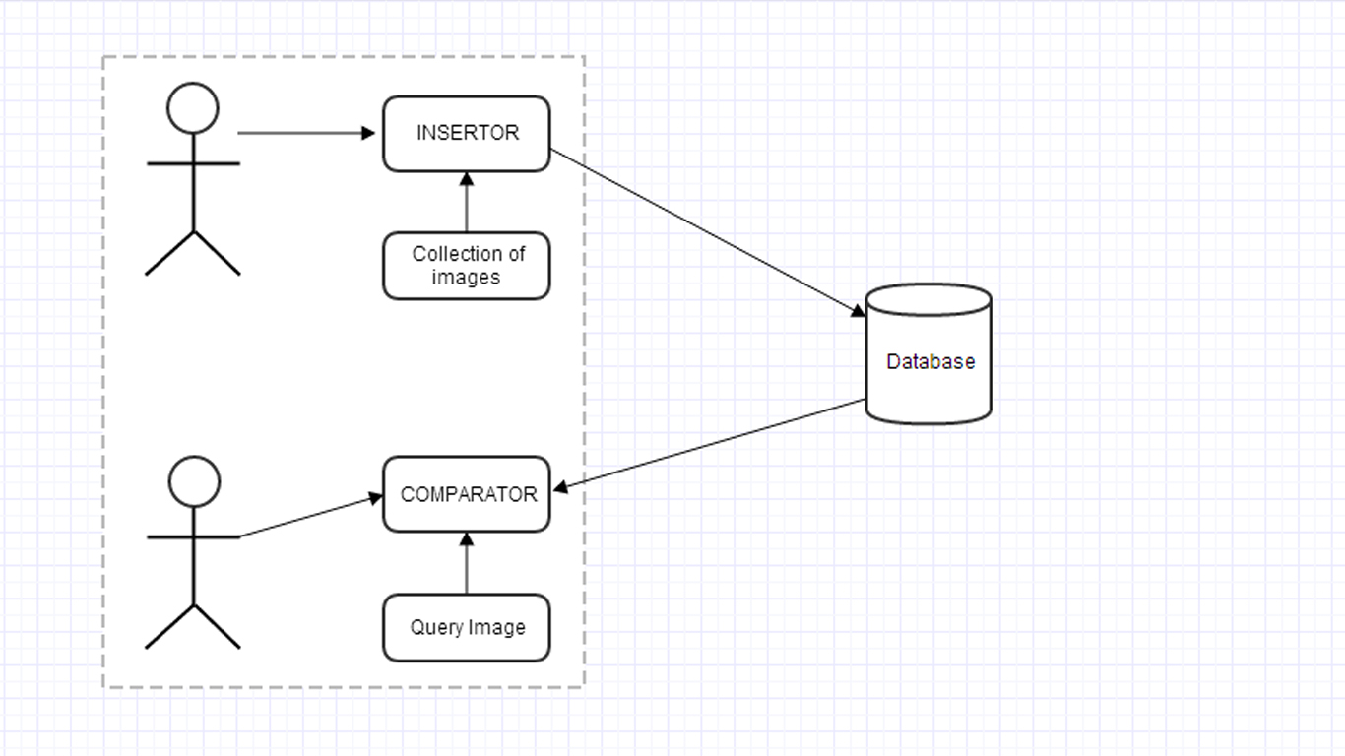
DEPLOYMENT MODEL

Slide 4
Database Operations

Slide 5
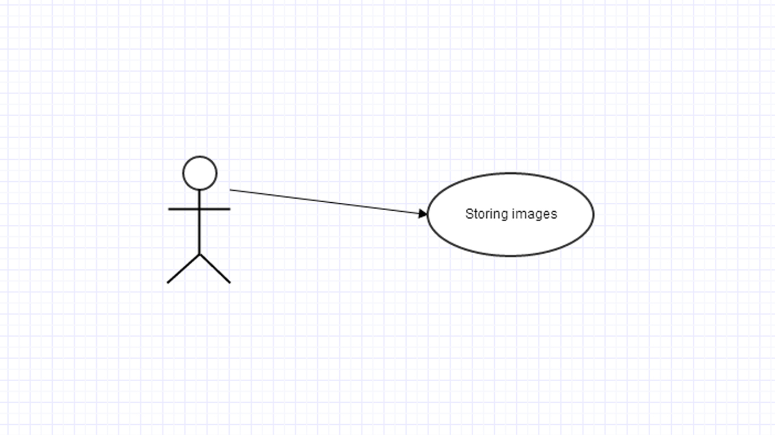
INSERTOR

Slide 6
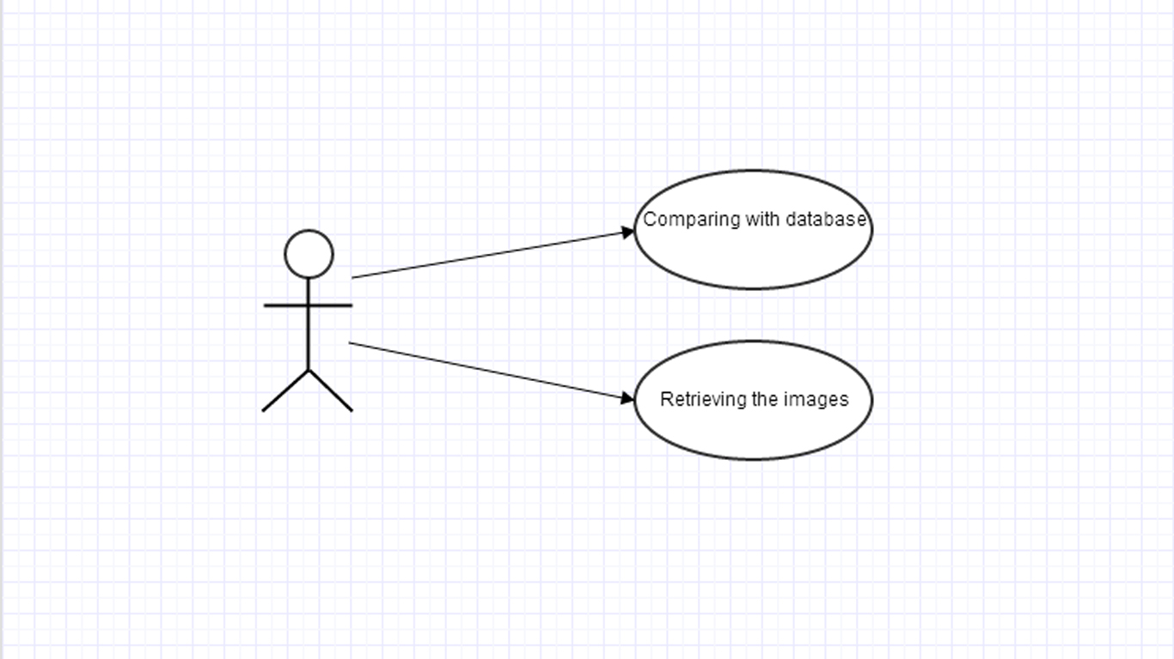
COMPARATOR

Slide 7
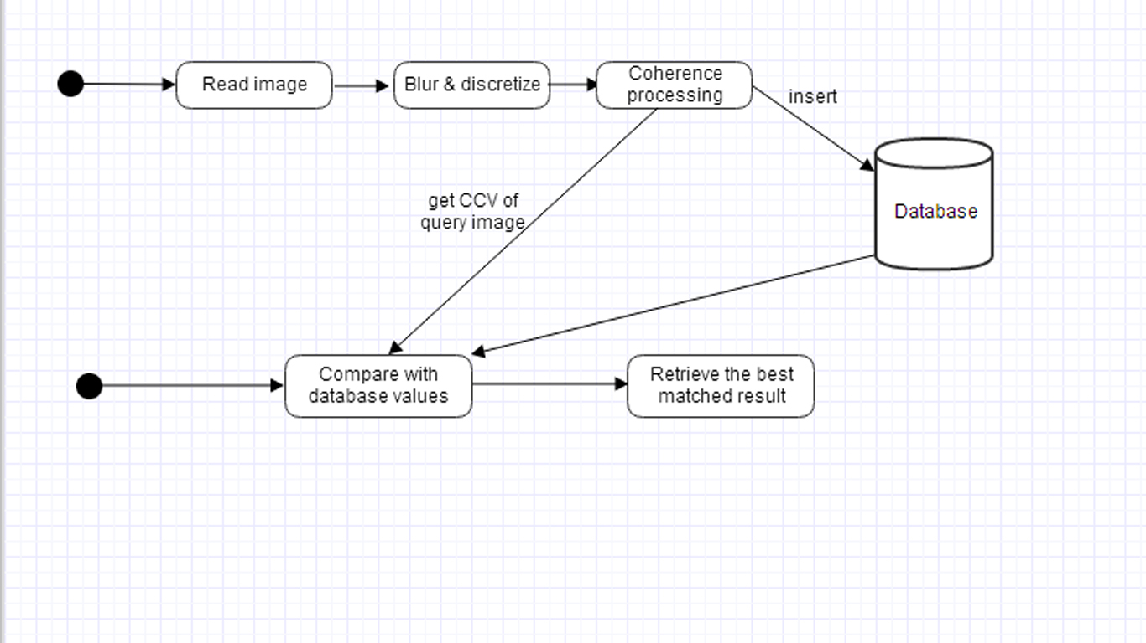
SYSTEM INTERFACE INSERTING AND COMPARING

Slide 8
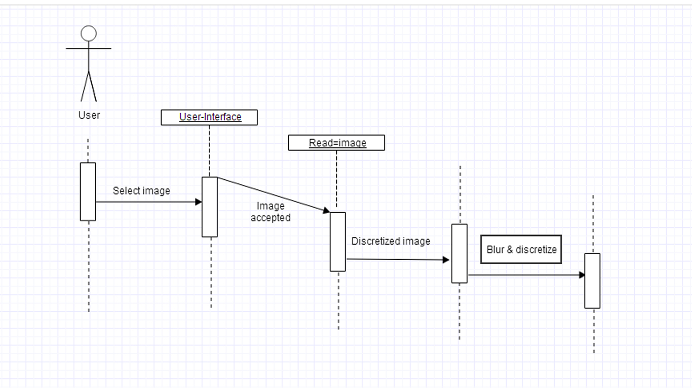
TIMELINE DIAGRAMS

