Slide 1
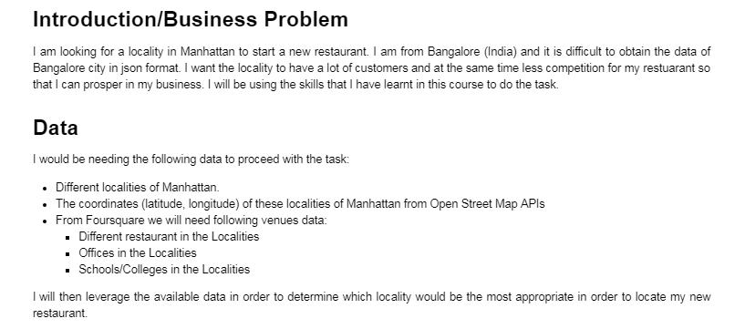

Slide 2
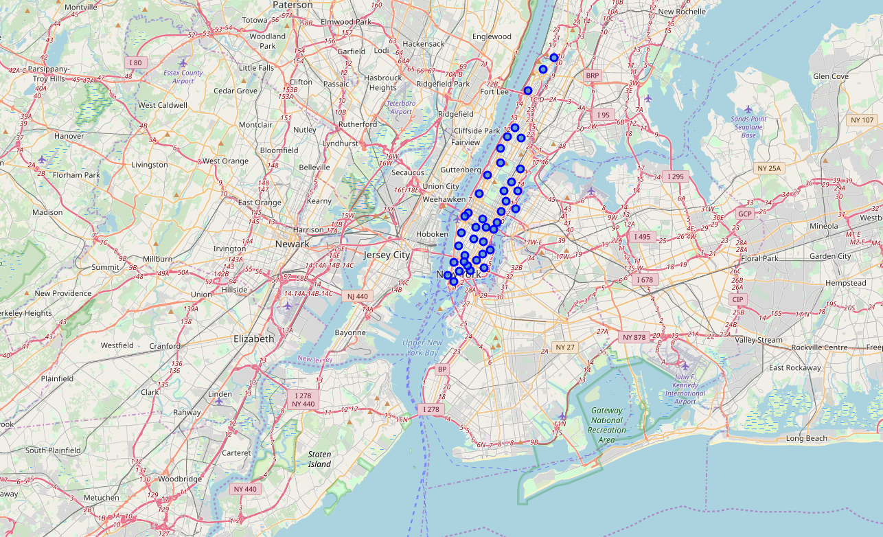
Neighbourhoods in Manhattan

Slide 3
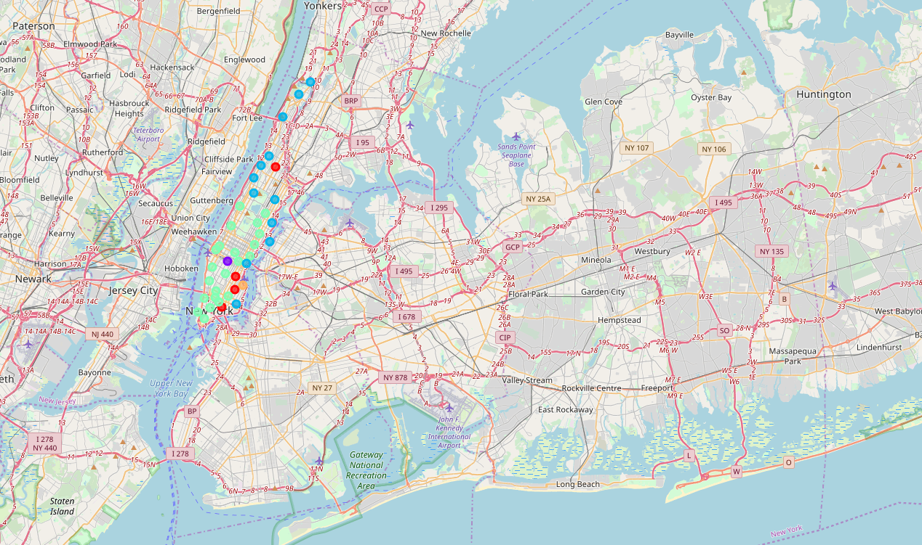
Clustered Neighbourhoods

Slide 4
