Slide 1


K.S.R.M.COLLEGE OF ENGINEERING (AUTONOMOUS) Pulivendala Road, Kadapa-516 005 Andhra Pradesh, India Approved by AICTE, New Delhi & Affiliated to JNTUA, Ananthapuramu. An ISO 14001:2004 & 9001: 2015 Certified Institution
Internship Presentation On
“APPLIED ROBOTIC CONTROL”
Presented by:- Under the guidance of
G. Manoj Dr . G.Suneel Kumar
209Y1A0460 Assistant Professor
ECE department

Slide 2
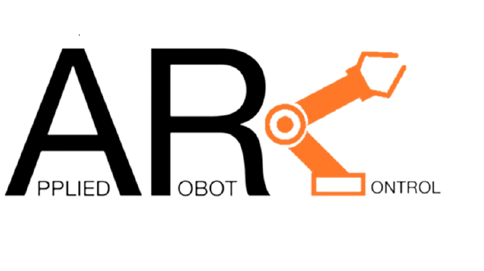
Advanced certification on emerging technologies

Slide 3
contents
Introduction
What is robotics
Industrial Applications
Working principle
Conclusion

Slide 4
INTRODUCTION
This presentation explores the application of robotics control in enhancing automation processes. We will delve into the benefits and challenges of integrating robotics in various industries.

Slide 5
What is robotics
Robotics is a branch of engineering and computer science that involves the conception, design, manufacture and operation of robots. The objective of the robotics field is to create intelligent machines that can assist humans in a variety of ways.
Robotics can take on a number of forms. A robot might resemble a human or be in the form of a robotic .

Slide 6
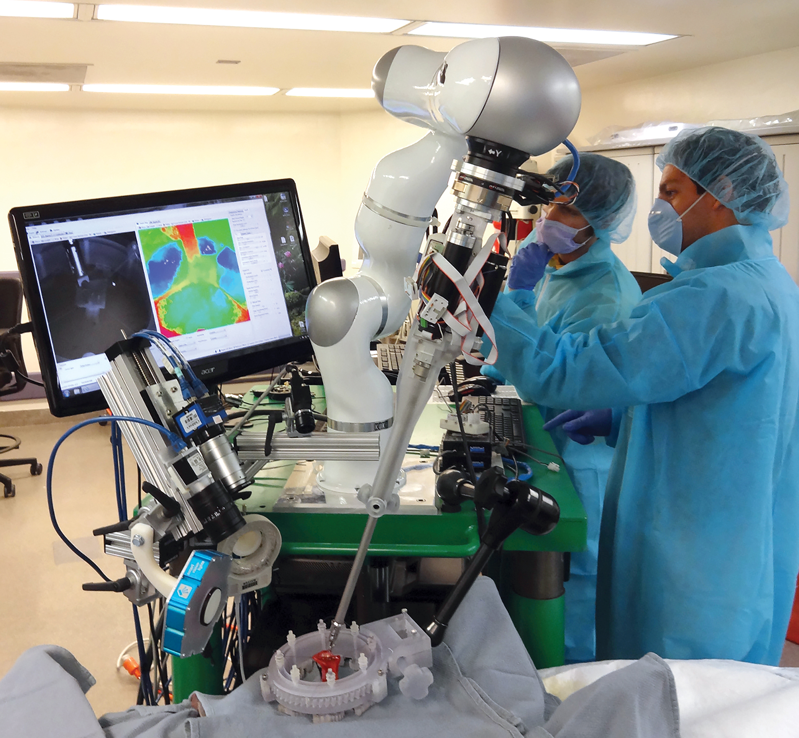
Industrial applications
Applied control robotics has diverse applications across industries, including manufacturing , logistics, healthcare ,and more . This slide will showcase real-world examples of robotic systems enhancing efficiency and productivity in various sectors

Slide 7
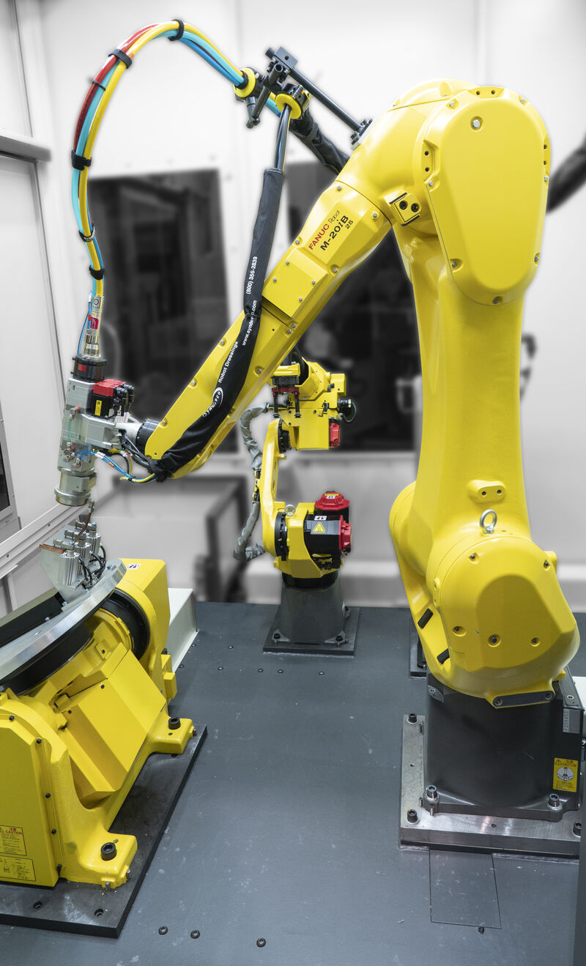
Robotic Control Systems
Robotic control systems are designed to optimize the efficiency of automated processes. They involve the use of advanced algorithms and sensors to ensure precise manipulation of objects.

Slide 8
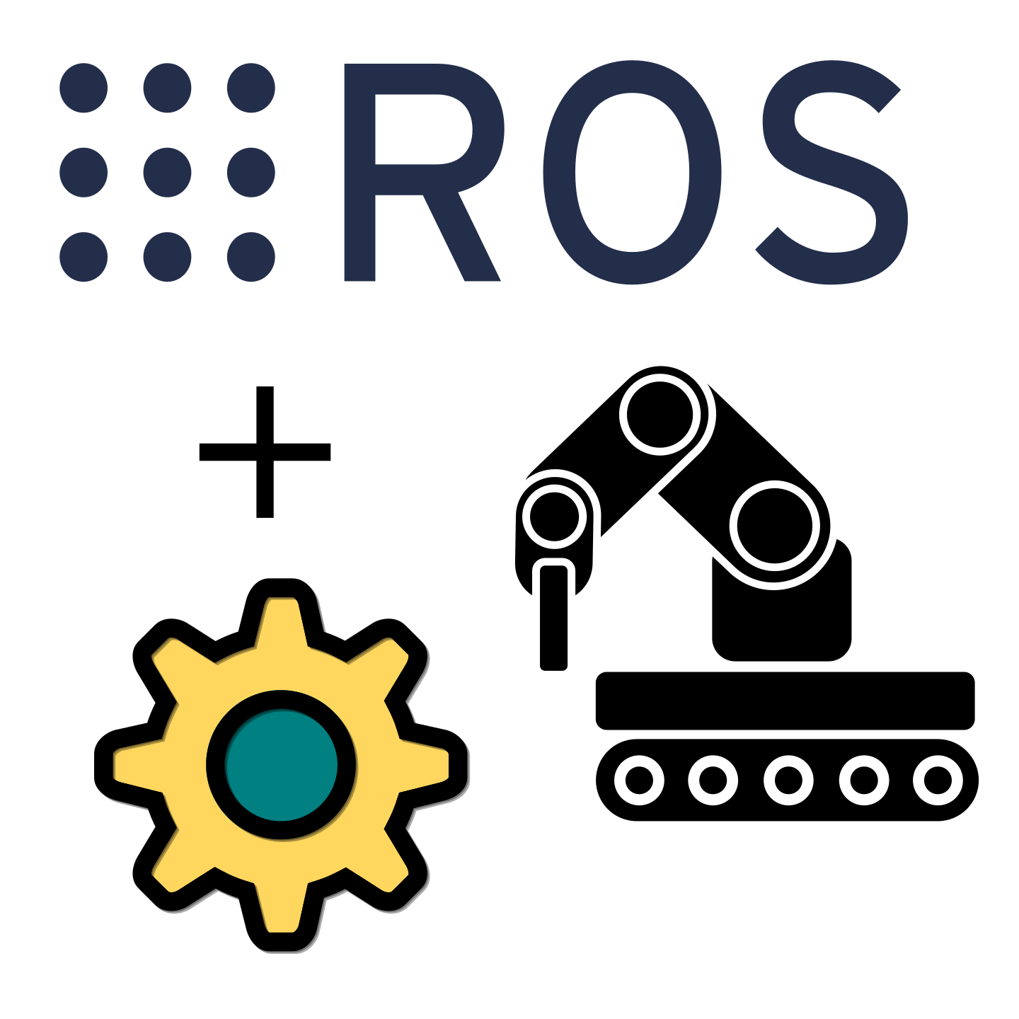
Robot operating system(ros)programming
ROS is a an open-source frame work for robot software development.
Ros is widely used in robotics research and industry applications.
It allows for modular development and easy integrating of different components
ROS support various programming language such as C++ , python ,and java

Slide 9
Working principle
IT contains several attachments throught joints known as axes. Every attachment has a stepper or servo motor that moves in a specific motion

Slide 10
Conclusion
Applied robotic control is a powerful tool that can be used to automate a wide variety of tasks. As the technology continues to develop, we can expect to see even more innovative applications for robots in the years to come.

Slide 11
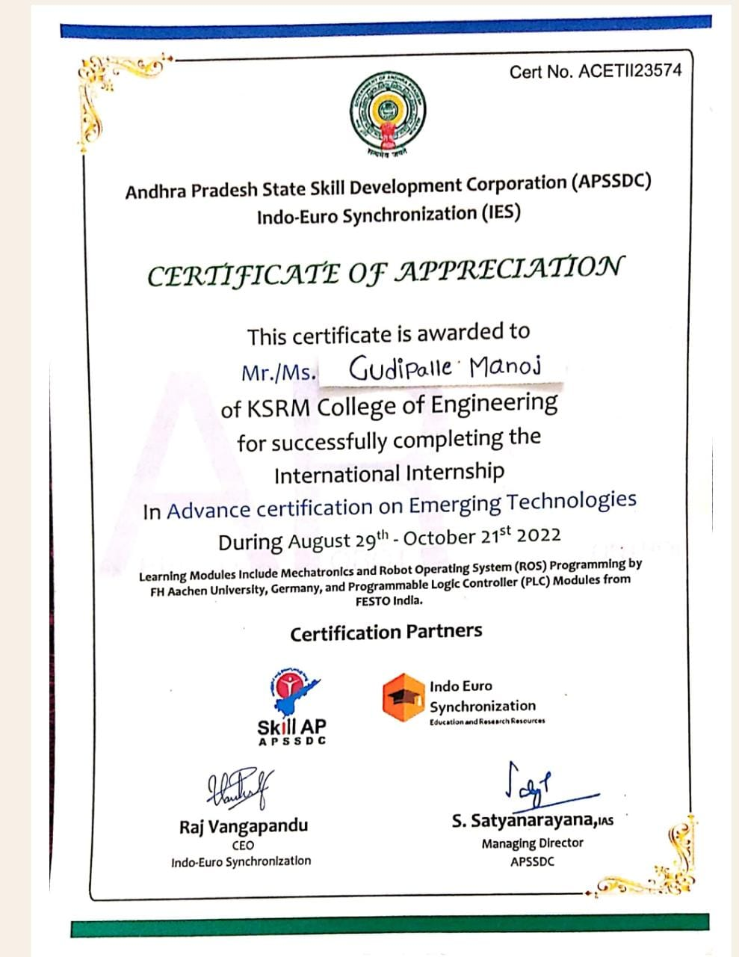

Slide 12
Thank you

