Slide 1

Battle of Neighbourhoods
It’s not rocket science!

Slide 2
Problem Background
The Toronto is the most populous city in the Canada. It is diverse and is the financial capital of Canada. It is multicultural. It provides lot of business opportunities and business friendly environment. It has attracted many different players into the market. It is a global hub of business and commerce. The city is a major centre for banking and finance, retailing, transportation, tourism, real estate, new media, traditional media, advertising, legal services, accountancy, insurance, theatre, fashion, and the arts in the Canada.
This also means that the market is highly competitive. As it is highly developed city so cost of doing business is also one of the highest. Thus, any new business venture or expansion needs to be analysed carefully. The insights derived from analysis will give good understanding of the business environment which help in strategically targeting the market. This will help in reduction of risk. And the Return on Investment will be reasonable.
The City of Canada is famous for its excellent cuisine, Art & culture and one of the best tourist locations in the world. Canada has a large domestic and foreign tourism industry. The second largest country in the world, Canada's incredible geographical variety is a significant tourist attractor. Much of the country's tourism is centred in the following (busiest) regions: Toronto, Montreal, Vancouver/Whistler, Niagara Falls, Vancouver Island, Calgary/Canadian Rockies, British Columbia's Okanagan Valley, and the national capital region Ottawa. The large cities are known for their culture, diversity, as well as the many national parks and historic sites.

Slide 3
Problem Description
The event management company must plan an event “A 7 days conference on Modern art”, where delegates will be attending from all over the world. To send them an invitation letter need to provide first-hand information to delegates like restaurants, shopping centres, cuisines, parks to meet their needs of comforts. Toronto has a big network of Modern art and natural architecture, the problem here was that event management company has never had any business in Toronto.
The management company need a better rekey around event location at Toronto and a better Hotel for stay. To optimize the cost of travelling around the Toronto.

Slide 4
Data:
Identification of Hotels around the conference venue at Toronto. This can be obtained from foursquare. Foursquare is an efficient digital location website that provides the data about numerous location data around the world.
Find parks around the Toronto from Foursquare
List of restaurants, shopping mall and cafeteria around the vicinity of Toronto.
With the complete data science analytics on the above data, it will help the event company to prepare an invitation letter mentioning suitable hotels, cuisines, museums, resting lounges to get a first-hand information for the delegates attending the conference at Toronto.

Slide 5
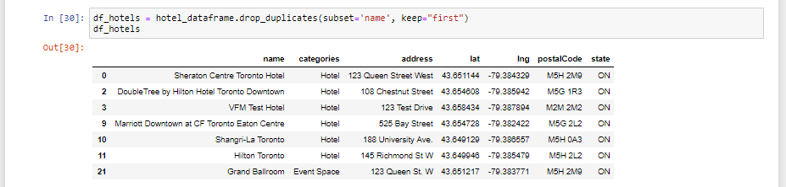
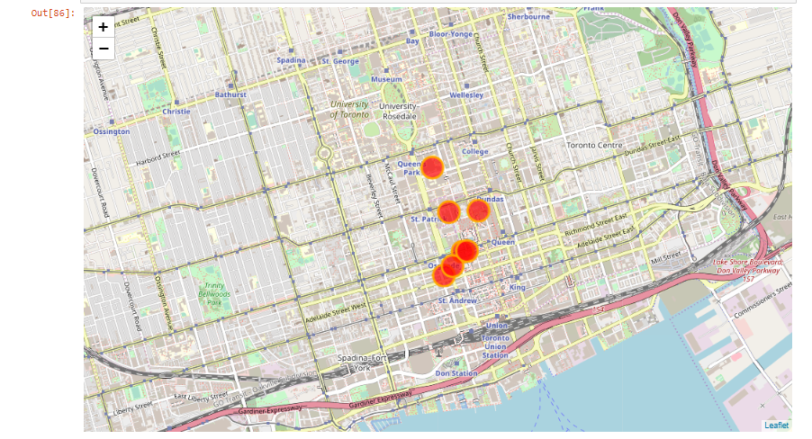
Methodology:
Initially the data about the restaurants and hotels and all the scenic places around the Toronto need to be collected.
We collect the total hotels data within the radius of 1000 meters and the list limiting to 35 needed. This could be easily done by get command and pinging to Foursquare site. We the total information about the hotels, which needed to be cleaned for better understanding by applying various cleaning techniques. The final data set will be available as.

Slide 6
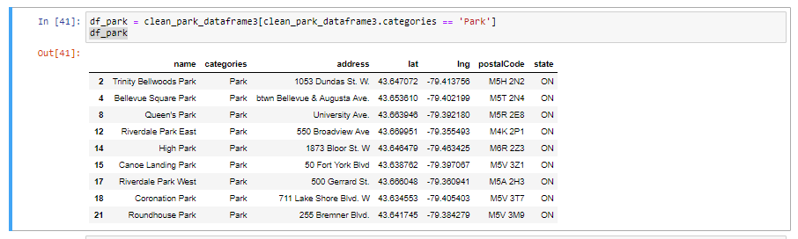
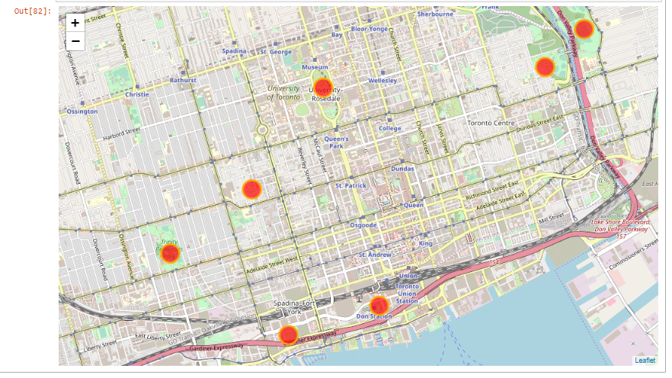
Methodology:
We collect the total parks data within the radius of 1000 meters and the list limiting to 35 needed. This could be easily done by get command and pinging to Foursquare site. We the total information about the parks, which needed to be cleaned for better understanding by applying various cleaning techniques. The final data set will be available as.

Slide 7
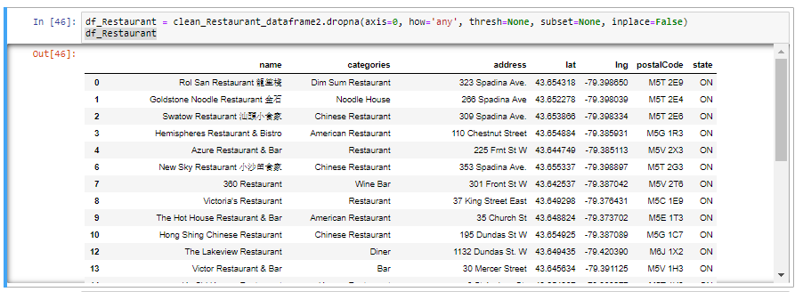
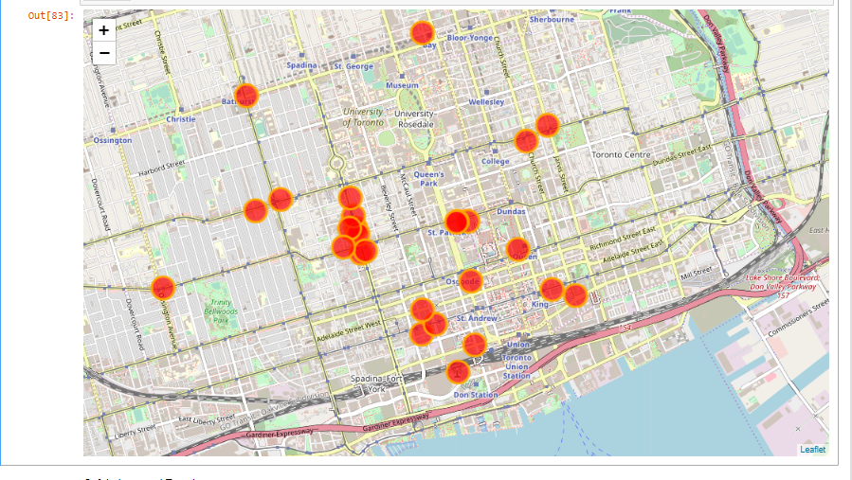
Methodology:
We collect the total restaurants data within the radius of 1000 meters and the list limiting to 35 needed. This could be easily done by get command and pinging to Foursquare site. We the total information about the restaurants, which needed to be cleaned for better understanding by applying various cleaning techniques. The final data set will be available as.

Slide 8
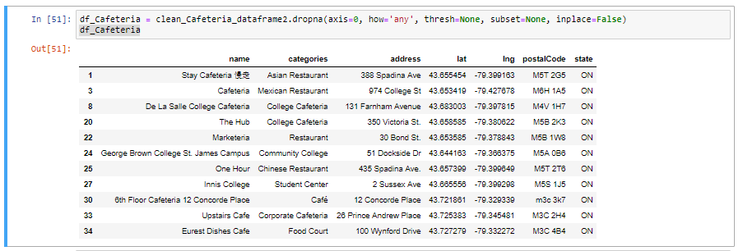
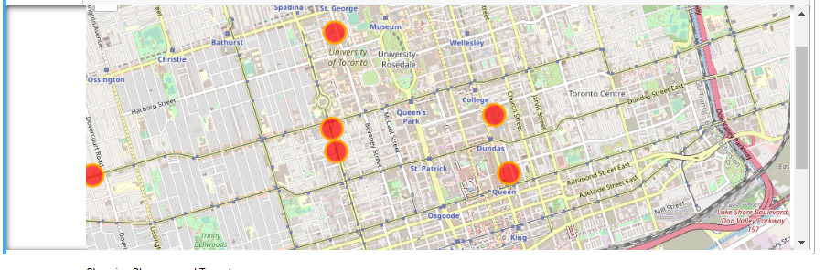
Methodology:
We collect the total cafeteria data within the radius of 1000 meters and the list limiting to 35 needed. This could be easily done by get command and pinging to Foursquare site. We the total information about the cafeteria, which needed to be cleaned for better understanding by applying various cleaning techniques. The final data set will be available as.

Slide 9
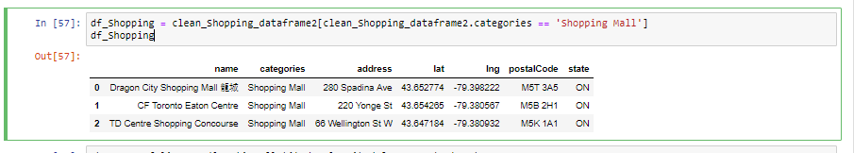
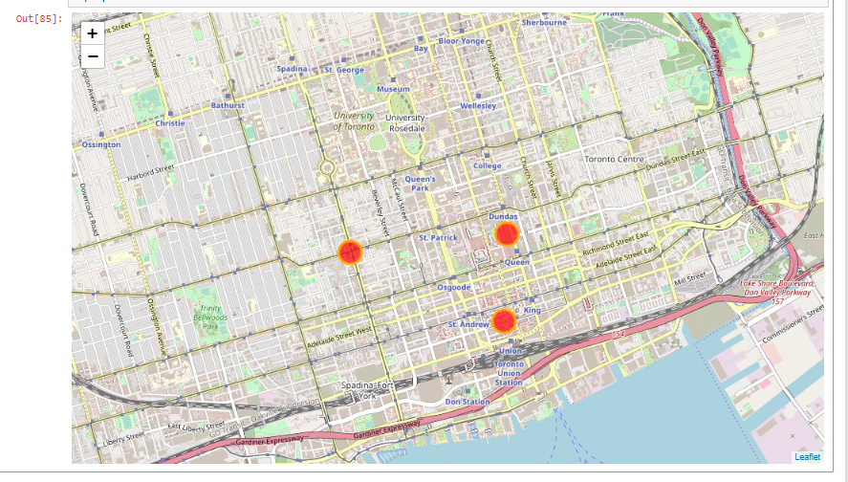
Methodology:
We collect the total shopping malls data within the radius of 1000 meters and the list limiting to 35 needed. This could be easily done by get command and pinging to Foursquare site. We the total information about the shopping malls, which needed to be cleaned for better understanding by applying various cleaning techniques. The final data set will be available as.

Slide 10
Result:
By applying clustering analysis on the collected data and finding the hotels that are closest to the maximum facilities are found to be Sheraton Centre Toronto Hotel. By booking this hotel the event management company could gain profit by quoting minimum amount for the conference.
Conclusion:
The event management company with help of this analysis can optimize the cost of event as well as delight the customer experience in any unexplored location.

