Slide 1
CNN
이미지 인식
슈퍼비전 우승

Slide 2
Convolutional neural network
컨볼루션: 정보를 섞는다는 개념(ex. 내적)

Slide 3
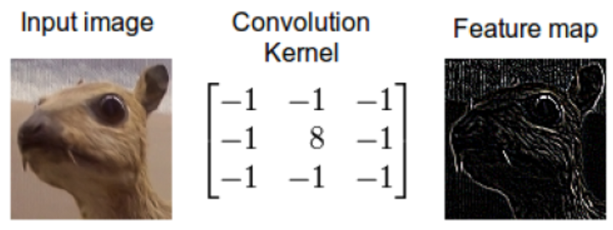
인풋이미지, 커널, 피쳐맵
<채널당 1개>
CNN의 목적 : feature engineering 을 CNN이 대신 처리해주

Slide 4
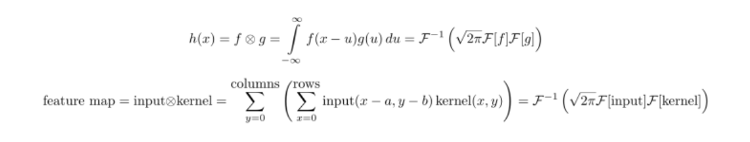
Convolutional theorem
Continuous
F: fourier transform
Discrete

Slide 5

Fast Fourier Tranfrom
슬라이드로 동영상보기
If the red signal is a song then the blue values might be the equalizer bars displayed by your mp3 player. 출처: http://hamait.tistory.com/536 [HAMA 블로그]

Slide 6
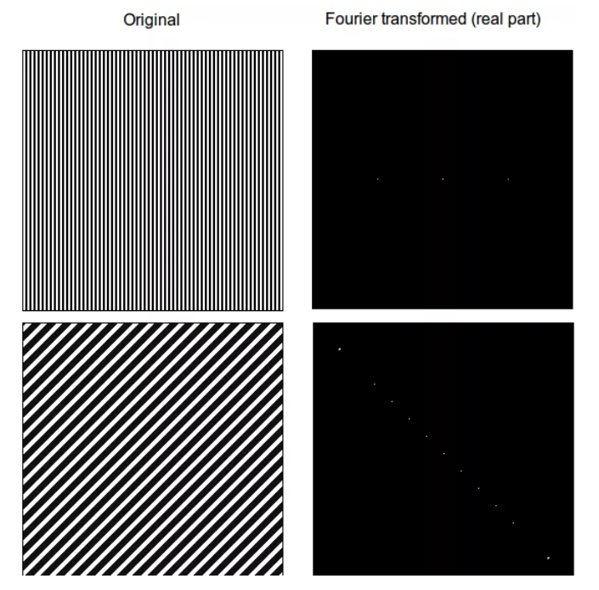
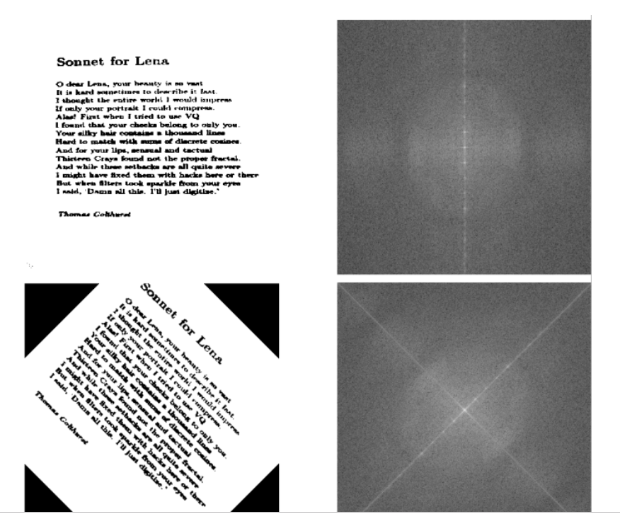
The Fourier domain for images

Slide 7
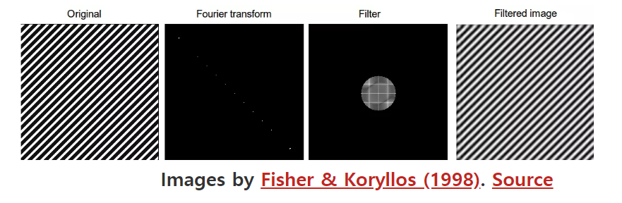
Frequency filtering and convolution
input
Kernel,filter
output
Zero padding
High frequency illiminated

Slide 8
Insights from fluid mechanics
Fourier transforms not only simplify convolution, but also differentiation
Fourier transforms are widely used in the field of fluid mechanics

Slide 9
Diffusion
Convolution = diffusion process (propagator = pdf) = change color of pixel
: which direction fluid particles diffuse over time
Intensity of pixel = Salt concentration

Slide 10
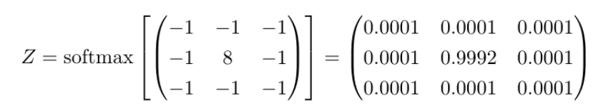
Interpreting the propagator
Propagator(probability density function) 이 diffusion procces를 수행함
-pdf를 곱한다는 데서 확산의 의미
-(softmaxed)kerne을 곱한다는 데서 classificatio의 의미
Propagator = pdf = softmaxed normalization of kernel

Slide 11
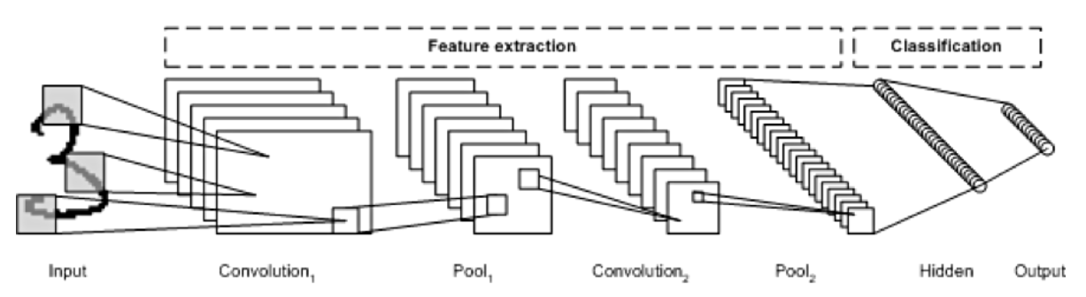

Slide 12
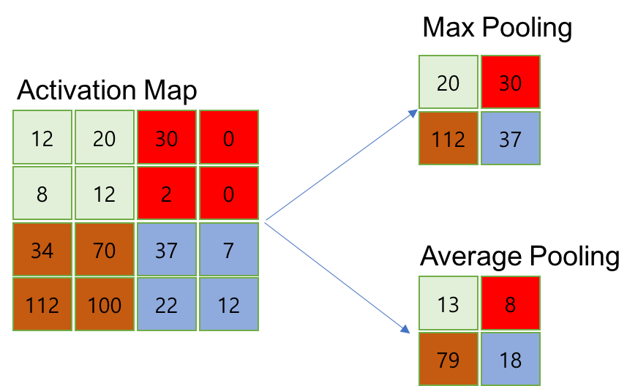
Pooling

