Slide 1
DCGAN

Slide 2
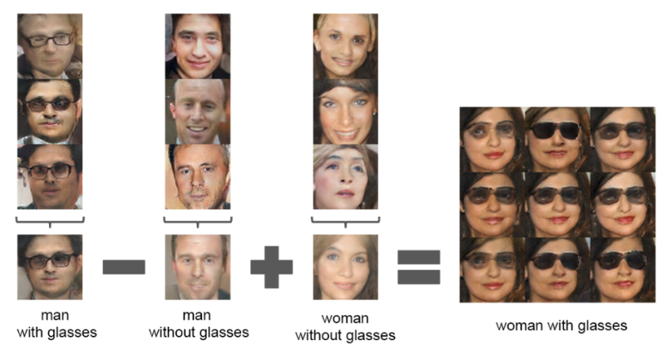
<input average>

Slide 3


