Slide 1
BEGAN
Boundary equilibrium GAN

Slide 2
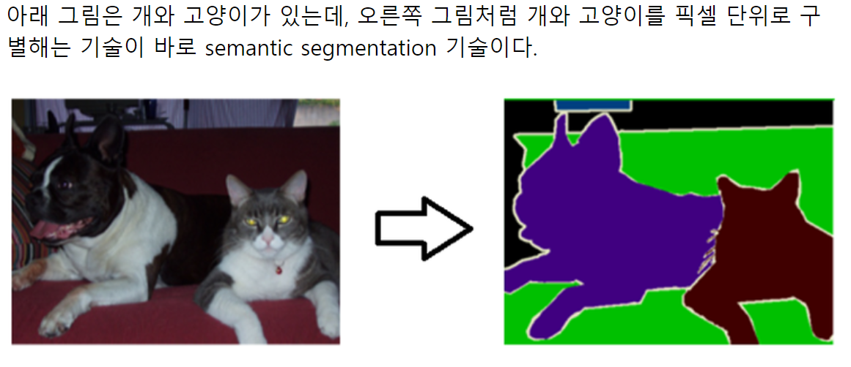
Semantic segmentation
-> What + Where (Semantic + Location)

Slide 3
Semantic segmentation map을 만듬
Generator를 이용해서 알맞은 region과 texture를 가진 이미지를 생성함

Slide 4
auto-encoder loss distribution 맞추기
진짜, 가짜 이미지 loss사이의 Wasserstein distance 계산
Auto-encoder사용

Slide 5
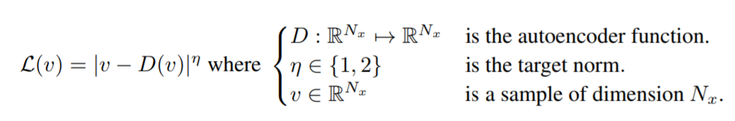
loss for training a pixel-wise autoencoder

Slide 6

Wassertein distance
Maximum value of lower boundery
µ1,2 be two distributions of auto-encoder losses
µ1:L(x)
µ2:L(G(x))

Slide 7

maximize

Slide 8
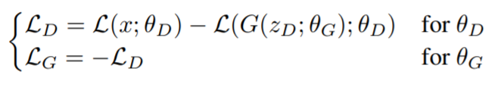
Loss function
we match distributions between losses, not between samples

