Slide 1
Random Forests
Ensemble of the bagged unpruned decision trees

Slide 2
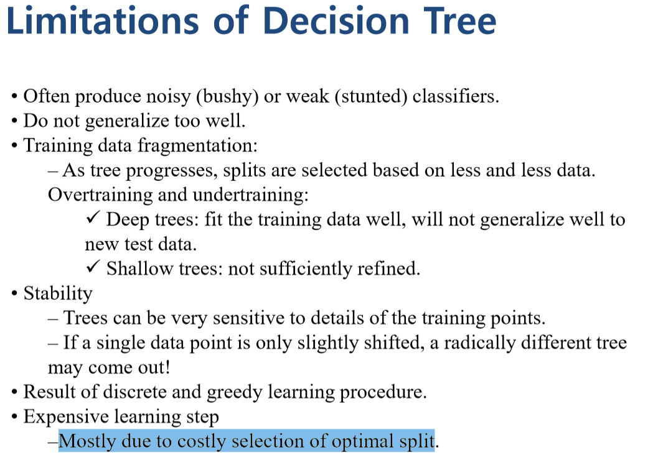

Slide 3
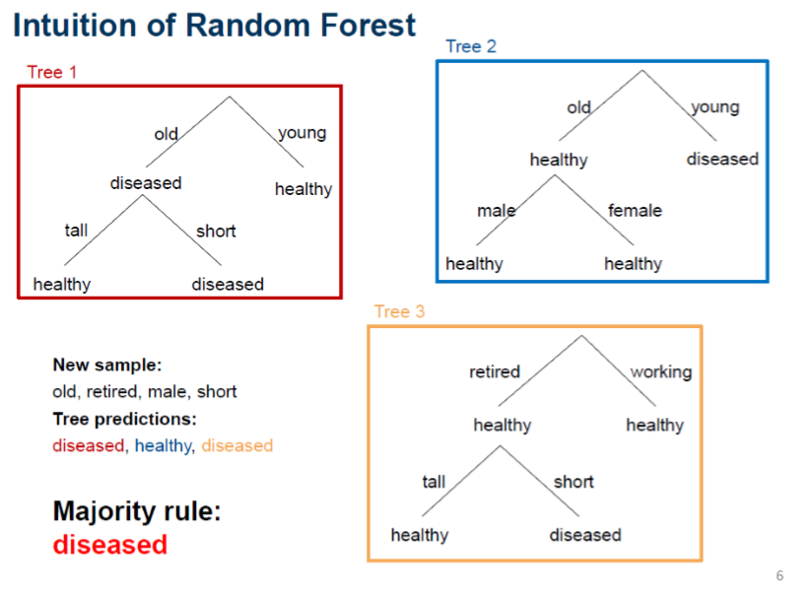

Slide 4
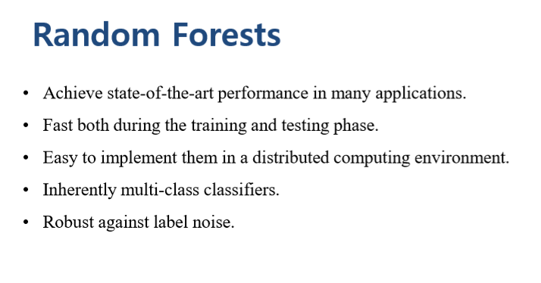

Slide 5
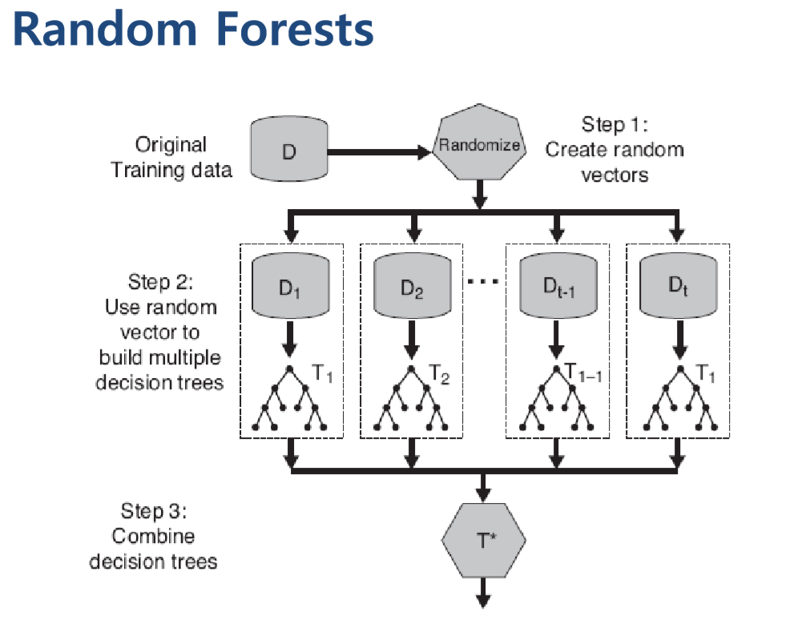
bagging
Majority vote

Slide 6
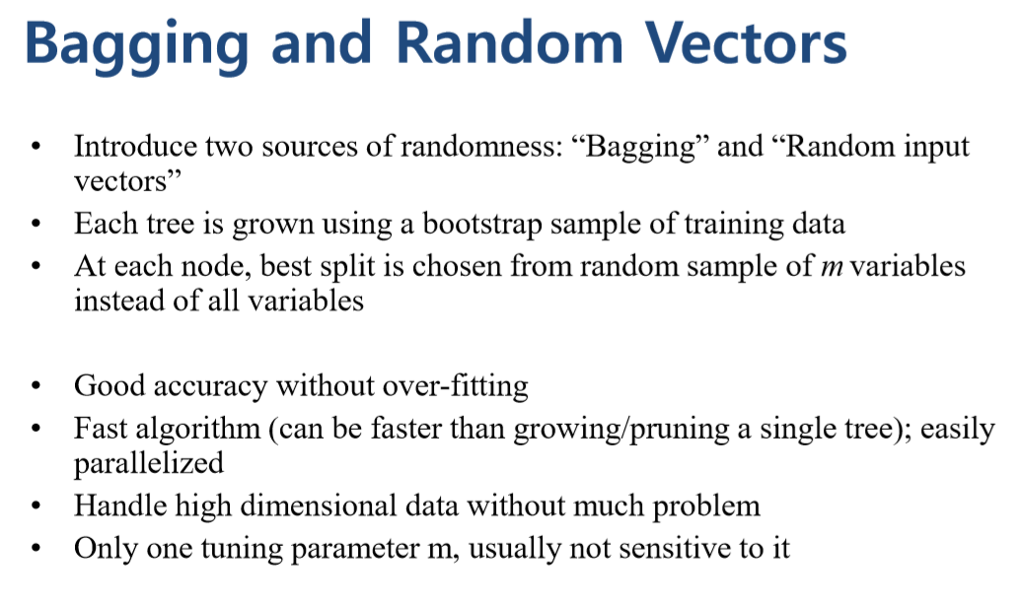
Diversity 증가

Slide 7
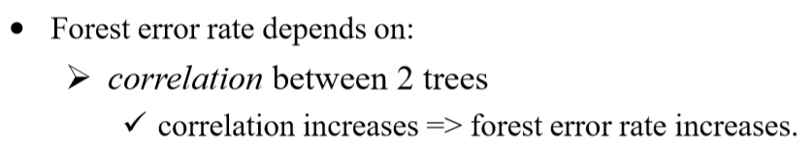
One parameter m
m: num of bagged attribute

Slide 8
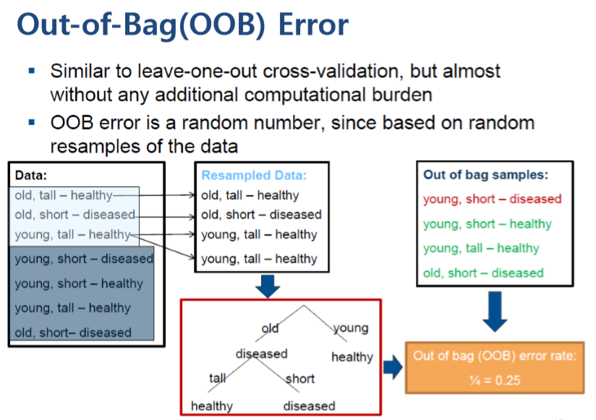
Training
data
x
o
o
o
Each bootstrap
Out of bag data
(Test data)
Small dicision tree(used to majority vote)

Slide 9
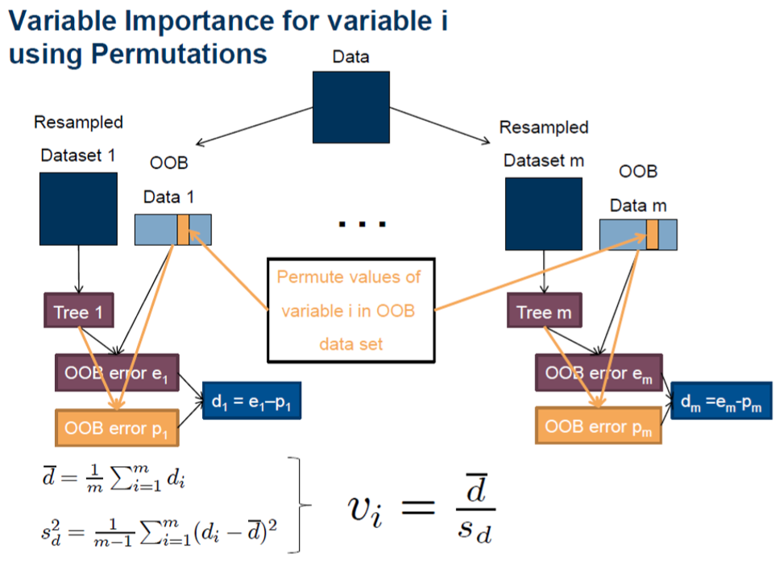
gender
Male -> Femal
original
Modified
(Male->Female)
normalize
If == 0 : gender
Is NOT important

Slide 10
Proximity plots
shows this similarity between the samples in the Out of Bag (OOB) set
for any case, only M closest cases are recorded. M is usually less than 100.
https://seis.bristol.ac.uk/~enicgc/pubs/misc/es2014-144.pdf

Slide 11
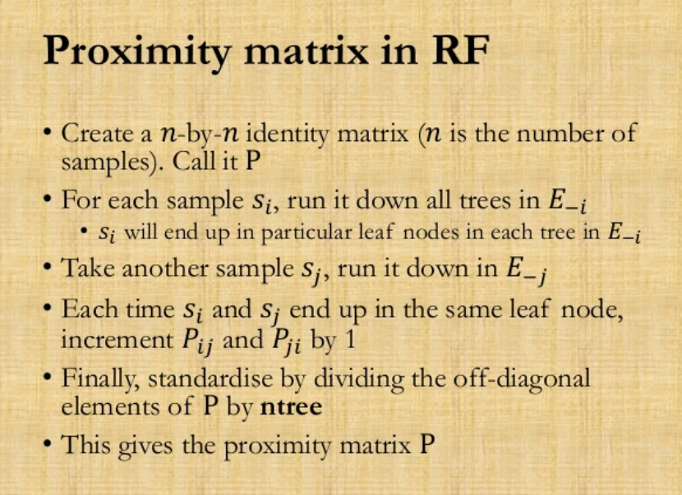

Slide 12
cons
The primary disadvantage of Random Forests is that the model is complex and cannot be visualized like a single tree.

