Slide 1
clustering
Unsupervised learning

Slide 2
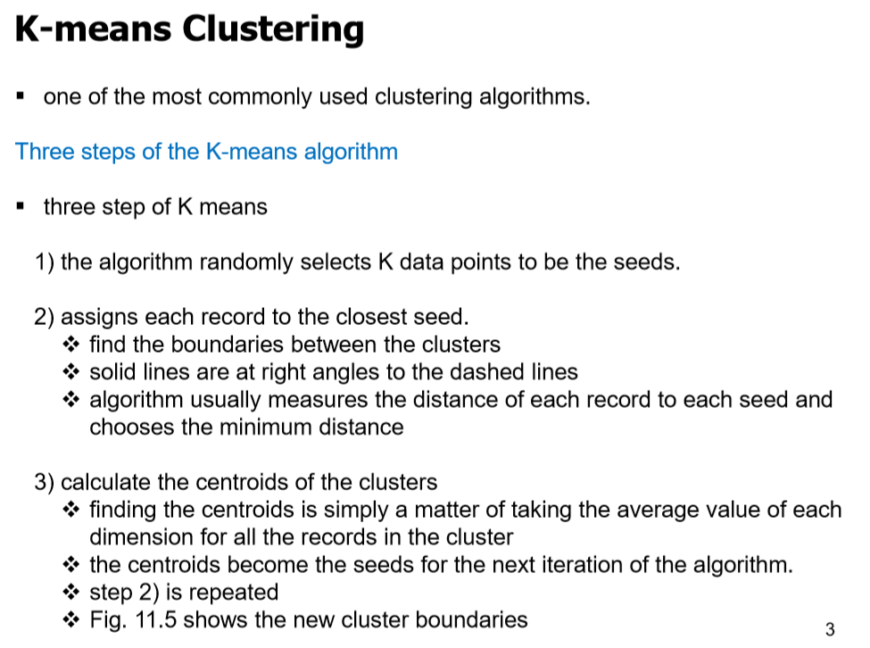

Slide 3
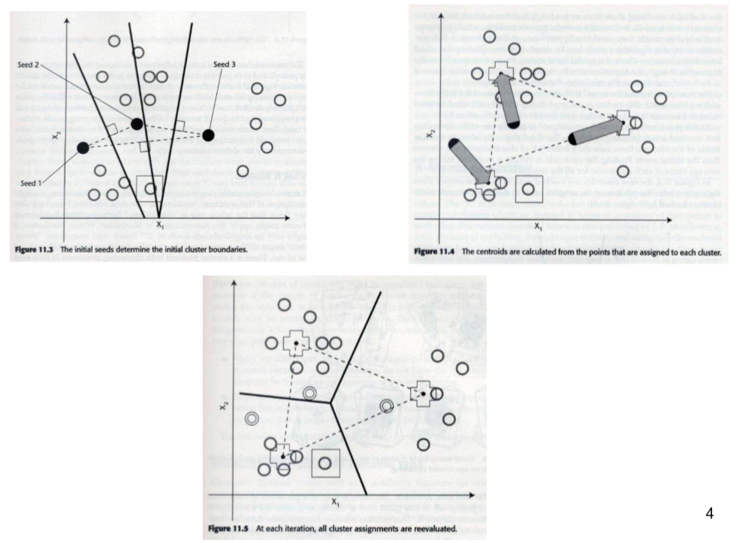
until the cluster boundaries
or centroid stop changing

Slide 4
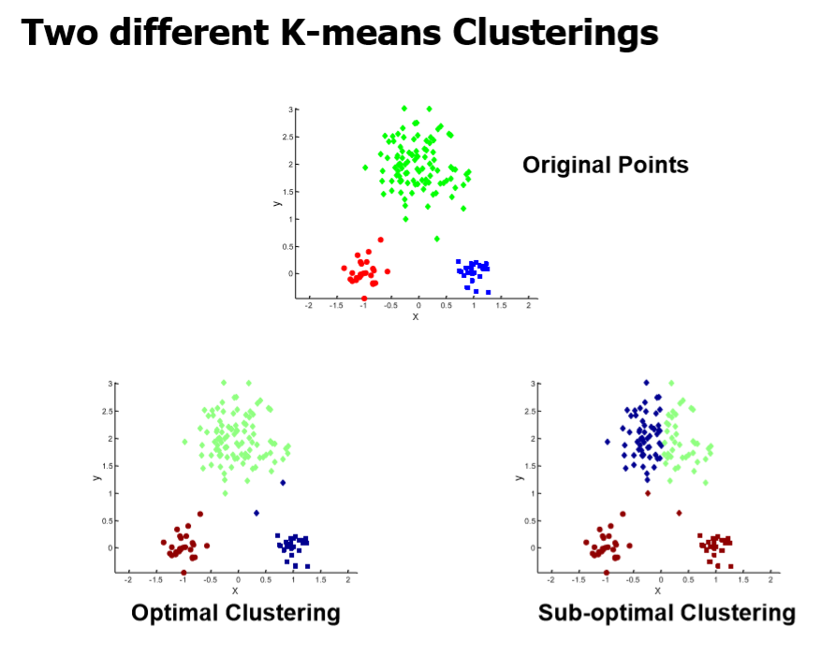
Choosing a
Initial centroid
Is important

Slide 5
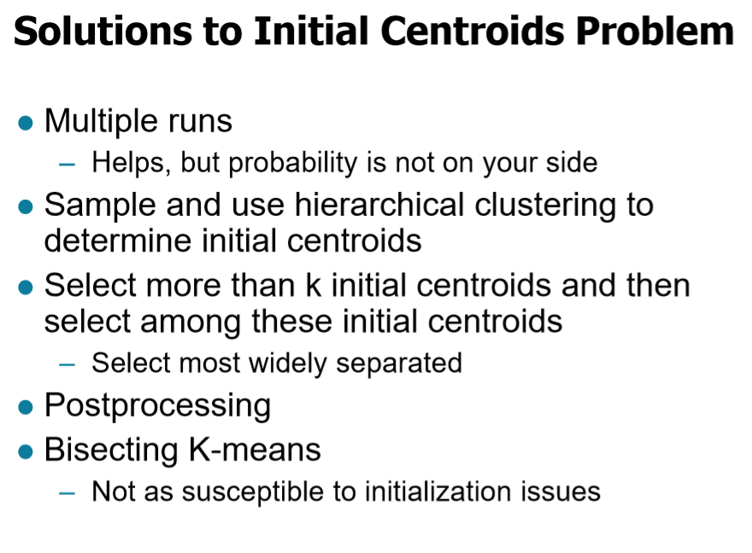

Slide 6
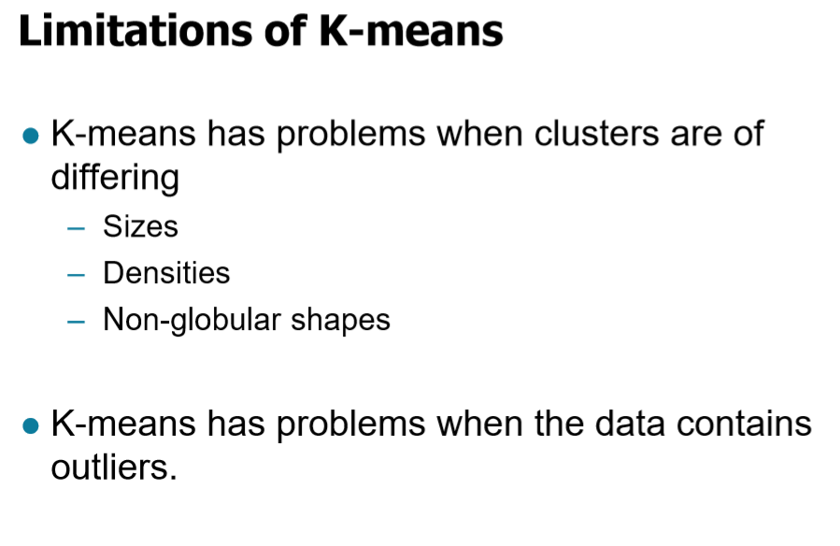

Slide 7
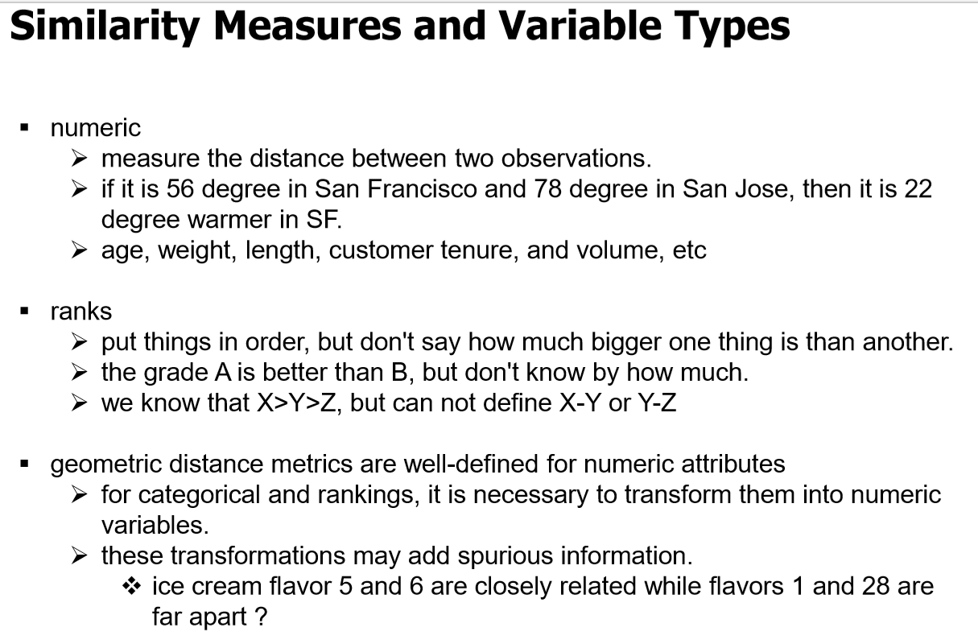

Slide 8
Formal measure of similarity
Geometric distance of two points -> Euclidian distance
Angle between two vectors(cosine similarity)

Slide 9
