Slide 1
ensemble

Slide 2
Multiple classifier
select a collection (ensemble) of hypotheses and combine their predictions

Slide 3
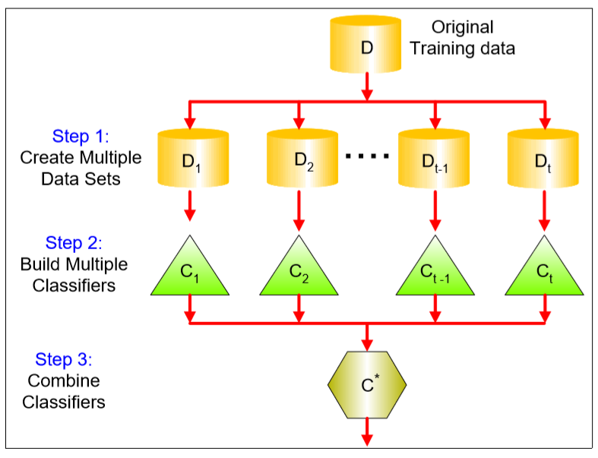

Slide 4
Combing multiple classifiers rule
Independent and diverse classifiers
Diversity is most important!!!

Slide 5
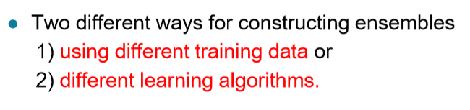
+ Weighted Voting

Slide 6
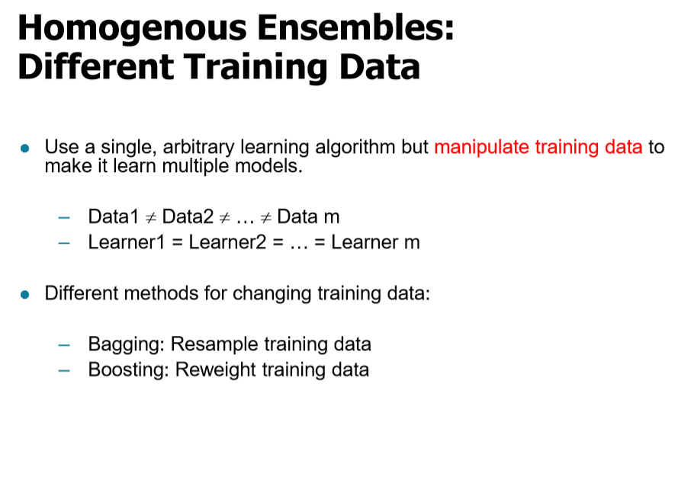

Slide 7
Ensemble methods
Bagging(bootstrap aggregating)
Boosting
Random Forests

Slide 8
Bagging(bootstrap aggregating)
M개의 속성을 가진 data가 있을 때, m(m<M)개의 속성을 각각 샘플마다 임으로 중복을 허용하며 뽑아서(bootstap)
각 각 Classifier을 학습시킴

Slide 9
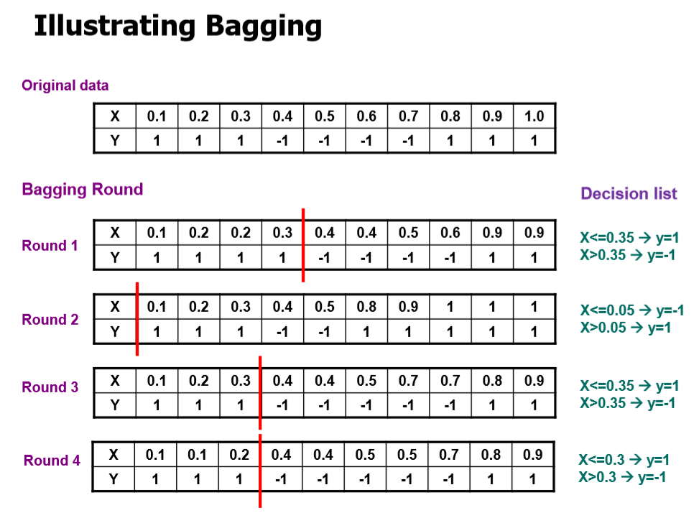
Linear
classifier
error

Slide 10
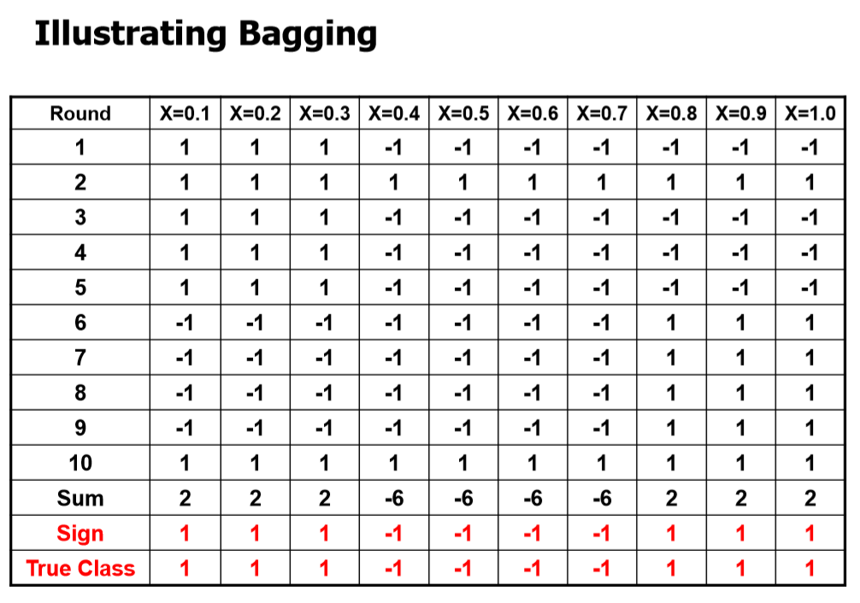
Majority
voting

Slide 11
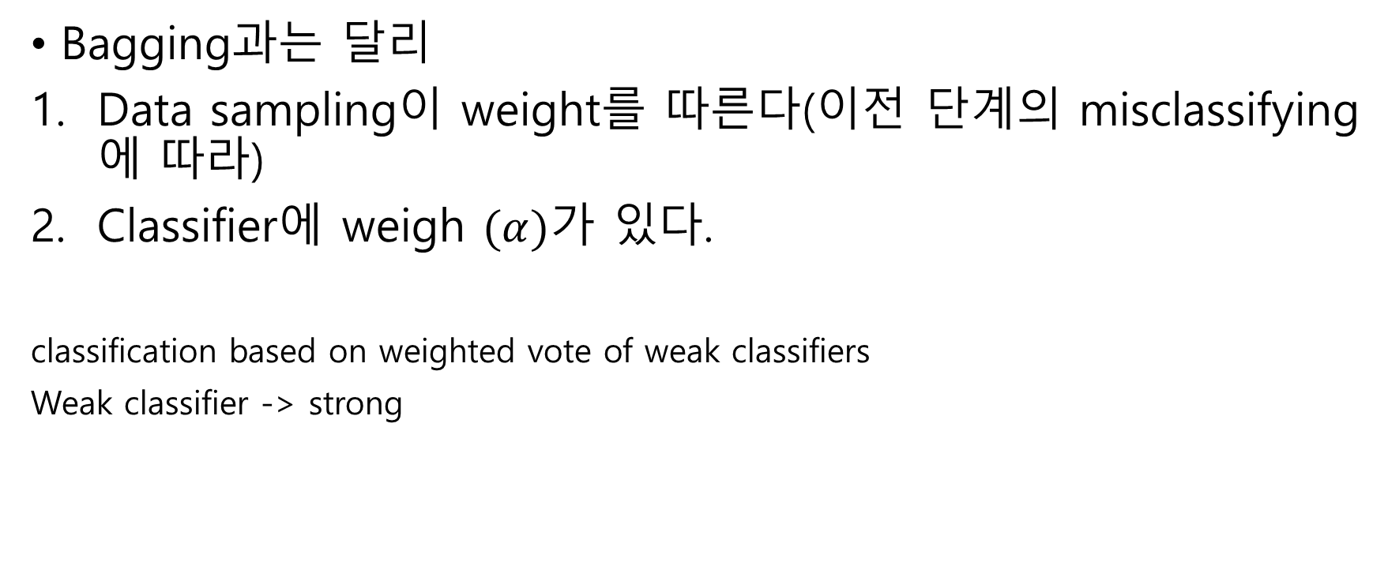
Boosting
Bagging과는 달리
Data sampling이 weight를 따른다(이전 단계의 misclassifying에 따라)
Classifier에 weigh $(α)$가 있다.
classification based on weighted vote of weak classifiers
Weak classifier -> strong

Slide 12
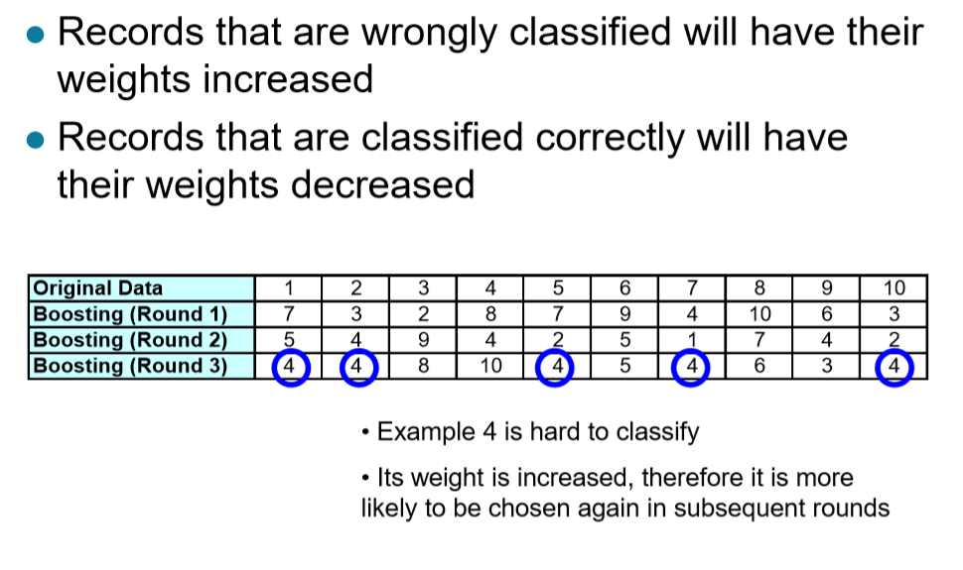
misclassifying

Slide 13
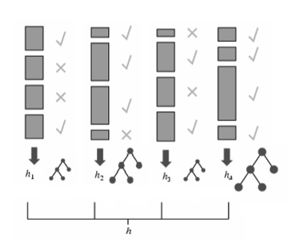
Weight 증가
error
Accuracy:
half
75%
half
100%

Slide 14
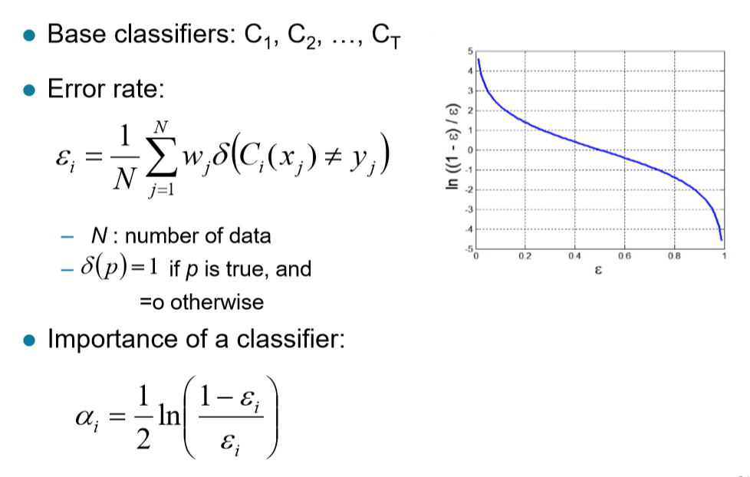
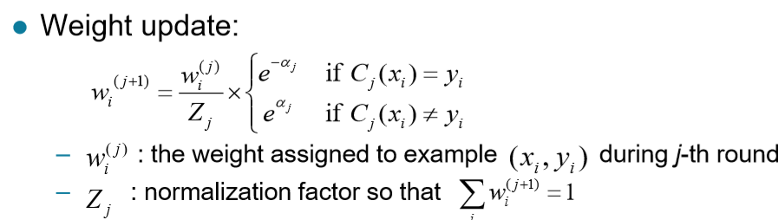
Adaboost Error, Weight
Error 가 증가하면 importance 감소

Slide 15
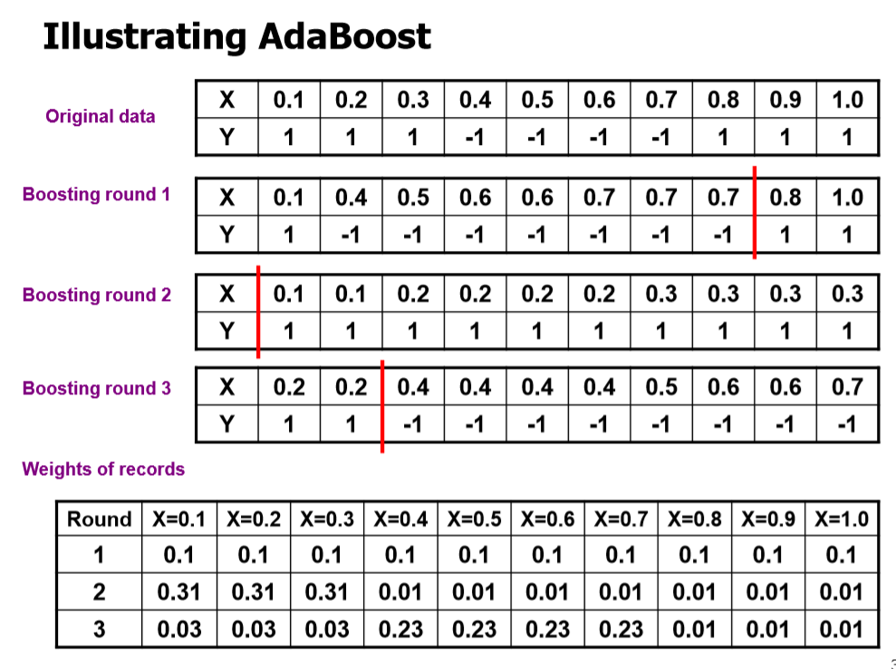
classifier
error
All same weight
Weight 증가

Slide 16
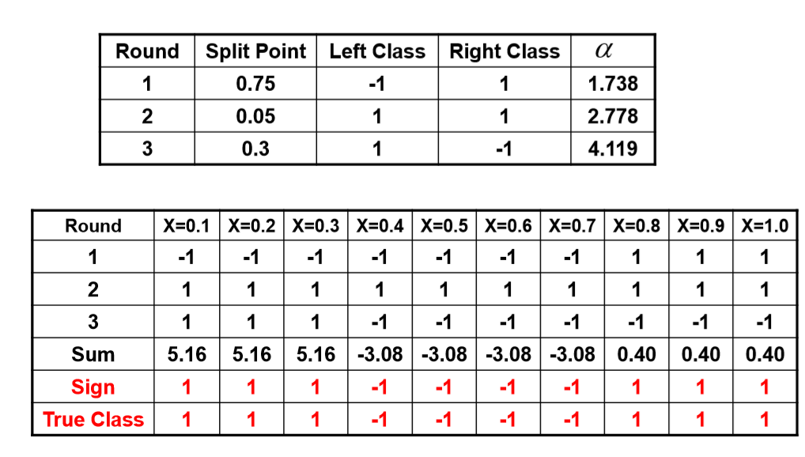
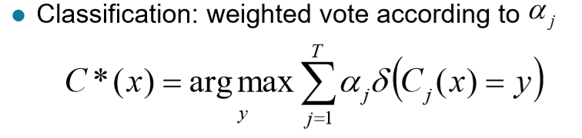
Classifier weight
-1.738 + 2,778 + 4.119

Slide 17
