Slide 1

QML: Harnessing Entanglement for PV Fault Detection
Glen S Uehara, PhD
Notes:
I have a BS and MSE in Electrical Engineering, from University of Hawaii and Arizona State University, respectively. Since my first degree, I have been working as a communication and signal processing engineering in both commercial and defense industry. In the recent years, I have also earned several certifications in cyber security and have applied these techniques to my programs. With these backgrounds, I’ve been working with ASU Tempe, Poly, UofA and NAU on various capstones related to these fields.
As I continue mentoring students, I decided to return and earn a Ph.D. Currently, as a Ph.D. student in the School of Electrical, Computer and Energy Engineering at ASU, I am specializing in Quantum Information Algorithms specifically for Signal & Information Processing w/ emphasis Machine Learning techniques. I am also working in the Quantum Laboratory at General Dynamics as a Quantum Algorithm Researcher. I am hoping to explore new techniques and methods in Quantum Algorithms to grow this knowledge for both ASU and GD.

Slide 2
1. Introduction
Background
Research
Photovoltaic (PV) systems produce multi-sensor, high-dimensional data (voltage, current, irradiance, temperature).
Faults such as shading, soiling, degradation, and disconnections are hard to detect due to non-linear feature correlations.
Investigates designing custom quantum circuits for large-scale PV fault detection.
Use quantum encoding, superposition, and entanglement to capture hidden correlations.
Develop hybrid quantum–classical models to uncover fault patterns beyond classical reach.
Develop and analyze quantum computing algorithms that can identify complex, high-dimensional correlations
Notes:
We used the PV dataset to help to generate complex, high-dimensional data (voltage, current, irradiance, temperature, etc.). The algorithm we built is to detect faults (e.g., shading, soiling, degradation, etc), which requires identifying subtle, non-linear correlations.
MOTIVATION:
The core motivation is to develop and analyze algorithms that can identify complex, high-dimensional correlations, thereby unlocking insights from data that remain hidden from even the most advanced classical techniques.
This dissertation is motivated by the need for more powerful computational approaches to pattern recognition and classification. We hypothesize that quantum and hybrid quantum–classical models can achieve similar performance by efficiently navigating vast feature spaces with today’s NISQ-era quantum computers (Noisy Intermediate-Scale Quantum). This would show the potential and promise for a future quantum computer with reduced noise, improved noise detection, or enhanced noise mitigation.

Slide 3
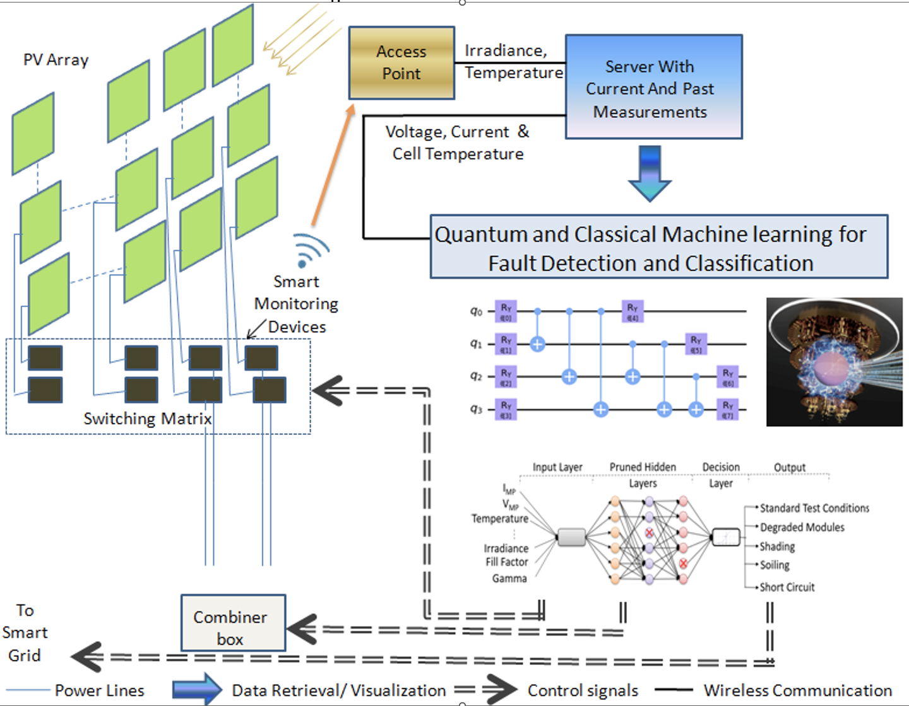
3. Quantum Algorithms for PV Fault Detection
PV Monitoring Concept
Notes:
This dissertation investigates the potential of custom quantum circuits to advance classification performance in large-scale PV fault detection. Rather than refining existing classical methods, we explore how quantum data correlation and high-dimensional encoding can unlock fundamentally new capabilities in feature extraction and anomaly detection.
Quantum circuits operate in exponentially large Hilbert spaces, where amplitude, rotation, and coherent state encodings enable richer representations. We use entanglement to capture multivariable correlations and superposition to facilitate parallel exploration of fault signatures.
By integrating these mechanisms into our new hybrid quantum–classical models, we aim to reveal dependencies and fault behaviors that remain inaccessible to classical techniques.

Slide 4
PV Monitoring and Fault Detection
Classical ML and its application to PV fault detection has been demonstrated.
The study in Rao et al. demonstrated successful use of classical neural networks for fault detection in a relatively small solar array system.
To address high complexity computation, we published a feasibility study where we described a simple Quantum Neural Network (QNN) binary classifier (IEEE IISA 2021).
Notes:
Based on Rao et al. we demonstrated successful use of classical neural networks for fault detection in a relatively small solar array system. In large-scale solar arrays or when managing multiple utility-scale PV power sites, fault detection often requires substantial computational resources. In the initial quantum computing feasibility study for PV fault detection, we demonstrated the use of quantum circuits with a small number of qubits, achieving modest fault detection accuracy due to the limitations of low-qubit computations and the absence of a mechanism to capture data correlations.

Slide 5
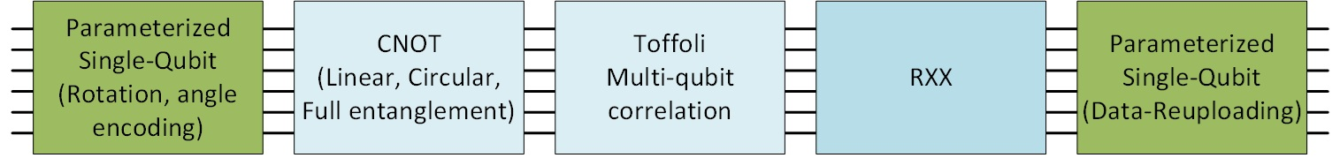
Enhanced Quantum ML for PV Fault Detection
We focus on improving classification results by designing more complex and customized quantum circuits for large-scale solar array faults.
The proposed enhanced quantum circuits leverage quantum data correlation effectively for feature extraction in PV fault detection.
Notes:
We design quantum data correlation mechanisms that leverage entanglement to model interdependencies between PV features directly.

Slide 6
The Feature Maps we considered
Feature Map | Circuit Elements | Encoding Role | Ising Analog | Transverse Ising Analog
Z | RZ(xᵢ) | Phase encoding of classical data | Local field: hᵢZᵢ | None
ZZ | RZ(xᵢ) + ZZᵢⱼ | Pairwise correlations | Coupling: JᵢⱼZᵢZⱼ | None
ZZZ | RZ(xᵢ) + ZZZᵢⱼₖ | Higher-order correlations | Extended coupling: ZᵢZⱼZₖ | None
X-ZZ | RX(xᵢ) + ZZᵢⱼ | Adds quantum fluctuations | Coupling: ZᵢZⱼ | Transverse field: gᵢXᵢ
Z-Y-ZZ | RZ(xᵢ) + RY(xᵢ) + ZZᵢⱼ | Rich encoding + entanglement | hᵢZᵢ + JᵢⱼZᵢZⱼ | Transverse field via gᵢYᵢ
Notes:
The Transverse Ising Model (TIM) is a quantum spin model widely used to study quantum correlations, entanglement, and phase transitions in many-body systems. It provides a structured and interpretable framework for encoding and processing data within quantum machine learning and variational quantum circuits.
The spins (qubits) represent measurement features (e.g., voltage, current, irradiance, temperature).
The coupling term ($Z_{i}Z_{i+1}$) captures correlations between neighboring or related measurements.
The transverse field term ($hX_{i}$) enables superposition and exploration of alternative feature configurations, representing non-linear dependencies and possible fault states.
Concept Classical Analogy Quantum Advantage
Spin coupling Correlation between sensors Encodes multi-variable dependencies
Transverse field Feature variation Explores alternate fault states
Ground state Optimal model configuration Captures global fault context

Slide 7
Binary Classification: Testing Results
Simulator | Feature Map | Qubits | Ansatz | Train Score | Test Score
AER Simulator | X, ZZ, 1 layer | 6 | full | 71.35% | 71.40%
AER Simulator | X, ZZ, 1 layer | 6 | circular | 80.05% | 79.26%
AER Simulator | X, ZZ, 1 layer | 6 | linear | 79.52% | 79.22%
AER Simulator | X, ZZ, 1 layer | 4 | full | 86.36% | 86.53%
IBM Osaka Noise Model | X, ZZ, 1 layer | 4 | full | 78.27% | 78.10%
AER Simulator | Y, ZZ, 1 layer | 6 | full | 69.93% | 69.67%
AER Simulator | Y, ZZ, 1 layer | 6 | circular | 69.95% | 69.67%
Sample 1
Notes:
1024 shots that allow us to collect probability distributions. This is similar to classical Monte Carlo

Slide 8
Binary Classification: Testing Results
Simulator | Feature Map | Qubits | Ansatz | Train Score | Test Score
AER Simulator | ZZ, 1 layer | 6 | full | 84.40% | 84.04%
AER Simulator | ZZ, 1 layer | 6 | linear | 83.54% | 83.59%
AER Simulator | ZZ, 1 layer | 6 | sca | 82.22% | 82.72%
AER Simulator | ZZ, 1 layer | 6 | circular | 81.95% | 81.37%
IBM Osaka Noise Model | ZZ, 1 layer | 6 | full | 83.39% | 83.36%
IBM Torino Noise Model | ZZ, 1 layer | 6 | full | 81.24% | 82.39%
AER Simulator | ZZ, 1 layer | 4 | full | 82.35% | 82.27%
IBM Osaka Noise Model | ZZ, 1 layer | 4 | full | 84.78% | 84.57%
AER Simulator | X, ZZ, 2 layer | 6 | full | 81.65% | 81.86%
AER Simulator | ZZ, 2 layer | 6 | full | 84.15% | 84.87%
Sample 1

Slide 9
Testing Results
Simulator | Feature Map | Qubits | Ansatz | Train Score | Test Score
AER Simulator | ZZ, 1 layer, full | 8 | full | 72.97% | 73.13%
AER Simulator | X, ZZ, 1 layer, full | 8 | full | 77.45% | 77.76%
AER Simulator | X, ZZ, 1 layer, full | 4 | full | 74.09% | 74.69%
AER Simulator | ZZ, 1 layer, full | 4 | full | 97.19% | 96.67%
Sample 2

Slide 10
Binary Classification: Testing Results
Simulator | Feature Map | Qubits | Ansatz | Train Score | Test Score
AER Simulator | ZZ, 1 layer, full | 8 | full | 72.97% | 73.13%
AER Simulator | X, ZZ, 1 layer, full | 8 | full | 77.45% | 77.76%
AER Simulator | X, ZZ, 1 layer, full | 4 | full | 74.09% | 74.69%
AER Simulator | ZZ, 1 layer, full | 4 | full | 97.19% | 96.67%
Sample 3

Slide 11
Binary Classification: Testing Results
Simulator | Feature Map | Qubits | Ansatz | Train Score | Test Score
AER Simulator | ZZ, 1 layer, full | 10 | full | 78.94% | 78.57%
AER Simulator | X, ZZ, 1 layer, full | 10 | full | 77.93% | 77.26%
AER Simulator | X, ZZ, 1 layer, full | 4 | full | 95.67% | 96.18%
AER Simulator | X, ZZ, 1 layer, full | 4 | linear | 92.01% | 92.02%
AER Simulator | X, ZZ, 1 layer, full | 4 | circular | 90.34% | 90.39%
AER Simulator | ZZ, 1 layer, full | 4 | full | 97.68% | 97.53%
Sample 4 (Synthetic)

Slide 12
Constructing Feature Maps
The inclusion of both X and ZZ terms in the feature map consistently enhanced the model’s generalization and robustness across multiple datasets and simulation environments.
Feature maps that encode both single-qubit rotations (X) and two-qubit entangling interactions (ZZ) effectively emulate a transverse-field Ising-like structure, enabling the circuit to explore a richer manifold of the Hilbert space during state preparation.
Notes:
The results presented highlight the impact of feature map construction on the performance of quantum models. These interactions reveal controlled quantum fluctuations in the feature embedding, thereby enhancing the separability of the encoded data.
The results show that feature maps with both X and ZZ encodings achieved superior accuracy (e.g., 80–86% in AER simulation and 78% under the IBM Osaka noise model), compared to single-term encodings.
This suggests that quantum fluctuations introduced through the transverse field enhance the circuit’s ability to adapt and mitigate noise effects
The result is a feature space that reflects not only classical similarity between input data points but also quantum correlations, allowing the model to explore a broader manifold of the Hilbert space.
A key advantage in quantum machine learning applications.

Slide 13
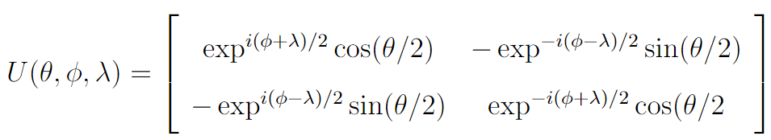
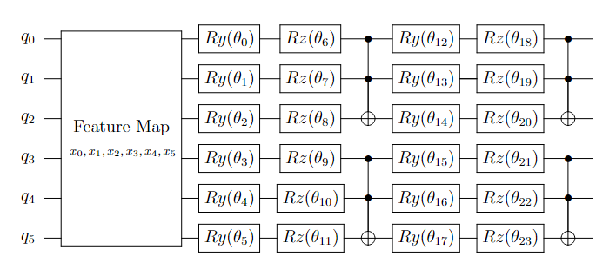
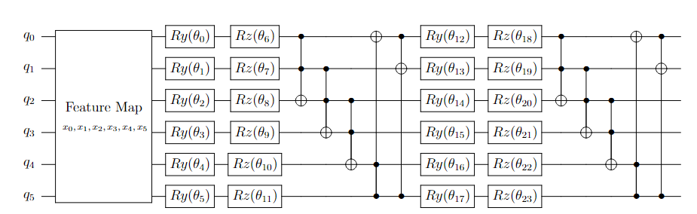
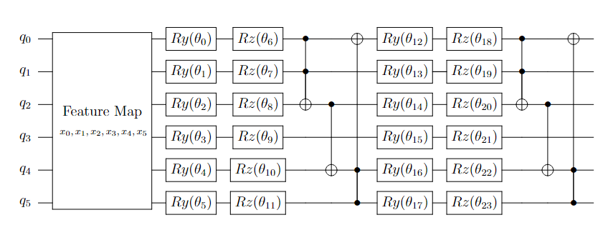
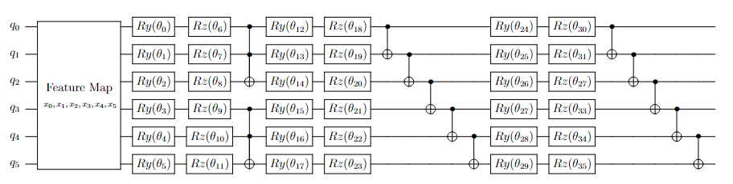
Ansatz Baseline
Special Unitary (SU) Group Ansatz
Linear Entanglement
Full Entanglement
Toffoli-Based
Circular Entanglement
Toffoli with CNOT
Notes:
Special Unitary (SU) Group Ansatz, focusing on different entanglement schemes for a hardware-efficient SU(2) 2-local circuit. The SU(2) Ansatz consists of layers of SU(2) single-qubit operations combined with controlled entanglement gates, such as Controlled-NOT (CNOT).

Slide 14
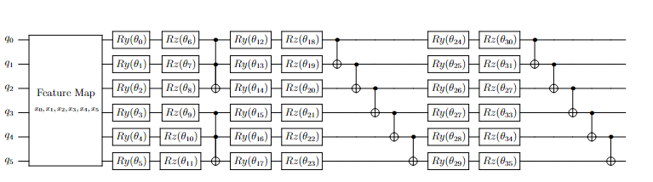
Building our Ansatz
Toffoli gates were initially tested to encode high-order feature interactions.
The prototype circuit featured entanglement coverage, enabling expressive modeling of conditional dependencies in the PV datasets.
However, this configuration introduced excessive gate depth and noise sensitivity.

Slide 15
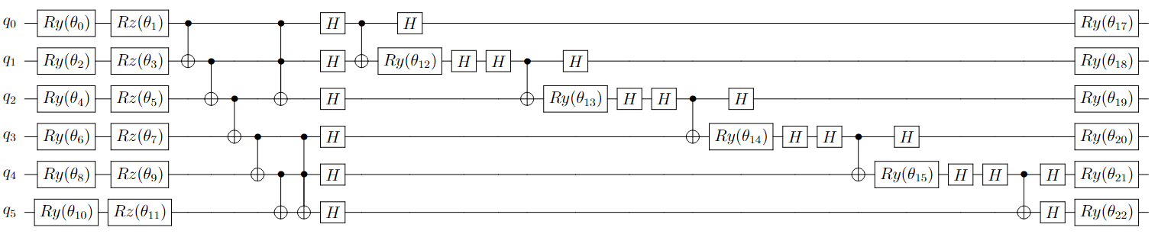

Optimizing our Ansatz
The final circuit preserves essential entanglement while significantly reducing gate count and execution time.
This refined architecture was used in PV fault detection, demonstrating improved classification accuracy and robustness on NISQ hardware.
Notes:
To optimize performance and hardware feasibility, we applied a pruning strategy based on empirical feature relevance and entanglement contribution. The pruning process involved:
Correlation Analysis: Evaluated mutual information between features to identify impactful entanglement paths.
Gradient Sensitivity: Assessed gate-level influence on model loss during training iterations.
Gate Reduction: Removed low-impact Toffoli gates and replaced redundant structures with CNOT or single-qubit rotations.
Layer Simplification: Collapsed multi-controlled operations into modular blocks with reduced depth.
Novel Ansatz for PV Fault Detection
Layer 1: Initial Feature Embedding: Each qubit undergoes SU(2) parameterization via single-qubit rotations: Urefine
Layer 2: Entanglement and Intermediate Re-Uploading: Entanglement is introduced via CNOT and Toffoli gates. Hadamard gates create superposition, and controlled Ry gates reintroduce feature parameters conditionally: Uentangle
Layer 3: Final Feature Refinement and Re-Uploading A final round of Hadamard gates and single-qubit rotations re-encodes the data and prepares the quantum state for measurement: Uembed

Slide 16
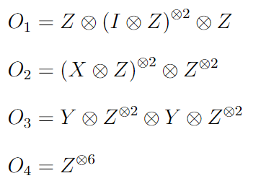
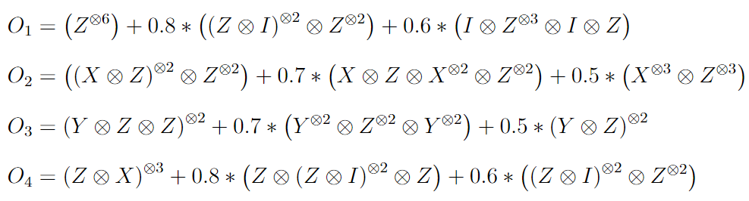
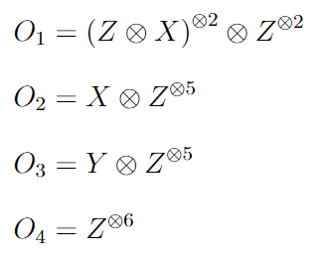
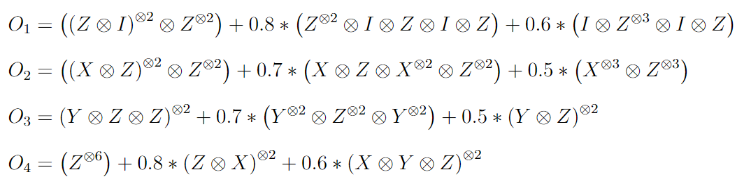
Building our Observables
1
3
2
4
Notes:
Type Structure Basis Expressivity Use Case
1 Pure tensor product Z Low Benchmarking
2 Mixed Pauli tensor products X, Y, Z Medium Coherence, phase probing
3 Weighted combination Mostly Z High Cost function, QML observables
4 Full basis mixing + weights X, Y, Z Maximal Fault detection, image fusion
Main Feature Component Role in Fault Detection
Z^{⊗6} Captures baseline classical fault states across all qubits
(X ⊗ Z)^{⊗2} Detects faults that disrupts superposition or causes phase flips
(Y ⊗ Z ⊗ Z)^{⊗2} Encodes complex, entangled fault patterns
Coefficients Allows tuning sensitivity to different fault types during training
The observable includes:
Z-axis terms: Classical fault signatures (e.g., voltage drops, binary sensor states).
X-axis terms: Superposition-sensitive anomalies (e.g., coherence loss, interference).
Y-axis terms: Phase-sensitive faults (e.g., timing drift, polarization shifts).
Weighted combinations: Tunable emphasis on different fault modalities.
The hypothesis for PV fault classification models, this observable:
Enhances detection of nonlinear, entangled fault signatures.
Improves robustness against noise and decoherence.
Supports multi-modal feature fusion.

Slide 17
Testing Modules
Module | Parameter | Description
1 | Feature Map 1: ZZ | Single-qubit rotations and entangling ZZ interactions between qubits.
2 | Feature Map 2: Z-Y-ZZ | Combines Z-axis and Y-axis rotations with ZZ entangling interactions, encoding individual features and their pairwise correlations.
3 | Feature Map 3: X-ZZ | Rotation around the X-axis followed by ZZ entangling interactions, encoding both individual features and their pairwise correlations.
4 | Feature Map 4: Toffoli-enhanced | Leverages controlled-controlled operations to encode high-order feature interactions.
5 | Ansatz 1: Enhanced SU2 | Extends the SU(2) ansatz by incorporating additional layers of single-qubit rotations and entangling gates.
6 | Ansatz 2: Toffoli Linear Entangle | Linear Toffoli entanglement.
7 | Ansatz 3: Toffoli Circular Entangle | Circular Toffoli entanglement.
8 | Ansatz 4: Toffoli Full Entangle | Full Toffoli entanglement.
9 | Ansatz 5: Toffoli with CNOT | Toffoli + CNOT entanglement.
10 | Ansatz 6: Toffoli with CNOT and single qubit | Complex Ansatz using Toffoli, CNOT, and single-qubit operations.

Slide 18
Testing Results
Comparing with Original Binary PV Fault Detection (2021) Algorithm
Highlight of Results
Feature Map | Ansatz | Observable | Training (%) | Testing (%)
1 | 1 | 2 | 67 | 68 | Original/Baseline
1 | 4 | 2 | 48 | 48
1 | 5 | 3 | 73 | 73
1 | 5 | 4 | 59 | 58
1 | 7 | 2 | 58 | 61
2 | 5 | 4 | 56 | 55
3 | 5 | 1 | 66 | 66
3 | 5 | 2 | 63 | 63
3 | 5 | 3 | 59 | 61
3 | 5 | 4 | 58 | 56
3 | 9 | 4 | 78 | 77
3 | 10 | 4 | 84 | 85 | New Quantum Algorithm
3 | 10 | 3 | 63 | 63
3 | 10 | 4 | N/A | 72 | Heron Quantum Computer
Notes:
Training was not possible on the hardware due to access. The weights from the simulator were used to create the final circuit. This circuit was loaded with the PV data and testing results were taken.
The quantum hardware used for this validation was a Heron-based quantum processor, which features over 120 qubits. For the evaluation, we loaded the optimized weights from our simulation and ran the circuit for 1,024 shots for each of the observables.

Slide 19
4. Conclusion for PV Fault Detection
Our results, demonstrate substantial performance gains. Accuracy improved from 67% in the baseline QNN model to over 84% using the new Toffoli-based Ansatz, with hardware runs yielding 72%.
These improvements were primarily attributed to two innovations:
X–ZZ feature mapping for semi-correlated PV data, and
Toffoli-based nonlinear correlation extraction in the Ansatz.
Prepare
|0>
0
Hybrid
Quantum
Computing
1
|1>
Classical
Computer
Output
Quantum
Computer
Notes:
While these findings are strongly tied to the specific structure of the PV dataset, they highlight a broader principle. Our algorithm applied on other datasets with proper encoding will be interesting. The strategy of leveraging higher-dimensional feature interactions through Toffoli-type gates will stay a powerful design approach for parameterized quantum circuits.

Slide 20
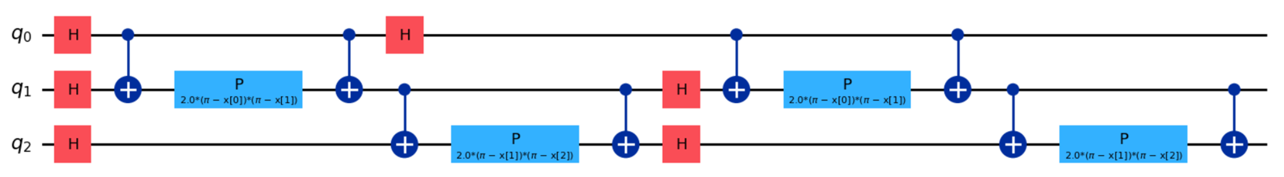
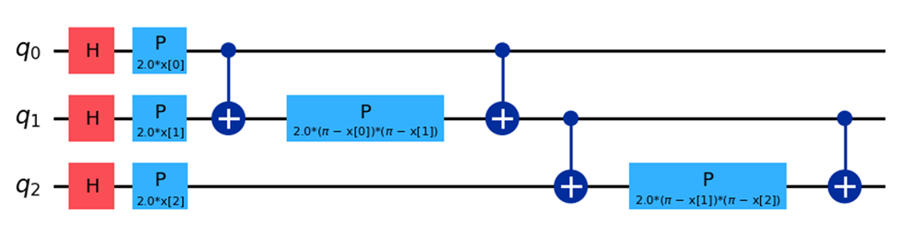
5. Broader Impact : Other Applications of QML
An alternative to fully developing a parametrized quantum circuit is to leverage the quantum circuit as a pre-processing or feature encoding.
In this hybrid framework, a quantum feature map performs the data encoding, after which the quantum state is measured and collapsed back into a classical feature vector.
The resulting transformed features then serve as enriched inputs for traditional machine learning algorithms on classical systems.
Pre-processing
Feature encoding
Quantum Circuit
Solvers
Image Processing
Notes:
This hybrid methodology leverages the representational power of quantum encodings—specifically, the ability to utilize exponentially large Hilbert spaces—without necessitating a fully parameterized quantum classifier.

Slide 21
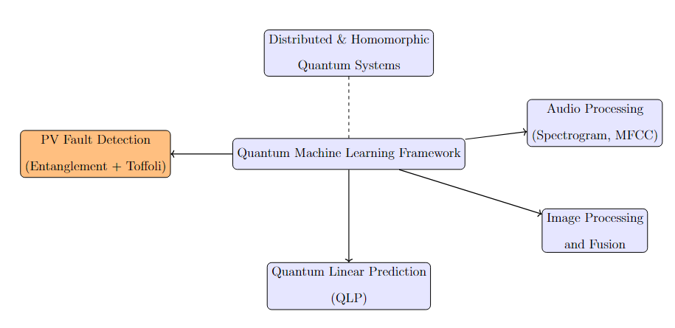
Findings
The development and deployment of hybrid quantum-classical algorithms continue to face fundamental challenges inherent to the current Noisy Intermediate-Scale Quantum (NISQ) era.
Chief among these are the intrinsic noise, gate errors, and limited measurement fidelity that characterize contemporary quantum hardware.
Notes:
These constraints restrict circuit depth, reduce the number of reliable shots, and ultimately cap model complexity and scalability. Despite these limitations, this dissertation demonstrates how carefully engineered quantum circuits, paired with classical preprocessing and post-selection, can yield performance across a range of signal processing tasks.
Beginning with PV fault detection, the work expands into broader domains including image processing, audio classification, and linear prediction. Each application leverages quantum circuits, entangled observables, and data re-uploading strategies to extract meaningful features from high-dimensional inputs.
Notably, the introduction of homophoric quantum algorithms, designed to preserve structural symmetries while enhancing expressivity, marks a significant advancement in the design of interpretable quantum models.
These algorithms enable the encoding of domain-specific priors directly into quantum observables, facilitating improved generalization and reduced training overhead.
By integrating Toffoli-based entanglement pruning and multi-axis measurement strategies, this work contributes a scalable framework for quantum-enhanced signal analysis. The results highlight the potential of quantum machine learning to surpass fault detection and tackle complex inference tasks across multiple modalities.

Slide 22
6. Summary
QNN Design
Research Contributions
Data-Informed Encoding
Match encoding schemes to dataset structure (e.g., X–ZZ rotations for correlated data).
Structured Correlation Extraction
Add higher-order gates (e.g., Toffoli) to model nonlinear dependencies.
Enables problem-tailored yet reusable PQCs across application domains.
New quantum algorithms, circuit designs, and system frameworks.
Applied to:
PV Fault Detection
Audio Processing
Image Analysis
Secure Distributed Learning
➡️ Data-Informed Encoding → Structured Ansatz → QML Framework
Notes:
This work proposes a reusable design template for QNN development, starting with encoding schemes that align with the statistical structure of the dataset (e.g., X–ZZ rotations for correlated data), and then enriching the Ansatz with gates that naturally introduce higher-order feature interactions (e.g., Toffoli gates).
This two-step strategy, data-informed encoding followed by structured correlation extraction, offers a principled way to construct PQCs that are not only tailored to specific datasets but also adaptable across application domains where nonlinear feature entanglement is a core challenge.
We advance the field of QML by developing novel algorithms, circuit designs, and system-level frameworks tailored for real-world applications, including PV fault detection, audio and image processing, and secure distributed learning.
The contributions combine theoretical innovation with practical implementation, bridging the gap between quantum computing algorithm design, feature encoding strategies, and privacy-preserving computation.

