Slide 1


Quantum Machine Learning Frameworks
Glen S Uehara, PhD
Notes:
I have a BS and MSE in Electrical Engineering, from University of Hawaii and Arizona State University, respectively. Since my first degree, I have been working as a communication and signal processing engineering in both commercial and defense industry. In the recent years, I have also earned several certifications in cyber security and have applied these techniques to my programs. With these backgrounds, I’ve been working with ASU Tempe, Poly, UofA and NAU on various capstones related to these fields.
As I continue mentoring students, I decided to return and earn a Ph.D. Currently, as a Ph.D. student in the School of Electrical, Computer and Energy Engineering at ASU, I am specializing in Quantum Information Algorithms specifically for Signal & Information Processing w/ emphasis Machine Learning techniques. I am also working in the Quantum Laboratory at General Dynamics as a Quantum Algorithm Researcher. I am hoping to explore new techniques and methods in Quantum Algorithms to grow this knowledge for both ASU and GD.

Slide 2
Agenda & Scope
Primary Objectives
• Transcend classical processing limits in high-dimensional datasets.
• Code directly to the physical metal via pulse control platforms (JAX / Amazon Braket).
• Bridge academic framework validation with scalable industrial deployment.
We will go through mathematical and structural framework spanning four key areas of contemporary quantum translation:
Multi-Label QML Architectures: High-dimensional sensor parsing for grid infrastructure resilience.
Hardware-Aware NISQ Dynamics: Counteracting physical parasitic cross-talk via pulse optimization.
Generative Many-Body States: Utilizing QCBMs for distribution modeling without barren plateaus.
Sub-SQL Quantum Sensing: Breaking standard limits to extract LPD signals below thermal noise.

Slide 3
Photovoltaic Anomaly Extraction & Multi-Label QML

Slide 4
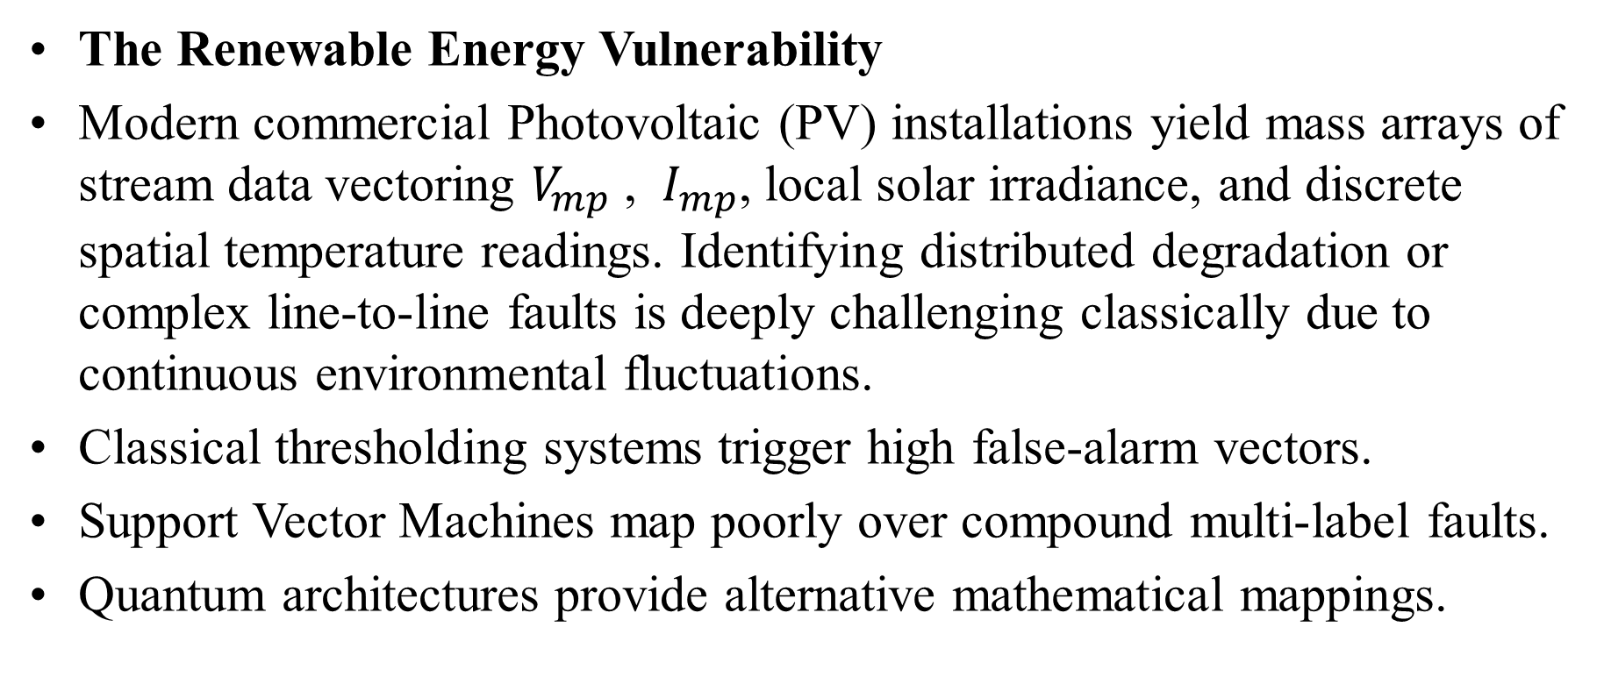
The High-Dimensional Cyber-Physical Topology
The Renewable Energy Vulnerability
Modern commercial Photovoltaic (PV) installations yield mass arrays of stream data vectoring $V_{mp}$ , $I_{mp}$, local solar irradiance, and discrete spatial temperature readings. Identifying distributed degradation or complex line-to-line faults is deeply challenging classically due to continuous environmental fluctuations.
Classical thresholding systems trigger high false-alarm vectors.
Support Vector Machines map poorly over compound multi-label faults.
Quantum architectures provide alternative mathematical mappings.

Slide 5
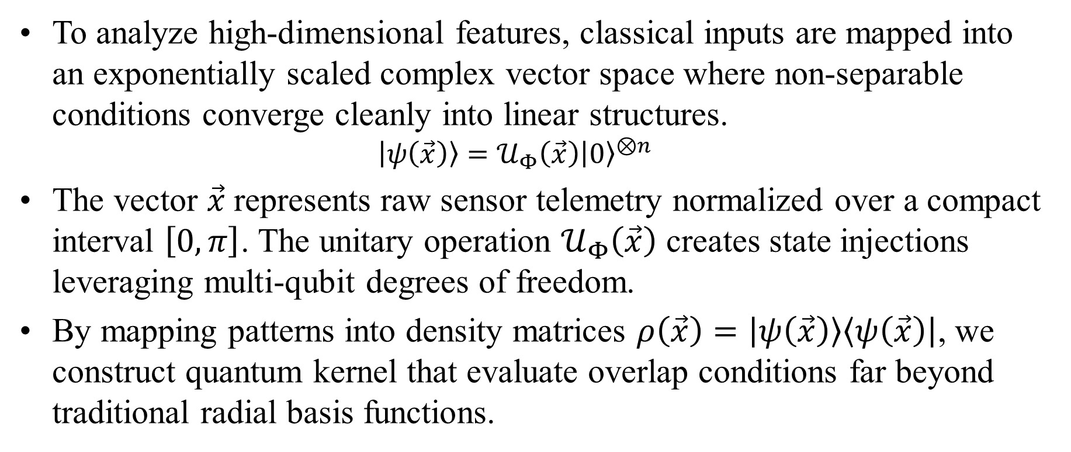
Mathematical Mapping into Hilbert Space
To analyze high-dimensional features, classical inputs are mapped into an exponentially scaled complex vector space where non-separable conditions converge cleanly into linear structures.
$$\left|ψ\left(\vec{x}\right)\right\rangle =𝒰_{Φ}\left(\vec{x}\right){\left|0\right\rangle }^{⊗n}$$
The vector $\vec{x}$represents raw sensor telemetry normalized over a compact interval $\left[0,π\right]$. The unitary operation $𝒰_{Φ}\left(\vec{x}\right)$ creates state injections leveraging multi-qubit degrees of freedom.
By mapping patterns into density matrices $ρ\left(\vec{x}\right)=\left|ψ\left(\vec{x}\right)\right\rangle \left\langle ψ\left(\vec{x}\right)\right|$, we construct quantum kernel that evaluate overlap conditions far beyond traditional radial basis functions.

Slide 6
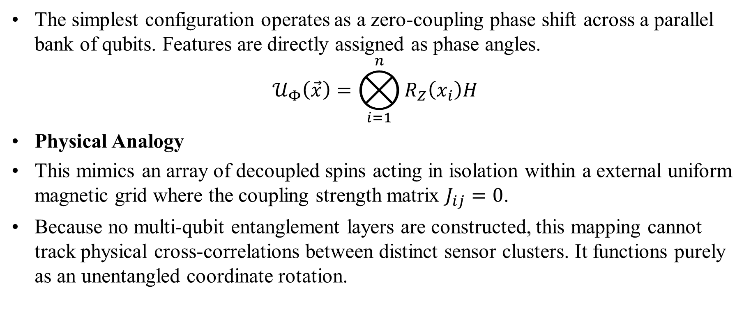
Quantum Feature Maps: ZRZ Phase Encoding
The simplest configuration operates as a zero-coupling phase shift across a parallel bank of qubits. Features are directly assigned as phase angles.
$$𝒰_{Φ}\left(\vec{x}\right)=⨂_{i=1}^{n}{R_{Z}\left(x_{i}\right)H}$$
Physical Analogy
This mimics an array of decoupled spins acting in isolation within a external uniform magnetic grid where the coupling strength matrix $J_{ij}=0$.
Because no multi-qubit entanglement layers are constructed, this mapping cannot track physical cross-correlations between distinct sensor clusters. It functions purely as an unentangled coordinate rotation.

Slide 7
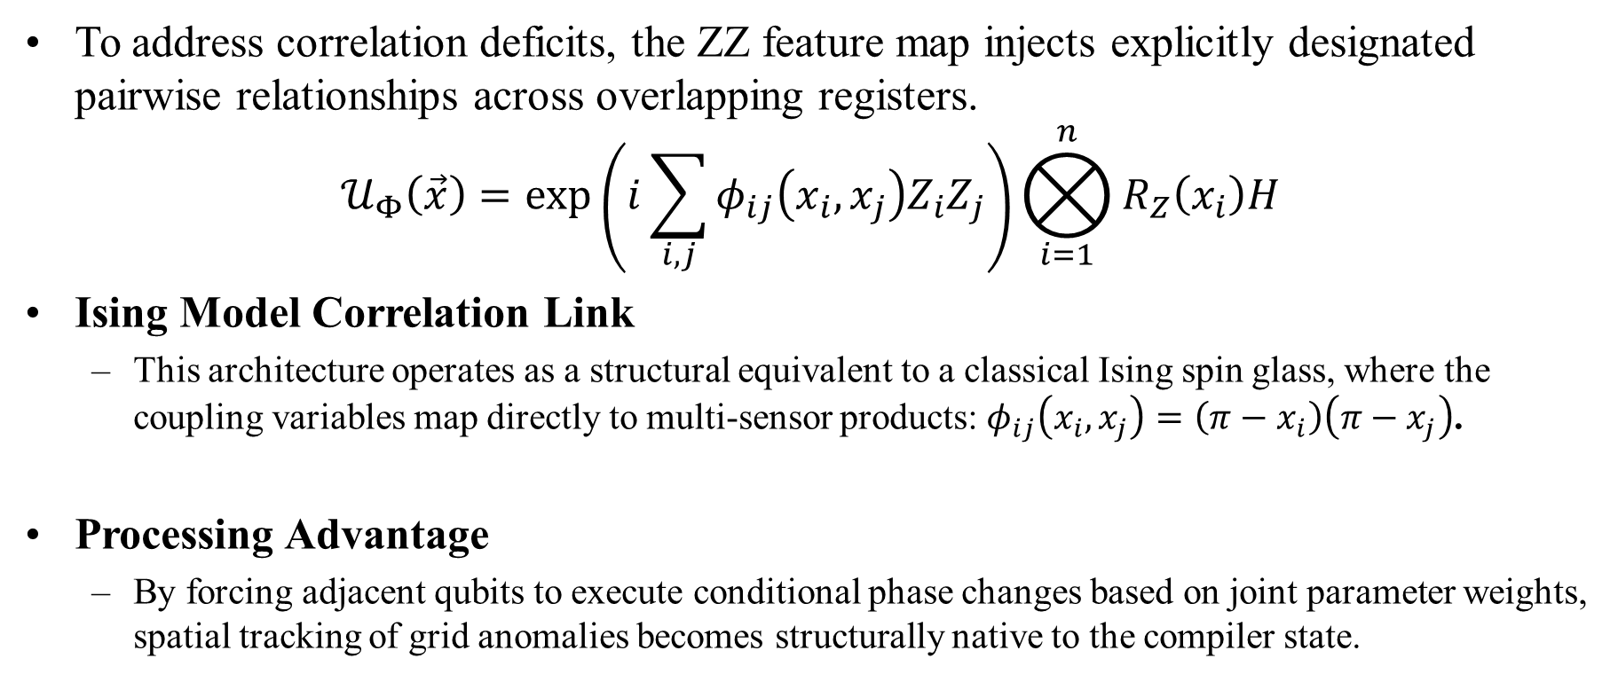
Quantum Feature Maps: ZZ Entangling Interaction
To address correlation deficits, the ZZ feature map injects explicitly designated pairwise relationships across overlapping registers.
$$𝒰_{Φ}\left(\vec{x}\right)=\exp\left(i\sum_{i,j}{φ_{ij}\left(x_{i},x_{j}\right)Z_{i}Z_{j}}\right)⨂_{i=1}^{n}{R_{Z}\left(x_{i}\right)H}$$
Ising Model Correlation Link
This architecture operates as a structural equivalent to a classical Ising spin glass, where the coupling variables map directly to multi-sensor products: $φ_{ij}\left(x_{i},x_{j}\right)=\left(π−x_{i}\right)\left(π−x_{j}\right)$.
Processing Advantage
By forcing adjacent qubits to execute conditional phase changes based on joint parameter weights, spatial tracking of grid anomalies becomes structurally native to the compiler state.

Slide 8
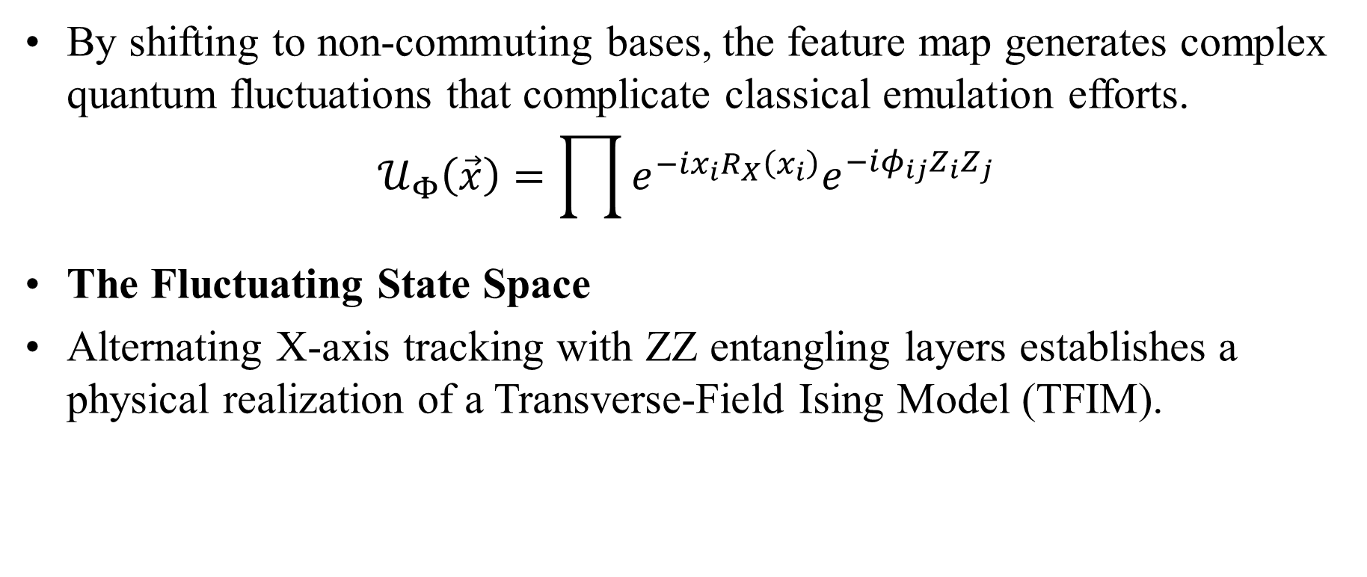
Quantum Feature Maps: X-ZZ Transverse-Field Maps
By shifting to non-commuting bases, the feature map generates complex quantum fluctuations that complicate classical emulation efforts.
$$𝒰_{Φ}\left(\vec{x}\right)=\prod{e^{−ix_{i}R_{X}\left(x_{i}\right)}e^{−iφ_{ij}Z_{i}Z_{j}}}$$
The Fluctuating State Space
Alternating X-axis tracking with ZZ entangling layers establishes a physical realization of a Transverse-Field Ising Model (TFIM).

Slide 9
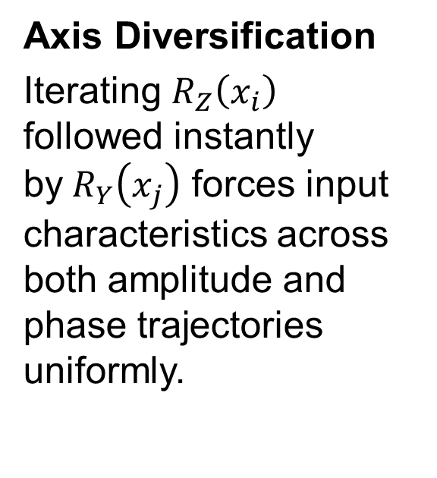
Quantum Feature Maps: Z-Y-ZZ Dense Architecture
The core methodology deployed within our primary dissertation framework uses a multi-axis rotation setup paired with comprehensive connectivity mapping.
Axis Diversification
Iterating $R_{Z}\left(x_{i}\right)$ followed instantly by$R_{Y}\left(x_{j}\right)$ forces input characteristics across both amplitude and phase trajectories uniformly.
All-to-All Entanglement
Coupling arrays do not limit entanglers to linear strings; instead, they stretch across all operational registers to encapsulate macro grid interactions.
Multi-Label Optimization
This mapping layout serves as the foundational interface enabling the extraction of multiple overlapping labels from complex datasets.

Slide 10
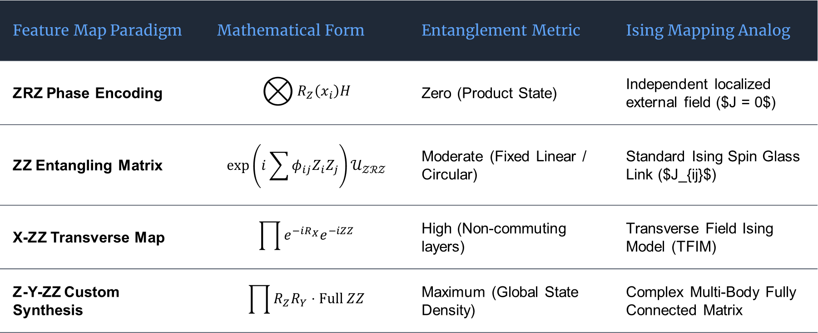
Comparative Analysis of Feature Mapping unitaries
A rigorous breakdown of mathematical footprints across evaluated encoding routines:
Feature Map Paradigm | Mathematical Form | Entanglement Metric | Ising Mapping Analog
ZRZ Phase Encoding | $$⨂{R_{Z}\left(x_{i}\right)H}$$ | Zero (Product State) | Independent localized external field ($J = 0$)
ZZ Entangling Matrix | $$\exp\left(i\sum{φ_{ij}Z_{i}Z_{j}}\right)𝒰_{𝒵ℛ𝒵}$$ | Moderate (Fixed Linear / Circular) | Standard Ising Spin Glass Link ($J_{ij}$)
X-ZZ Transverse Map | $$\prod{e^{−iR_{X}}e^{−iZZ}}$$ | High (Non-commuting layers) | Transverse Field Ising Model (TFIM)
Z-Y-ZZ Custom Synthesis | $$\prod{R_{Z}R_{Y}}⋅\text{Full} ZZ$$ | Maximum (Global State Density) | Complex Multi-Body Fully Connected Matrix

Slide 11
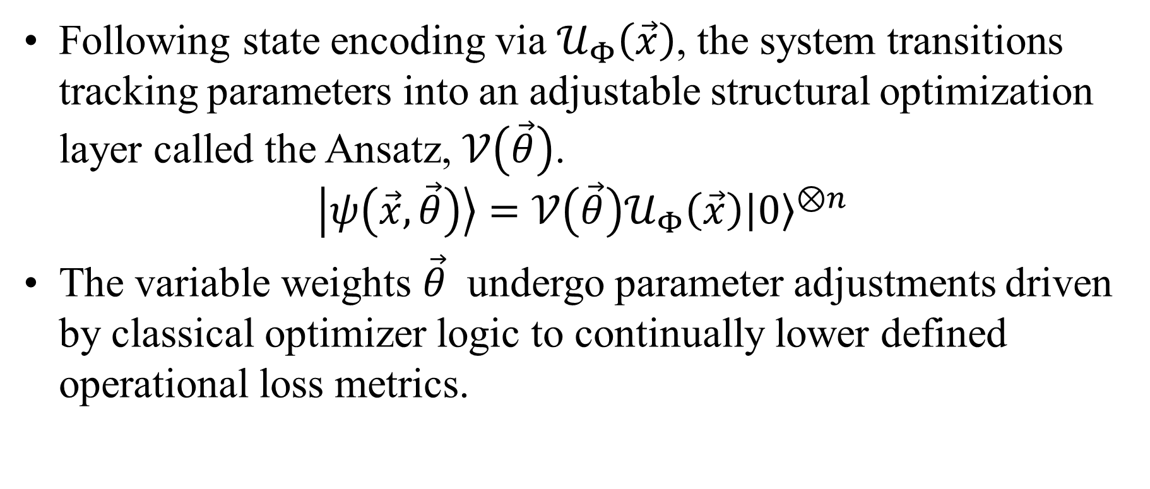
Parameterized Quantum Circuits & Ansatz Design
Following state encoding via $𝒰_{Φ}\left(\vec{x}\right)$, the system transitions tracking parameters into an adjustable structural optimization layer called the Ansatz, $𝒱\left(\vec{θ}\right)$.
$$\left|ψ\left(\vec{x},\vec{θ}\right)\right\rangle =𝒱\left(\vec{θ}\right)𝒰_{Φ}\left(\vec{x}\right){\left|0\right\rangle }^{⊗n}$$
The variable weights $\vec{θ}$ undergo parameter adjustments driven by classical optimizer logic to continually lower defined operational loss metrics.

Slide 12
Structural Topology: Linear vs. Circular Ansatz
Linear Entanglement Topology
Entangling operations (CNOT fields) apply sequentially between position i and neighboring position i+1. While resource-efficient regarding physical hardware tracks, information takes multiple cycles to propagate across long-distance configurations.
Best for: Simple 1D sensor telemetry arrays.
Circular Entanglement Topology
CNOT chains loop back completely, connecting the terminal register n directly to the primary origin register 1. This establishes periodic boundary conditions natively within the hardware setup.
Best for: Cyclic physical loops, power systems, and rotation metrics.

Slide 13
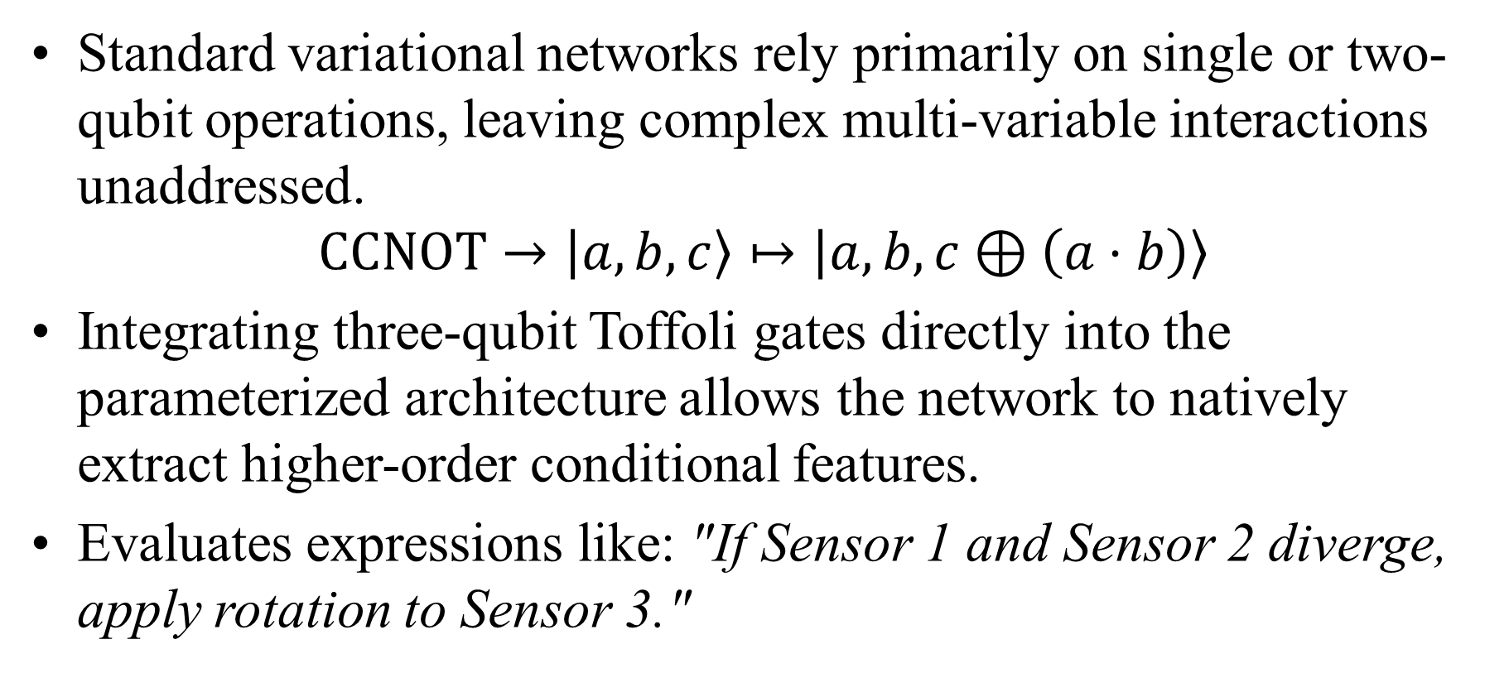
The Toffoli Ansatz: Accessing Non-Linear Correlations
Standard variational networks rely primarily on single or two-qubit operations, leaving complex multi-variable interactions unaddressed.
$$\text{CCNOT}→\left|a,b,c\right\rangle ↦\left|a,b,c⊕\left(a⋅b\right)\right\rangle$$
Integrating three-qubit Toffoli gates directly into the parameterized architecture allows the network to natively extract higher-order conditional features.
Evaluates expressions like: "If Sensor 1 and Sensor 2 diverge, apply rotation to Sensor 3."

Slide 14
Experimental Performance Benchmarking
Algorithm Framework | Feature Map Used | Ansatz Style | Training Accuracy | Testing Accuracy
Standard QNN (2021 Baseline) | ZZ Feature Map | Enhanced SU2 (Linear) | 67.0% | 68.0%
Toffoli Proposed System | Z-Y-ZZ Dense Map | Fully-Connected Toffoli | 84.0% | 85.0%
Hardware Deployment Run | X-ZZ Sub-Map | Toffoli Compiler Compiled | -- | 72.0%

Slide 15
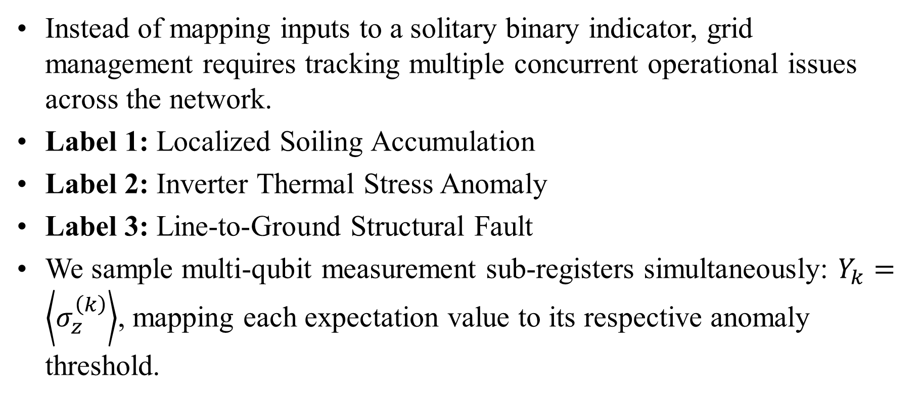
Multi-Label Classification Mechanics
Instead of mapping inputs to a solitary binary indicator, grid management requires tracking multiple concurrent operational issues across the network.
Label 1: Localized Soiling Accumulation
Label 2: Inverter Thermal Stress Anomaly
Label 3: Line-to-Ground Structural Fault
We sample multi-qubit measurement sub-registers simultaneously: $Y_{k}=\left\langle σ_{z}^{\left(k\right)}\right\rangle$, mapping each expectation value to its respective anomaly threshold.

Slide 16
Hardware Constraints & Superconducting Qubit Physics

Slide 17
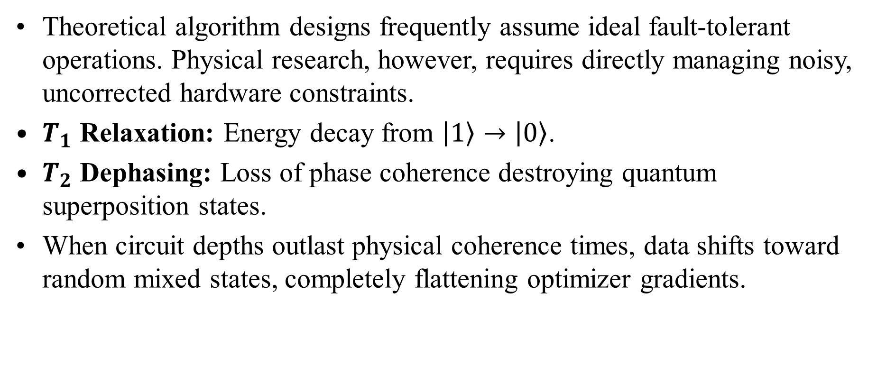
The NISQ Reality: Navigating Physical Decoherence
Theoretical algorithm designs frequently assume ideal fault-tolerant operations. Physical research, however, requires directly managing noisy, uncorrected hardware constraints.
$T_{1}$ Relaxation: Energy decay from $\left|1\right\rangle →\left|0\right\rangle$.
$T_{2}$ Dephasing: Loss of phase coherence destroying quantum superposition states.
When circuit depths outlast physical coherence times, data shifts toward random mixed states, completely flattening optimizer gradients.

Slide 18
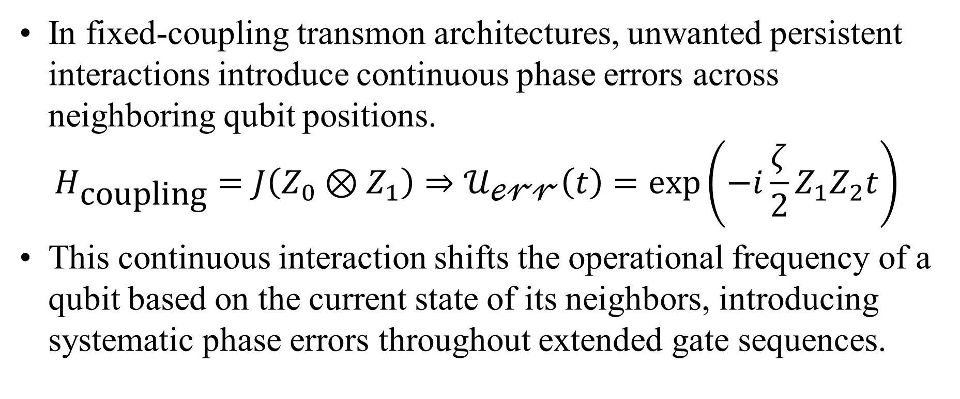
Parasitic Always-On ZZ Crosstalk Dynamics
In fixed-coupling transmon architectures, unwanted persistent interactions introduce continuous phase errors across neighboring qubit positions.
$$H_{\text{coupling}}=J\left(Z_{0}⊗Z_{1}\right)⇒𝒰_{\text{ℯ𝓇𝓇}}\left(t\right)=\exp\left(−i\frac{ζ}{2}Z_{1}Z_{2}t\right)$$
This continuous interaction shifts the operational frequency of a qubit based on the current state of its neighbors, introducing systematic phase errors throughout extended gate sequences.

Slide 19
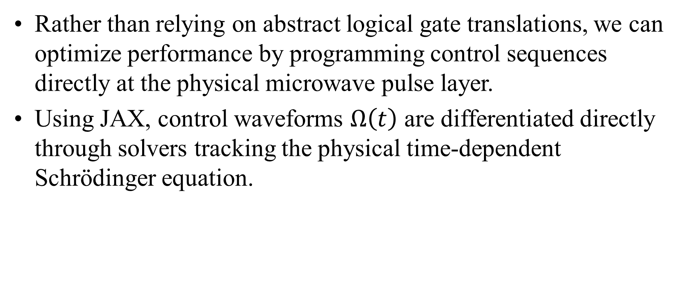
Differentiable Pulse Programming via JAX
Rather than relying on abstract logical gate translations, we can optimize performance by programming control sequences directly at the physical microwave pulse layer.
Using JAX, control waveforms $Ω\left(t\right)$ are differentiated directly through solvers tracking the physical time-dependent Schrödinger equation.

Slide 20
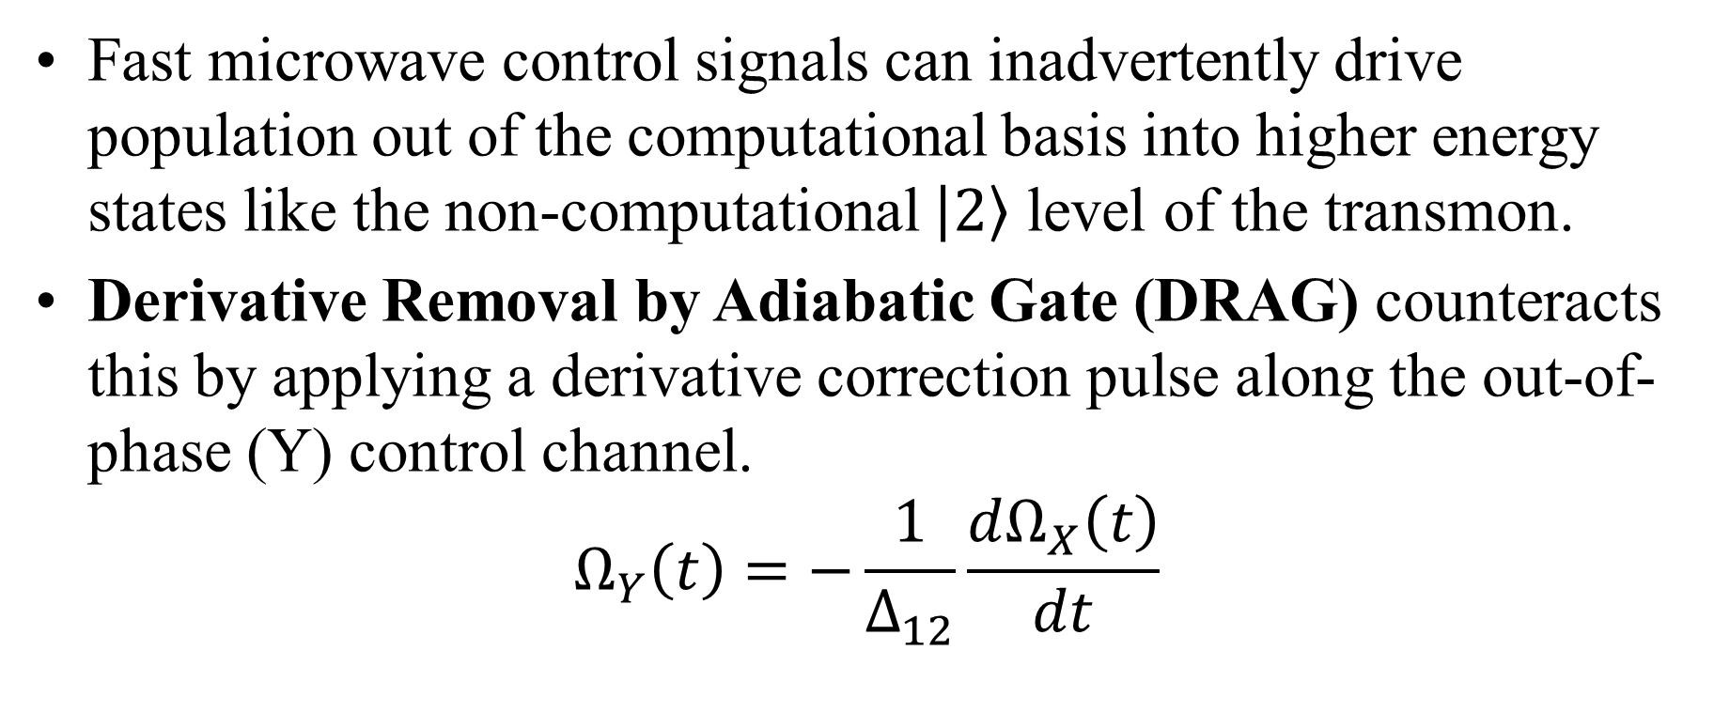
DRAG Pulse Optimization & Leakage Control
Fast microwave control signals can inadvertently drive population out of the computational basis into higher energy states like the non-computational $\left|2\right\rangle$ level of the transmon.
Derivative Removal by Adiabatic Gate (DRAG) counteracts this by applying a derivative correction pulse along the out-of-phase (Y) control channel.
$$Ω_{Y}\left(t\right)=−\frac{1}{Δ_{12}}\frac{dΩ_{X}\left(t\right)}{dt}$$

Slide 21
Error Mitigation vs. Error Correction
Active Error Mitigation
Instead of relying on dense multi-qubit logical encodings, error mitigation applies classical post-processing techniques over structured circuit variations to clean raw measurement outputs.
Zero-Noise Extrapolation (ZNE): Artificially scales noise levels upward to mathematically extrapolate back to an ideal zero-noise baseline.
Probabilistic Error Cancellation (PEC): Samples from inverted error channels to systematically cancel out physical noise contributions.

Slide 22
Hardware Execution: IBM Heron Case Analysis
Deploying our multi-label fault detection circuits onto physical IBM Heron hardware highlighted a clear performance divergence from idealized classical simulations.
Raw unmitigated accuracy dropped rapidly to 51%.
Applying DRAG shape matching and active ZNE loops recovered accuracy up to a verified 72% success metric.

Slide 23
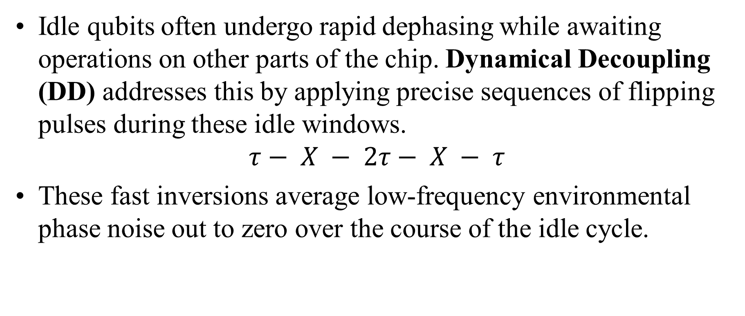
Dynamical Decoupling (DD) Sequencing
Idle qubits often undergo rapid dephasing while awaiting operations on other parts of the chip. Dynamical Decoupling (DD) addresses this by applying precise sequences of flipping pulses during these idle windows.
$$τ− X − 2τ− X − τ$$
These fast inversions average low-frequency environmental phase noise out to zero over the course of the idle cycle.

Slide 24
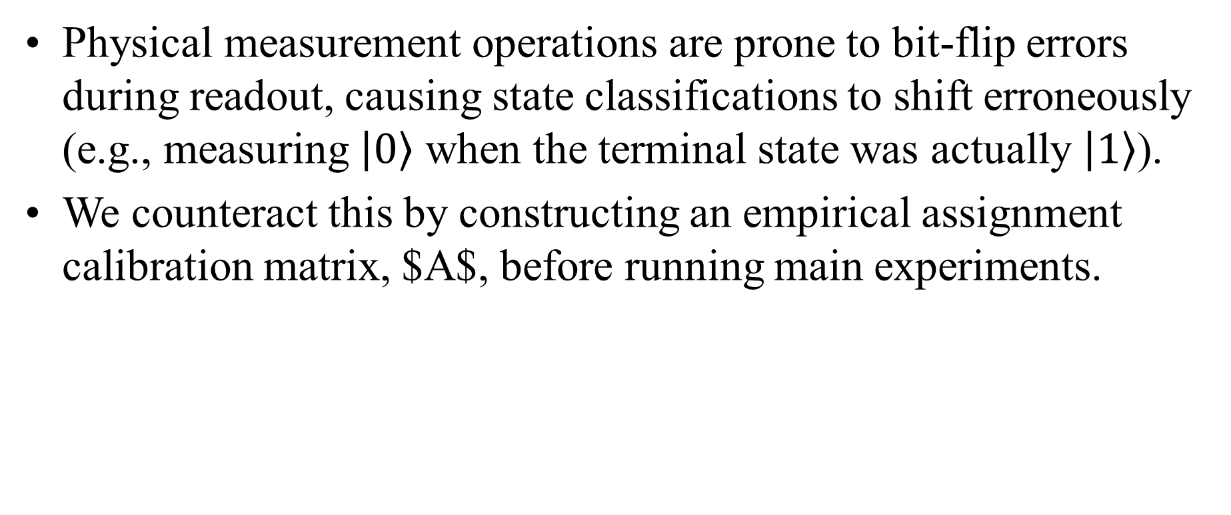
Readout Error Mitigation (Assignment Matrices)
Physical measurement operations are prone to bit-flip errors during readout, causing state classifications to shift erroneously (e.g., measuring $\left|0\right\rangle$ when the terminal state was actually $\left|1\right\rangle$).
We counteract this by constructing an empirical assignment calibration matrix, $A$, before running main experiments.

Slide 25
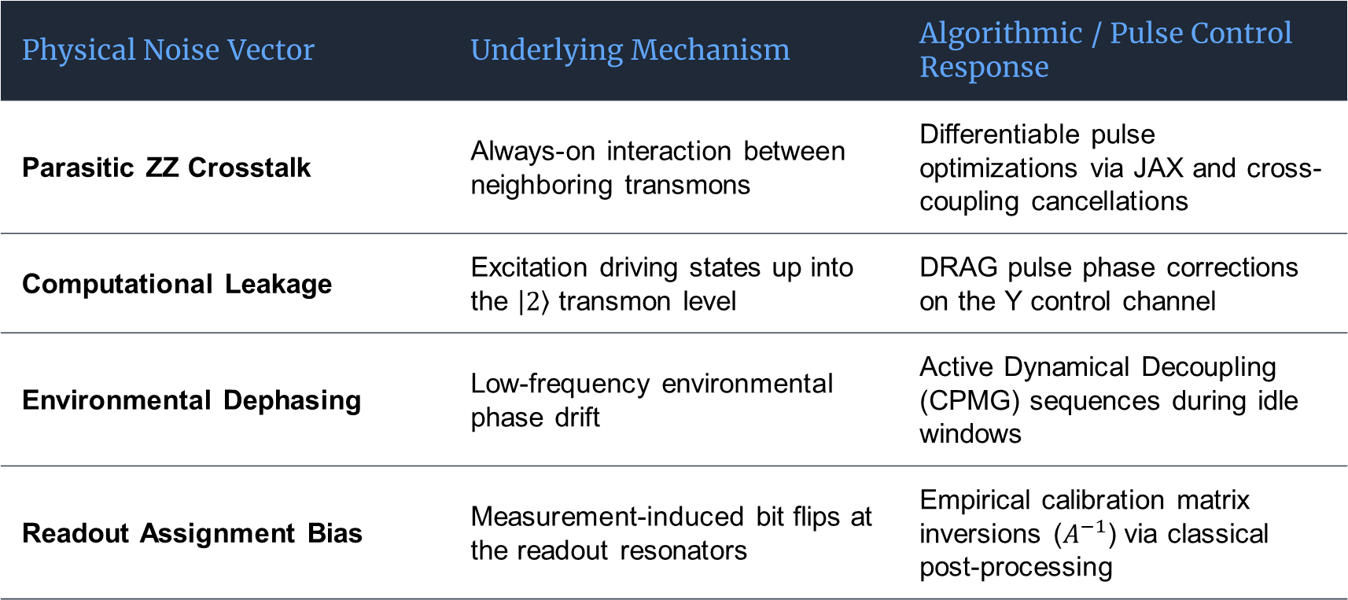
Quantum Noise Sources & Mitigation Controls
Physical Noise Vector | Underlying Mechanism | Algorithmic / Pulse Control Response
Parasitic ZZ Crosstalk | Always-on interaction between neighboring transmons | Differentiable pulse optimizations via JAX and cross-coupling cancellations
Computational Leakage | Excitation driving states up into the $\left|2\right\rangle$ transmon level | DRAG pulse phase corrections on the Y control channel
Environmental Dephasing | Low-frequency environmental phase drift | Active Dynamical Decoupling (CPMG) sequences during idle windows
Readout Assignment Bias | Measurement-induced bit flips at the readout resonators | Empirical calibration matrix inversions ($A^{−1}$) via classical post-processing

Slide 26
Many-Body Quantum Distributions & Generative Born Machines

Slide 27
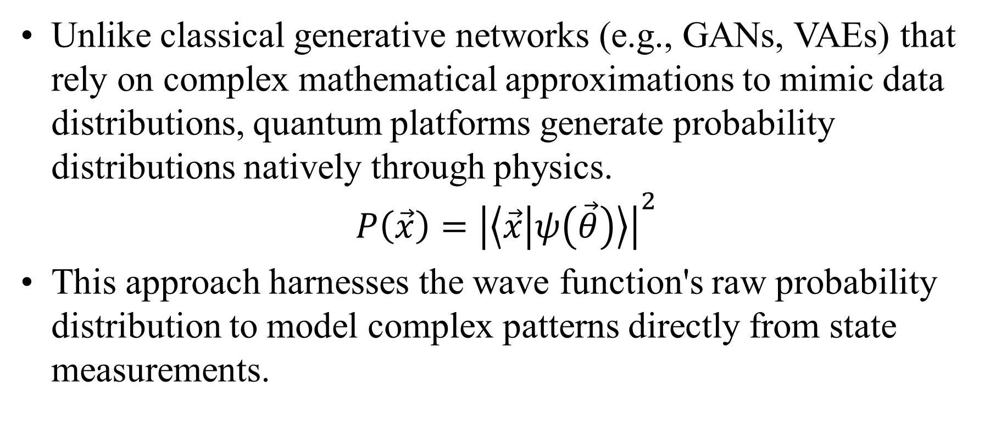
Generative Modeling Foundations: Born Rule Sampling
Unlike classical generative networks (e.g., GANs, VAEs) that rely on complex mathematical approximations to mimic data distributions, quantum platforms generate probability distributions natively through physics.
$$P\left(\vec{x}\right)={\left|\left\langle \vec{x} | ψ\left(\vec{θ}\right)\right\rangle \right|}^{2}$$
This approach harnesses the wave function's raw probability distribution to model complex patterns directly from state measurements.

Slide 28
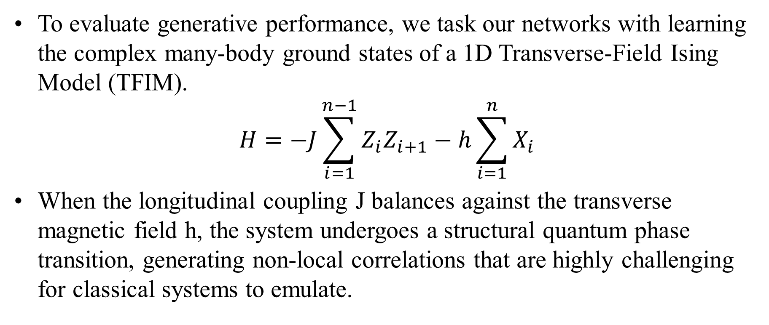
The Transverse-Field Ising Model Target
To evaluate generative performance, we task our networks with learning the complex many-body ground states of a 1D Transverse-Field Ising Model (TFIM).
$$H=−J\sum_{i=1}^{n−1}{Z_{i}Z_{i+1}}−h\sum_{i=1}^{n}{X_{i}}$$
When the longitudinal coupling J balances against the transverse magnetic field h, the system undergoes a structural quantum phase transition, generating non-local correlations that are highly challenging for classical systems to emulate.

Slide 29
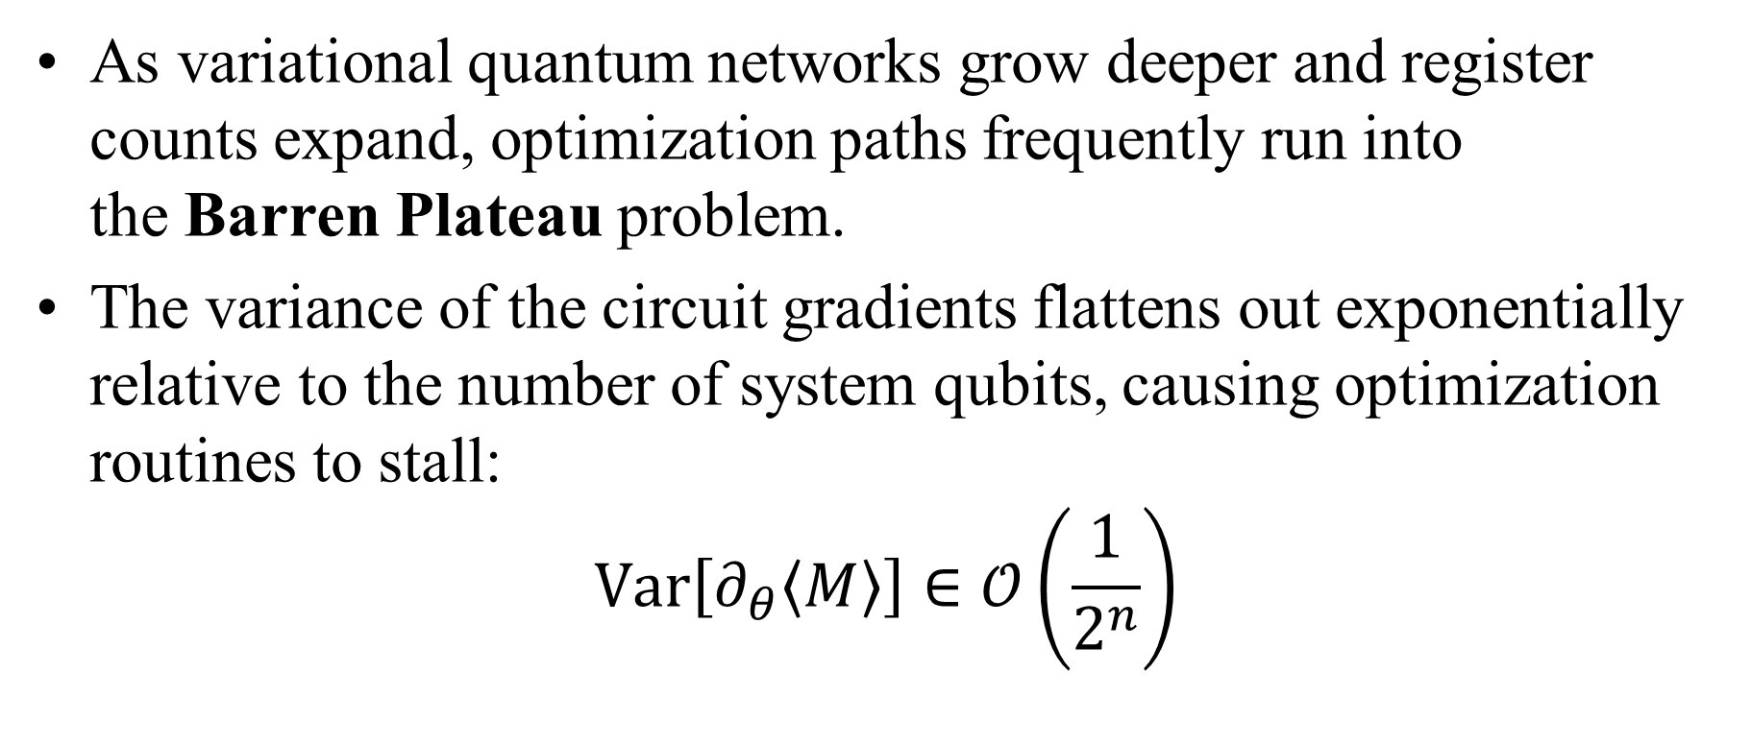
The Barren Plateau Wall in Variational Training
As variational quantum networks grow deeper and register counts expand, optimization paths frequently run into the Barren Plateau problem.
The variance of the circuit gradients flattens out exponentially relative to the number of system qubits, causing optimization routines to stall:
$$\text{Var}\left[∂_{θ}\left\langle M\right\rangle \right]∈𝒪\left(\frac{1}{2^{n}}\right)$$

Slide 30
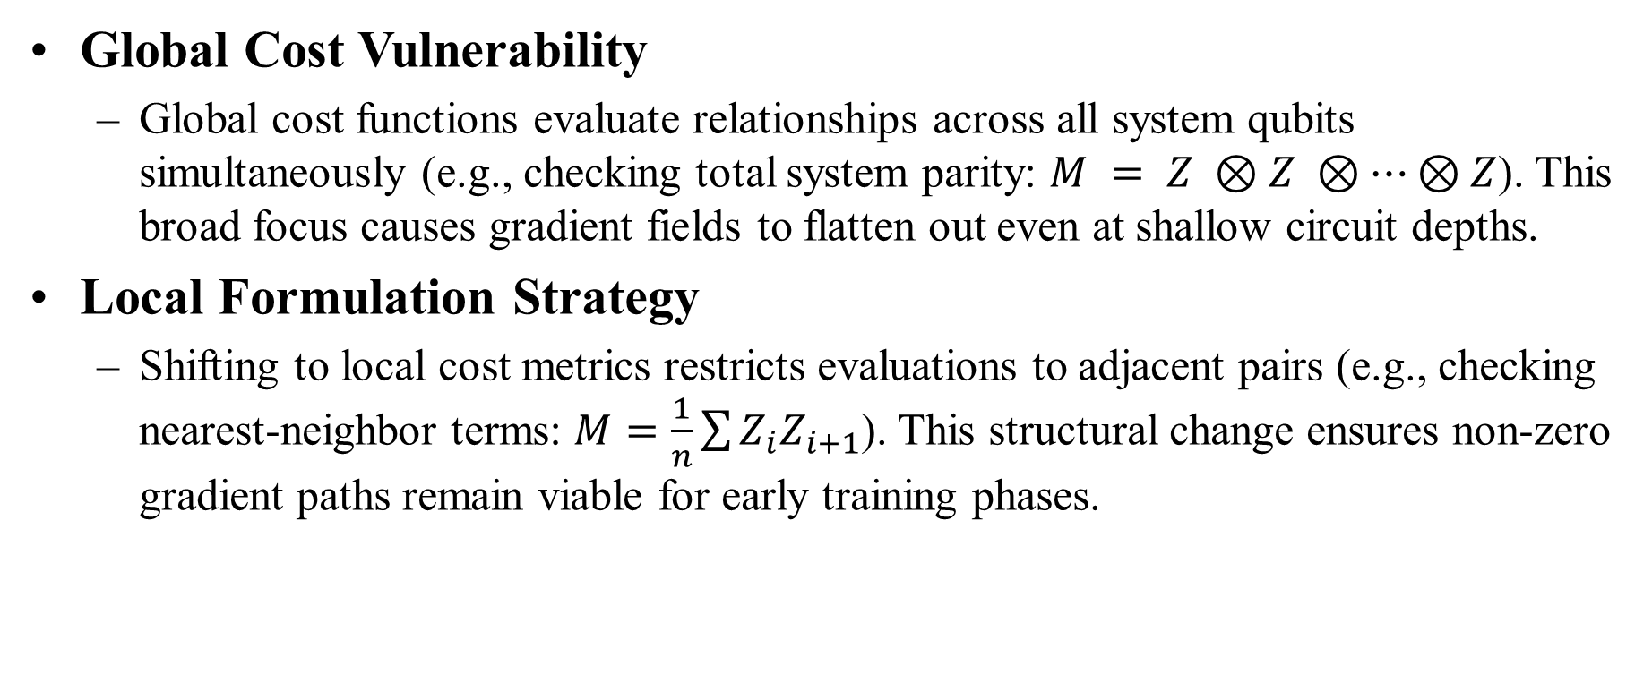
Bypassing Plateaus: Local Cost Functions
Global Cost Vulnerability
Global cost functions evaluate relationships across all system qubits simultaneously (e.g., checking total system parity: $M = Z ⊗Z ⊗…⊗Z$). This broad focus causes gradient fields to flatten out even at shallow circuit depths.
Local Formulation Strategy
Shifting to local cost metrics restricts evaluations to adjacent pairs (e.g., checking nearest-neighbor terms: $M=\frac{1}{n}\sum{Z_{i}Z_{i+1}}$). This structural change ensures non-zero gradient paths remain viable for early training phases.

Slide 31
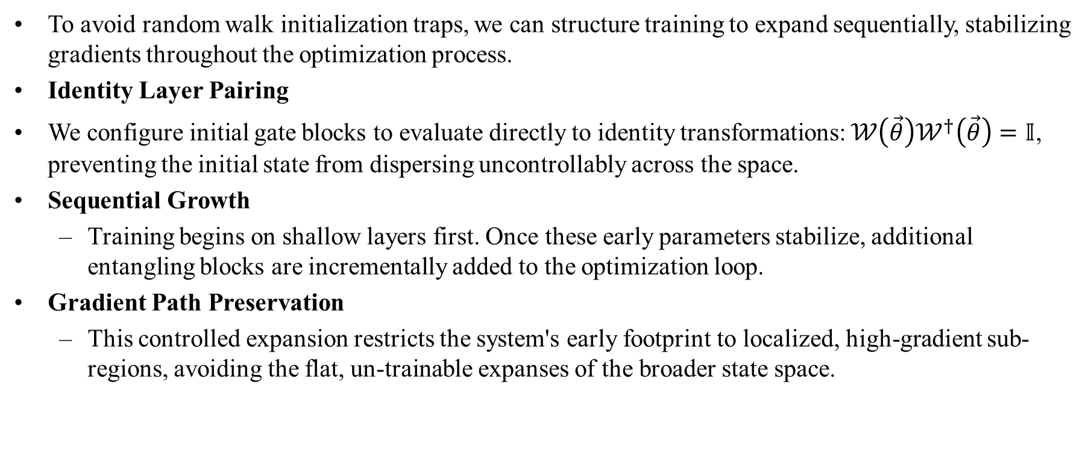
Layerwise Initialization & Identity Blocks
To avoid random walk initialization traps, we can structure training to expand sequentially, stabilizing gradients throughout the optimization process.
Identity Layer Pairing
We configure initial gate blocks to evaluate directly to identity transformations: $𝒲\left(\vec{θ}\right)𝒲^{†}\left(\vec{θ}\right)=𝕀$, preventing the initial state from dispersing uncontrollably across the space.
Sequential Growth
Training begins on shallow layers first. Once these early parameters stabilize, additional entangling blocks are incrementally added to the optimization loop.
Gradient Path Preservation
This controlled expansion restricts the system's early footprint to localized, high-gradient sub-regions, avoiding the flat, un-trainable expanses of the broader state space.

Slide 32
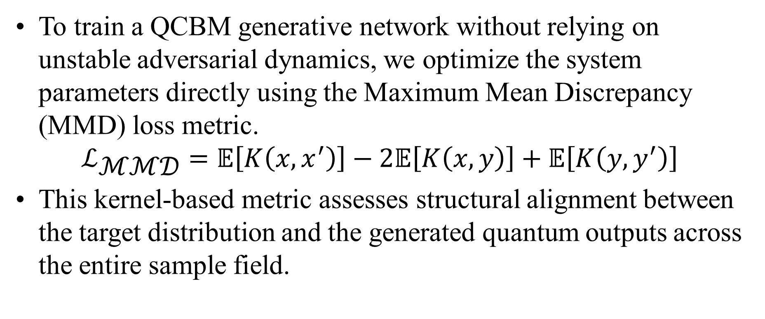
Maximum Mean Discrepancy (MMD) Tracking
To train a QCBM generative network without relying on unstable adversarial dynamics, we optimize the system parameters directly using the Maximum Mean Discrepancy (MMD) loss metric.
$$ℒ_{\text{ℳℳ𝒟}}=𝔼\left[K\left(x,x^{′}\right)\right]−2𝔼\left[K\left(x,y\right)\right]+𝔼\left[K\left(y,y^{′}\right)\right]$$
This kernel-based metric assesses structural alignment between the target distribution and the generated quantum outputs across the entire sample field.

Slide 33
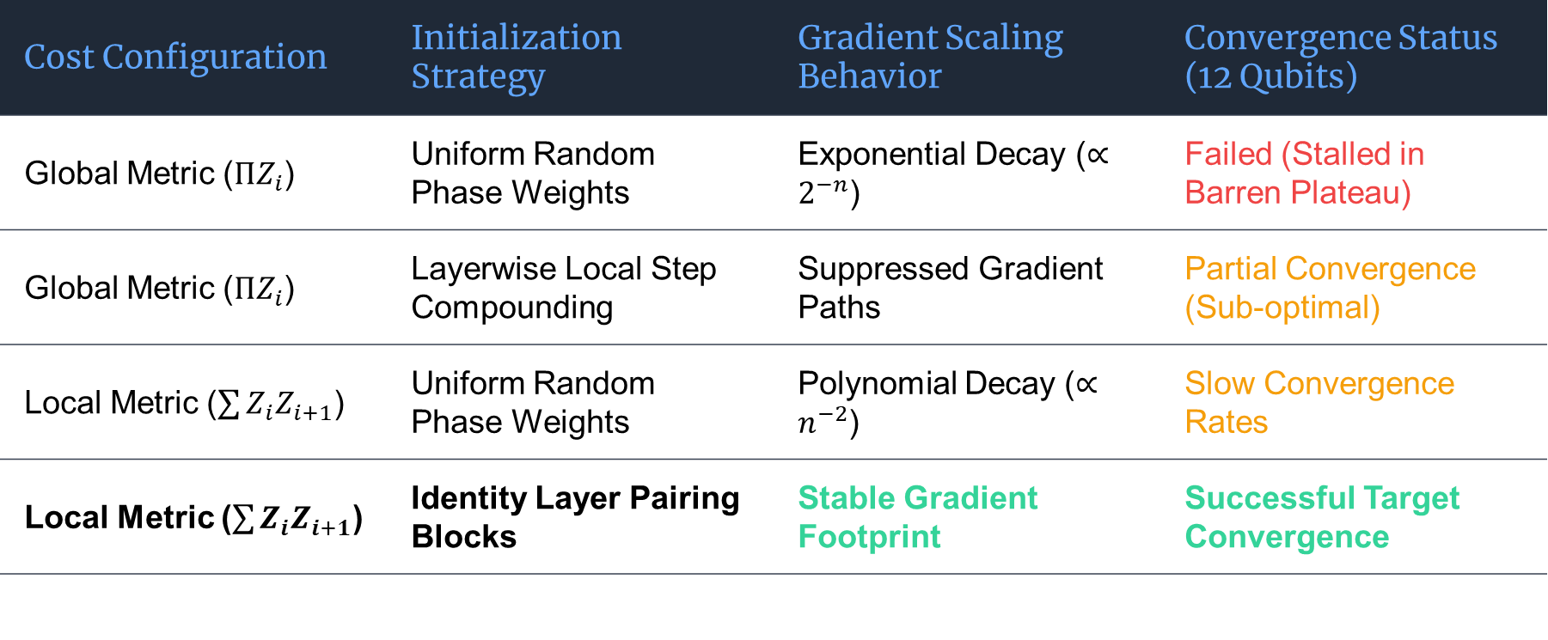
Generative Training Stability Summary
Cost Configuration | Initialization Strategy | Gradient Scaling Behavior | Convergence Status (12 Qubits)
Global Metric ($ΠZ_{i}$) | Uniform Random Phase Weights | Exponential Decay ($∝2^{−n}$) | Failed (Stalled in Barren Plateau)
Global Metric ($ΠZ_{i}$) | Layerwise Local Step Compounding | Suppressed Gradient Paths | Partial Convergence (Sub-optimal)
Local Metric ($\sum{Z_{i}Z_{i+1}}$) | Uniform Random Phase Weights | Polynomial Decay ($∝n^{−2}$) | Slow Convergence Rates
Local Metric ($\sum{Z_{i}Z_{i+1}}$) | Identity Layer Pairing Blocks | Stable Gradient Footprint | Successful Target Convergence

Slide 34
Sub-SQL Quantum Sensing & Low Probability of Detection Signals

Slide 35
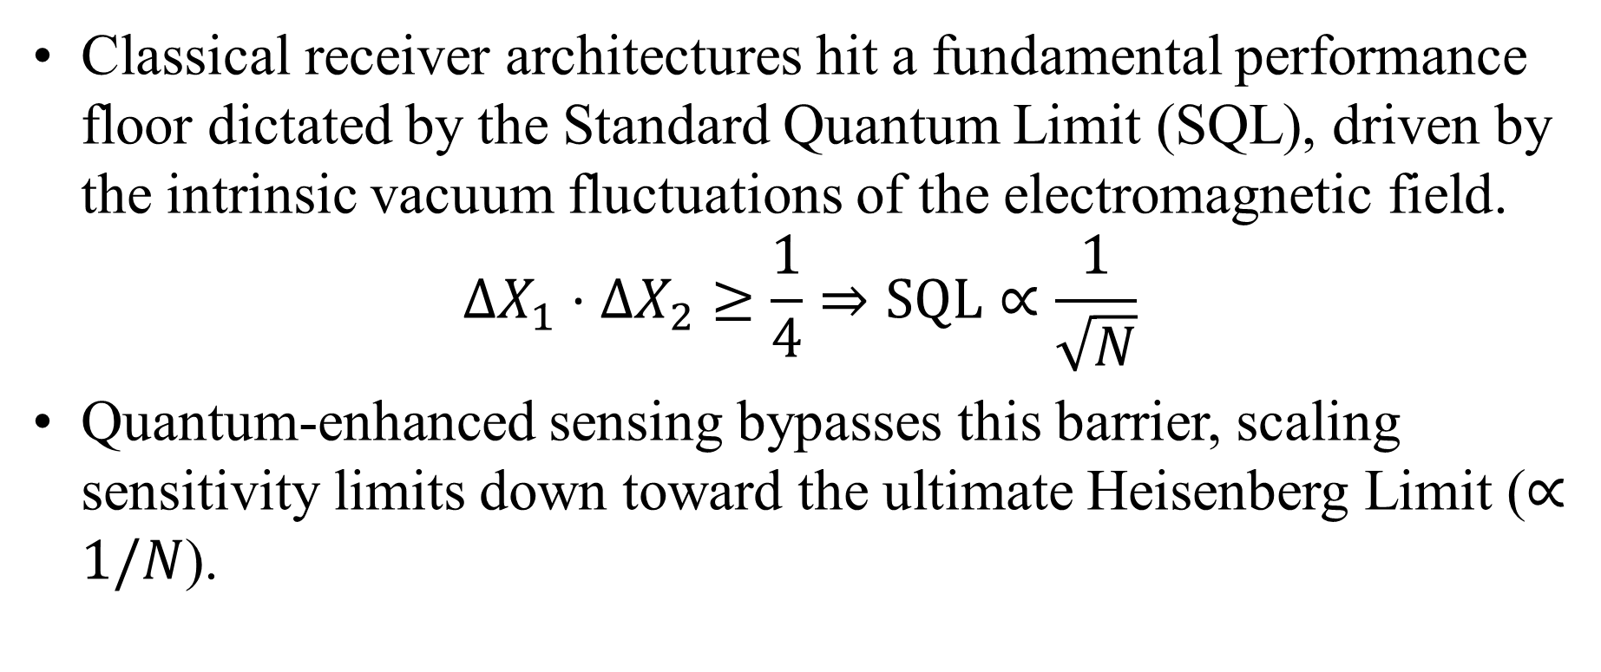
Breaking Through the Standard Quantum Limit
Classical receiver architectures hit a fundamental performance floor dictated by the Standard Quantum Limit (SQL), driven by the intrinsic vacuum fluctuations of the electromagnetic field.
$$ΔX_{1}⋅ΔX_{2}≥\frac{1}{4}⇒\text{SQL}∝\frac{1}{\sqrt{N}}$$
Quantum-enhanced sensing bypasses this barrier, scaling sensitivity limits down toward the ultimate Heisenberg Limit ($∝1/N$).

Slide 36
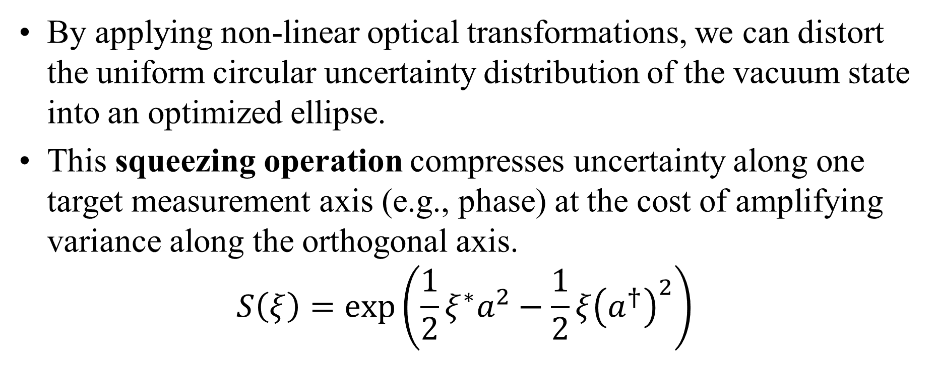
Squeezed Vacuum States & Phase Uncertainty
By applying non-linear optical transformations, we can distort the uniform circular uncertainty distribution of the vacuum state into an optimized ellipse.
This squeezing operation compresses uncertainty along one target measurement axis (e.g., phase) at the cost of amplifying variance along the orthogonal axis.
$$S\left(ξ\right)=\exp\left(\frac{1}{2}ξ^{∗}a^{2}−\frac{1}{2}ξ{\left(a^{†}\right)}^{2}\right)$$

Slide 37
LFM Chirp Detection at -25 dB SNR
Linear Frequency Modulated (LFM) chirp signals distribute their energy across wide frequency bands, rendering them virtually invisible to standard Fourier analysis under heavy noise conditions.
Sub-Floor Exposure
When signals are buried at -25 dB SNR, classical systems register only uniform white noise across the spectrum.
Quantum State Translation
Mapping the incoming analog RF traces directly onto a multi-qubit coherent phase network translates the problem into a quantum tracking domain.
Coherent Filtering
Leveraging continuous phase tracking across the register isolates the underlying chirp trajectory, pulling hidden signal trends out from the noise background.

Slide 38
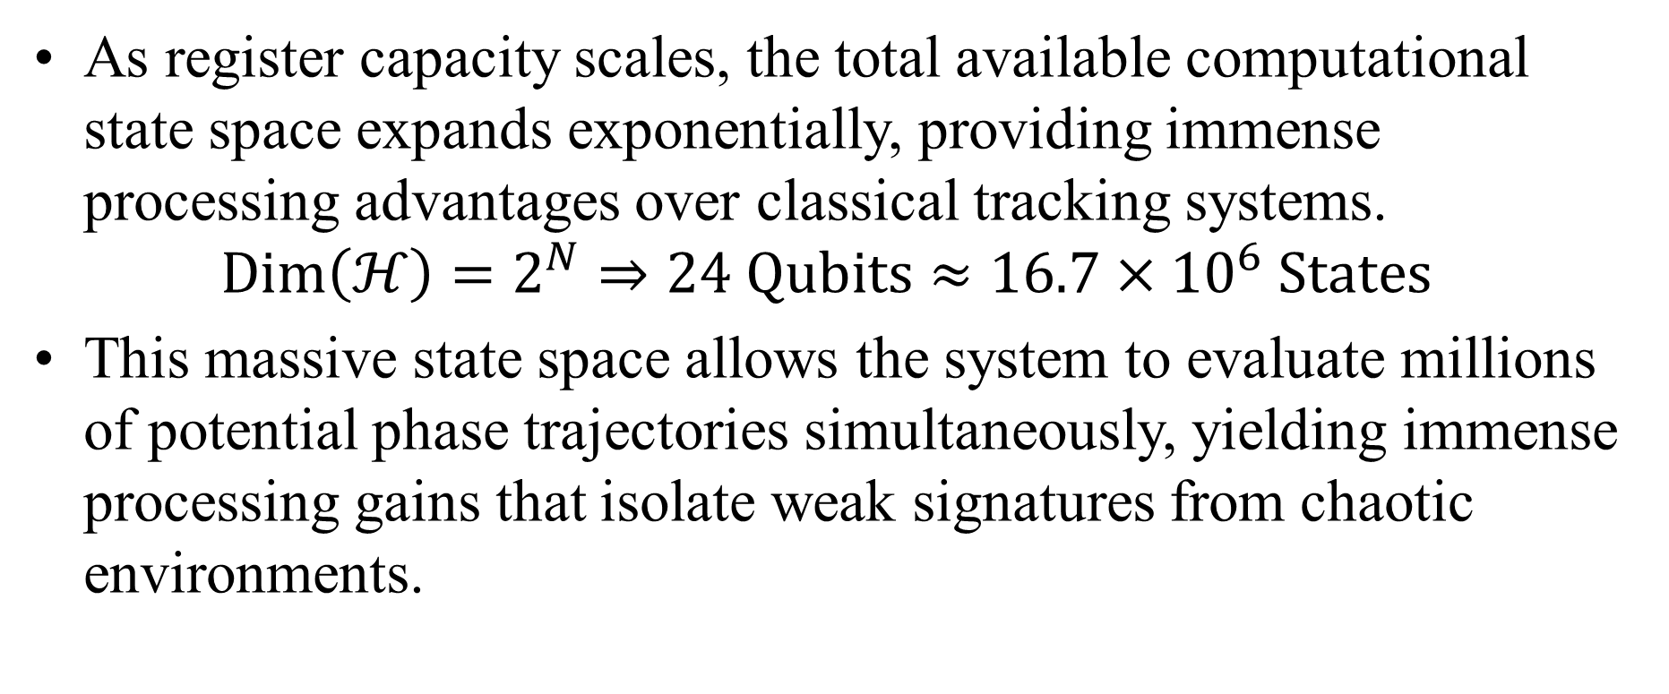
Processing Gains in High-Dimensional Hilbert Space
As register capacity scales, the total available computational state space expands exponentially, providing immense processing advantages over classical tracking systems.
$$\text{Dim}\left(ℋ\right)=2^{N}⇒24 \text{Qubits}≈16.7×{10}^{6} \text{States}$$
This massive state space allows the system to evaluate millions of potential phase trajectories simultaneously, yielding immense processing gains that isolate weak signatures from chaotic environments.

Slide 39
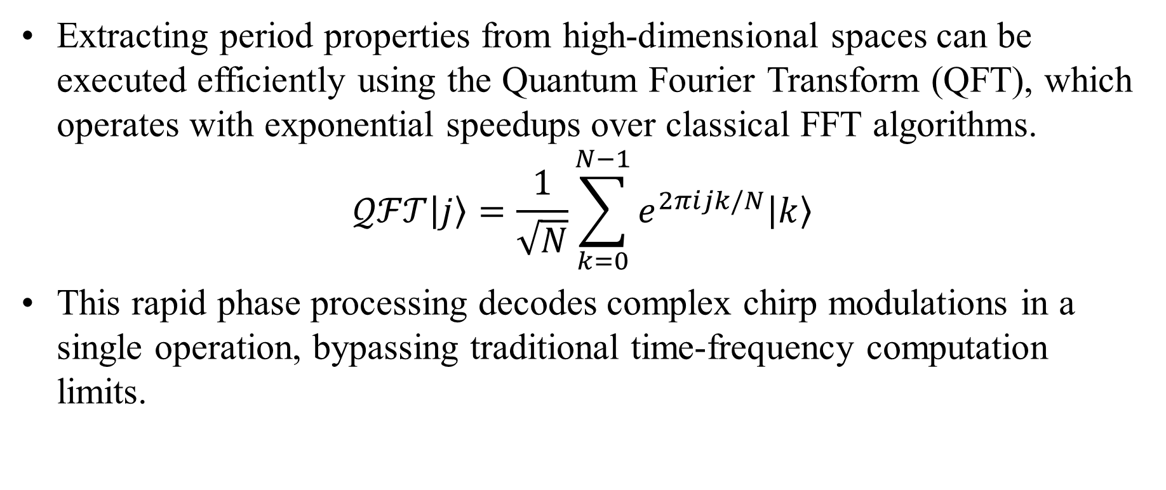
The Quantum Fourier Transform (QFT) Link
Extracting period properties from high-dimensional spaces can be executed efficiently using the Quantum Fourier Transform (QFT), which operates with exponential speedups over classical FFT algorithms.
$$𝒬ℱ𝒯\left|j\right\rangle =\frac{1}{\sqrt{N}}\sum_{k=0}^{N−1}{e^{2πijk/N}\left|k\right\rangle }$$
This rapid phase processing decodes complex chirp modulations in a single operation, bypassing traditional time-frequency computation limits.

Slide 40
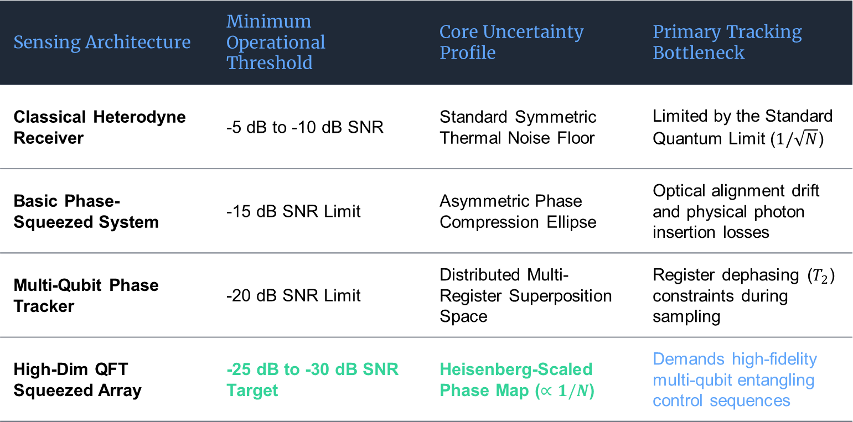
Sensing Regimes & Detection Boundaries
Sensing Architecture | Minimum Operational Threshold | Core Uncertainty Profile | Primary Tracking Bottleneck
Classical Heterodyne Receiver | -5 dB to -10 dB SNR | Standard Symmetric Thermal Noise Floor | Limited by the Standard Quantum Limit ($1/\sqrt{N}$)
Basic Phase-Squeezed System | -15 dB SNR Limit | Asymmetric Phase Compression Ellipse | Optical alignment drift and physical photon insertion losses
Multi-Qubit Phase Tracker | -20 dB SNR Limit | Distributed Multi-Register Superposition Space | Register dephasing ($T_{2}$) constraints during sampling
High-Dim QFT Squeezed Array | -25 dB to -30 dB SNR Target | Heisenberg-Scaled Phase Map ($∝1/N$) | Demands high-fidelity multi-qubit entangling control sequences
A structural comparison highlighting performance boundaries across evaluated sensing configurations:

Slide 41
Advanced QML: Graphs, Attention & Quantum Autoencoders

Slide 42
Quantum Graph Neural Networks (QGNN)
Physical distribution systems, such as electrical power grids, do not arrange themselves in flat, linear sequences; instead, they operate as complex, interconnected topologies.
Quantum Graph Neural Networks (QGNN) address this by mapping physical grid nodes directly onto specific qubit positions within the processor layout.

Slide 43
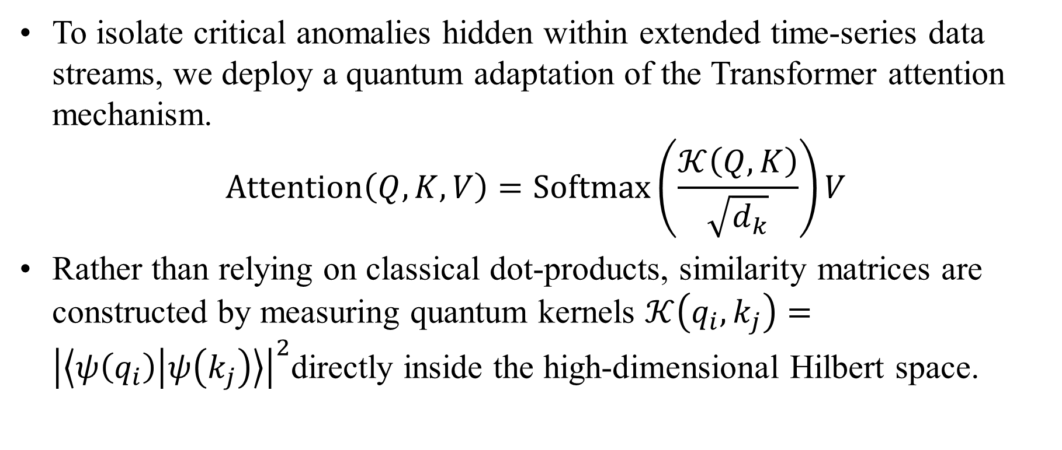
Quantum Kernel Self-Attention Mechanisms (QKSAN)
To isolate critical anomalies hidden within extended time-series data streams, we deploy a quantum adaptation of the Transformer attention mechanism.
$$\text{Attention}\left(Q,K,V\right)=\text{Softmax}\left(\frac{𝒦\left(Q,K\right)}{\sqrt{d_{k}}}\right)V$$
Rather than relying on classical dot-products, similarity matrices are constructed by measuring quantum kernels $𝒦\left(q_{i},k_{j}\right)={\left|\left\langle ψ\left(q_{i}\right) | ψ\left(k_{j}\right)\right\rangle \right|}^{2}$directly inside the high-dimensional Hilbert space.

Slide 44
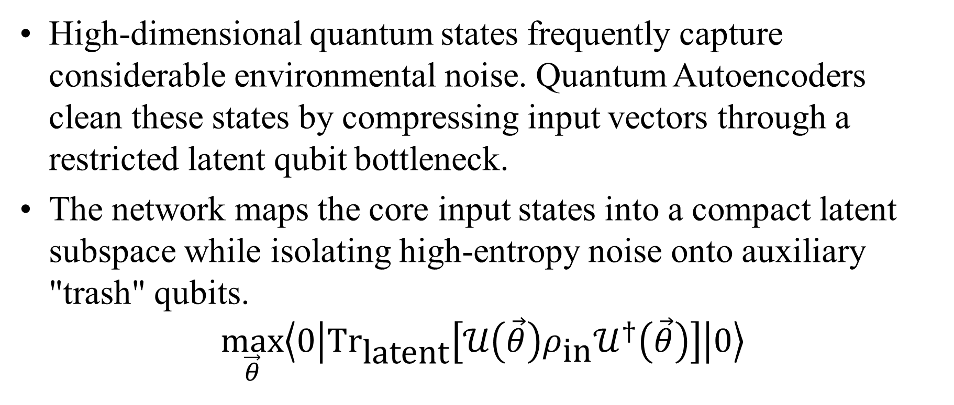
Quantum Autoencoders (QAE) for State Compression
High-dimensional quantum states frequently capture considerable environmental noise. Quantum Autoencoders clean these states by compressing input vectors through a restricted latent qubit bottleneck.
The network maps the core input states into a compact latent subspace while isolating high-entropy noise onto auxiliary "trash" qubits.
$$\max_{\vec{θ}}\left\langle 0\left|{\text{Tr}}_{\text{latent}}\left[𝒰\left(\vec{θ}\right)ρ_{\text{in}}𝒰^{†}\left(\vec{θ}\right)\right]\right|0\right\rangle$$
Optimization Target

Slide 45
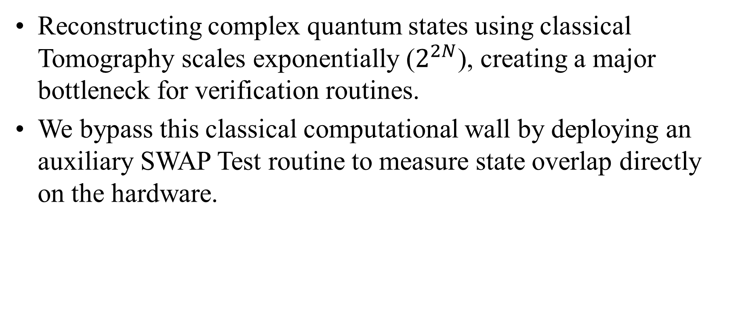
State Verification Mechanics via the SWAP Test
Reconstructing complex quantum states using classical Tomography scales exponentially ($2^{2N}$), creating a major bottleneck for verification routines.
We bypass this classical computational wall by deploying an auxiliary SWAP Test routine to measure state overlap directly on the hardware.

Slide 46
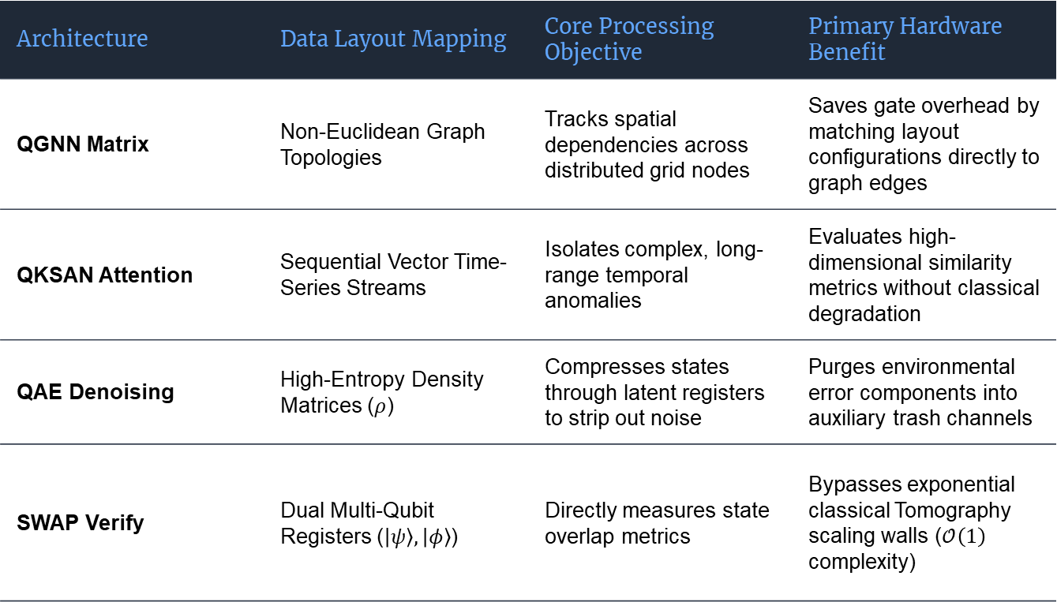
Advanced Architectural Footprints
Architecture | Data Layout Mapping | Core Processing Objective | Primary Hardware Benefit
QGNN Matrix | Non-Euclidean Graph Topologies | Tracks spatial dependencies across distributed grid nodes | Saves gate overhead by matching layout configurations directly to graph edges
QKSAN Attention | Sequential Vector Time-Series Streams | Isolates complex, long-range temporal anomalies | Evaluates high-dimensional similarity metrics without classical degradation
QAE Denoising | High-Entropy Density Matrices ($ρ$) | Compresses states through latent registers to strip out noise | Purges environmental error components into auxiliary trash channels
SWAP Verify | Dual Multi-Qubit Registers ($\left|ψ\right\rangle ,\left|φ\right\rangle$) | Directly measures state overlap metrics | Bypasses exponential classical Tomography scaling walls ($𝒪\left(1\right)$ complexity)

Slide 47
Hardware Co-Compilation & Layout Routing
Translating theoretical designs to physical hardware requires restructuring algorithms to match the chip's physical constraints.
Our compiler routines map heavily connected gates to localized, high-fidelity physical clusters, routing long-distance interactions through optimized SWAP chains to minimize gate overhead.

Slide 48
Workforce Development, Translation & Strategic Roadmap

Slide 49
Workforce Scaling & Ecosystem Translation
Advancing quantum research requires building comprehensive talent pipelines that bridge academic engineering principles with large-scale industrial deployment.
ASU SenSIP Integration: Directing student researchers toward hardware-aware development practices.
Cross-Sector Collaboration: Aligning academic milestones with corporate cloud testing environments (AWS Braket / IBM Quantum Hub).

Slide 50
Open Discussion & Questions?
Glen S. Uehara, PhD
guehara@asu.edu

