Slide 1
AR/VR-APPLICATIONS CORONA EXHIBIT
SHILA RASTIZADEH, ESHA ANEES, GÜLSÜM SANVERDI (04.02.21)

Slide 2
AGENDA
Ideation - Idea, Motivation
Project scope - Personas, User Stories, Story Board
Implementation
Usability test
Prototype
Lessons learned
Notes:
Ideation - GÜli
function scope - Güli
Implementation - shila
usability test - Esha
prototype - shila
lessons learned - Esha

Slide 3
IDEATION
Idea:
To create a virtual tour through an exhibition
The possibility to interact with an art piece in Virtual Reality
Sit at home and have a VR tour through an exhibition and even seeing further information about the artworks
Some buttons to click and get extra auditive or visual information (e.g. background story)
Notes:
The idea is to create a virtual tour through an exhibition. Imagine teleporting yourself from one 360° view to another one and having the possibility to interact with an art piece in Virtual Reality. You can easily sit at home and have a virtual tour through an exhibition and even display further information about the artworks. There will be some buttons you can click to get extra information like the background story or how the art piece was made. This could be displayed as a text or you will get audio feedback. If there is already an audio guide for the exhibition we could implement them too.

Slide 4
IDEATION
Motivation:
during the pandemic were forced to stay at home and cultural activities became a rare event
this Application could help museums or other institutions to stay active and this could be an alternative for spreading their art.
It´s a great opportunity for the customers to interact with the exhibition and to be not totally excluded from great cultural activities.
Notes:
During the pandemic people were forced to stay at home and cultural activities became a rare event. Museums or other institutions were forced to shut down their locations or needed to think about creative ways to bypass the restrictions that came with COVID-19. This Application could help the institutions to stay active and could be an alternative for them to spread their art. On the other hand side, it is a great opportunity for the customers, who will be able to interact with the exhibitions. During the pandemic most of us learned the value of culture, because it was a good distraction from the virus. Another point we should point to, is the possibility to spread cultural good worldwide.

Slide 5
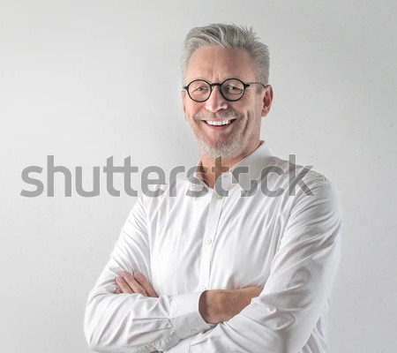
PERSONAS
HANS MEIER, 61
is a lawyer
is married and has 2 children
is not technically affine
has no experience with AR/VR
likes art and goes often to art exhibitions

Slide 6
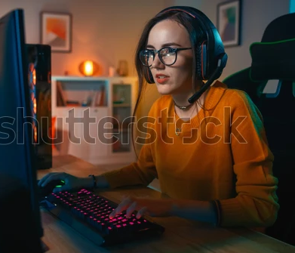
PERSONAS
LAURA HAIN, 24
24 years old
born in Germany
studies and lives in London
likes technologies, especially VR and AR
likes gaming

Slide 7

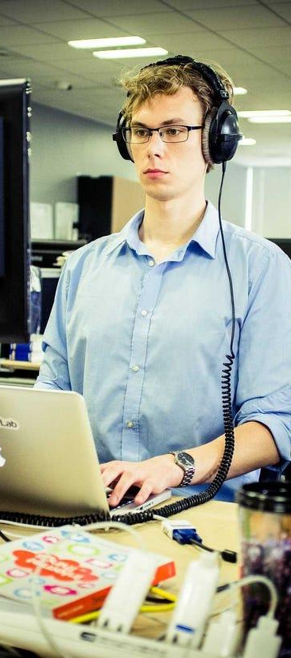
USER STORIES
Notes:
As a 60-year-old person, I want to sit and enjoy the whole museum experience
As I am a technology enthusiast, I want to explore more into Virtual Reality
As I am a student, I want to experience virtual Map for my Project
As I am an Introvert, I want to experience real-time without going out in public
As a Librarian, I want to give people a Virtual Experience in the Library.
As a lab assistant, I want to give my student Virtual Experience in the lab.

Slide 8



STORY BOARD
Welcome
Tutorial
Experience
Notes:
Welcome The first view will be from the outside, to get a connection with the Exhibit. Because it is an actual Exhibit we will start right in front of the Museum, so there will be a connection to the real world.
Most of the users won´t have any experiences with Virtual Reality, so it´s important to give a short but informative Tutorial before the experience starts.
After acclimatizing, the user will be able to jump from Hotspot to Hotspot. When focusing on a Marker, either text appears or the Audiofile (if available). They can interact with the art piece if they focus on a Marker

Slide 9

VIRTUAL EXHIBITION
https://preview.npi.re/shila-prototype/dev/
Notes:
Welcome The first view will be from the outside, to get a connection with the Exhibit. Because it is an actual Exhibit we will start right in front of the Museum, so there will be a connection to the real world.
Most of the users won´t have any experiences with Virtual Reality, so it´s important to give a short but informative Tutorial before the experience starts.
After acclimatizing, the user will be able to jump from Hotspot to Hotspot. When focusing on a Marker, either text appears or the Audiofile (if available). They can interact with the art piece if they focus on a Marker

Slide 10
IMPLEMENTATION
Putting the virtual cameras in the pictures
Rendering 360° pictures
Put pictures to Pano2VR
Level up the pictures and sorting
Adding Hotspots
Link Hotspots with Text
Export the 1. Prototype
Link to the Exhibit
Usabiliity Test
Implement the changes
Export the 2. Prototype
BE VR HAPPY
Notes:
Making pictures and videos with the 360° camera and the tripod
removing the faces/Tripod etc.
put pictures to Pano2VR
level up pictures and sort them to the right order
Adding Hotspots
Linking Hotspots with Media (Description Text/Audio etc.)
link to the Website of the Museum
Export the File
Make a Usability Test with someone from the university/other people
Implement the changes in Pano 2 VR again
Export the File

Slide 11



USABILITY TEST
Usability test at THI and at home with our own cardboards and smartphones
Questionnaire and comments during the test
In total 17 Usability tests
Notes:
We conducted a usability test in THI's VR lab with our prototype version that could be opened with any smartphone. We then placed the smartphone in our VR cardboard and began the test. During the test, comments, overall satisfaction ratings, questions, and feedback were documented. Afterward, participants were also allowed to fill out a questionnaire on the computer.
We created questions to test the usability of the VR-App. One part of the questions were tick questions and one part was open questions.
Some tests we did also with family, friends with our own cardboards or sent them a link to our App. In total, we could do 17 usability tests.

Slide 12
USABILITY TEST - REPORT
94,1 % think the VR-App is enjoyable / very enjoyable, one Test-User was neutral.
94,1 found it interesting /very interesting, only one Test-User found the App not interesting.
10/17 Test-User think the App is fast and 7/17 were neutral. (neutral = good speed.)
More than 80 % found the App as informative, whereas only one person thinks it is not informative.
Over 70 % think the App is rather clear, whereas 29,4 % tend to think it is confusing.
Everyone thinks the App is rather exciting.
Over 70 % think the App is organized, whereas 5,9 % think it is rather cluttered.
Almost 90 % think that the App is innovative, the rest is neutral.
Notes:
94,1 % think the VR-App is enjoyable / very enjoyable, which is a very good resonance. Only one Test-User was neutral.
94,1 found it interesting /very interesting, only one Test-User found the App not interesting.
10/17 Test-User think the App is fast and 7/17 were neutral. Some Test-Users said that neutral means for them, that it is a good speed.
More than 80 % found the App as informative, whereas only one person thinks it is not informative.
Over 70 % think the App is rather clear, whereas 29,4 % think tend to think it is confusing.
Everyone thinks the App is rather exciting.
Over 70 % think the App is organized, whereas 5,9 % think it is rather cluttered.
Almost 90 % think that the App is innovative, the rest is neutral.

Slide 13
USABILITY TEST - REPORT
Vast majority found the app to be quite good and enjoyable
They liked the university building of TH Nürnberg, the surrounding and the pictures
Users found the App realistic
… „super interesting and fascinating“
Some users got VR-sick
Some users found it hard to understand how to gaze the points and switch to the next picture
Sometimes the pictures got unsharp or pixely
Some users would like to have background music
Some users did miss instructions for gazing or an introduction at the beginning
Notes:
In summary, the vast majority found the app to be quite good. They found the App as really enjoyable and liked the university building of TH Nürnberg, the surrounding, and the pictures a lot. Especially in Corona-times, a virtual exhibition is a good idea. Some Test-Users got VR-sickness and some found that it was hard to understand how to gaze the points and switch to the next picture.
What did you like most about the VR-Application?
Did something disturbed you? If yes, could you explain that?
Did you get VR sickness?
Did you miss any functions or information?
Would you like to add anything into the VR-App?

Slide 14
AND NOW ENJOY THE CORONA EXHIBIT (2. PROTOTYPE)
https://preview.npi.re/shila-prototype/dev/
Notes:
Link unserer VR App einfügen

Slide 15
LESSONS LEARNED
Time-Management is really important: you always need more time for problem solving, planning, changing!
Users do not always understand everything we implement in the VR-App
Usability Tests are so important in order to improve our App
Communication and Team-Work is important
GitHub is not that easy (we had problems)
Nothing can stop you from exploring things!
Nothing can replace real exhibitions and real & social interaction in exhibitions/cultural activities!
Handle Lighting was a real problem!

Slide 16

THANK YOU!

