Slide 1
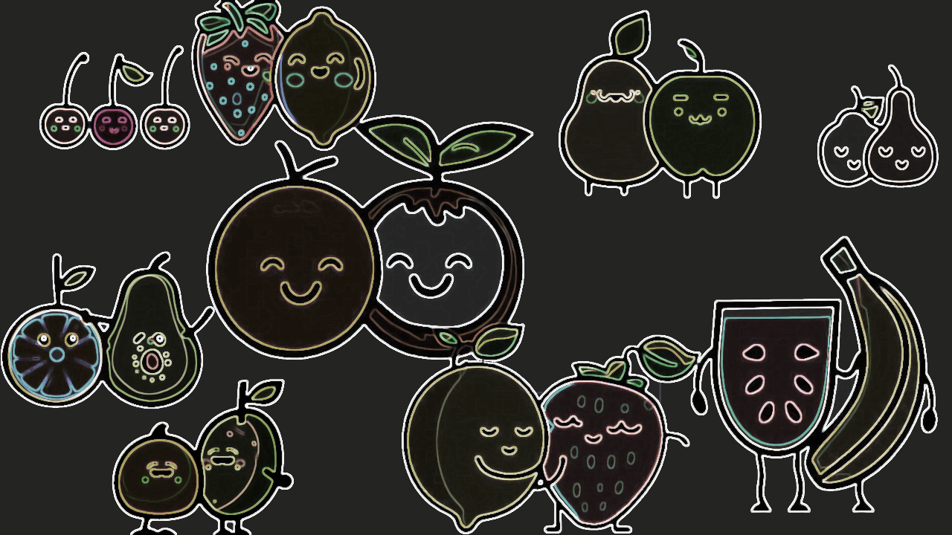

ETHGlobal Paris 2023
2023/07/23

Slide 2

Keep your secrets!
Dating apps know too much…
Personal preferences
Sexual orientation
Location information
And so much more!
We need a privacy-preserving
matchmaking service.

Slide 3

Privacy!
Keep your preferences and location private thanks to proof-of-intersection and proof-of-proximity powered by Noir.
Stop the bots!
Interact with verified humans thanks to
Worldcoin and Polygon ID.
No peaking!
Your messages are encrypted end-to-end
thanks to XMTP.

Slide 4
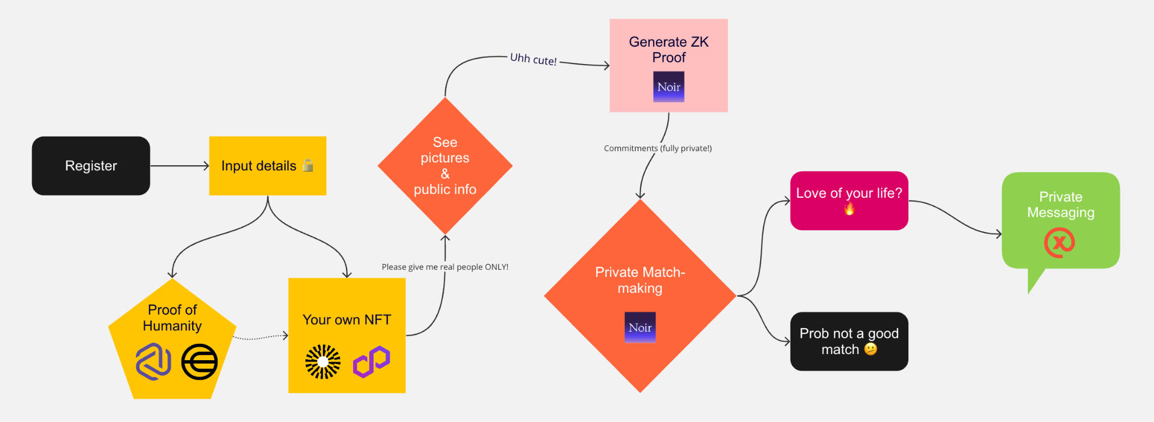
OK but… How?

Slide 5

Thanks to all the fruits lovers!

