Slide 1
Workflow Engine (ELSA)

Slide 2
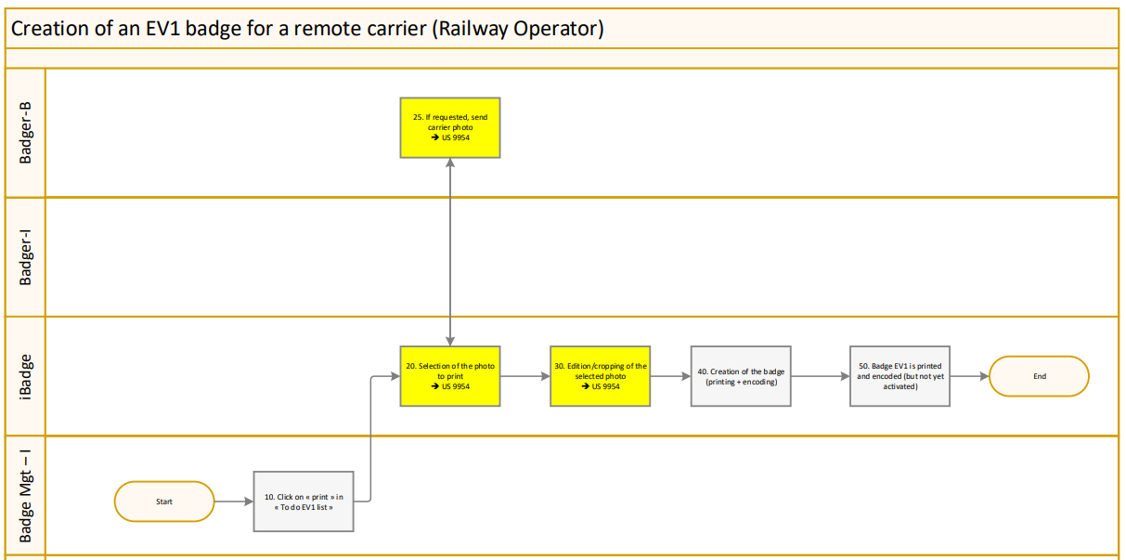


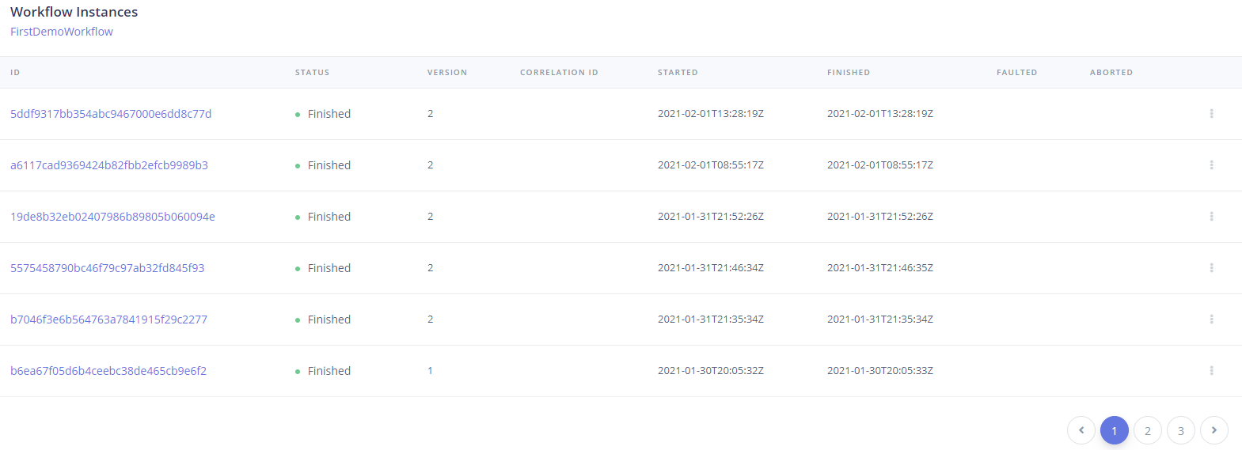
Why ?
Workflow Designer
Executed Workflow Dashboard

Slide 3
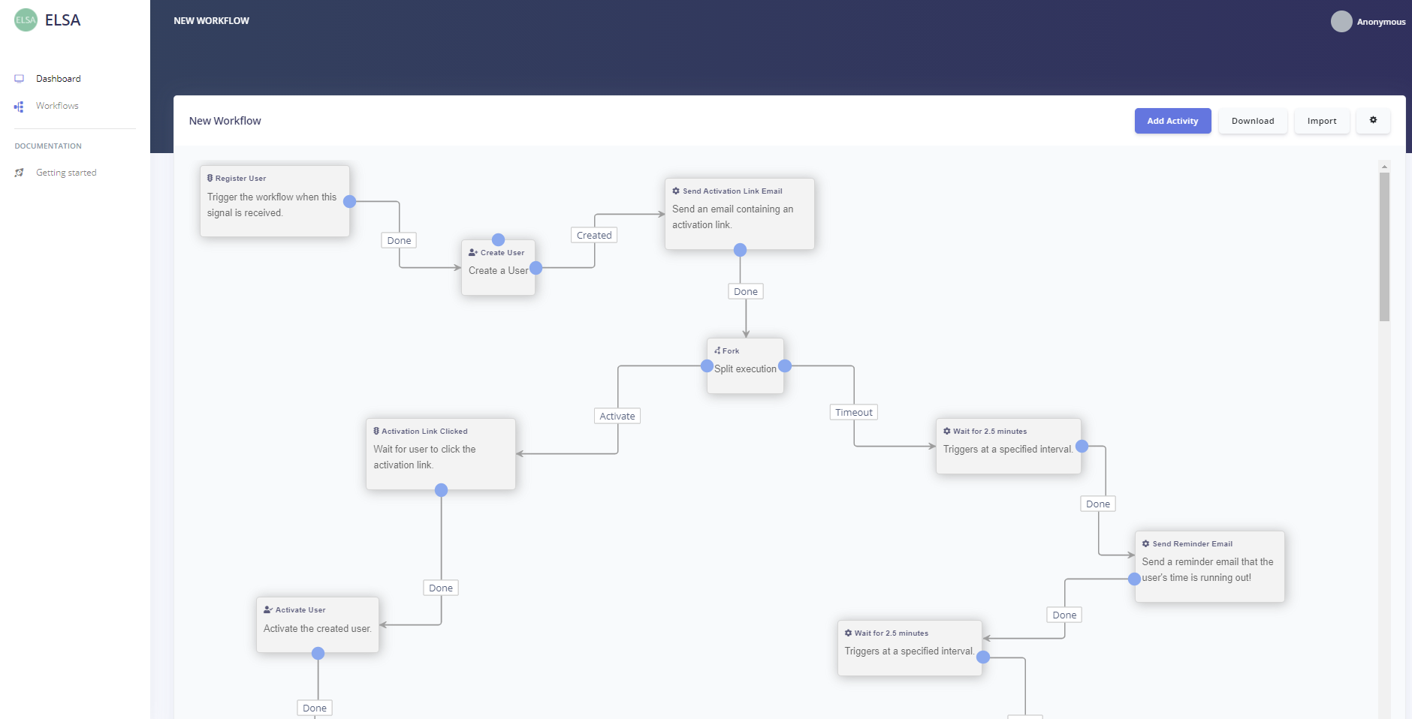
Workflow Designer
Enforce collaboration between analysts and devs
High-level documentation always in sync with the code
Activities can be grouped by semantic
Let’s demo…

Slide 4

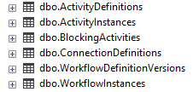
START/RESUME workflow (in this POC)
MyApp REST API
Workflow Designer
ASP.NET CORE
ASP.NET CORE
EF Core
Workflow Nuget Packages
EF Core
Workflow Nuget Packages
Start/Resume workflow
MyApp DB

Slide 5
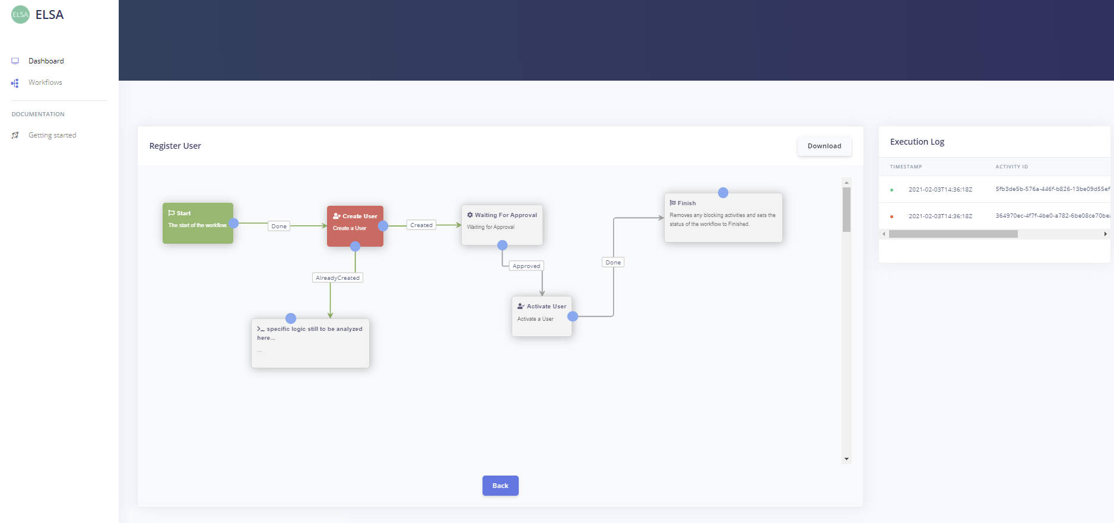
Workflow Dashboard
Audit
Monitoring
Diagnostic
Let’s demo…

Slide 6
NOT AN ‘Enterprise’ Solution ?
Would require:
Service bus messaging
Workflow Server
Support for multi-node environments
Check ELSA roadmap here

Slide 7
Main advantage
Improve collaboration between analysts/devs/testers/support

Slide 8
Questions
Do you know alternatives already in place at INFRABEL?
What about transactions ? (saga)
Is ELSA a reliable framework for the long-term
Etc…

