Slide 1
Workflow Engine (ELSA)
https://github.com/guerinsylvain/poc-state-machine-elsa

Slide 2
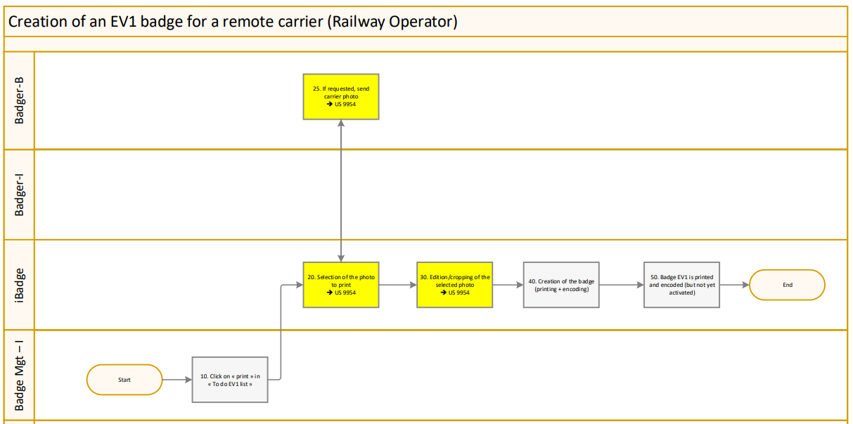

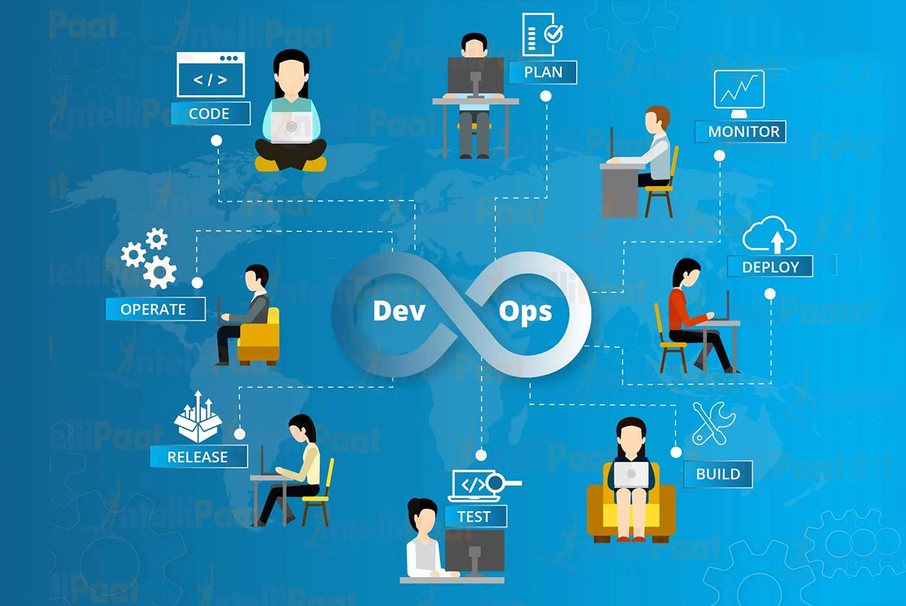
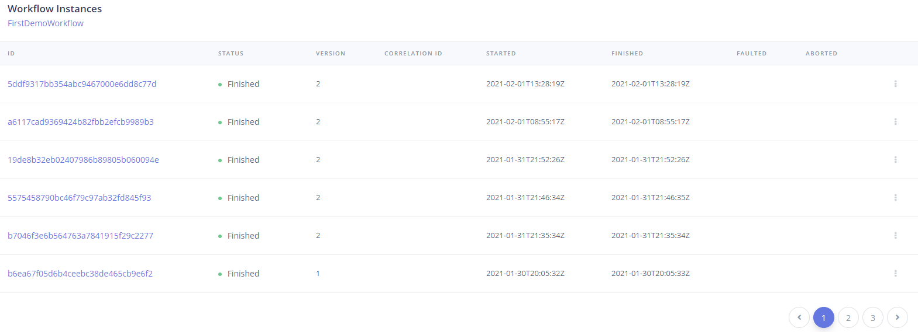
Why ?
Workflow Designer
Executed Workflow Dashboard

Slide 3
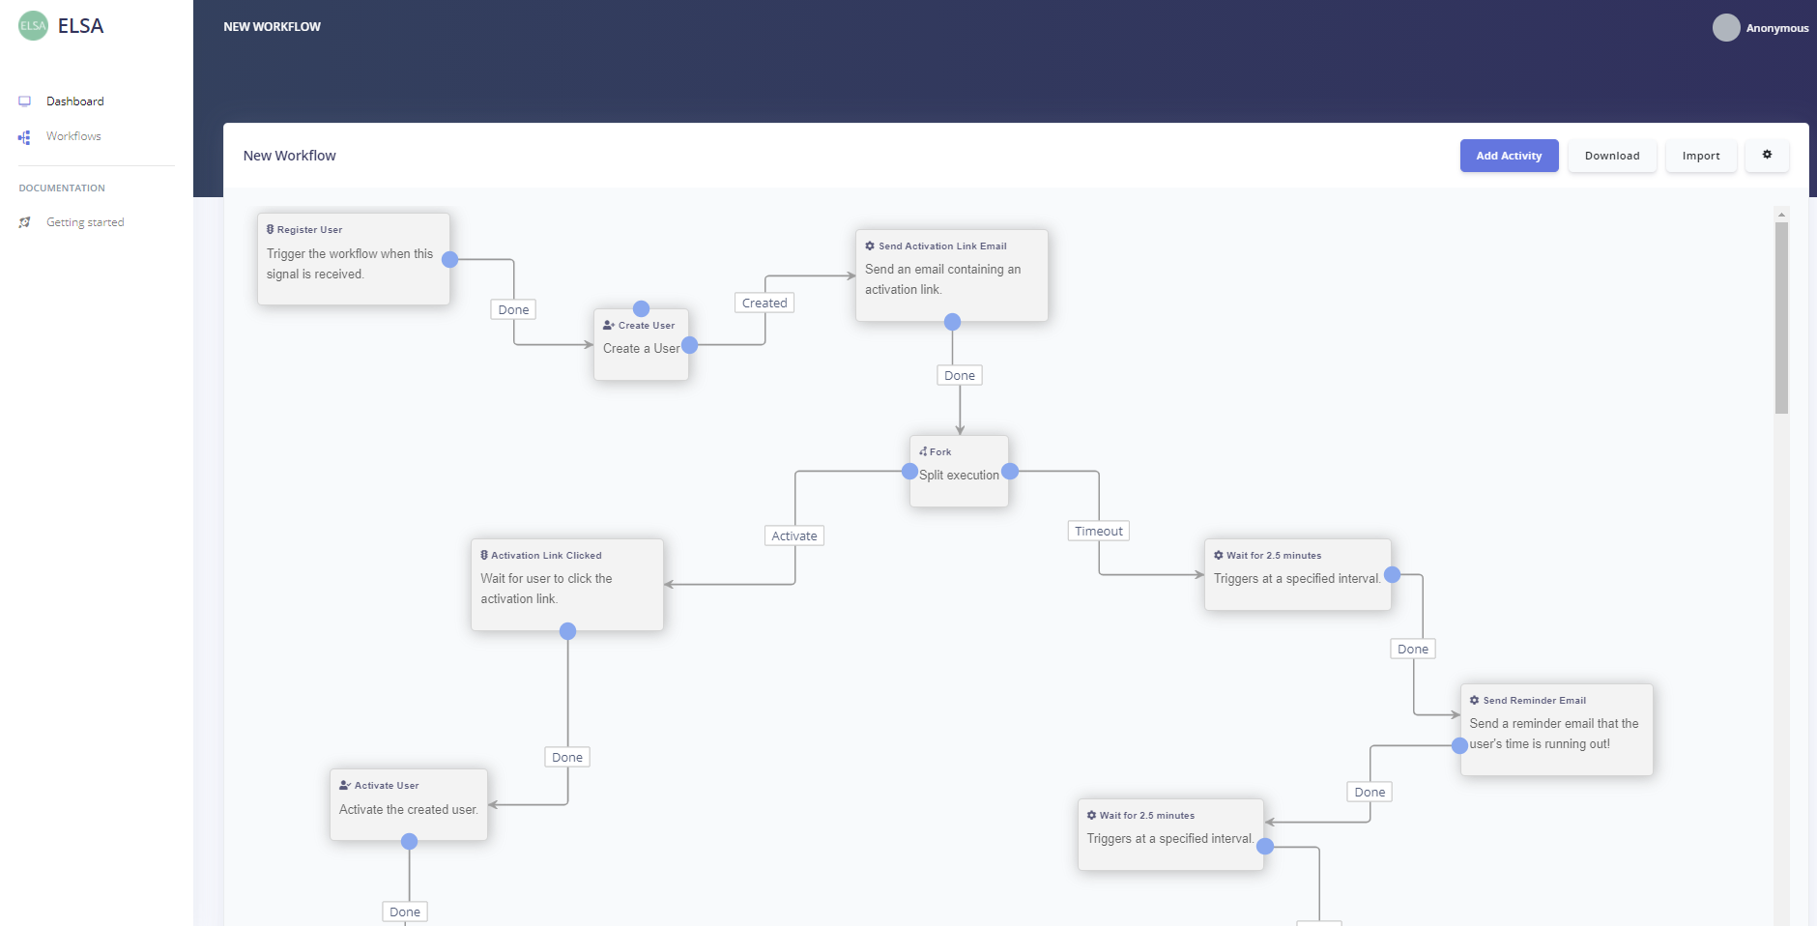
Workflow Designer
Enforce collaboration between analysts and devs (and also with testers and support)
High-level up to date documentation always in sync with the code
Activities can be grouped by semantic
State can be spread through the workflow
Let’s demo…

Slide 4

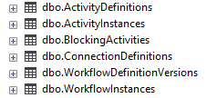
START/RESUME workflow (in this POC)
MyApp REST API
Workflow Designer
ASP.NET CORE
ASP.NET CORE
EF Core
Workflow Nuget Packages
EF Core
Workflow Nuget Packages
Start/Resume workflow
MyApp DB

Slide 5
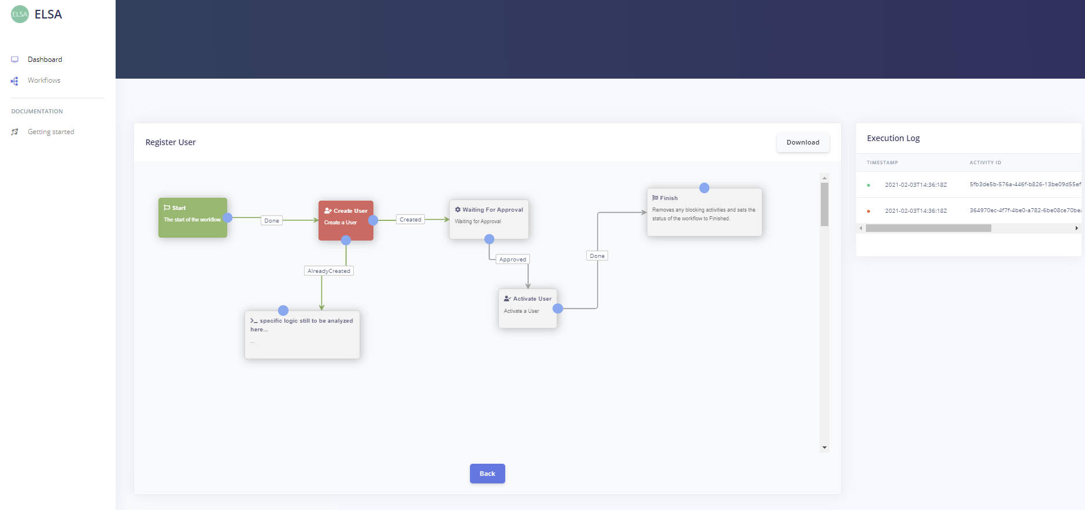
Workflow Dashboard
Audit
Monitoring
Diagnostic
Let’s demo…

Slide 6
NOT AN ‘Enterprise’ Solution ?
Would require:
Service bus messaging
Workflow Server
Support for multi-node environments
Check ELSA roadmap here

Slide 7

Main advantage
Improve collaboration between analysts/developpers/testers/support

Slide 8
Questions
Is ELSA a reliable framework for the long-term?
Will the future ELSA 2.0 be 100% backward compatible
Workflow strategy deployment from dev/test/acc to prod
Workflows are versioned but what about activities (.NET code)
What about transactions ? (saga)
Do you know alternatives already in place at INFRABEL?
We could add a channel on Teams to continue the discussion
Etc…

