Slide 1
ELSA Workflow Engine

Slide 2
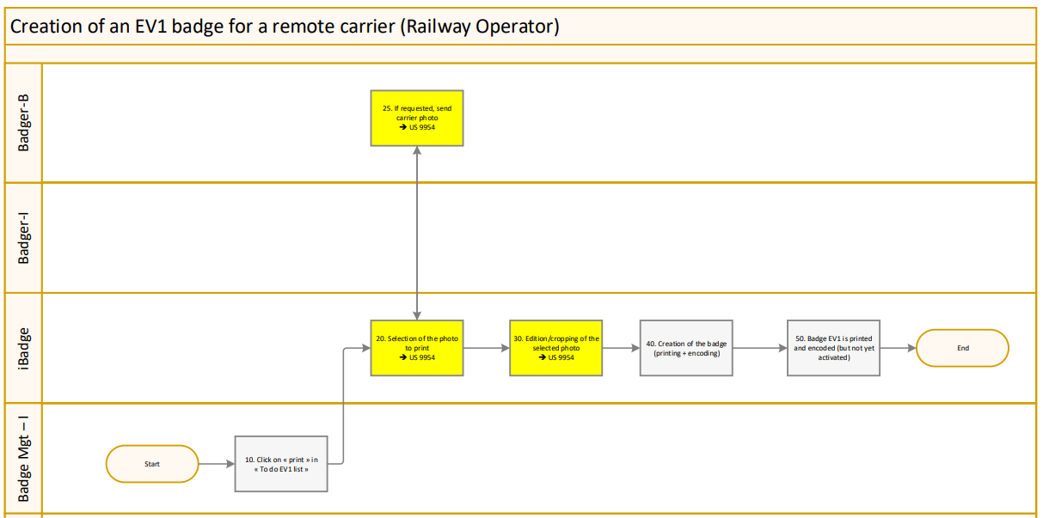


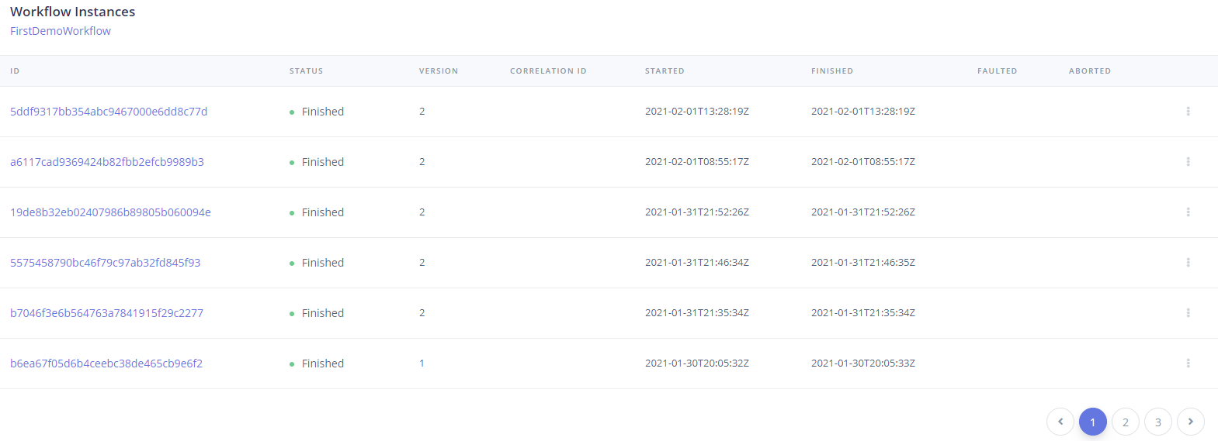
Why ?
Workflow Designer
Executed Workflow Dashboard

Slide 3
Workflow Designer
High-level documentation always in sync with the code
Activities can be grouped by semantic
Demo designer…

Slide 4
Workflow Dashboard
Audit
Monitoring
Debugging

