Slide 1
No-Show
Jorge Guerra
Luis Ahumada
October 03, 2016

Slide 2
OUTLINE
System specifications
Data pre-processing
Methodology
Results
Future Work

Slide 3






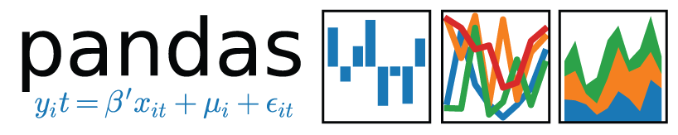
System SPECIFICATIONS
Windows Server 2012 R2
2 Intel® Xeon® CPU E5-2650 v4 @ 2.20GHz
12 core(s), 24 Logical Processor(s)
512 GB RAM
2.8TB hard drive
Anaconda 4.3.25
Python 3.6.1
Keras 2.0.6
Numpy 1.12.1
Scikit-learn 0.18.1
Pandas 0.20.1
Tensorflow 1.3.0
Logging 0.5.1.2

Slide 4
Data PRE-processing
Data located in CHOP Data Warehouse Production (CDW_PROD)
Updated on the daily basis
5532066 records i.e. patients’ encounters
76 Features or explanatory variables i.e. PATIENT_KEY, TIME_TO_APPT ENCOUNTER_APPOINTMENT_WEEK_DAY,…, NOSHOW
Features
PATIENT_KEY = patient ID
TIME_TO_APPT = days patient has to wait for the appointment
ENCOUNTER_APPOINTMENT_TYPE i.e. “sick, follow up, etc.”
ENCOUNTER_TYPE i.e. “Appointment, Office visit, etc.”
Unbalance dataset
Need to sample the points

Slide 5

Data PRE-processing
Calculate the history or frequencies of the NOSHOW per patient
- For training dataset, for each repeated patient, calculate:
Insert NOSHOW_FREQUENCY for the respective patients’ in the test dataset
Dataset was divided into a training set (70%), testing set (30%) with a 20 folds for cross-validation

Slide 6
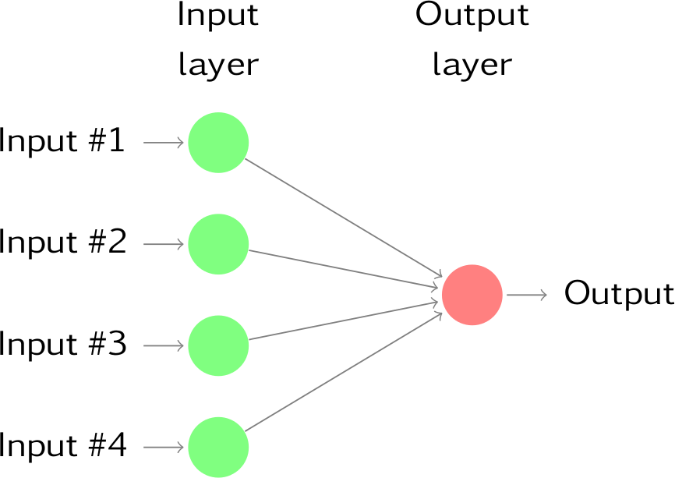
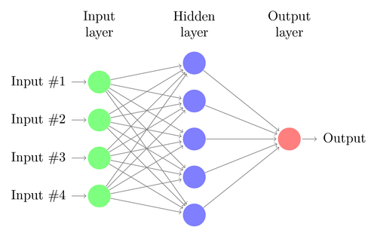
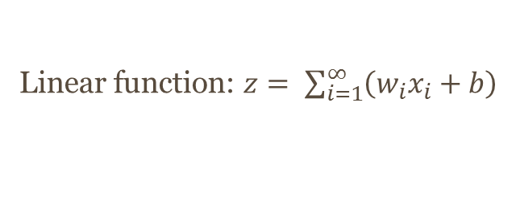
SHALLOW VS DEEP Learning
Logistic Regression vs Deep Neural Networks
INPUT
LAYER
OUTPUT
LAYER
INPUT
LAYER
HIDDEN
LAYER
OUTPUT
LAYER
TIME_TO_APPT
TIME_TO_APPT
w0
ENCT_APPT_TIME
w1
ENCT_APPT_TIME
w2
OUTPUT
OUTPUT
ENCOUNTER_TYPE
ENCOUNTER_TYPE
w3
NOSHOW_FREQ
NOSHOW_FREQ
Linear function: $z= \sum_{i=1}^{∞}{\left(w_{i}x_{i}+b\right)}$
$$activation function or sigmoid funciton: a= \frac{1}{1+ e^{−z}}$$

Slide 7
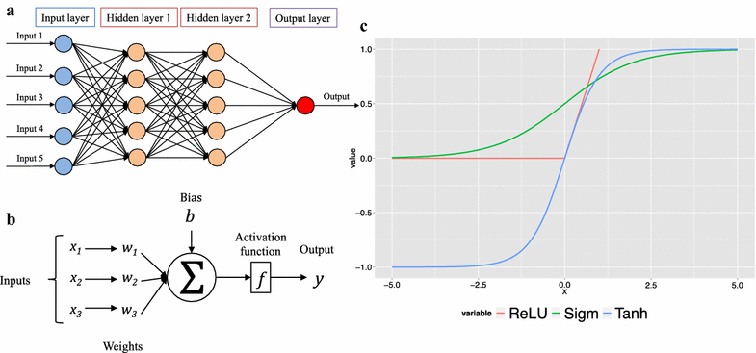
DEEP Neural NETWORK
Using Grid Search in scikit-learn for hyperparameter optimization:
learning rate
number of iterations
number hidden layers
Number of hidden units
Choice of activation function
Notes:
the activation function of a node defines the output of that node given an input or set of inputs.

Slide 8
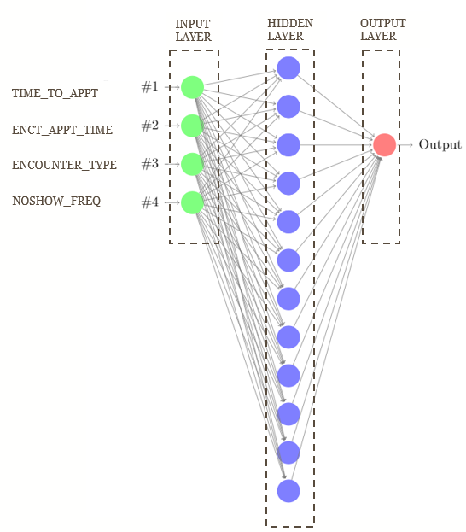
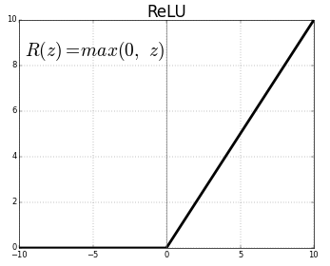
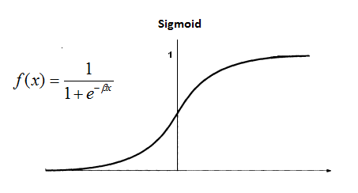
Dense NEURAL NETWORK
Sequential: build high-level
features through their
successive layers
Dense (fully connected)
1 Hidden Layer using
Activation function = Rectified Linear Unit (ReLU)
Output
Activation function = sigmoid function)
Notes:
activation function of a node defines the output of that node given an input or set of inputs.
Dense/fully connected layer: A linear operation on the layer's input vector.
Dense layer: A linear operation in which every input is connected to every output by a weight (so there are n_inputs * n_outputs weights - which can be a lot!). Generally followed by a non-linear activation function

Slide 9
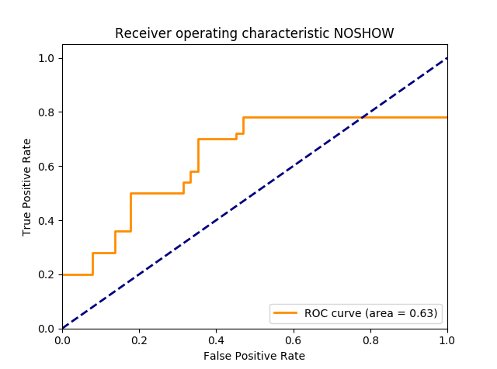
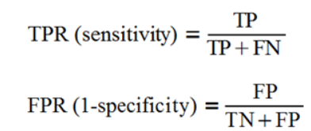
RESULTS
AUC = 0.63

Slide 10
Problems / Future WORK
Unbalance classes
Sampled dataset for model development
Better feature engineering
Use of regularization for noise removal or improve overfitting
Look into convolution neural networks
Notes:
Convolutional layer: A linear operation using a subset of the weights of a dense layer. Nearby inputs are connected to nearby outputs (specifically - a convolution33). The weights for the convolutions at each location are shared. Due to the weight sharing, and the use of a subset of the weights of a dense layer, there's far less weights than in a dense layer. Generally followed by a non-linear activation function

Slide 11

QUESTIONS

