Slide 1
Skin.ly
Jorge Guerra, Victor Ruiz, Andreina Torres and Prasanth Pullareddygari
group 5

Slide 2
Background
Diagnosed with skin cancer higher than all other cancers combined
One in five Americans will develop skin cancer by the age of 70
The annual cost of treating skin cancers is $8.1 billion:
~ $4.8 billion for nonmelanoma skin cancers
~ $3.3 billion for melanoma.
Notes:
More people are diagnosed with skin cancer each year in the U.S. than all other cancers combined.
One in five Americans will develop skin cancer by the age of 70.
The annual cost of treating skin cancers in the U.S. is estimated at $8.1 billion: about $4.8 billion for nonmelanoma skin cancers and $3.3 billion for melanoma.

Slide 3






Proposed Solution
Mobile Health Care Providing Preventive Health Screenings. E.g. Patient Upload the Skin Mole Pictures to the app
Diagnose the Skin pictures uploaded to identify benign and malignant cancer cells.
Connect with Medical and Social resources in Patient’s community
Identify Cost effective options
Find economical and close medical providers

Slide 4
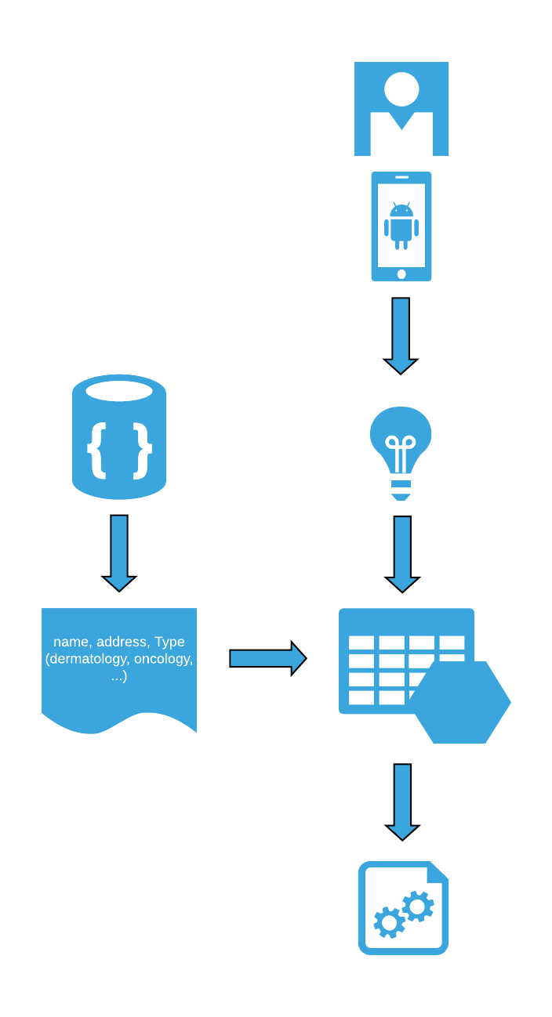
Pipeline
Picture
Center for Medicare & Medicaid Services (CMS)
Convolution
Neural Network
Filtered Providers
Process results and match results to providers if maligned

Slide 5
Implementation Details
Backend
Providers data obtain from Medicare Physician and Other Supplier Aggregate table, CY2016, Interactive Dataset
Processed and filtered with Python
Deep learning prediction
Convolutional neural network
Keras + Tensorflow
Dashboard
R Shiny

Slide 6
DEMO

