Slide 1

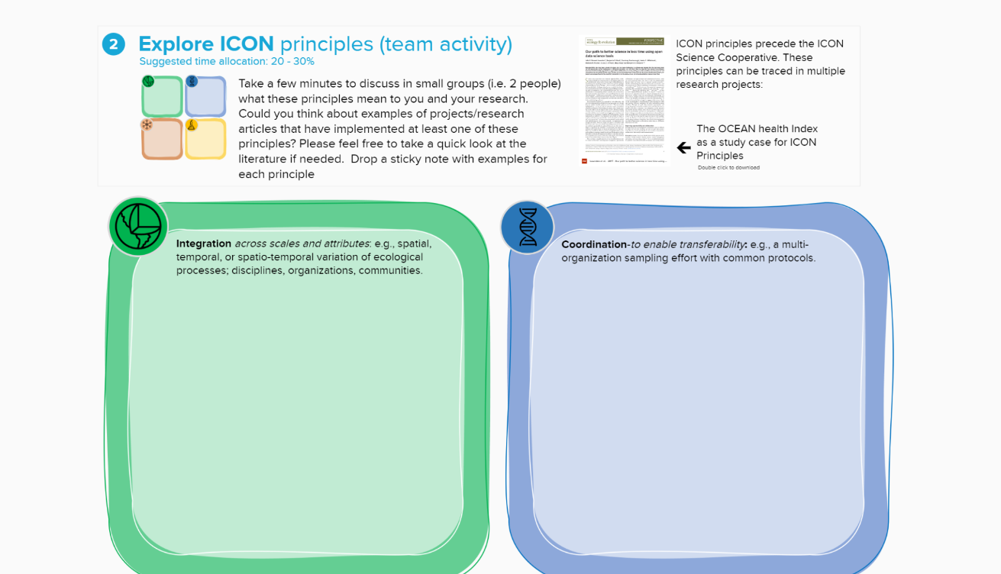
Interact with MURAL
Notes:
Each section is articulated through instructions, guiding questions, or both.
Responses to the questions are provided individually by each team member through sticky notes.
We have added some of the literature we used to create this resource. We hope it will help you clarify some concepts, and more importantly dig deeper into some of the ideas used for the design of this MURAL.
Although this MURAL can be used asynchronously, we strongly encourage its use as part of a team discussion. We have identified the sections that benefit the most of synchronous team activities and which are more suitable for asynchronous work. A suggested time allocation (as a fraction of a total) is indicated at the beginning of each section. Finally, we have added some of the literature we used to create this resource. We hope it will help you clarify some concepts, and more importantly dig deeper into some of the ideas used for the design of this MURAL. With that…

