Slide 1
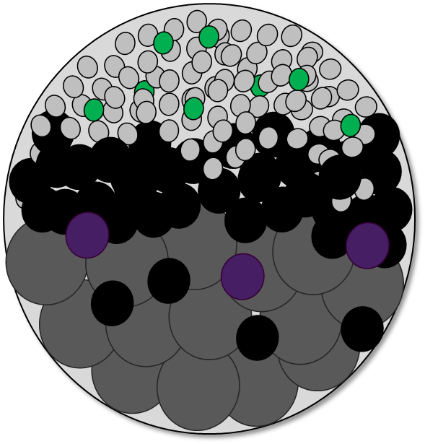
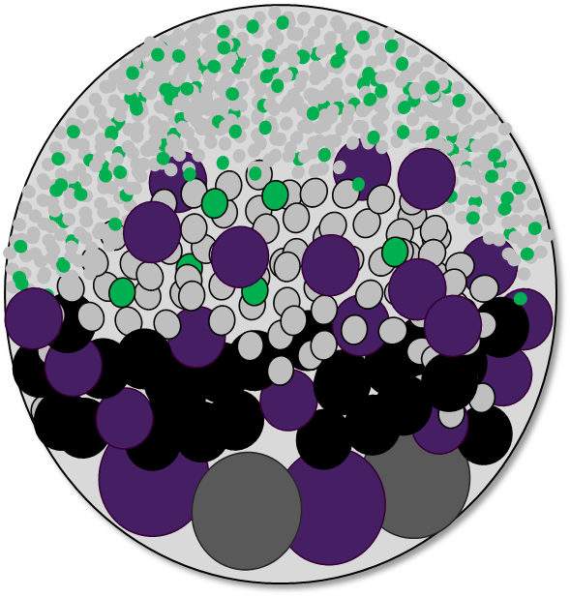
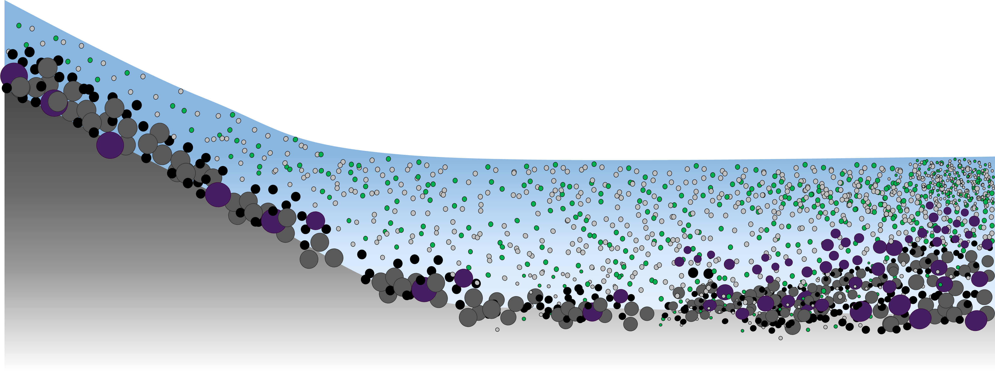
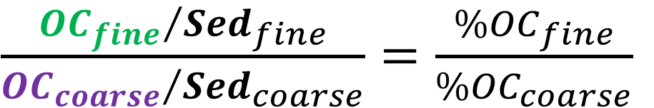

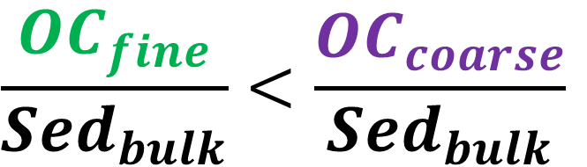

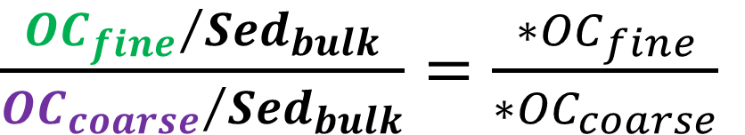
Upstream
deposit
Downstream
deposit
$$\frac{{OC}_{fine}}{{Sed}_{fine}}>\frac{{OC}_{coarse}}{{Sed}_{coarse}}$$
$$\frac{{OC}_{fine}}{{Sed}_{fine}}<\frac{{OC}_{coarse}}{{Sed}_{coarse}}$$
To the
headwaters
The coarse fraction is relatively OM-depleted when compared to the fine fraction. Thus, relative enrichment >1.
$$\frac{{OC}_{fine}}{{Sed}_{bulk}}<\frac{{OC}_{coarse}}{{Sed}_{bulk}}$$
The coarse fraction is relatively OM-enriched when compared to the fine fraction. Thus, relative enrichment < 1.
The mass ratio between OC_{coarse} and OC_{fine} is < 1 across overbank deposits and > 1 in suspended sediment samples.
To the
estuary
Relative Enrichment
Flow
$\frac{{{OC}_{fine}}/{{Sed}_{fine}}}{{{OC}_{coarse}}/{{Sed}_{coarse}}}=\frac{\%{OC}_{fine}}{{\%OC}_{coarse}}$
Mass Ratio
$\frac{{{OC}_{fine}}/{{Sed}_{bulk}}}{{{OC}_{coarse}}/{{Sed}_{bulk}}}=\frac{{∗OC}_{fine}}{{∗OC}_{coarse}}$
Bedrock channel

Slide 2
Upstream
deposit
Downstream
deposit
$$\frac{{OC}_{fine}}{{Sed}_{fine}}>\frac{{OC}_{coarse}}{{Sed}_{coarse}}$$
$$\frac{{OC}_{fine}}{{Sed}_{fine}}<\frac{{OC}_{coarse}}{{Sed}_{coarse}}$$
To the
headwaters
The coarse fraction is relatively OM-depleted when compared to the fine fraction.
The coarse fraction is relatively OM-enriched when compared to the fine fraction.
To the
estuary
Flow
Bedrock channel

