Slide 1
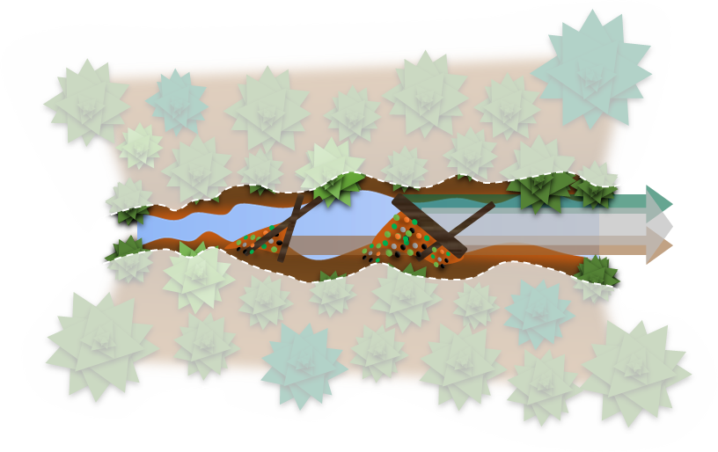
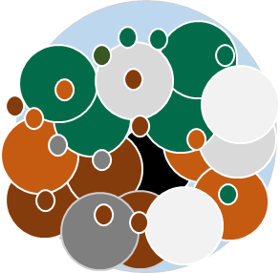
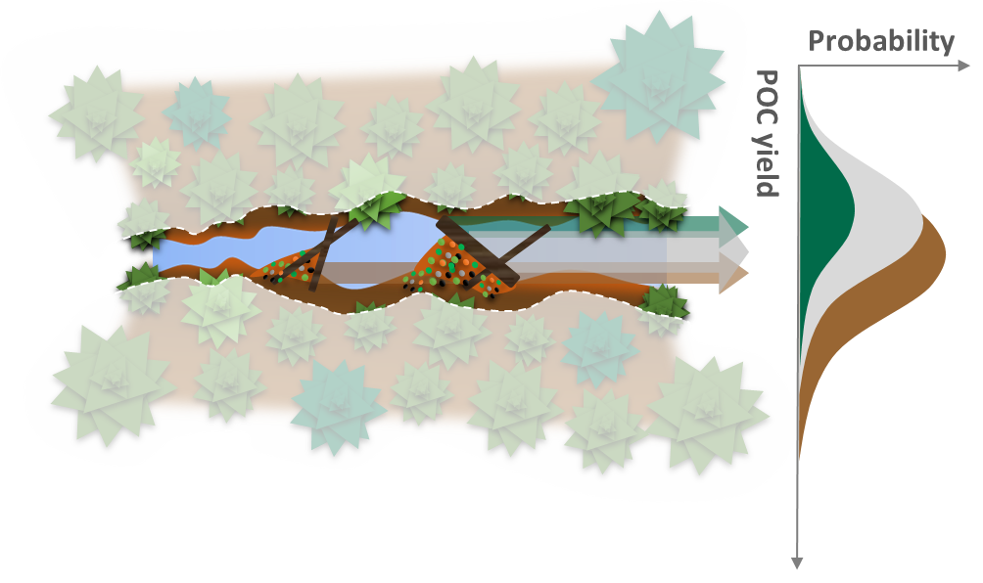
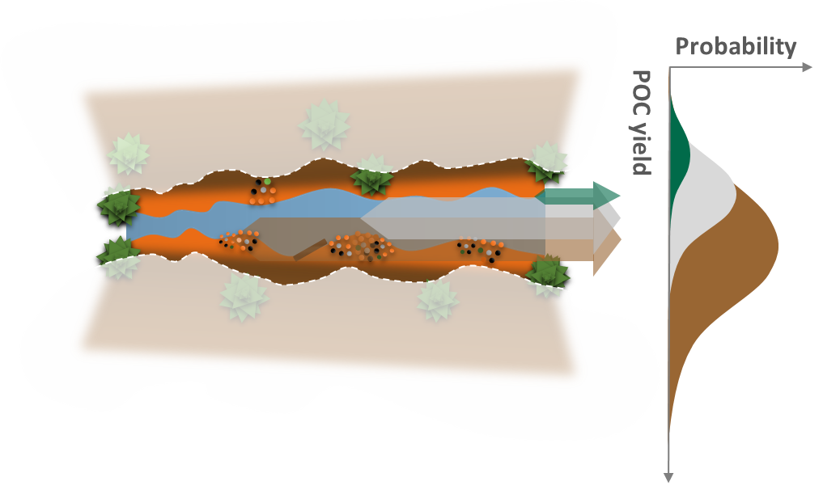
A 30-year record of Biospheric Particulate Organic Carbon Export from Two Small Forested Catchments with Contrasting Landscape Organization and Disturbance History
Probability
Carbon-rich particles
at low POC yields
POC yield
Hillslope
Total yield
Stream
channel
Coniferous
vegetation
Mixed
detritus
Carbon-poor particles
at high POC yields
Sediment
particles
Carbon Rich-Mineral Poor
(e.g., fresh litter inputs)
Instream retention structures
(e.g., large woody debris)
Mineral Rich-Carbon Poor
(e.g., mineral soil)
Old-growth forest
Logged forest + channel scouring event

Slide 2
Insert -> Shapes
Shape Format
Rotate -> Flip Vertical
Shape Outline -> No Outline
Shape Fill -> Gradient
Shape Format
Shape Effects -> Soft Edges
Insert -> Shapes
Superimpose
and rotate
Group
Ctrl + D (Duplicate) + Resize
Superimpose
and group
Shape Format
Shape Fill -> Gradient
Shape Effects -> Shadow
Ctrl + D (Duplicate)
Duplicate and resize as needed
Insert -> Shapes
Curve
Draw your free shape
Insert -> Shapes
Place squares at both ends,
Select All
Shape Format
Merge Shapes-> Fragment
Delete extra fragments

Slide 3
