Slide 1
Sediment respiration is
cumulatively added in the
direction of the flow
Segment length
Flow
Landscape heterogeneity
can be calculated at the local or
cumulative drainage area to
a given river segment.

Slide 2
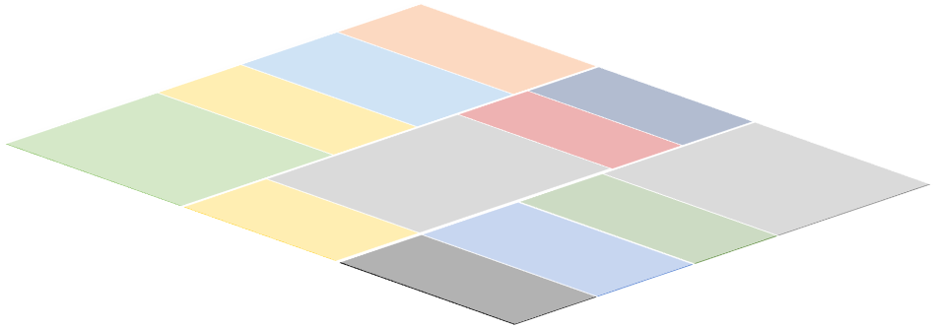
A Moving Average Approach for Signal Propagation along Stream Networks
Modified from Ver Hoef (2019)
White noise
(random process)
Flow
Moving Average
splits at confluences
Moving Average
Functions
Flow
Signal propagation
along the stream network
Flow
Accounting for the role of
land use and
other covariates

