Slide 1
Braitenberg
• Braitenberg Vehicules (Lover and Explorer)
  Thought experiments of abstract vehicules equipped with motors and sensors
• e-puck proximity sensors
• About Braitenberg implementation for e-pucks
Robotics, Béat Hirsbrunner and Simon Studer, diuf.unifr.ch/pai/rob, Lecture 3 – 5 march 2015
Notes:
Programmation impérative - Prof. Béat Hirsbrunner
été 2002

Slide 2
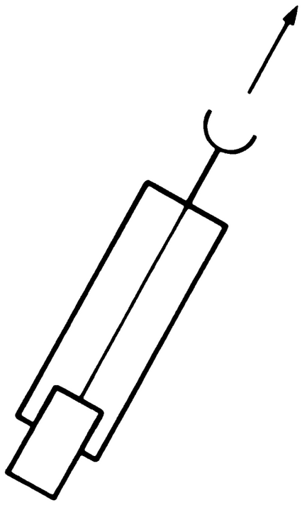
Basic Love Behavior
Hardware: 1 motor, 1 sensor
Property:
sensor | motor
high | low
low | high
Notes:
Programmation impérative - Prof. Béat Hirsbrunner
été 2002

Slide 3
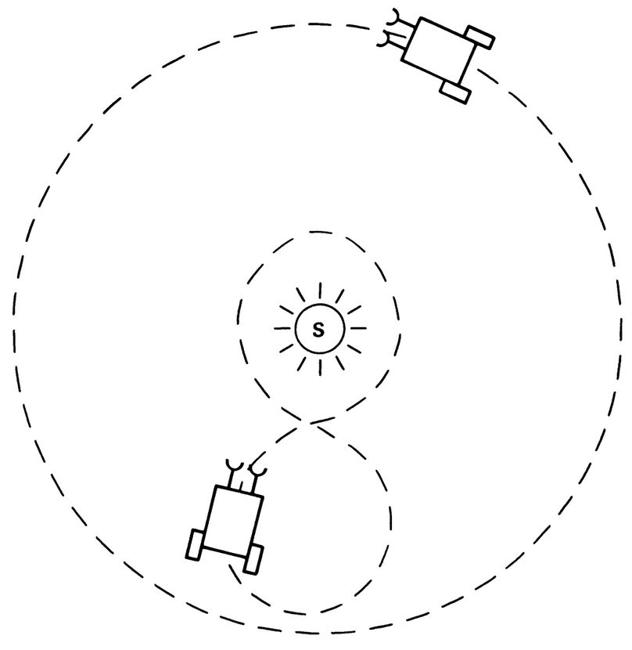
Advanced Love Behavior
Hardware:
• 2 motors, 2 sensors
• left motor couple with left sensor
and similar for right motor
Property when closer to stimulus:
left motor | right motor
accelerate | slow down
Notes:
Programmation impérative - Prof. Béat Hirsbrunner
été 2002

Slide 4
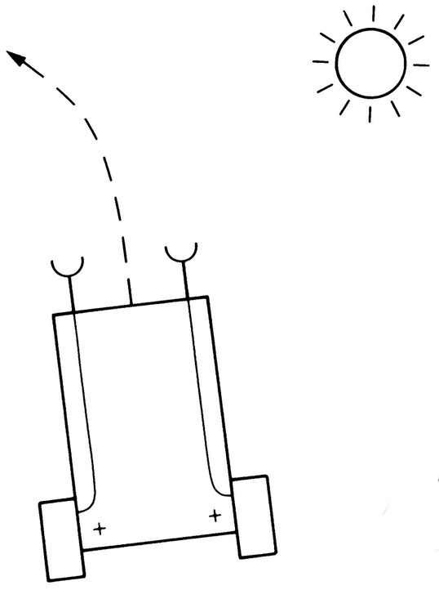
Explore Behavior
Hardware:
• 2 motors, 2 sensors
• left motor couple with left sensor
and similar for right motor
Property when closer to stimulus:
left motor | right motor
accelerate | accelerate
Notes:
Programmation impérative - Prof. Béat Hirsbrunner
été 2002

Slide 5
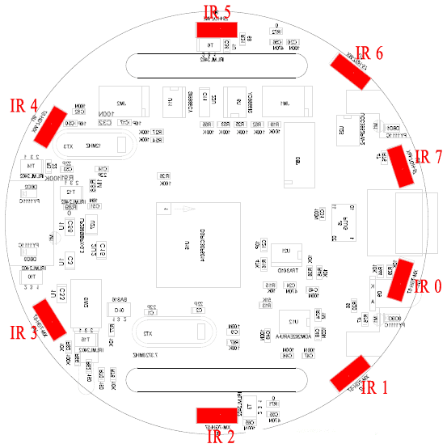
Proximity Sensors – e-puck

Slide 6
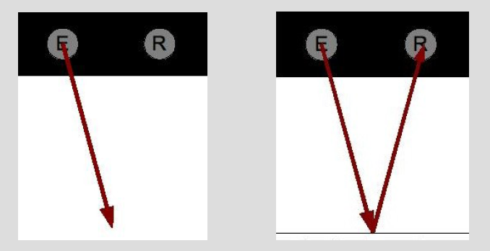
Proximity Sensors – Values
Distnce [cm] | Prox
0 | ~4000
~10 | 0

Slide 7
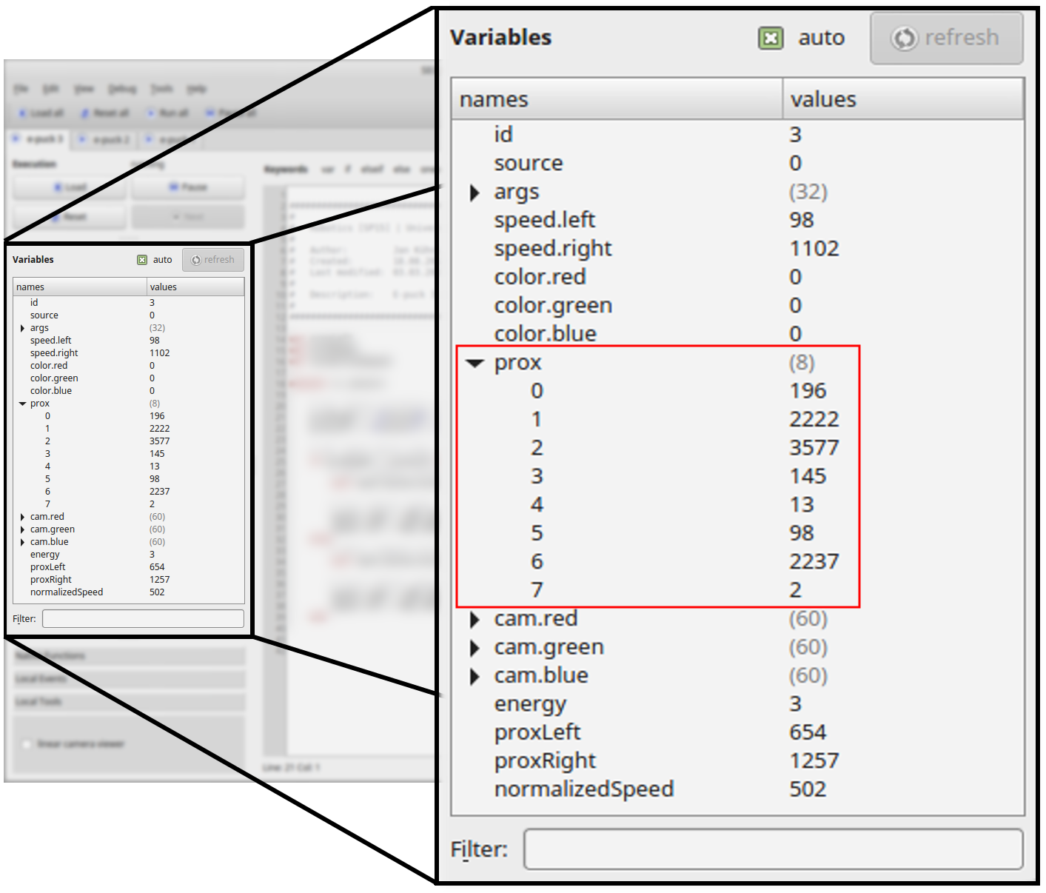
Proximity – Array
prox[0] <– 196
prox[1] <– 2222
prox[2] <– 3577
prox[3] <– 145
prox[4] <– 13
prox[5] <– 98
prox[6] <– 2237
prox[7] <– 2
5
object
6
4
7
0
3
1
2
object

Slide 8
Braitenberg formulas for e-puck
s = s₀ + ds,
where s:speed, s₀: initial speed, ds: delta speed
ds = +-(p/p_t) * s₀,
where p: current proximity, p_t: proximity threshold
proxRight = (a*prox[0] + b*prox[1] + c*prox[2] + d*prox[3]) / (a+b+c+d)
proxLeft = (a*prox[7] + b*prox[6] + c*prox[5] ] + d*prox[6]) / (a+b+c+d)
proxSingle = (a*proxRight + b*proxLeft) / (a+b)

Slide 9
Example: Lover
var proxFront
var ds # delta speed
onevent ir_sensors
# proximity
proxFront = (prox[0]+prox[7])/2
# delta speed ds
call math.muldiv(ds, S_INIT, proxFront, P_THRESH)
# right and left speed
speed.right = S_INIT - ds
speed.left = S_INIT – ds
ds = (S_INIT * proxFront) / P_THRESH

Slide 10
About math.muldiv(A,B,C,D)
• math.muldiv(A,B,C,D) semantics: A = (B*C) / D
• The assignment '=' is evaluated in 16-bit (-32'768 .. 32'767)
as the function is evaluated in 32-bit (-2'147'483'648 .. 2'147'483'648)
• with the typical values :
S_INIT <– 600,
prox <– 0..4000,
P_THRESH <– 1500
this computation will overflow in 16-bit

