Slide 1
• State Machine
• Event Execution Killed Problem
• Instruction Cycle
Robotics, Béat Hirsbrunner and Simon Studer, diuf.unifr.ch/pai/rob, Lecture 4 – 12 march 2015
Notes:
Programmation impérative - Prof. Béat Hirsbrunner
été 2002

Slide 2
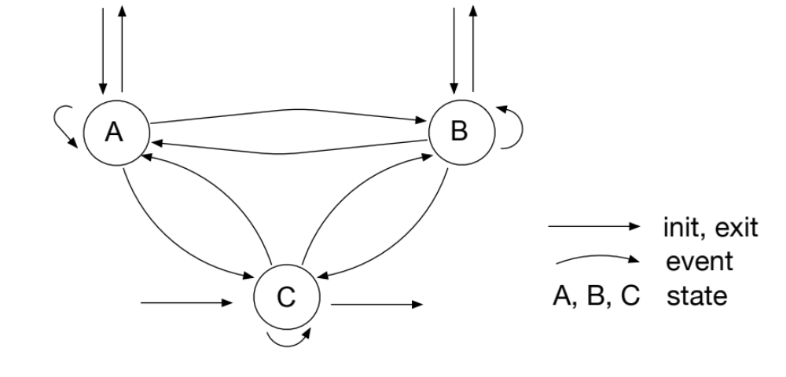
State Machine
Examples of states
  red, green, blue
  in, out
  lover, explorer
  …
Examples of events
  events from sensors or actuators
  incoming message
  incoming request
  update of a variable
  …

Slide 3
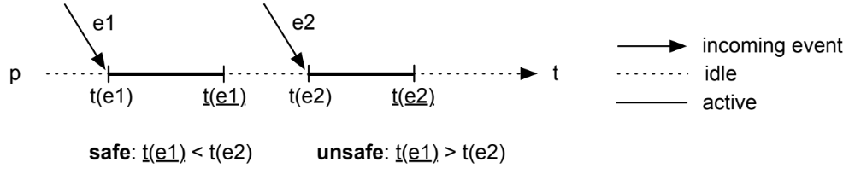
Event Execution Killed Problem
idle: e-puck p don't execute any Aseba code
active: e-puck p executes some Aseba code
unsafe: if an event e is received during an active state then the execution of the remaining code is stopped (and lost forever), and the code associated with e is resumed immediately

Slide 4
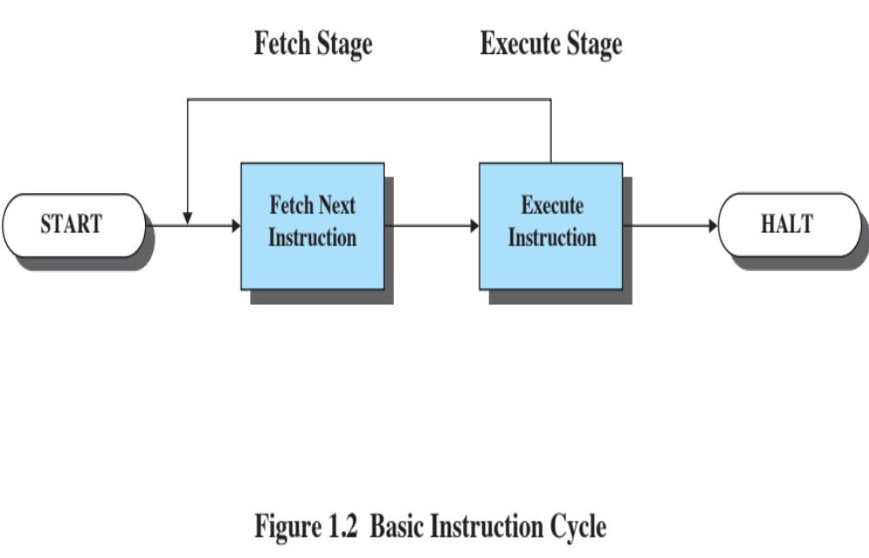
Basic Instruction Cycle

Slide 5
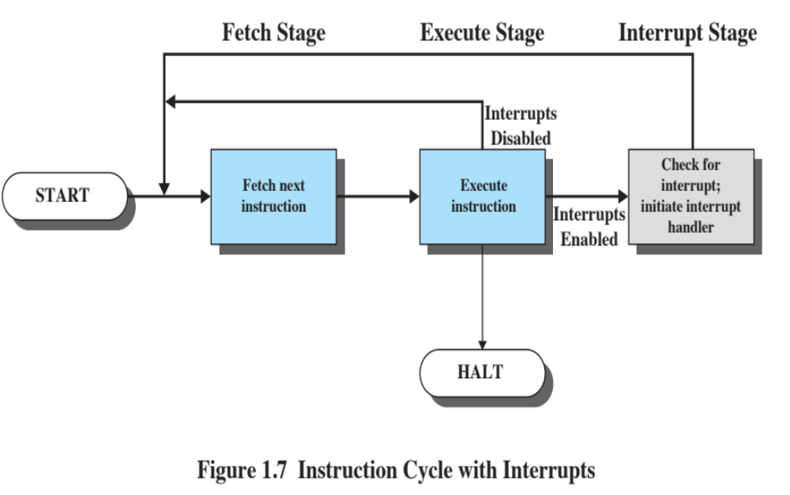
Instruction Cycle with Interrupts

