Slide 1
Camera
RGB color model
Digital color cameras
Hexadecimal 8-bit RGB representations of the main 125 colors
Studio Playground Colors
Physical Arena Colors
e-puck Camera + Aseba Data Structure
Typical camera usage in Aseba
Comment about bytecode size in Aseba
Robotics, Béat Hirsbrunner and Simon Studer, diuf.unifr.ch/pai/rob, Lecture 5 – 19 march 2015
Notes:
Programmation impérative - Prof. Béat Hirsbrunner
été 2002

Slide 2
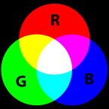
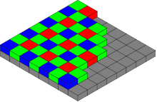

1. RGB Color Model + Digital Cameras
2D digital camera
arrangement of color filters on the pixel array of a digital image sensor:
  1st line: BGBG…
  2nd line: GRGR…
  3rd line: same as 1st line
  etc.
Additive colors
adding red to green yields yellow, etc.
A typical RGB color selector in graphic software. Each slider ranges from 0 to 255 (8-bit)
1D digital camera
1 line R, 1 line G, 1 line B
Ref: http://en.wikipedia.org/wiki/RGB_color_model

Slide 3
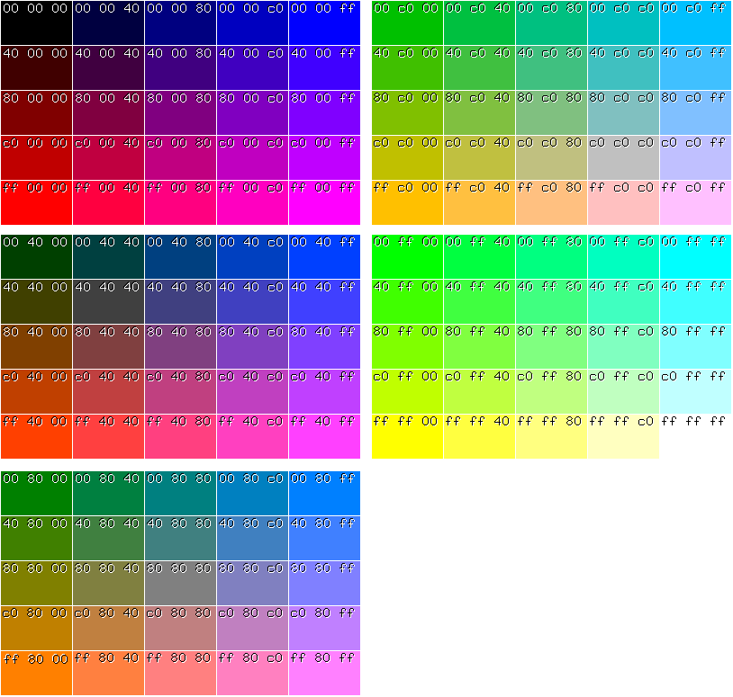
1. Hexadecimal 8-bit RGB representations of the main 125 colors
blue
black
red
green
white
yellow
Examples
black: 00 00 00
red: ff 00 00
green: 00 ff 00
blue: 00 00 ff
white: ff ff ff

Slide 4
2. Playground Colors and Physical Arena Colors
Aseba Playground (can be parametrized, but the values are fixed)
  white: 1 1 1
  red: 1 0 0
  green: 0 1 0
  blue: 0 0 1
  black: 0 0 0
Physical Arena in the labo (with the colored blocks and the LED tubes on)
  no shadow with shadow
  white block 90 90 90 70 70 70
  red block 80 30 30 50 20 20
  green block 30 80 30 20 50 20
  blue block 30 30 80 20 20 50
      Plausible average values for an e-puck
Note that these values are averages over all pixels and may vary significantly !
see source code of a playground file,
tag color (values from 0 to 1)
plausible camera values, from 0 to 100
(in percentage %)

Slide 5
3. e-puck Camera + Aseba Data Structure
e-puck
  1D camera
  3 lines of 60 R, G, resp. B pixels
  8-bit per pixel
Aseba Data Structure
  var cam.red[60]
  var cam.green[60]
  var cam.blue[60]
  the colors are encoded from 0 to 100 in pourcentages (%)

Slide 6
4. Typical Camera Usage in Aseba
in Aseba pseudo code !
Example in the simulation
var foundBlue = FALSE
onevent camera
if cam.blue[30] == 1 then foundBlue = TRUE end
Example in the physical arena
var foundBlue = FALSE, min, max, mean
onevent camera
call math.stat(cam.blue, min, max, mean)
if mean>50 && mean<70 then foundBlue = TRUE end
In both cases the remaining code typical contains something like:
onevent ir_sensors
if foundBlue == TRUE then
# react to color being found
end
see also the examples in the file demo_camera.aesl

Slide 7
5. Comment about bytecode size in Aseba
In the simulation Playgroud the bytecode is limited to 512 Bytes, and
in the physical e-puck to 1024 !
Example 1
  onevent camera
  for i in 0:59 do avgRed += cam.red[i] end
  avgRed /= 60
Example 2
    onevent camera
    call math.stat(cam.red, minRed, maxRed, meanRed)
The codebyte size of these examples have resp. 31 and 10 Bytes
Remark. The bytecode size can be accessed at:
Studio Aseba > View > Show memory usage

