Slide 1
Git + LaTeX
Git
LaTeX
Robotics, Béat Hirsbrunner and Simon Studer, diuf.unifr.ch/pai/rob, Lecture 26 march 2015
Notes:
Programmation impérative - Prof. Béat Hirsbrunner
été 2002

Slide 2
1. Git
Version control
Distributed
Decentralized
Repositories
  Local
  Remote
Branches

Slide 3
2. LaTeX (1)
Text processing
Markup language
Compiled documents
WYSIWIM (What you see is what you mean)
Good with large documents

Slide 4
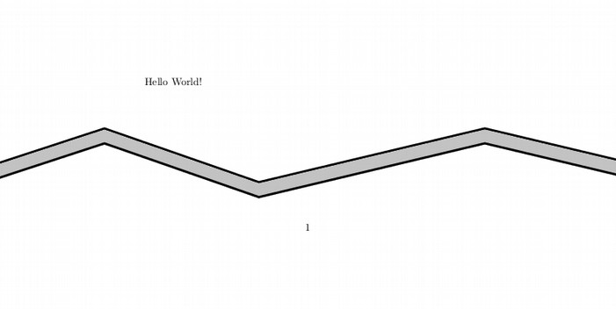
2. LaTeX (2) – Hello World
\documentclass[a4paper]{article}
\begin{document}
Hello World!
\end{document}

