Slide 1

Transformers: Capabilities and Limitations
ECE324, Winter 2022
Michael Guerzhoy
Slides from Jackie C.K. Cheung

Slide 2
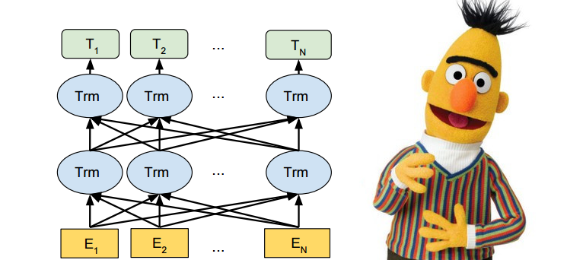
Pre-trained Language Models
BERT (Devlin et al., 2019) and friends are the most popular starting point of current NLP systems

Slide 3
BERTology
BERTology investigates what BERT-like models learn
Syntactic knowledge
Semantic knowledge
World knowledge

Slide 4
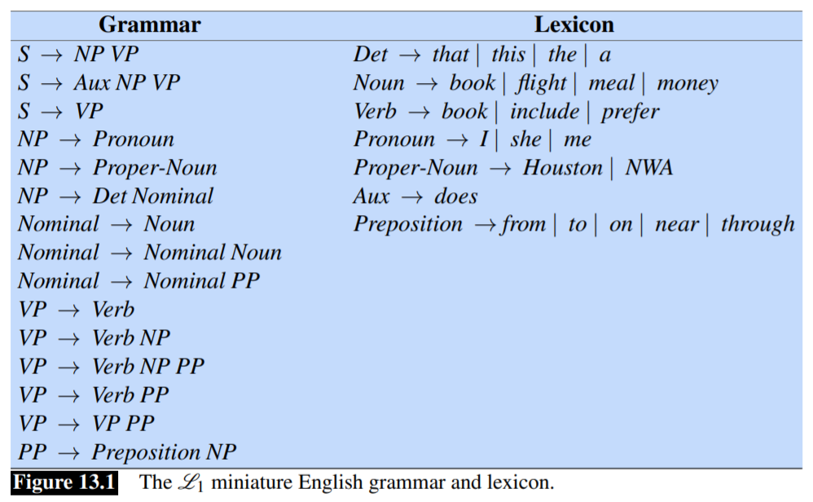
Syntactic knowledge
Syntax: the rules according to which sentences are formed
https://web.stanford.edu/~jurafsky/slp3/13.pdf

Slide 5
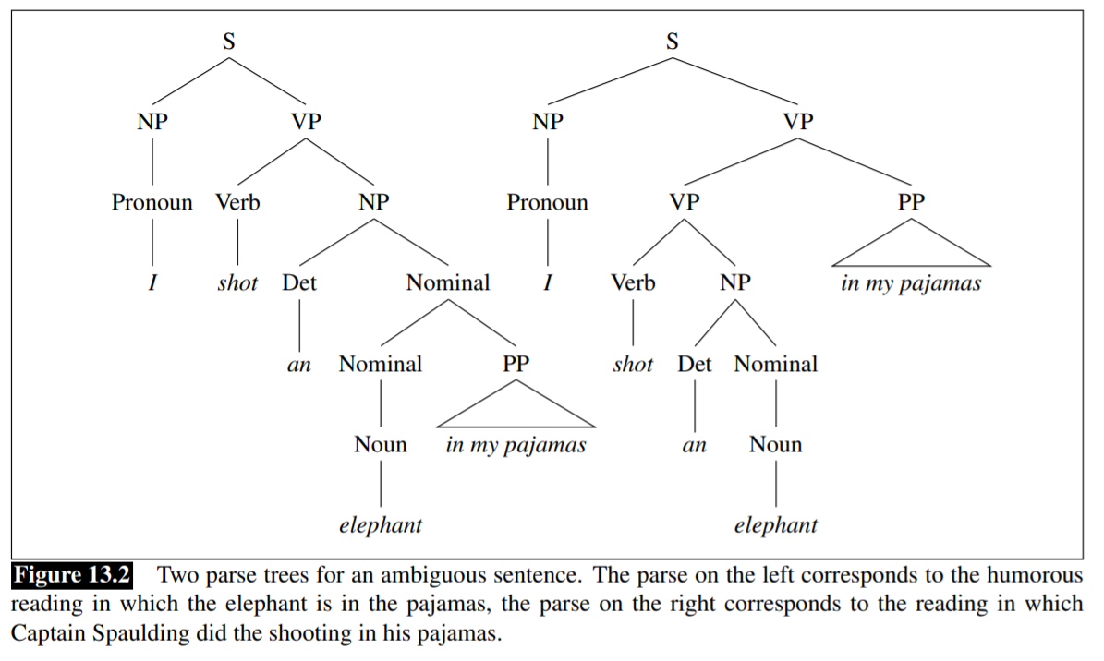

Parse trees

Slide 6
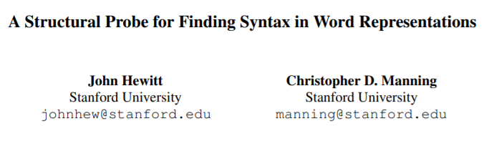
BERT’s syntactic representation study

Slide 7
Want to determine if BERT embeddings contain syntactic information
Idea: can we predict the distance in the parse tree from the embeddings

Slide 8
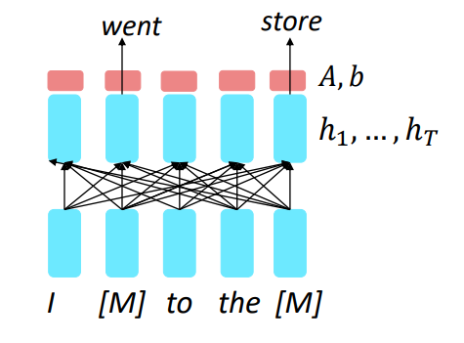
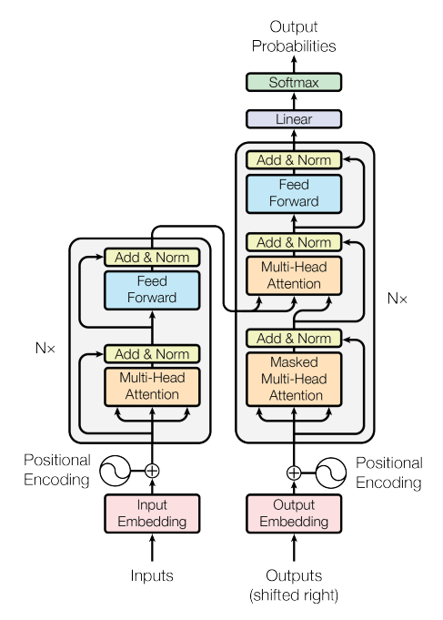
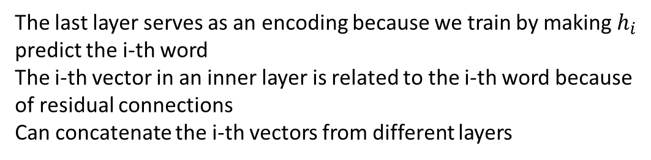
Aside: BERT embeddings
The last layer serves as an encoding because we train by making $h_{i}$ predict the i-th word
The i-th vector in an inner layer is related to the i-th word because of residual connections
Can concatenate the i-th vectors from different layers

Slide 9

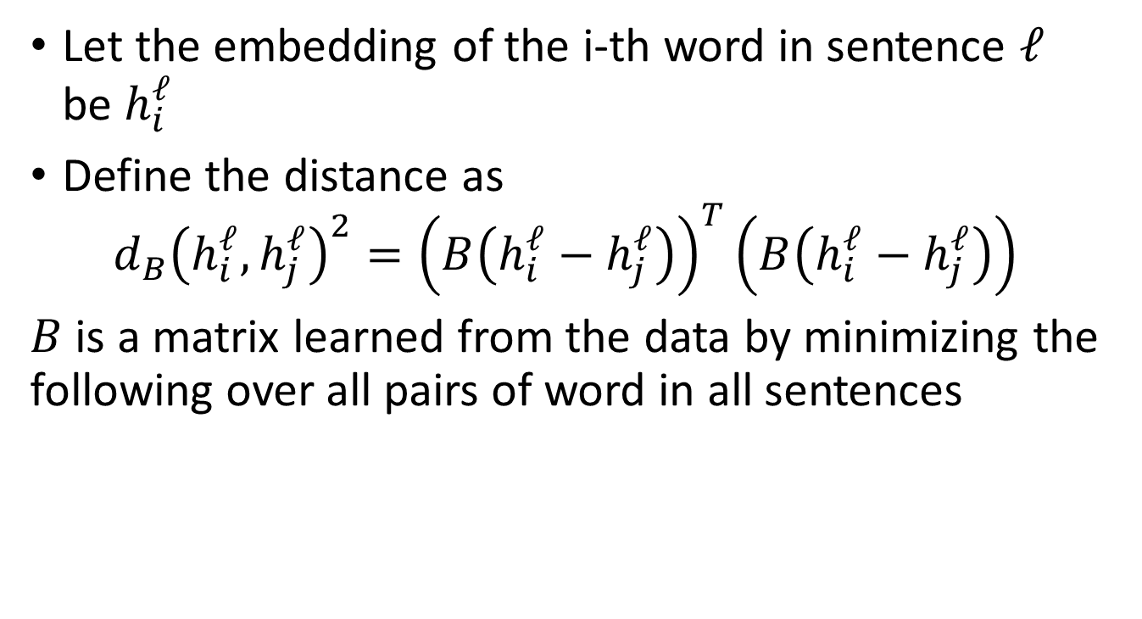
Let the embedding of the i-th word in sentence $ℓ$ be $h_{i}^{ℓ}$
Define the distance as $d_{B}{\left(h_{i}^{ℓ}, h_{j}^{ℓ}\right)}^{2}={\left(B\left(h_{i}^{ℓ}−h_{j}^{ℓ}\right)\right)}^{T}\left(B\left(h_{i}^{ℓ}−h_{j}^{ℓ}\right)\right)$
$B$ is a matrix learned from the data by minimizing the following over all pairs of word in all sentences
Distance in the parse tree

Slide 10
Results
Computing the distance using the middle layer of BERT produces distances that are very similar to parse tree distances

Slide 11
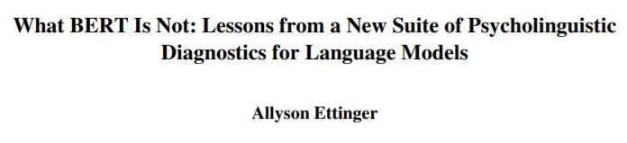
Semantic knowledge
Semantics: the meaning of words

Slide 12
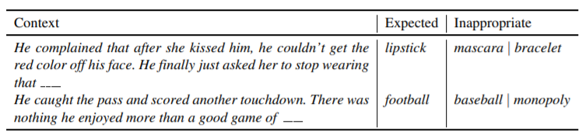
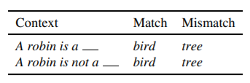
Idea: study how BERT predicts masked words (“cloze task”)

Slide 13
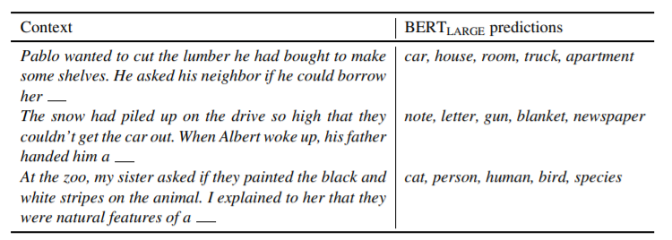
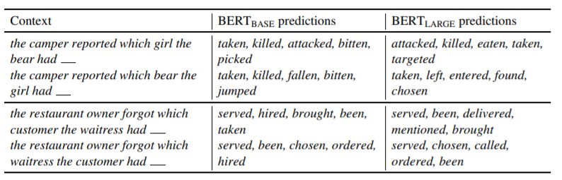

Slide 14
Semantic knowledge: summary
BERT’s overall good performance sometimes relies on shortcuts – statistical patterns that are not directly connected to meaning
BERT is good at identifying objects as belonging to categories
E.g. robin is a bird
BERT is bad at dealing with negation

Slide 15
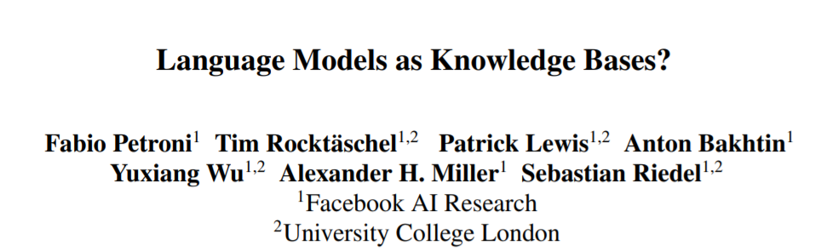
World knowledge

Slide 16
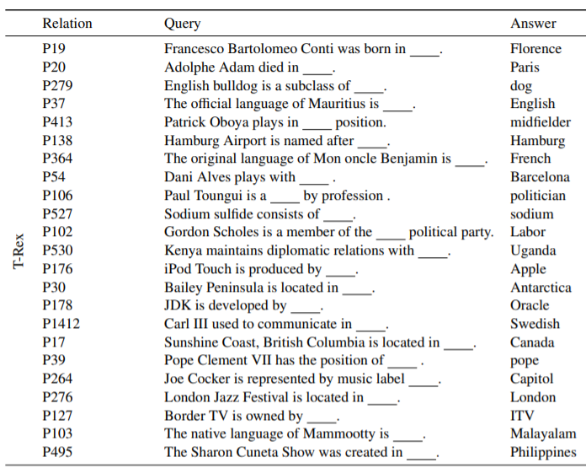
Results competitive with other systems

Slide 17
Can Transformer-like architectures understand language?
Argument for “yes”: remarkable performance on cloze tasks, remarkable ability to generate language
Arguments for “no”
Mistakes on cloze tasks show that the good performance is due merely to learning statistical patterns
Humans can to attribute meaning to generated language even when it’s meaningless
A bunch of matrix multiplications can’t understand anything

Slide 18

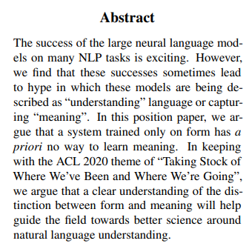

Slide 19
Meaning
Definitions in Climbing toward NLU
Form: any observable realization of language: marks on a page, pixels or bytes in memory, movements of articulators…
Meaning: the relation between the form and something external to language
Understanding: retrieving the communicative intent from an expression
Communicative intent is about something outside the language (e.g. “Open the window!” is about a the window)

Slide 20
Communication
“The speaker has a certain communicative intent i, and chooses an expression e with a standing meaning s which is fit to express i in the current communicative situation. Upon hearing e, the listener then reconstructs s and uses their own knowledge of the communicative situation and their hypotheses about the speaker’s state of mind and intention in an attempt to deduce i.”

Slide 21
This active participation of the listener is crucial to human communication For example, to make sense of (8) and (9) (from Clark, 1996, p.144), the listener has to calculate that Napoleon refers to a specific pose (hand inside coat flap) or that China trip refers to a person who has recently traveled to China.
(8) The photographer asked me to do a Napoleon for the camera.
(9) Never ask two China trips to the same party

Slide 22
“We argue that a model of natural language that is trained purely on form will not learn meaning: if the training data is only form, there is not sufficient signal to learn the relation M between that form and the non-linguistic intent of human language users, nor C between form and the standing meaning the linguistic system assigns to each form.”

Slide 23
Aside: Searle’s Chinese Room Experiment
A person is in a large room containing instructions for how to transform notes in Chinese to responses in Chinese
The person doesn’t speak Chinese but follow the instructions
Argument: the person doesn’t understand Chinese
Counterargument:
The person + the room (+ whatever energy is needed to go through the instructions in a short amount of time) is a complex system that might be said to understand Chinese

Slide 24
The Octopus test
A and B, both fluent speakers of English, are independently stranded on two uninhabited islands. They soon discover that previous visitors to these islands have left behind telegraphs and that they can communicate with each other via an underwater cable. A and B start happily typing messages to each other. Meanwhile, O, a hyper-intelligent deep-sea octopus who is unable to visit or observe the two islands, discovers a way to tap into the underwater cable and listen in on A and B’s conversations. O knows nothing about English initially, but is very good at detecting statistical patterns. Over time, O learns to predict with great accuracy how B will respond to each of A’s utterances. O also observes that certain words tend to occur in similar contexts, and perhaps learns to generalize across lexical patterns by hypothesizing that they can be used somewhat interchangeably. Nonetheless, O has never observed these objects, and thus would not be able to pick out the referent of a word when presented with a set of (physical) alternatives. At some point, O starts feeling lonely. He cuts the underwater cable and inserts himself into the conversation, by pretending to be B and replying to A’s messages. Can O successfully pose as B without making A suspicious? This constitutes a weak form of the Turing test (weak because A has no reason to suspect she is talking to a nonhuman); the interesting question is whether O fails it because he has not learned the meaning relation, having seen only the form of A and B’s utterances

Slide 25
Argument: the Octopus would not be able to fake a conversation where world knowledge is required
Now say that A has invented a new device, say a coconut catapult. She excitedly sends detailed instructions on building a coconut catapult to B, and asks about B’s experiences and suggestions for improvements. Even if O had a way of constructing the catapult underwater, he does not know what words such as rope and coconut refer to, and thus can’t physically reproduce the experiment

Slide 26
Finally, A faces an emergency. She is suddenly pursued by an angry bear. She grabs a couple of sticks and frantically asks B to come up with a way to construct a weapon to defend herself. Of course, O has no idea what A “means”. Solving a task like this requires the ability to map accurately between words and real-world entities (as well as reasoning and creative thinking). It is at this point that O would fail the Turing test, if A hadn’t been eaten by the bear before noticing the deception.7

Slide 27
Learning programming language semantics without grounding
Imagine that we were to train an LM on all of the well-formed Java code published on Github. The input is only the code. It is not paired with bytecode, nor a compiler, nor sample inputs and outputs for any specific program. We can use any type of LM we like and train it for as long as we like. We then ask the model to execute a sample program, and expect correct program output.

Slide 28
Not just language modeling
What about systems which are trained on a task that is not language modeling — say, semantic parsing, or reading comprehension tests — and that use word embeddings from BERT or some other large LM as one component? Numerous papers over the past couple of years have shown that using such pretrained embeddings can boost the accuracy of the downstream system drastically, even for tasks that are clearly related to meaning. Our arguments do not apply to such scenarios: reading comprehension datasets include information which goes beyond just form, in that they specify semantic relations between pieces of text, and thus a sufficiently sophisticated neural model might learn some aspects of meaning when trained on such datasets. It also is conceivable that whatever information a pretrained LM captures might help the downstream task in learning meaning, without being meaning itself.

Slide 29
Counterarguments
Perhaps a tiny bit of grounding (digits of pi?) is enough if there is a lot of data
Is missing just this tiny bit really important?
Perhaps using Occam’s Razor is enough
To explain a whole lot of text, it’s efficient to reinvent all of Physics
“Meaning”/”Understanding” are properties of complex systems
A large enough model is complex enough that it can understand in the sense that language models understand

