Slide 2
Project Description:

Slide 3
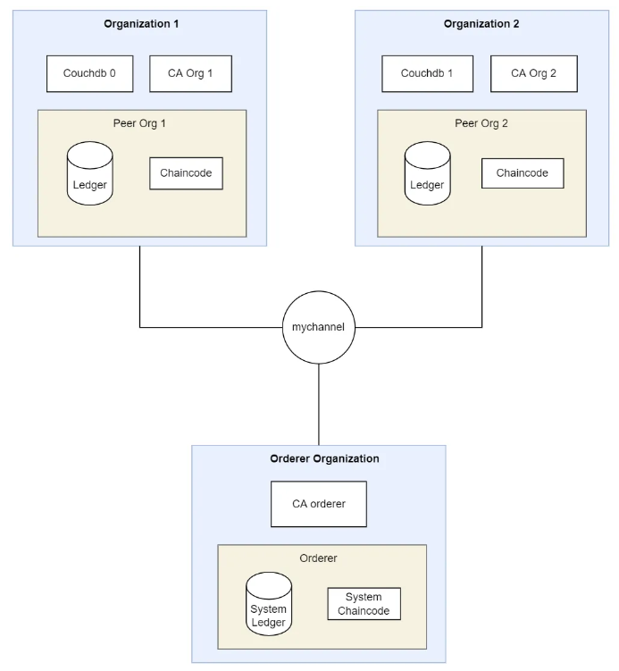


Network diagram:
User select the chaincode from the application UI
and submit it to the backend
Application UI
Backend
Backend calls fabric commands
to deploy, invoque, query chaincode

Slide 4
Use Cases :

Slide 5
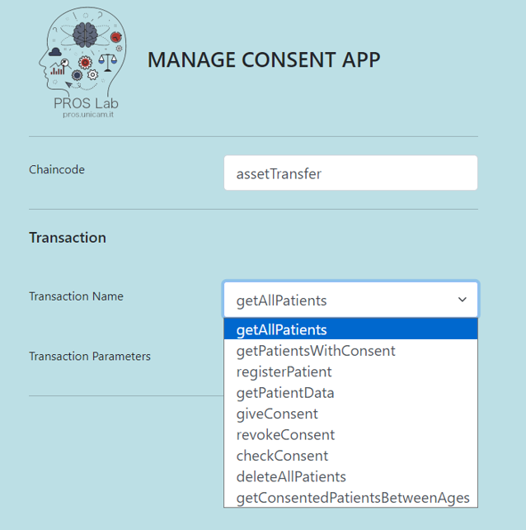
List of available functions
in the smart contract

Slide 6
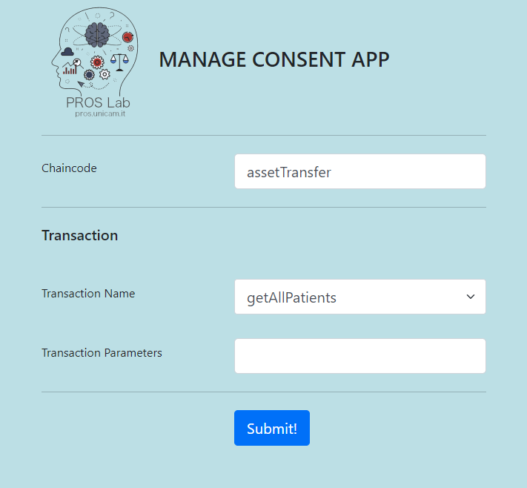
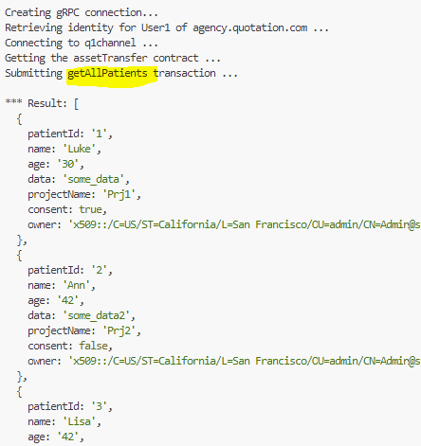
getAllPatients
Function call

Slide 7
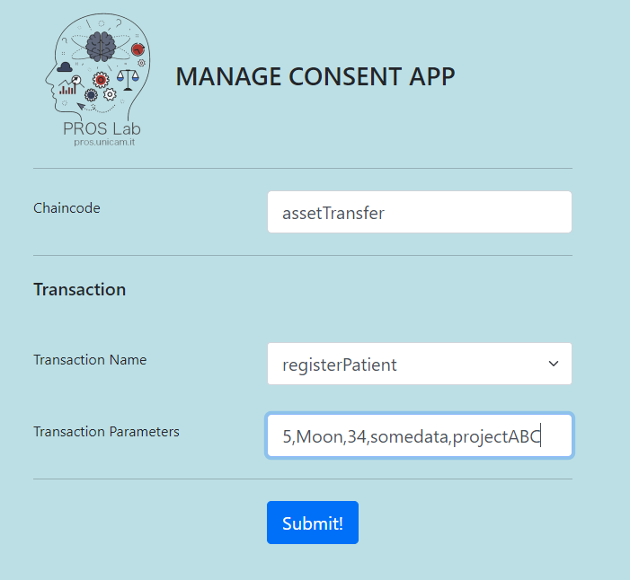
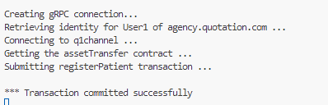
Patient Registration

Slide 8
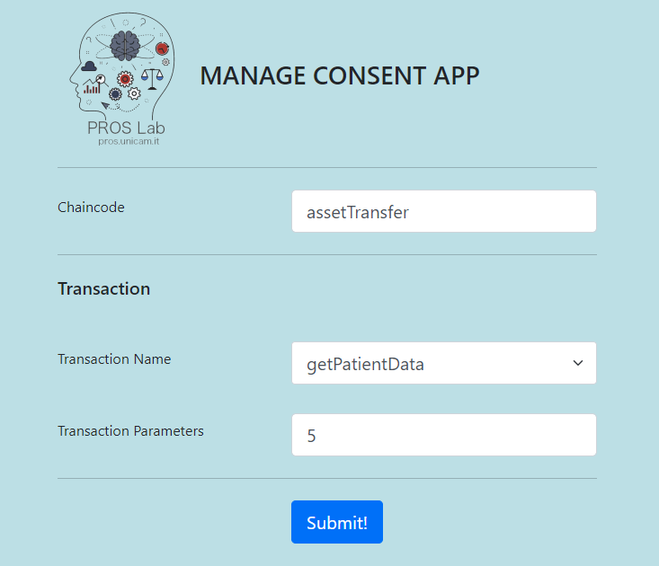
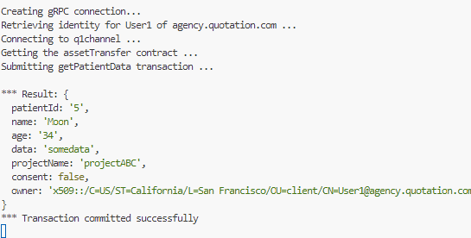
Check
Patient Registration

