Slide 1

Secure Login Application: Implementing 2FA with TOTP
This presentation showcases the development and implementation of a secure login application that prioritizes user data protection through the use of Time-Based One-Time Passwords (TOTP) for two-factor authentication.

Slide 2
Problem: Password-Based Authentication Weaknesses
Data Breaches
Phishing Attacks
Credential Stuffing
Stolen passwords compromise user accounts.
Users tricked into revealing credentials.
Automated attacks using stolen passwords.

Slide 3
Application Overview
1
Secure Authentication
2
User-Friendly Design
3
Robust Features
TOTP 2FA for enhanced security.
Intuitive interface for seamless login.
Session management, trusted locations.

Slide 4
Key Features
2FA with TOTP
Session Management
Time-based, dynamic codes for enhanced security.
Automated logout for inactive sessions.
Trusted Locations
Usual Login Times
Recognizing safe devices for seamless access.
Analyzing login patterns for anomaly detection.
Dark Mode
Biometric Authentication
Enhanced user experience and reduced eye strain.
(Future Update) Fingerprint/Face ID for effortless login.

Slide 5

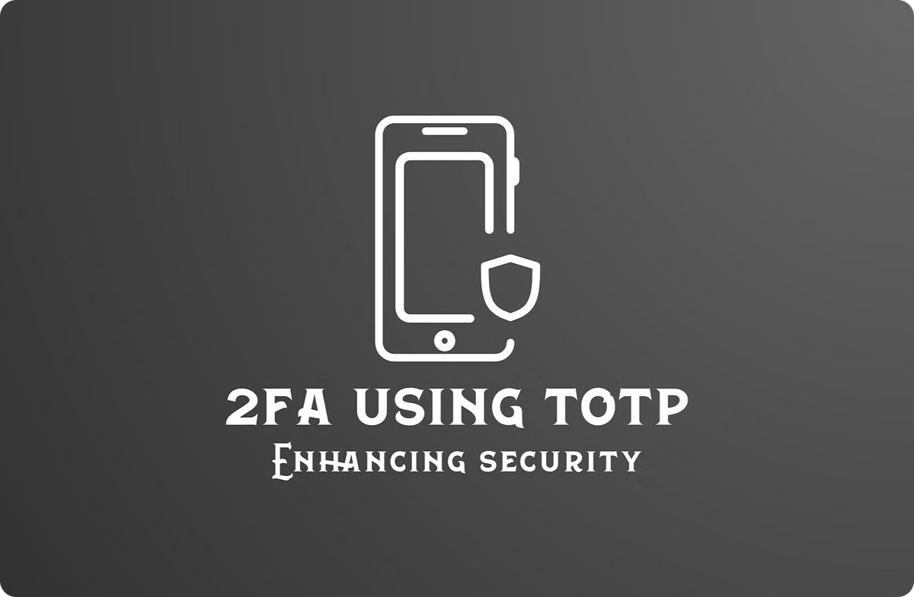
How 2FA with TOTP Works
1
User Login Attempt
User enters their username/email.
2
TOTP Code Generation
User's device generates a 6-digit code.
3
Code Verification
App validates the code for authentication.

Slide 6
Trusted Locations & Usual Login Times
Location Recognition
Login Time Analysis
Identifies trusted devices and locations.
Detects unusual login patterns and triggers alerts.

Slide 7
User-Friendly Enhancements
1
2FA Setup Modal
2
Backup Codes
3
Clear Instructions
Simplified process with step-by-step guidance.
Provides alternative access in case of device loss.
Easy-to-understand guidance for 2FA setup.

Slide 8



Setup Process
1
Install Dependencies
2
Configure Application Settings
3
Run the Application

Slide 9

Thank You!
We appreciate your time and interest. Any questions?

