Slide 1
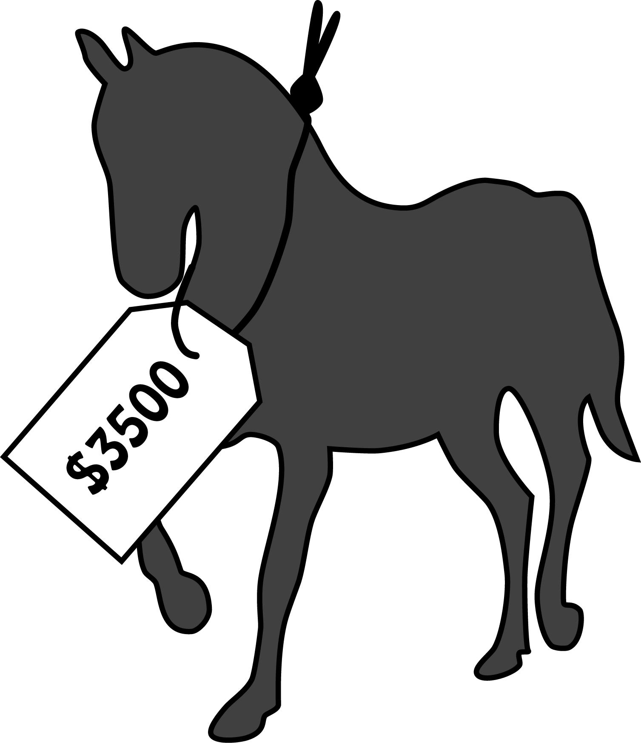
PriceYourHorse
Determine the Price Tag
Project emerging from the Data Science Immersive Program of
Galvanize, San Francisco

Slide 2
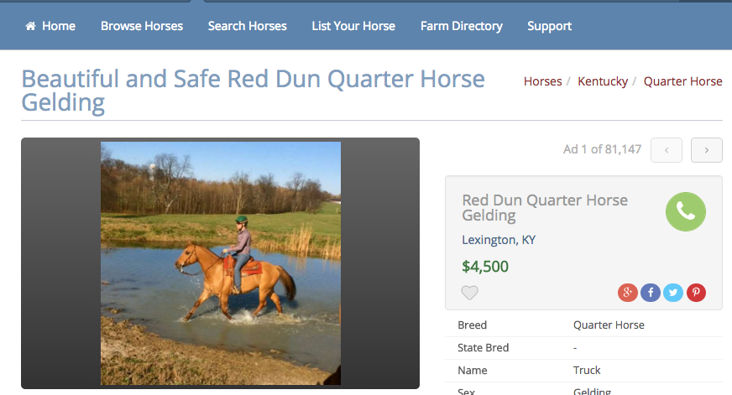
Is this price appropriate?

Slide 3
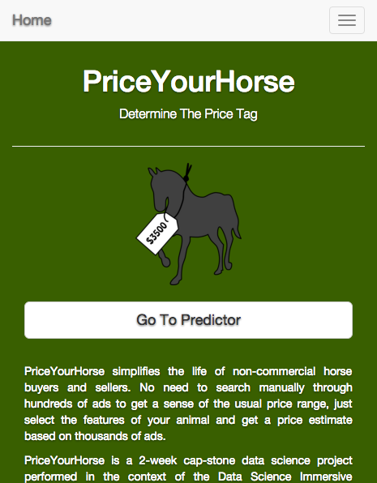
There is an App

Slide 4
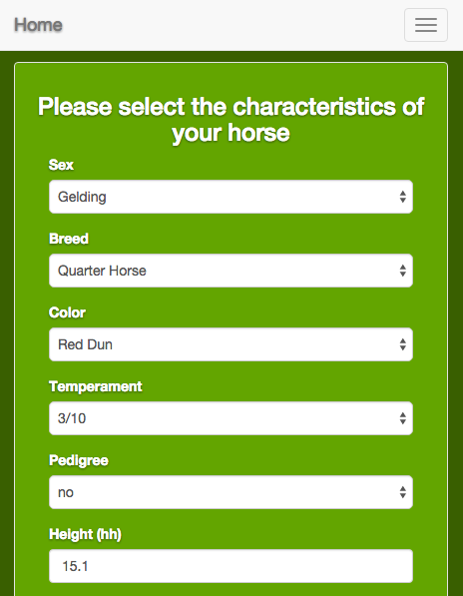
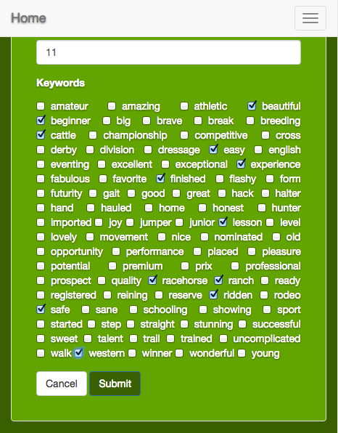
Let’s check…

Slide 5
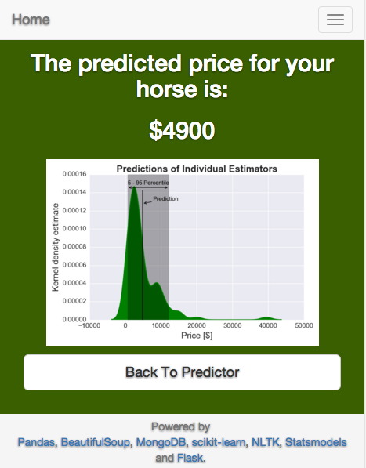
Seems to be a fair price

Slide 6
Under the hood
Tf-Idf Vectorizer
Scrape Data
Predict Prices
Engineer Features
Train Model
User Input
Predict Price
Present Price
Convert Features
Processor
Random Forest
Regressor
Development
Web Application

Slide 7
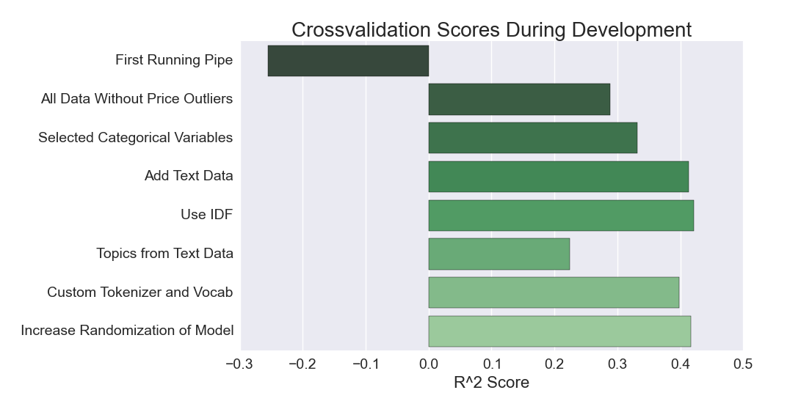
Performance
+ 45%

Slide 8
PriceYourHorse
Powered by:
Sandra Guetg
Data Scientist
www.linkedin.com/in/sandraguetg
https://github.com/guetgs/PriceYourHorse
and
Pandas, Beautiful Soup, MongoDB, scikit-learn, NLTK
Statsmodels and Flask
Data from
www.equinenow.com/horses

